Slide 1
The copyright to this original work is held by Dr. Forsythe and students registered in course Geo542 can use this material for the purposes of this course but no other use is permitted, and there can be no sale or transfer or use of the work for any other purpose without explicit permission of Dr. Forsythe.

Slide 2
Term Test 2
Tuesday November 24 beginning at 6:10pm via D2L
You MUST begin the Test between 6:10pm and 6:30pm
No going back on test questions
You will have 20 mins to complete the test
30 MC questions
Covers all lecture/lab material since Term Test 1

Slide 3
Lab 2 is due (submit using D2L) by 9:00pm November 24

Slide 4
Lab 2 study area choices (with image ID’s) (you must have your choice approved via email) are due by the end of the lab period (9:00pm) TONIGHT or you will receive a 10% total course grade reduction.

Slide 5
Lab 2 presentations are due (via D2L) by 9:00pm November 30
The file will be your named yourlastname.pptx. Email your instructor if you have questions.

Slide 6
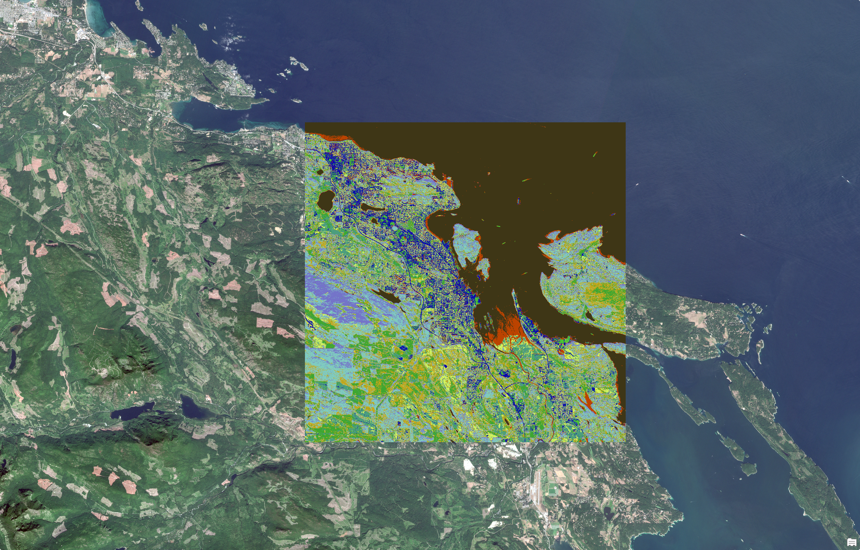
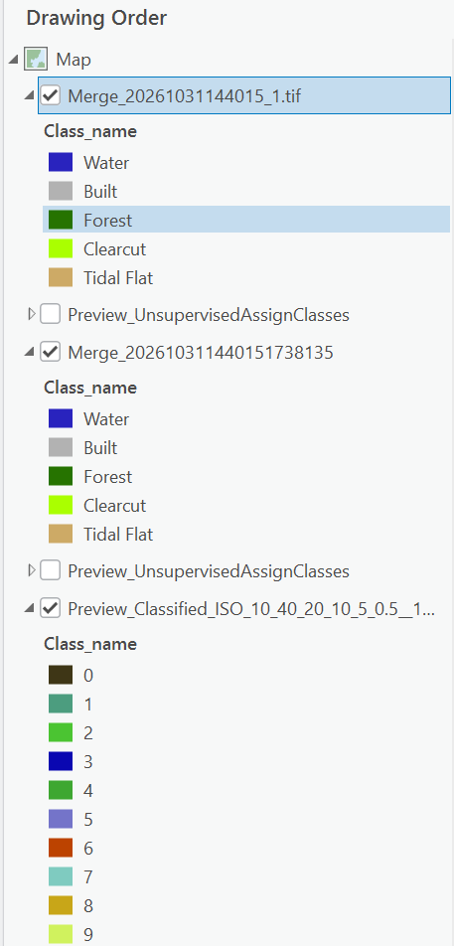

Slide 7
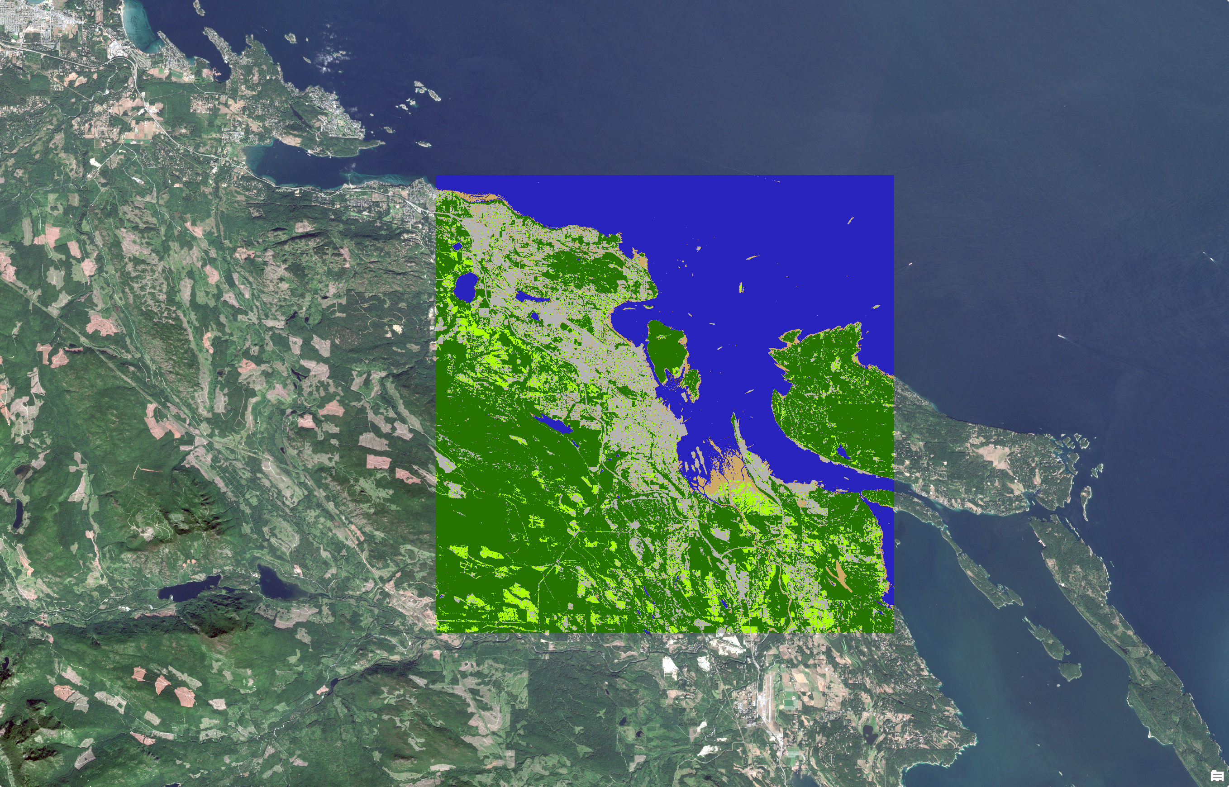

Slide 8
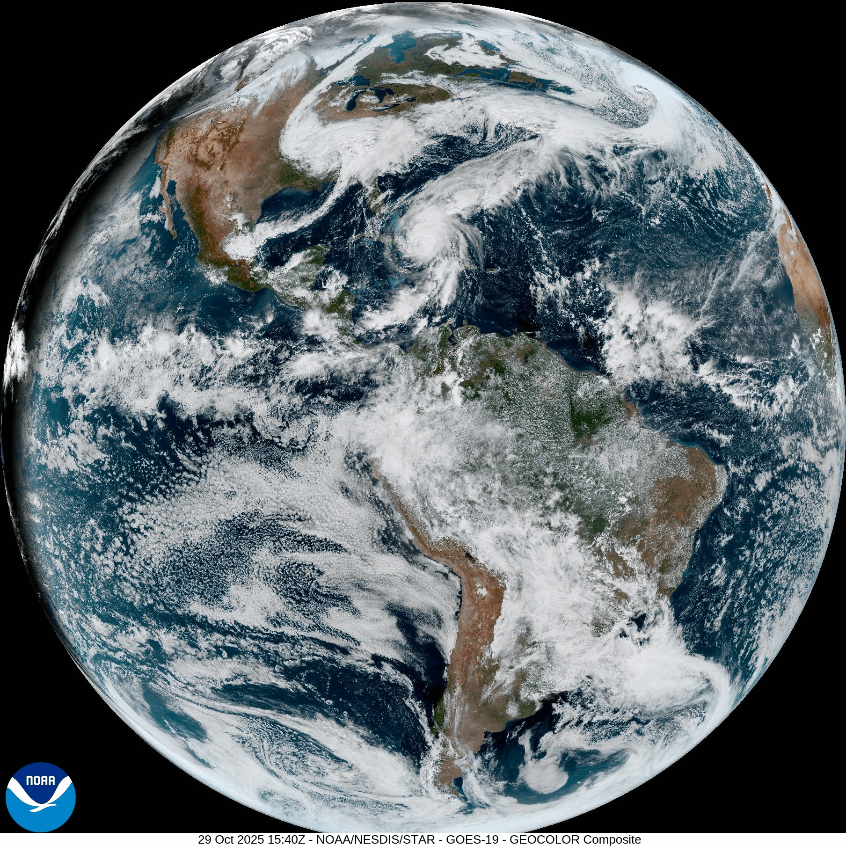
https://www.star.nesdis.noaa.gov/goes/fulldisk_band.php?sat=G16&band=GEOCOLOR&length=24&dim=11

Slide 9
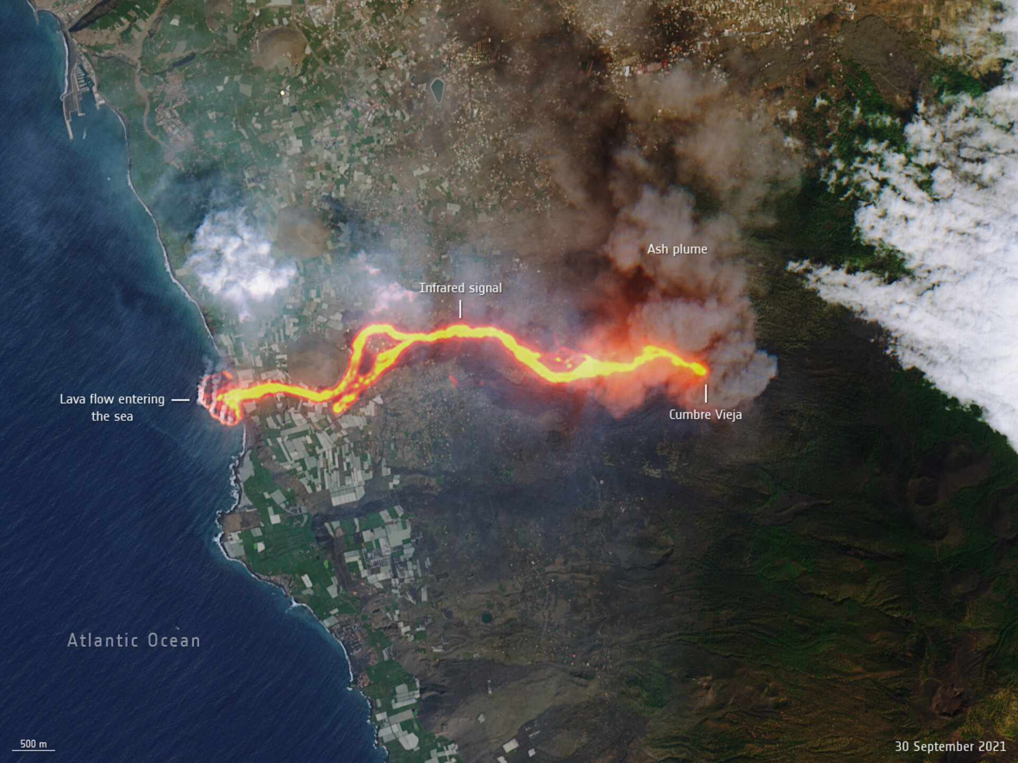
https://www.esa.int/ESA_Multimedia/Images/2021/10/La_Palma_lava_flows_into_the_sea

Slide 10
Historical “Land” Sensors
Landsat 1 – 1972, Landsat 9 -2021
Système Pour l’Observation de la Terre (Spot) - 1986
Indian Remote Sensing (IRS) - 1988

Slide 11
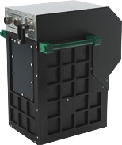
Historical “Land” Sensors
CASI
  hyperspectral sensor
  Spatial Resolution as high as 25 cm
http://www.itres.com/imagers/

Slide 12
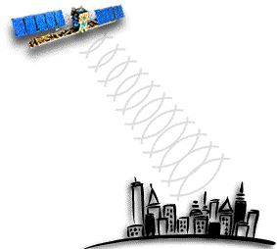
ERS Radar Satellites
ERS-1 – 1991
imaging synthetic aperture radar
ERS-2 – 1995
Overlapped with ERS-1, was launched in 1995
additional sensor for atmospheric ozone research
http://www.esa.int/

Slide 13
Radar Satellites
first ‘tandem’ mission
both satellites orbited Earth only 24 hours apart.
in March 2000, failure, ERS-1 ending its operations
in July 2011, ERS-2 was retired
http://www.esa.int/

Slide 14
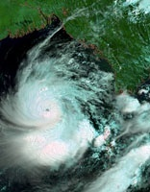
ERS Radar Satellites
Envisat - 2002
Envisat is the largest Earth Observation spacecraft ever built.
Communication with this satellite was “lost”.
http://www.esa.int/

Slide 15
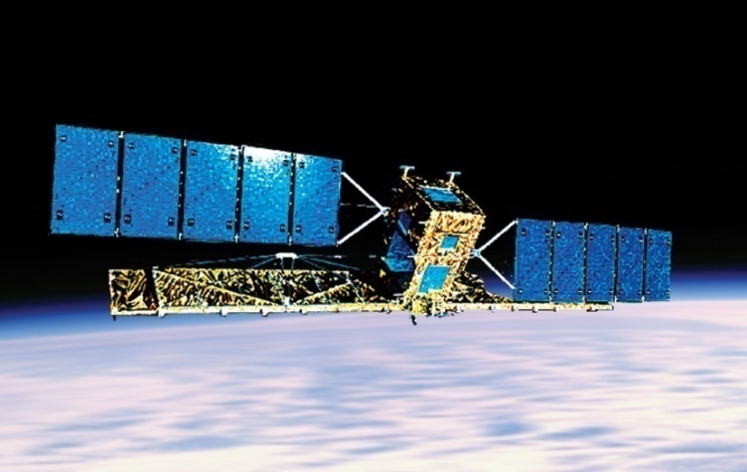
Canadian Radar Satellites
Radarsat - 1995
Synthetic Aperture Radar (SAR).
"see" through clouds, haze, smoke, and darkness.
significant advantages
http://gs.mdacorporation.com/SatelliteData/Radarsat1/Radarsat1.aspx

Slide 16
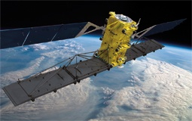
Radarsat -1
Initially operated by a company called Radarsat International (RSI)
This company was bought out by MacDonald Dettwiler and Associates (MDA)
RADARSAT-1 failed on March 29, 2013

Slide 17
Radarsat -2
RADARSAT-2: Canada's next-generation commercial SAR satellite.
MDA Geospatial Services operates the satellite and ground segment, and holds the worldwide distribution rights to RADARSAT-2 products.
http://gs.mdacorporation.com/SatelliteData/Radarsat2/Radarsat2.aspx
https://www.maxar.com/our-company/meet-maxar

Slide 18
MDA Controversy
Controversy about sale of MDA space division in 2008
http://www.cbc.ca/news/business/federal-government-blocks-sale-of-mda-space-division-1.703999

Slide 19
RADARSAT Constellation Mission (RCM)
is Canada's new generation of Earth observation satellites
http://www.asc-csa.gc.ca/eng/satellites/radarsat/what-is-rcm.asp (video)
Launched June 12, 2019
Data are available at no cost to public and vetted users (The Government of Canada retains ownership of all RCM data and image products).
https://www.asc-csa.gc.ca/eng/satellites/radarsat/default.asp

Slide 20
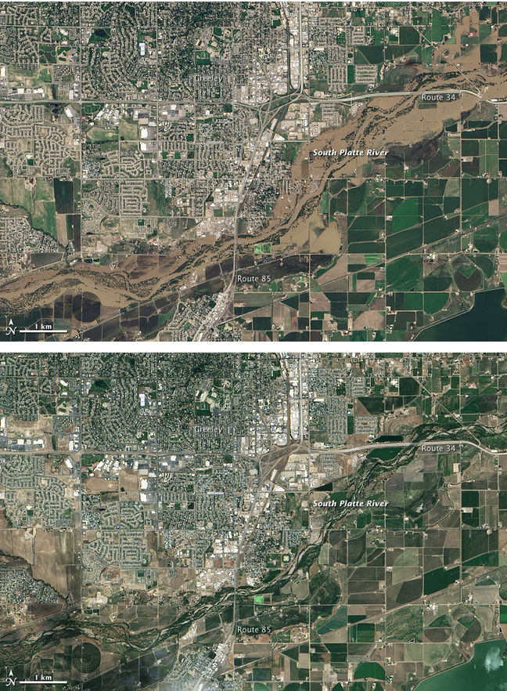

Slide 21
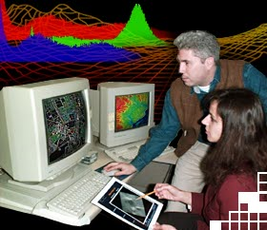
Image Analysis
Much interpretation and identification of targets in remote sensing imagery is performed manually or visually.
In many cases this is done using imagery displayed on computers.

Slide 22
Image Analysis
There are steps in the process

Slide 23
Applications
Many varied applications

Slide 24
IKONOS
Launched Sept. 24, 1999
Optical bands
Panchromatic
On October 12/99, Space Imaging released the world’s first high-resolution commercial satellite image of the Earth.

Slide 25
IKONOS
Company taken over by Geoeye (provides imagery to Yahoo, Microsoft and Google)
Retired in 2015

Slide 26
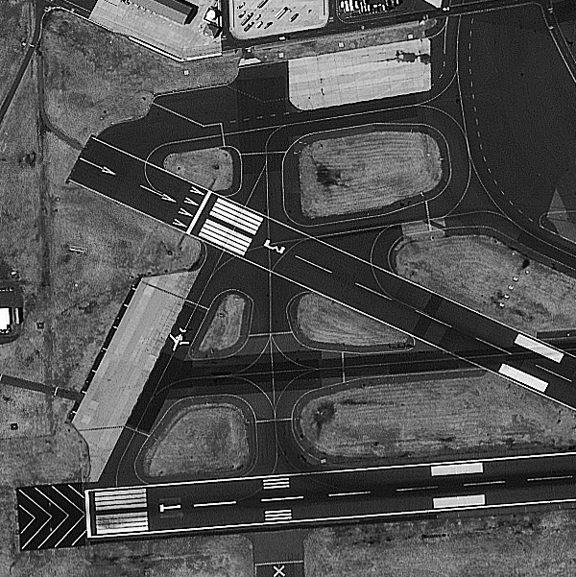
IKONOS

Slide 27
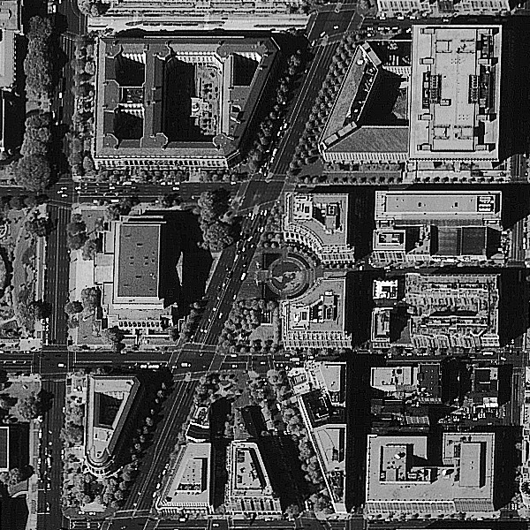
IKONOS

Slide 28
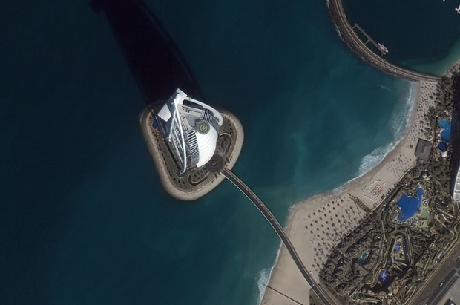
IKONOS Combined MS and PAN

Slide 29
Mergers
Consolidation over the years
Business models

Slide 30
Geo-Eye 1
GeoEye-1 Launched Sept. 6, 2008
still operational
Resolution
  Panchromatic
  Multispectral
  Initially restricted: Data reflects ground sample distance resolution at Nadir for exclusive use by the U.S. government and any foreign government that the U.S. government may designate.

Slide 31
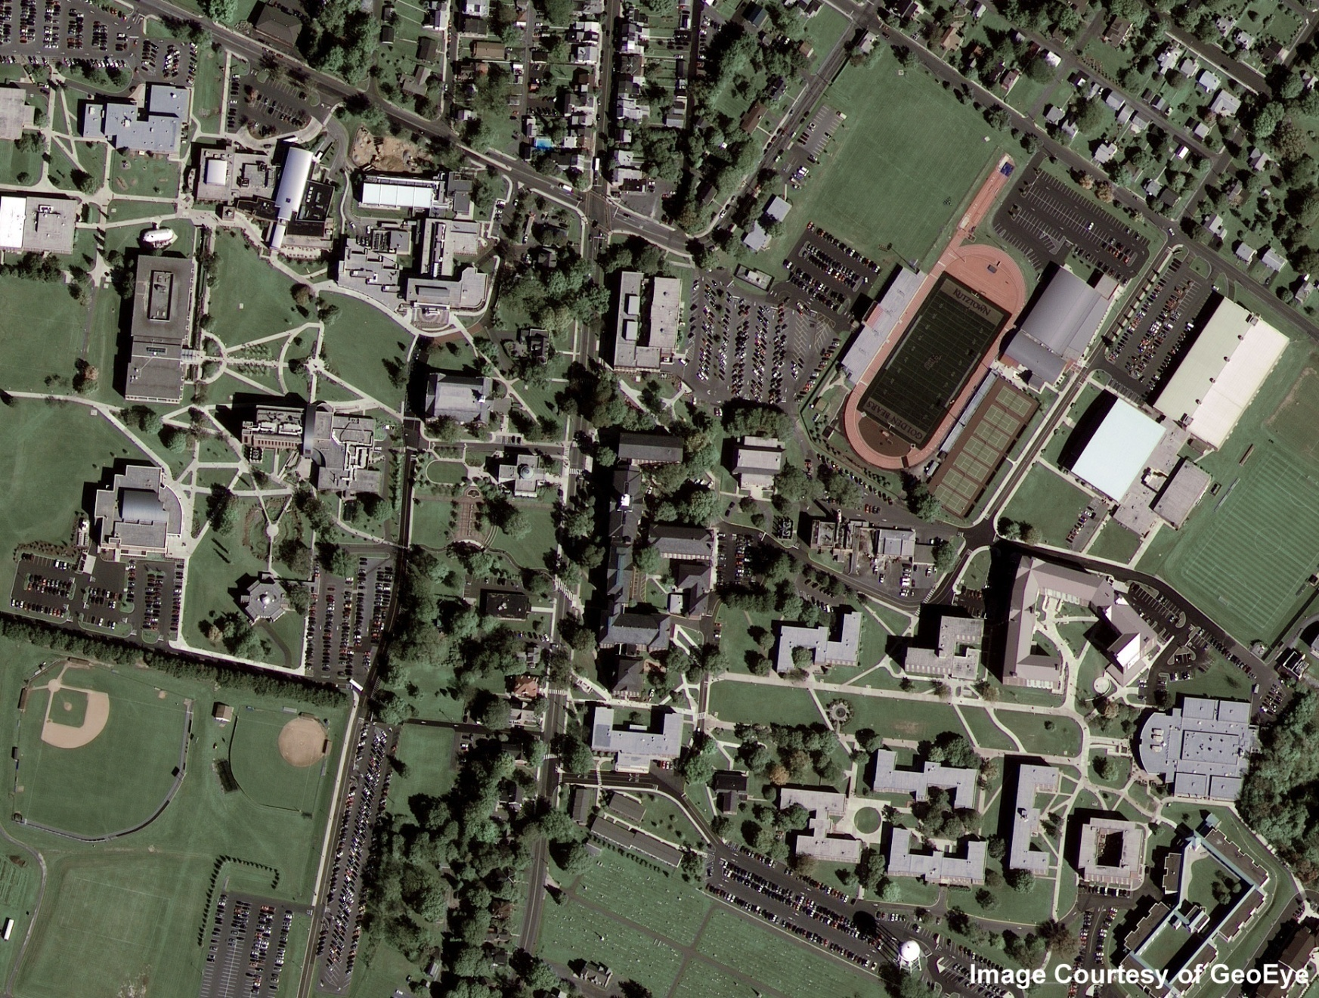
Geo-Eye 1 First Image
http://ssd.itt.com/heritage/pics/GeoEye-1-First-Image-Kutztown-Univ-Pa-07OCT08.jpg

Slide 32
Quickbird (Digital Globe)
Quickbird 2 launched Oct. 18, 2001
  2.5 m multispectral, 61 cm panchromatic (Quickbird 1 failed to reach orbit in 2000)
Ceased operations in 2015

Slide 33
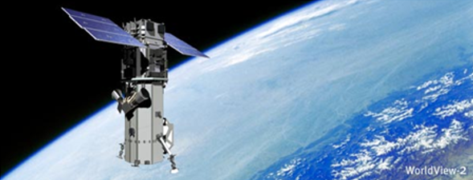
Worldview-1
2007 launch
Still operational

Slide 34
Worldview-2
2009 launch
46 cm panchromatic 1.84 m MS
Revisit time of 1 day
Still operational
http://www.digitalglobe.com/downloads/spacecraft/WorldView2-DS-WV2.pdf
https://earth.esa.int/eogateway/missions/worldview-2
http://vector1media.com/spatialsustain/worldview-2-launched-successfully.html

Slide 35
Worldview-3
Launched August 13, 2014
Multispectral:
SWIR
Panchromatic Nadir:
Multispectral Nadir:
Still operational
http://www.satimagingcorp.com/satellite-sensors/worldview-3/

Slide 36
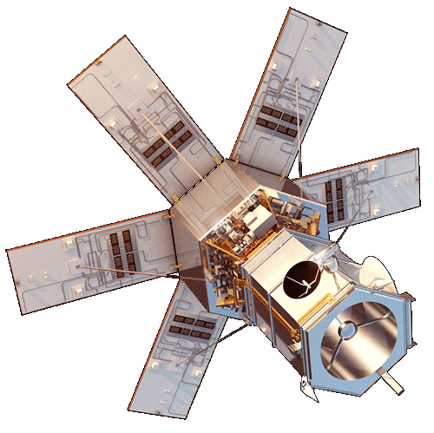
Worldview-4
Launched November 11, 2016
Operated in coordination with Worldview-3
Failure of Control Moment Gyros (CGMs)
https://earth.esa.int/eogateway/missions/worldview-4

Slide 37
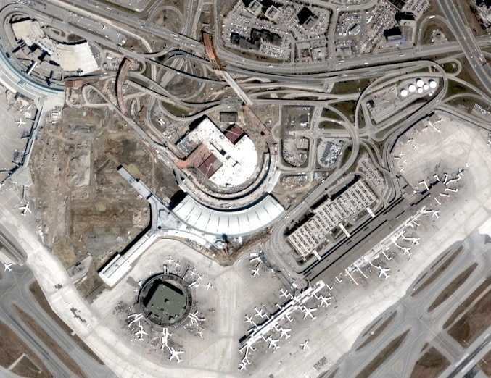
QUICKBIRD Pearson Airport 2002

Slide 38
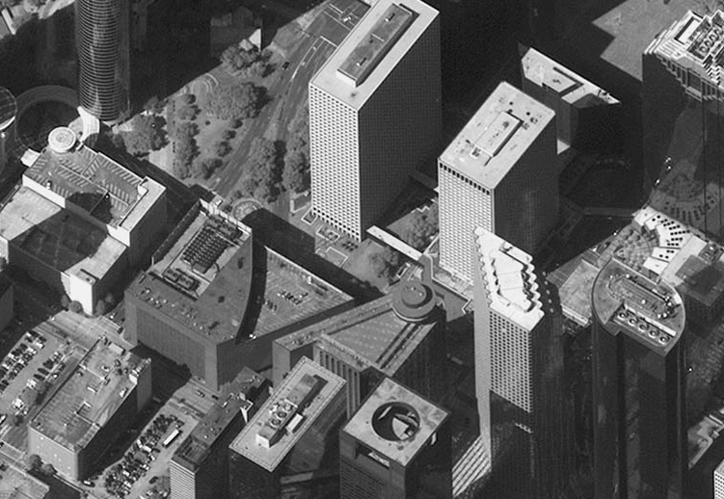
Worldview 2007 Houston

Slide 39
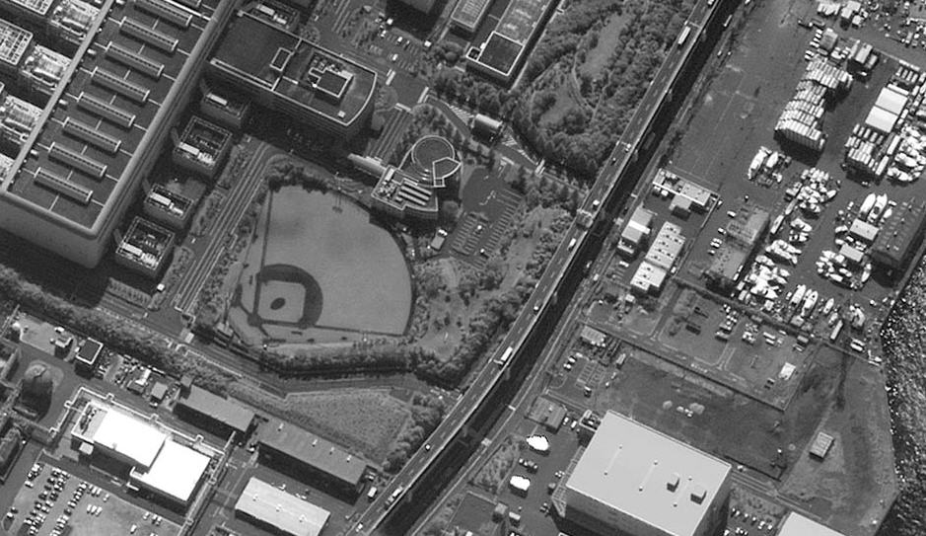
Worldview 2007 Yokohama

Slide 40
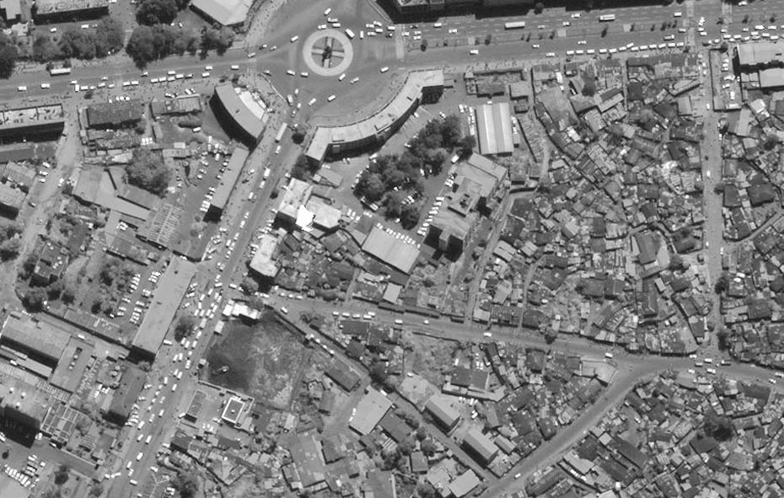
Worldview 2007 Addis Ababa

Slide 41
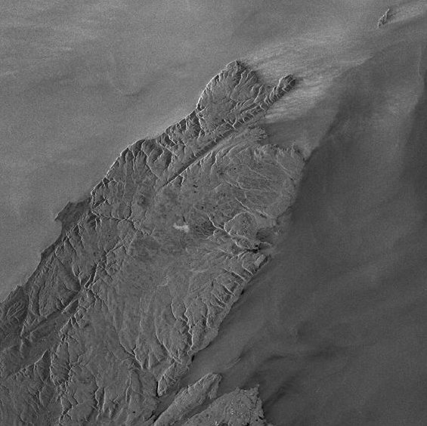
RADARSAT

Slide 42
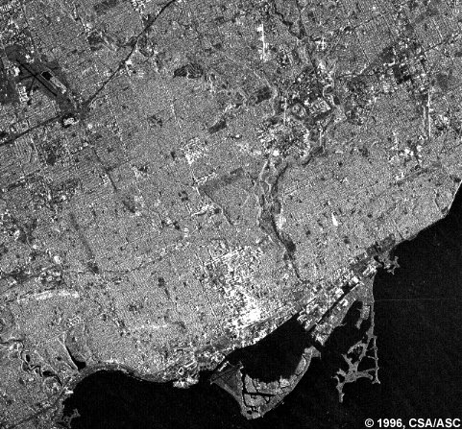
RADARSAT

Slide 43
Transition
Maxar to Vantor…

Slide 44
Worldview Legion
Six satellites beginning in 2024
34 cm pan
1.36 m ms
https://earth.esa.int/eogateway/missions/worldview-legion#instruments-section

Slide 45
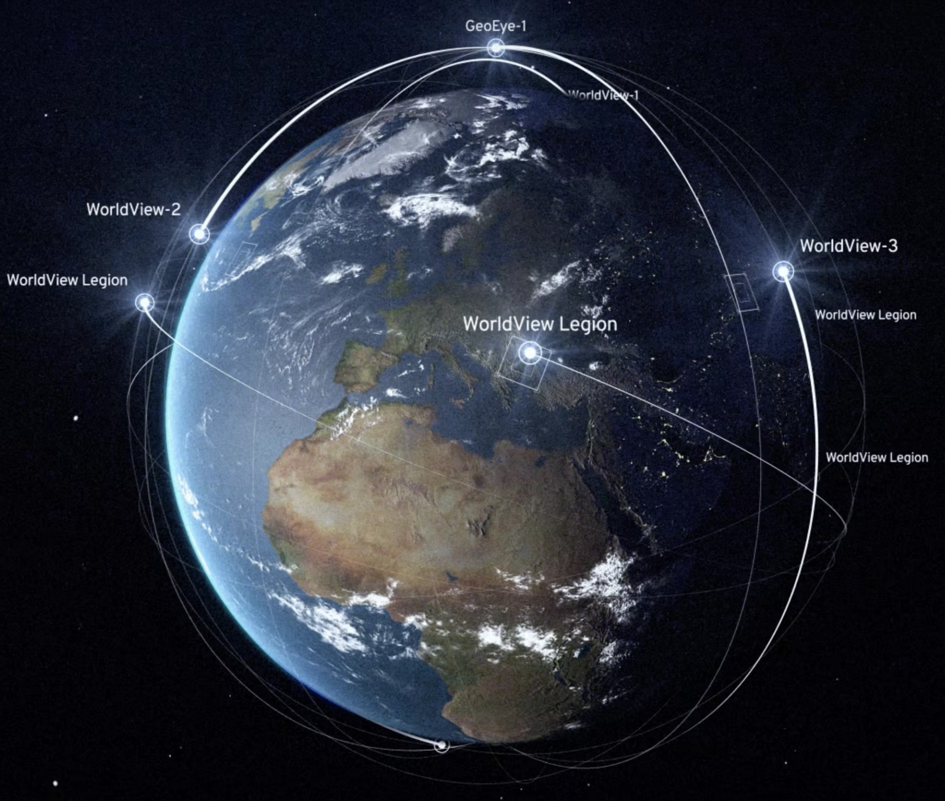
https://vantor.com/company/constellation/

Slide 46
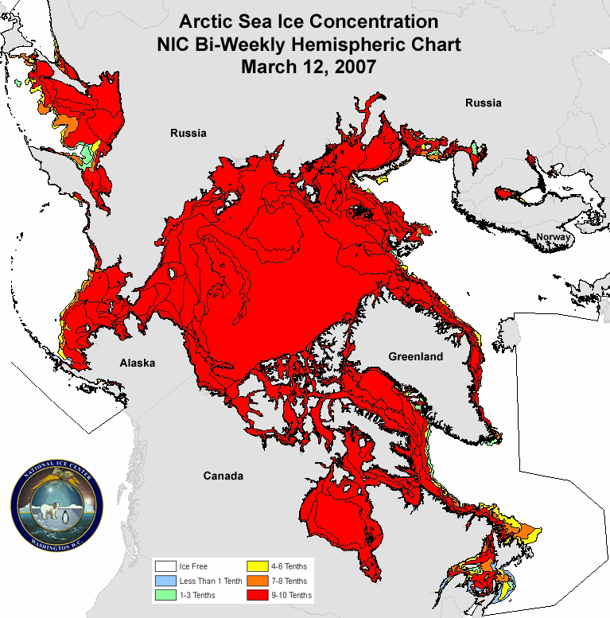
http://www.esa.int/esaEO/SEMVLJVH48F_index_1.html
The animation shows changing sea ice extent and concentration from 12 March to 24 September 2007
Credits: U.S. National Ice Center (NIC)

Slide 47
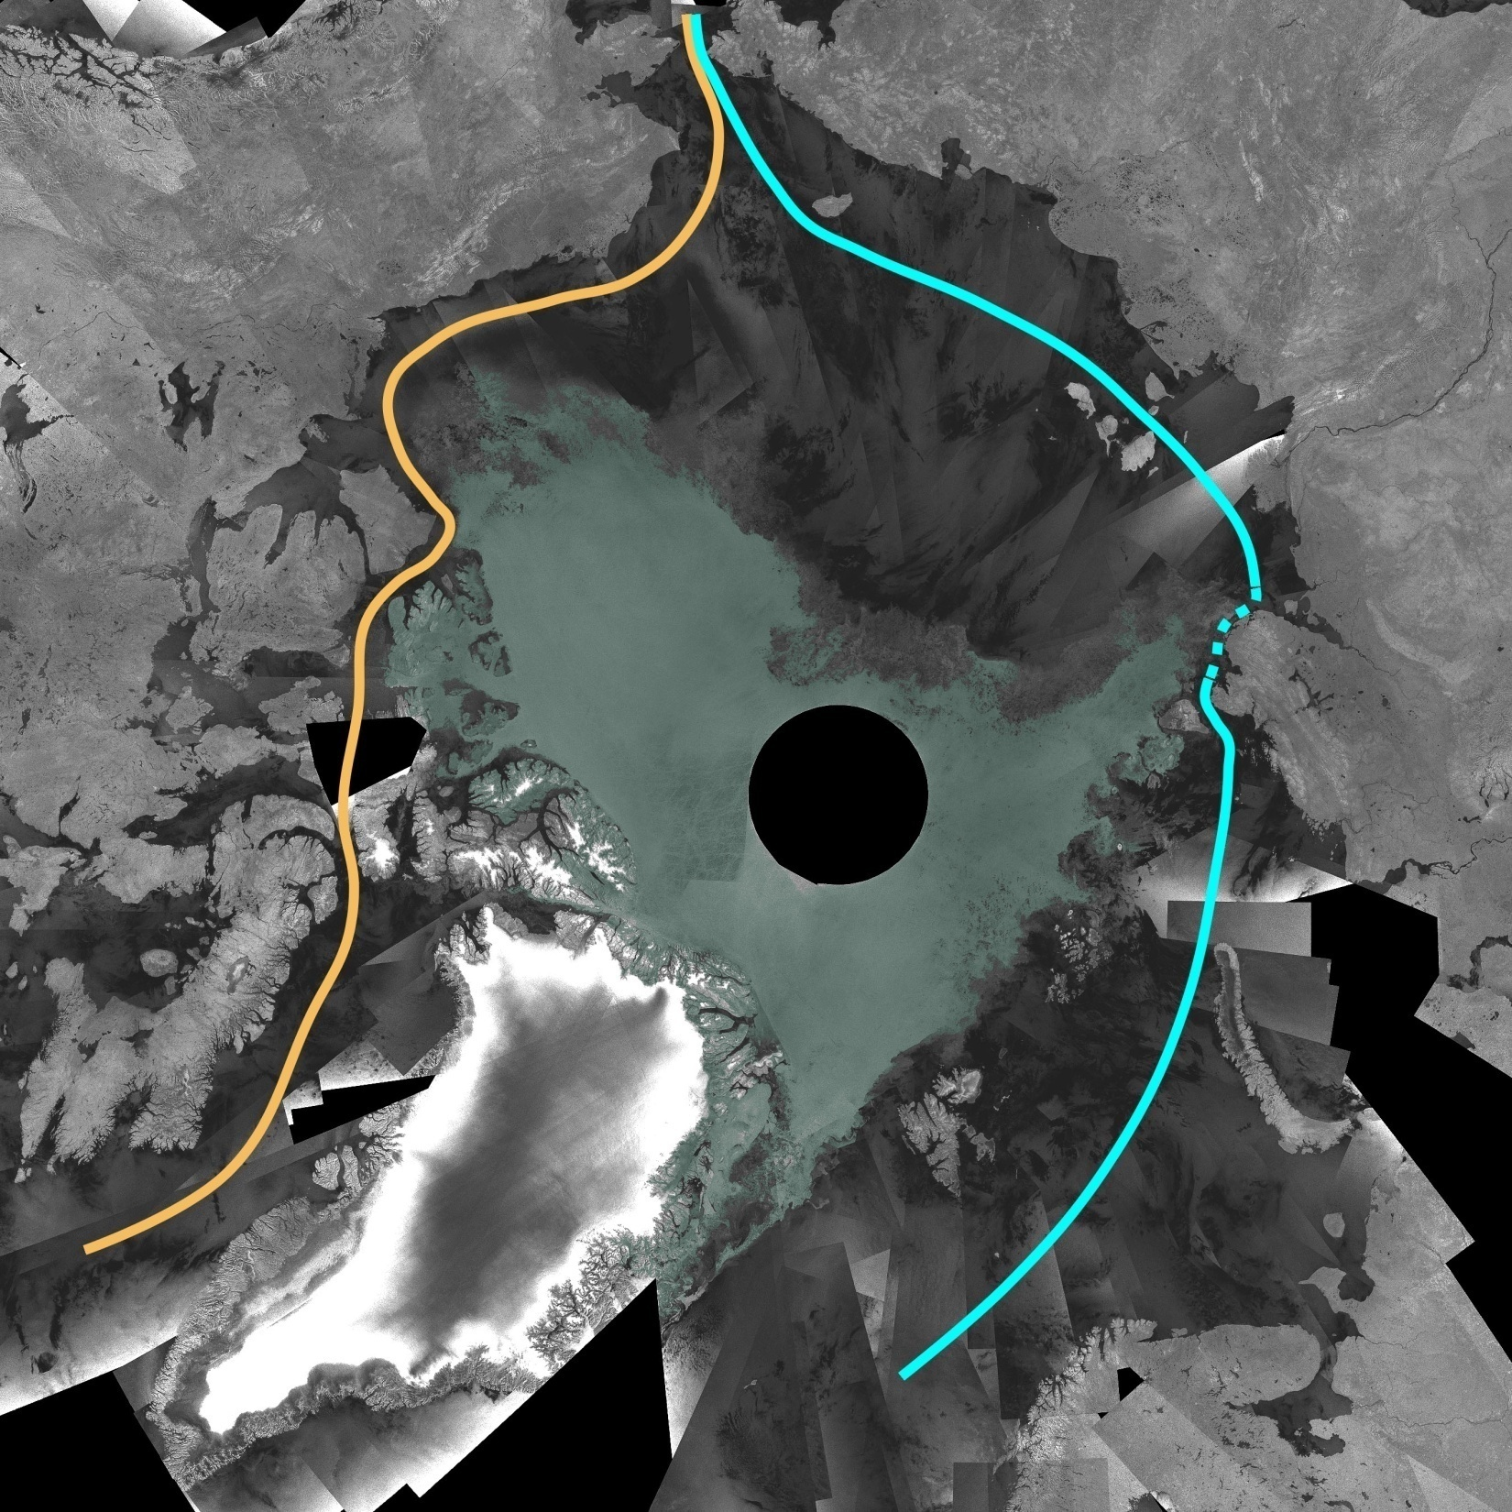
http://www.esa.int/esaEO/SEMVLJVH48F_index_1.html
Envisat ASAR mosaic of the Arctic Ocean for early September 2007, clearly showing the most direct route of the Northwest Passage (orange line) and the Northeast passage (blue line)..
Credits: ESA

Slide 48
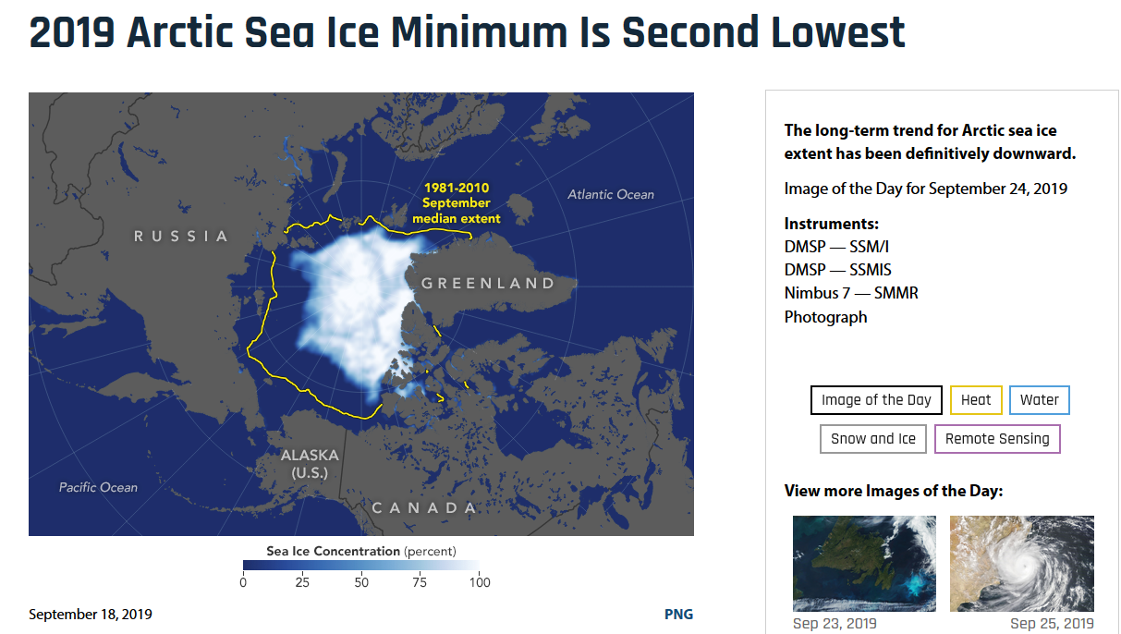
2012
https://earthobservatory.nasa.gov/images/145641/2019-arctic-sea-ice-minimum-is-second-lowest

Slide 49
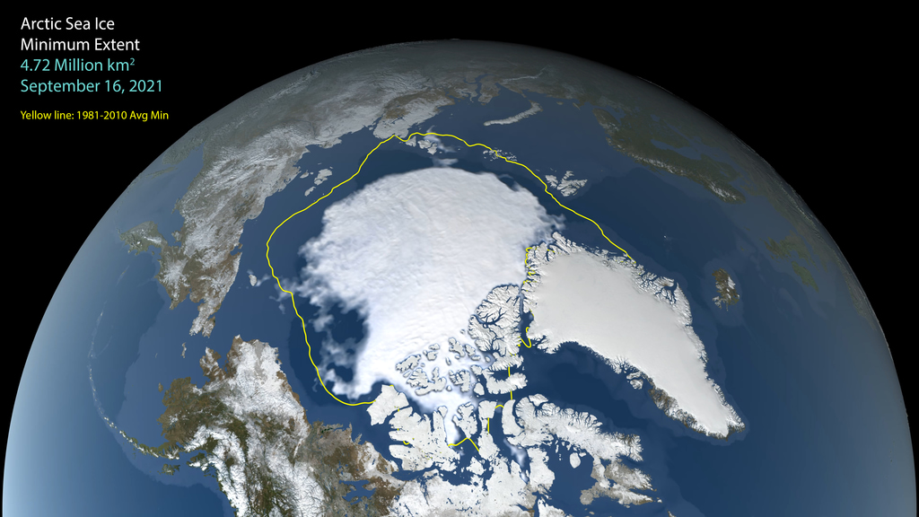
2021 Arctic Sea Ice Minimum Animation
https://svs.gsfc.nasa.gov/4941

Slide 50
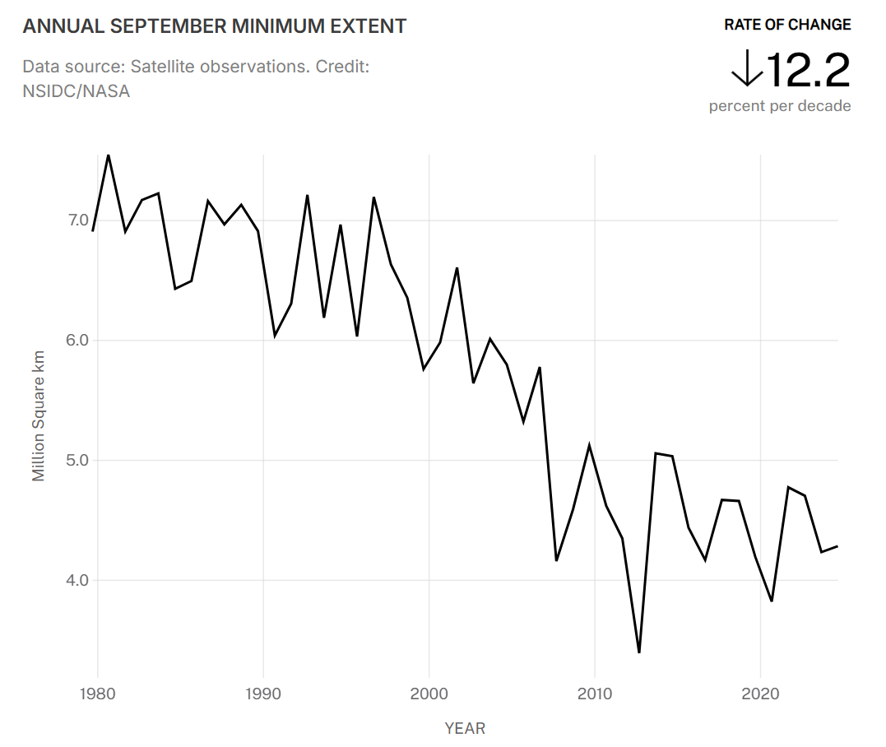
Arctic Sea Ice Minimum
https://climate.nasa.gov/vital-signs/arctic-sea-ice/

Slide 51
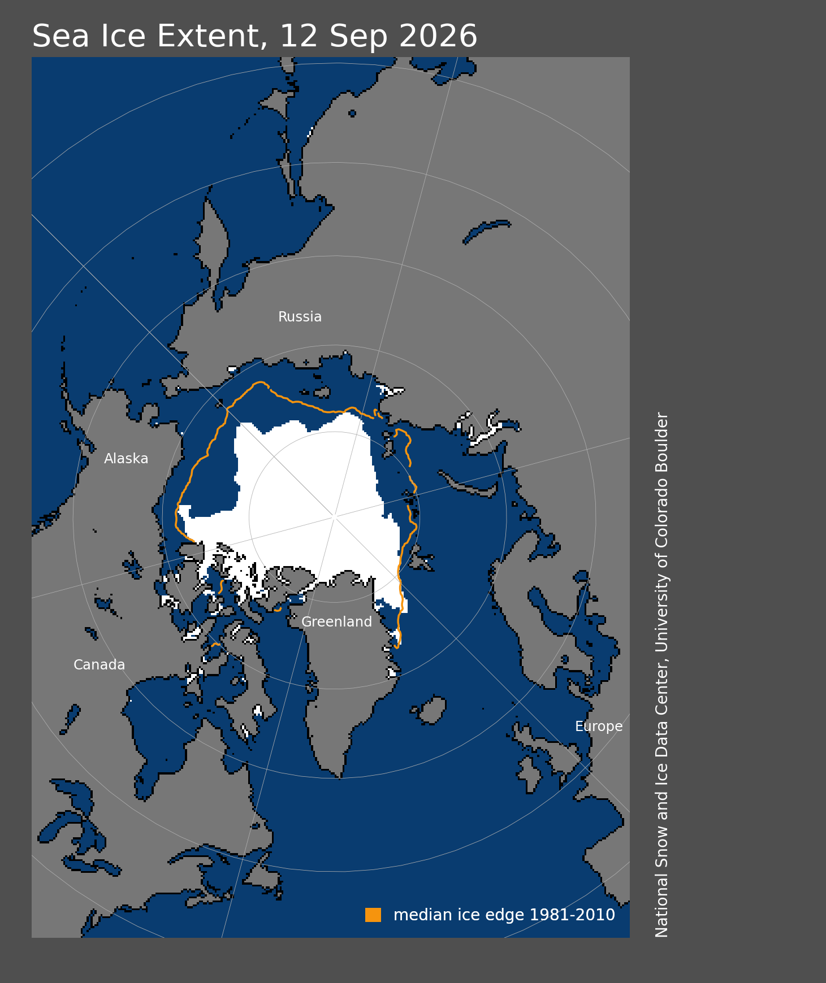
https://nsidc.org/sites/default/files/images/Map/n_20260912_extn_hires_v4.0.png

Slide 52
Sea levels rising and Arctic ice at a record low, global report says?
https://www.ctvnews.ca/climate-and-environment/sea-levels-rising-and-arctic-ice-at-a-record-low-global-report-says-1.5609064
Is that the case?
https://svs.gsfc.nasa.gov/vis/a000000/a004700/a004786/sea_ice_minimum_1080p30.mp4

Slide 53
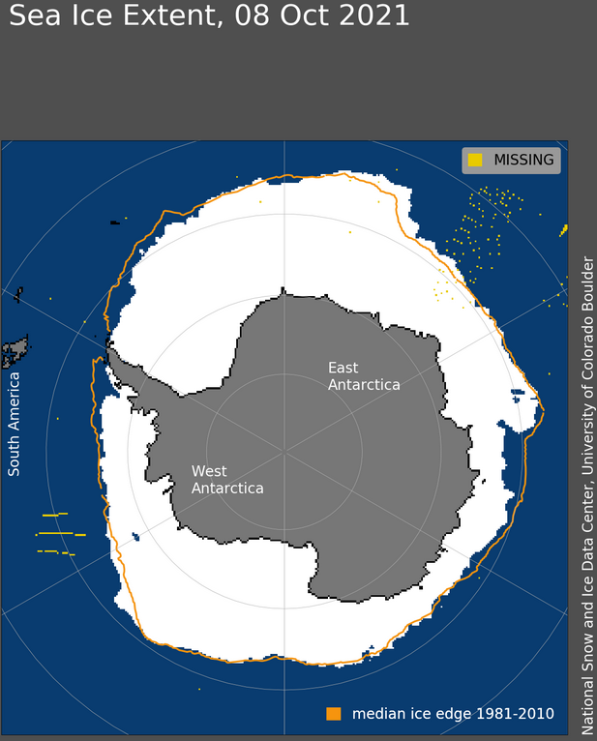
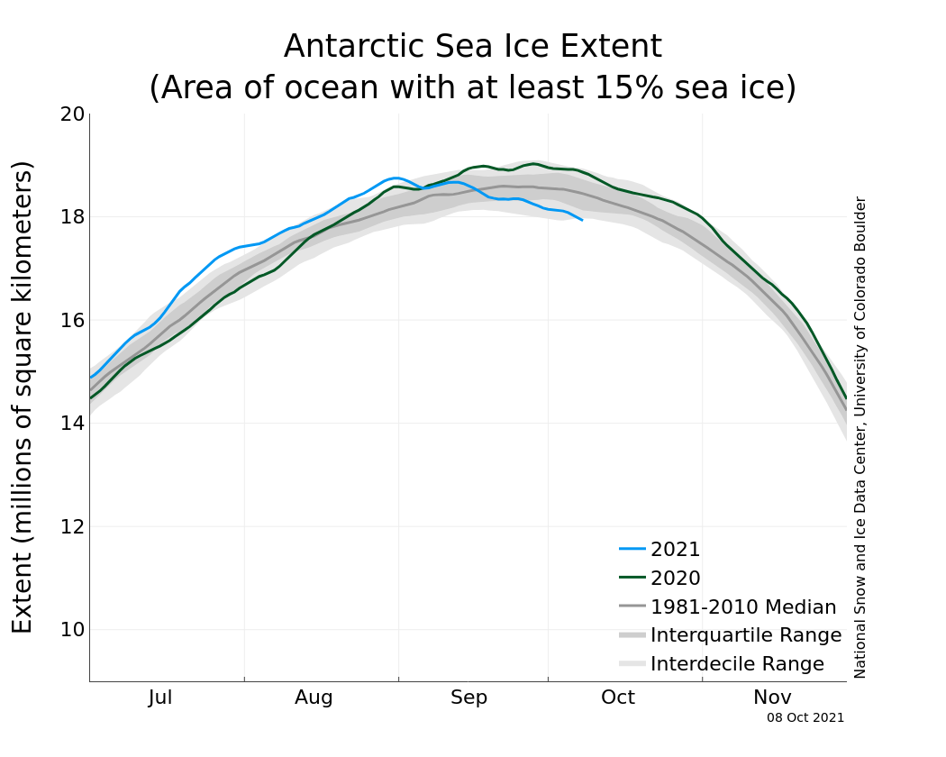
Antarctic Sea Ice Extent
https://nsidc.org/arcticseaicenews/antarctic-daily-image-update/

Slide 54
Sentinel Program (Copernicus)
https://www.esa.int/Our_Activities/Observing_the_Earth/Copernicus/Overview4

Slide 55
The copyright to this original work is held by Dr. Forsythe and students registered in course Geo542 can use this material for the purposes of this course but no other use is permitted, and there can be no sale or transfer or use of the work for any other purpose without explicit permission of Dr. Forsythe.

