Slide 1
The copyright to this original work is held by Dr. Forsythe and students registered in course Geo542 can use this material for the purposes of this course but no other use is permitted, and there can be no sale or transfer or use of the work for any other purpose without explicit permission of Dr. Forsythe.

Slide 2
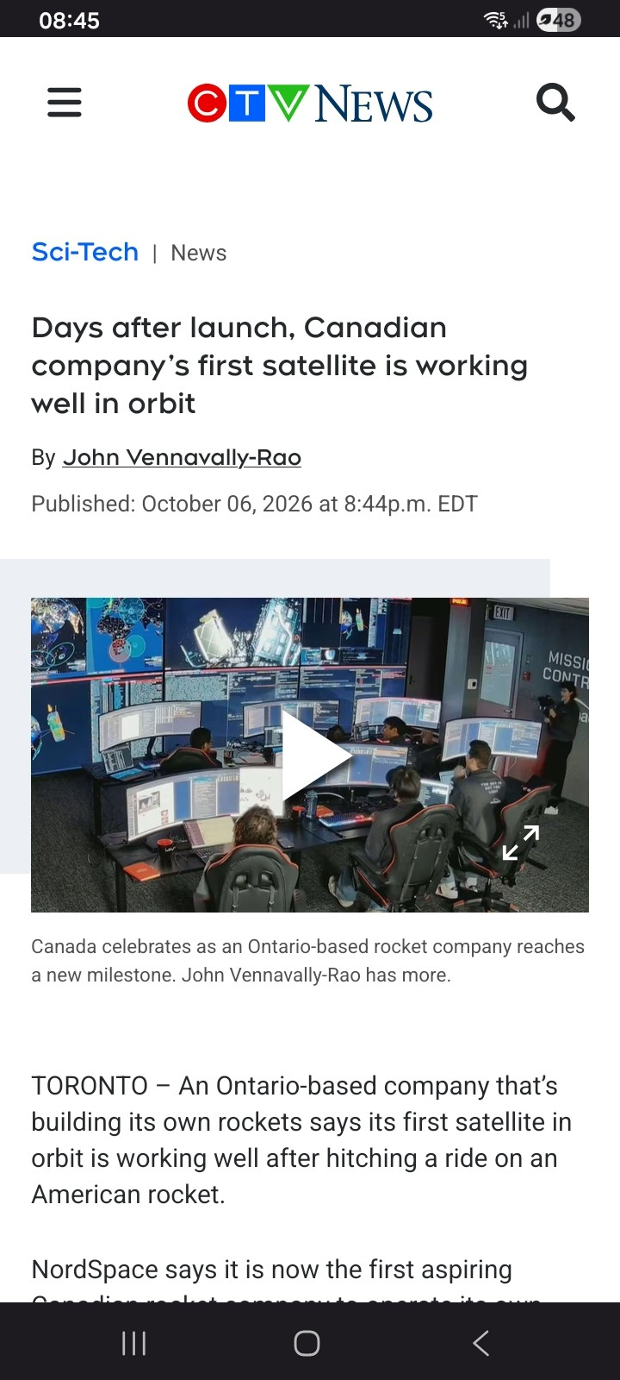
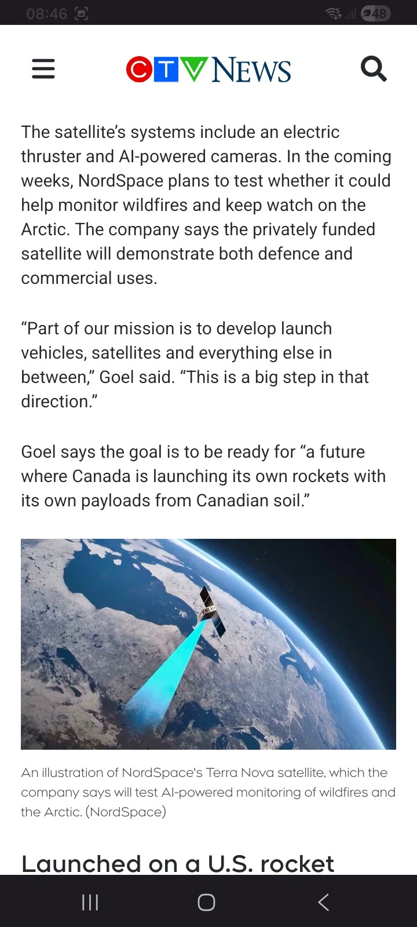
https://www.ctvnews.ca/sci-tech/article/days-after-launch-canadian-companys-first-satellite-is-working-well-in-orbit/

Slide 3
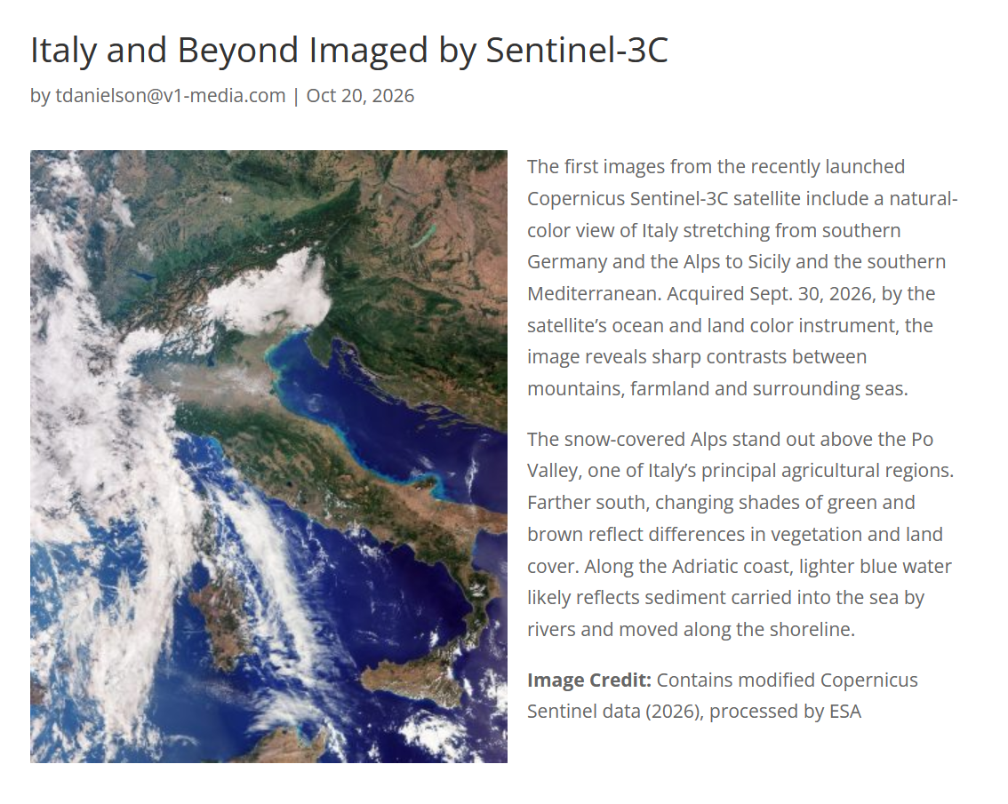
https://eijournal.com/slider-images/italy-and-beyond-imaged-by-sentinel-3c

Slide 4
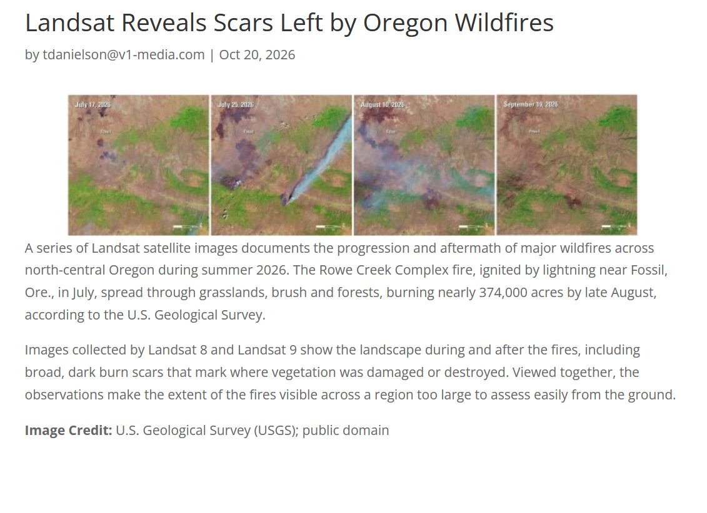
https://eijournal.com/news/industry-insights-trends/landsat-reveals-scars-left-by-oregon-wildfires

Slide 5
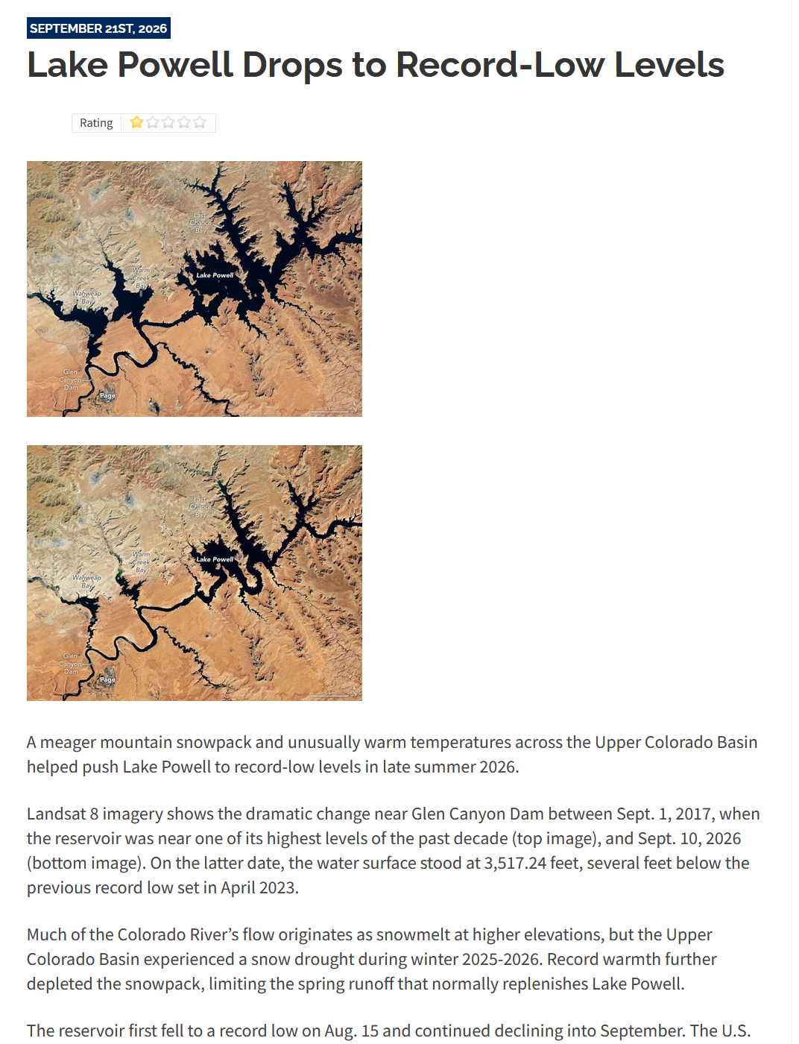
https://sensorsandsystems.com/lake-powell-drops-to-record-low-levels/

Slide 6
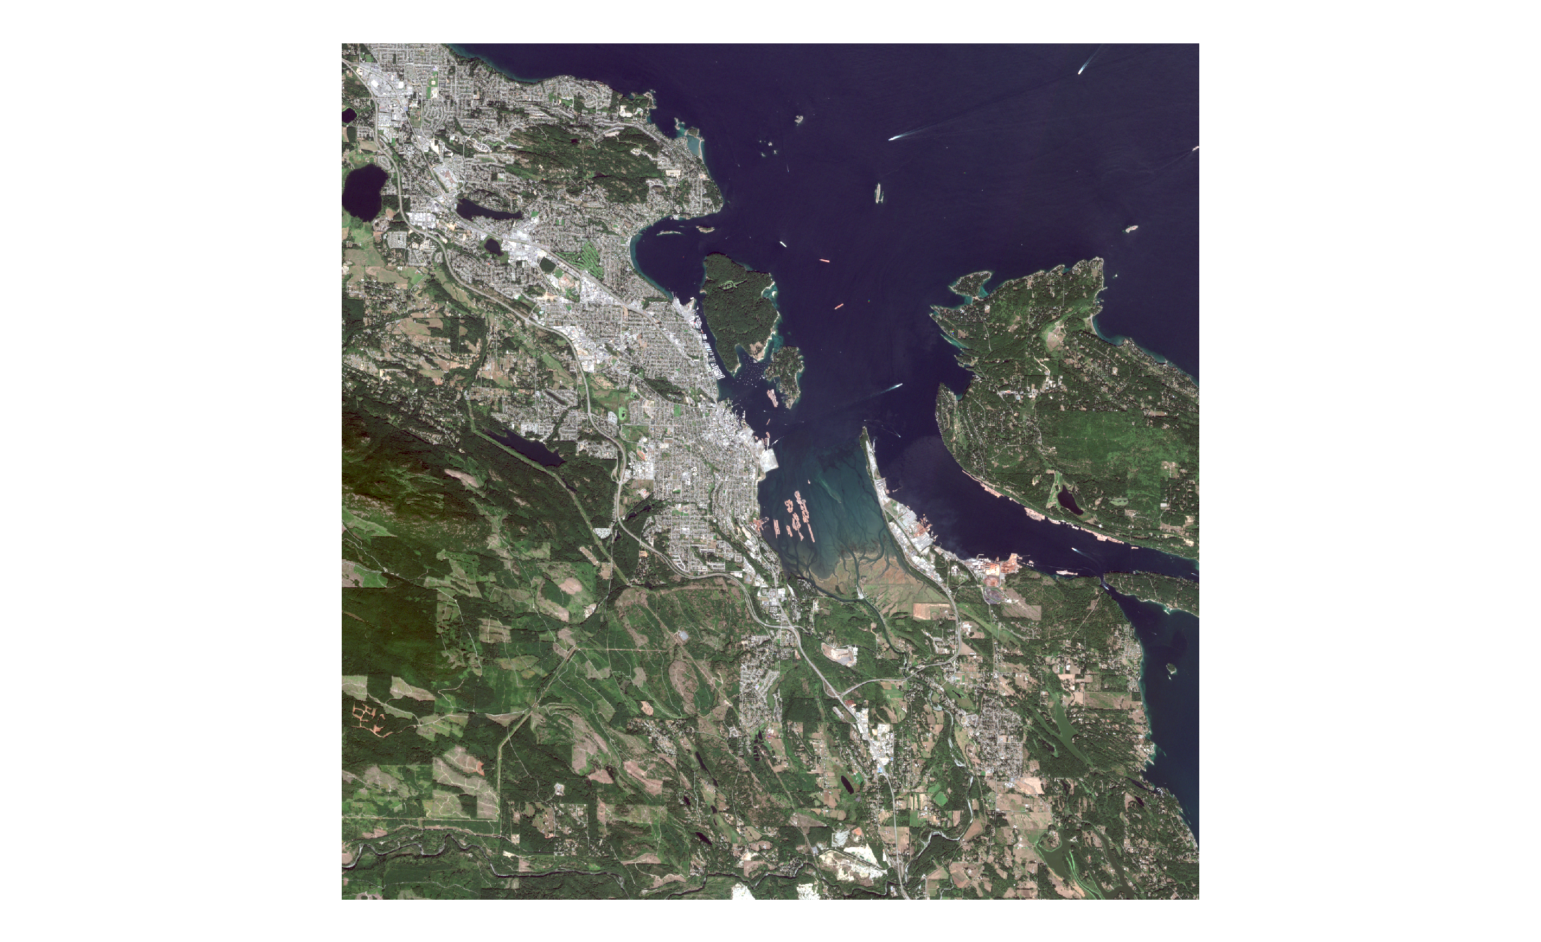

Slide 7
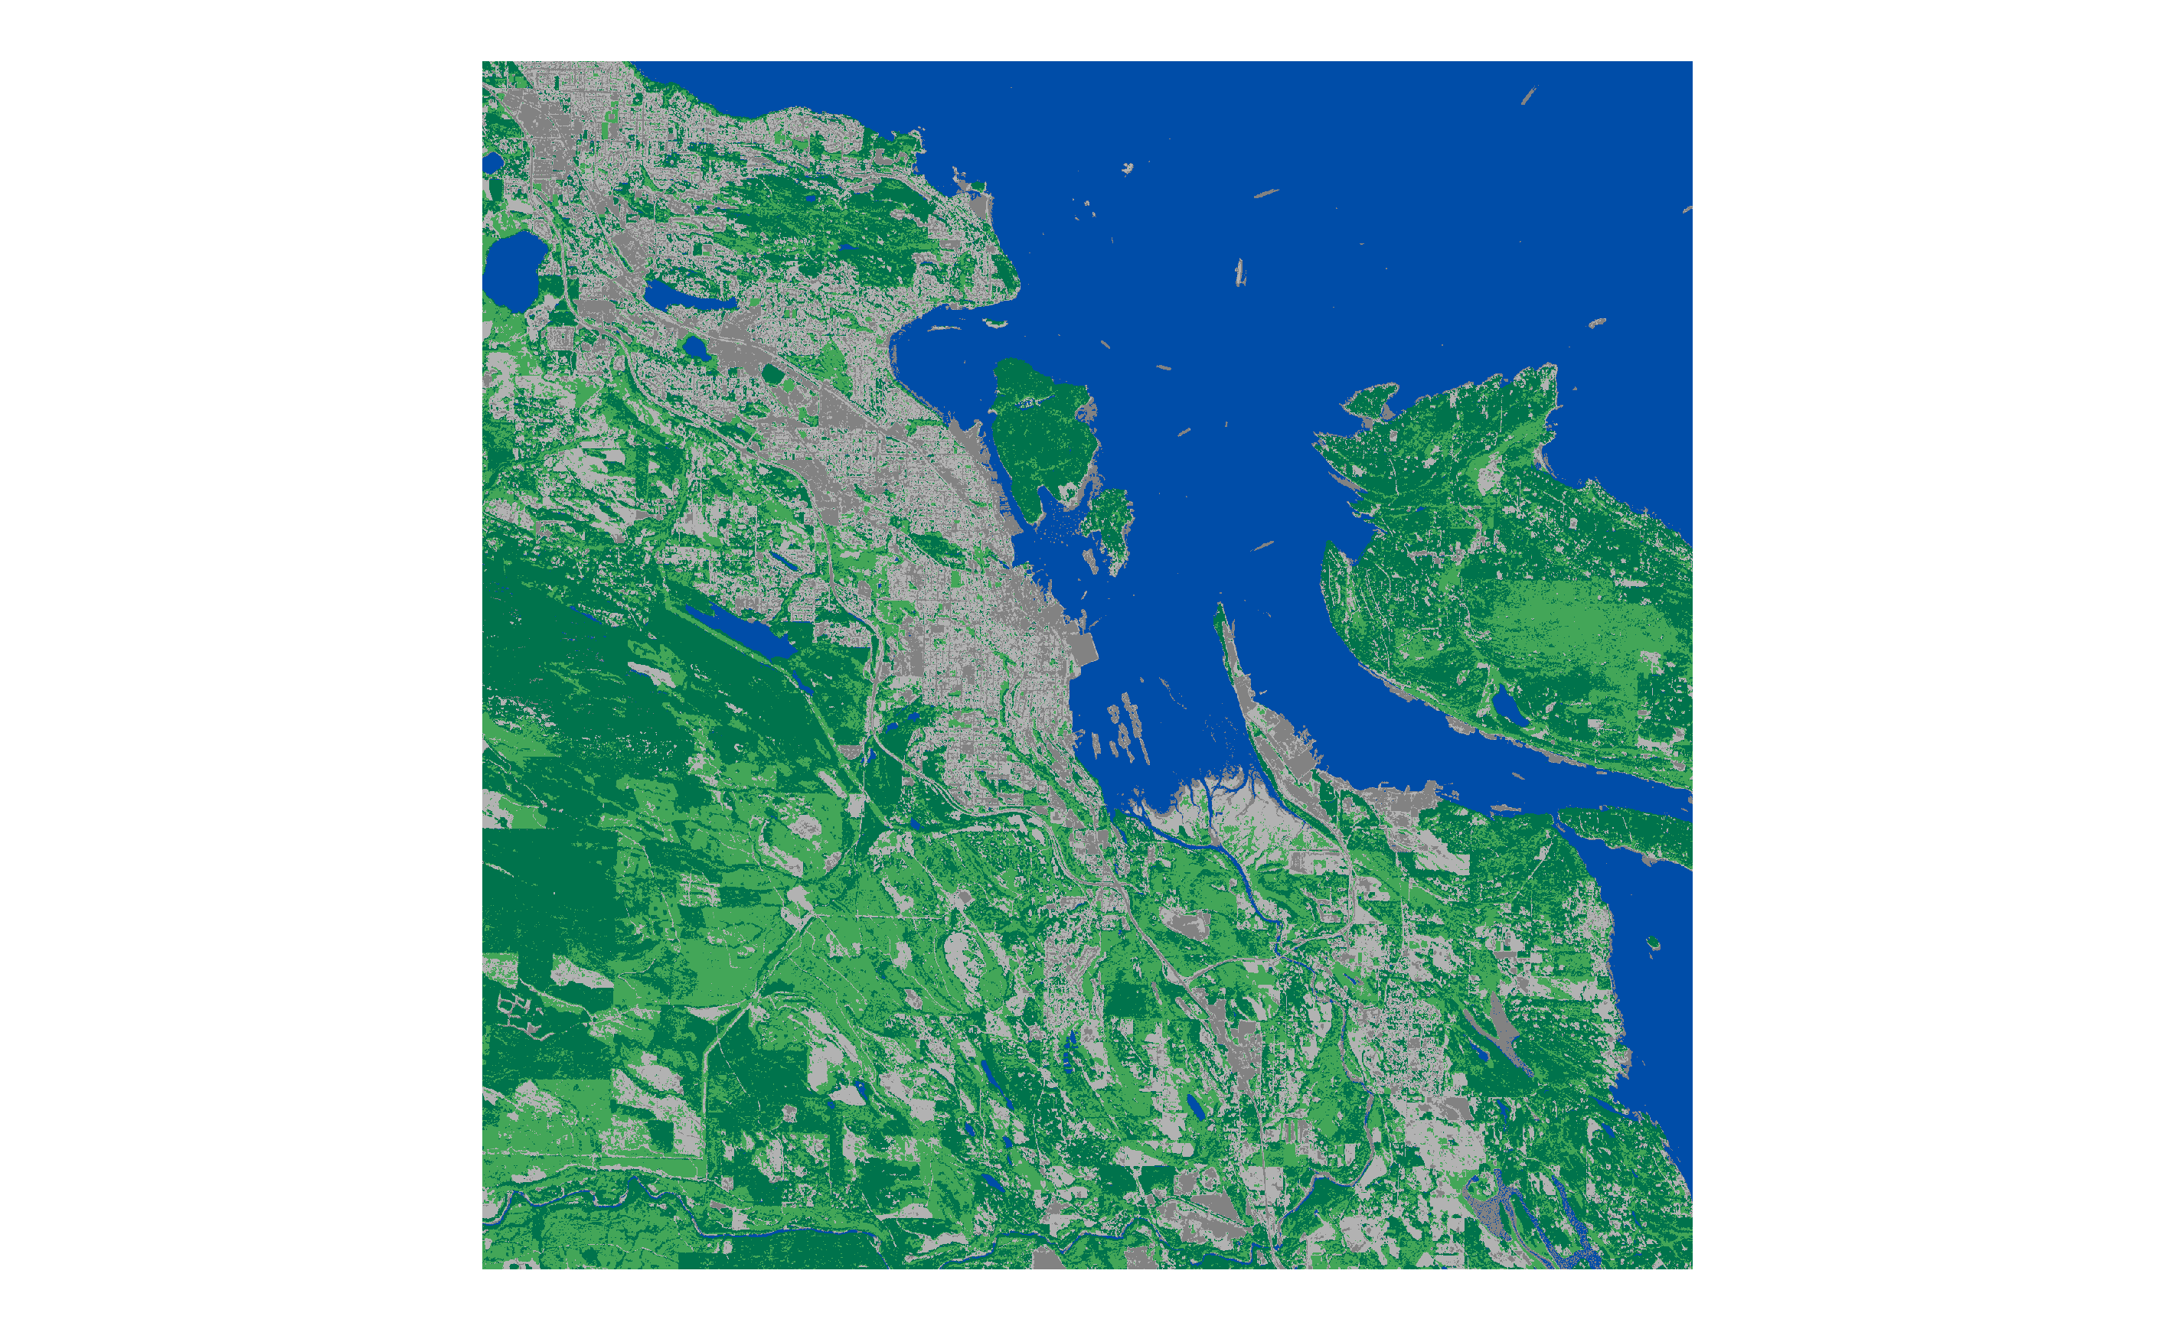
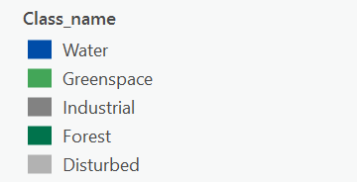

Slide 8
Lecture 5: Image Classification continued

Slide 9
Classification Techniques (Unsupervised)

Slide 10
Unsupervised Classification
Clustering algorithms are used to determine the natural structures or groupings in the data
Usually, the analyst specifies the number of desired classes
Lillesand et al., 2004. P 573-577

Slide 11
Unsupervised Classification
Each of the output classes are spectral classes
After the clustering process has ended, the analyst must identify the classes derived from the algorithm
This is done by comparing with reference data
Lillesand et al., 2004. P 573-577

Slide 12
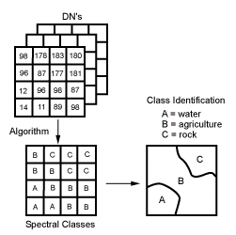
Unsupervised Classification
Canada Centre for Remote Sensing Tutorial
http://www.ccrs.nrcan.gc.ca/ccrs/eduref/tutorial/indexe.html

Slide 13
Classification Techniques (Supervised)

Slide 14
Classification Procedures – Supervised Classification
The analyst identifies homogenous representative samples of the different surface cover types of interest
Canada Centre for Remote Sensing Tutorial
http://www.ccrs.nrcan.gc.ca/ccrs/eduref/tutorial/indexe.html

Slide 15
Classification Procedures – Supervised Classification
These samples are referred to as training areas

Slide 16
Classification Procedures – Supervised Classification
The selection of training areas is based on:
    the analyst’s familiarity with the geographic area and
    their knowledge of actual land cover types present in the image
Canada Centre for Remote Sensing Tutorial
http://www.ccrs.nrcan.gc.ca/ccrs/eduref/tutorial/indexe.html

Slide 17
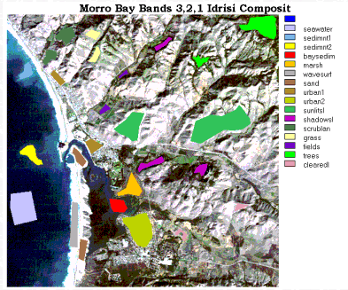
Training Areas - Morro Bay, California
Remote Sensing Tutorial, EOS Goddard, NASA
http://rst.gsfc.nasa.gov/Sect1/Sect1_17.html

Slide 18
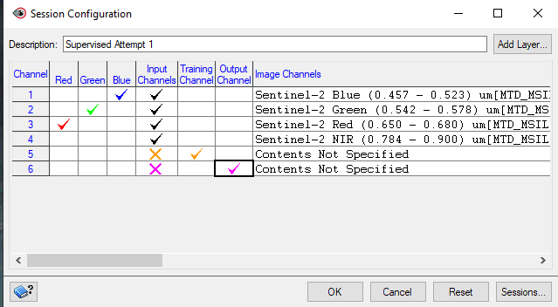
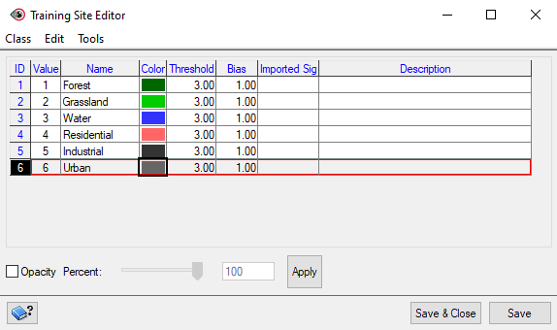

Slide 19
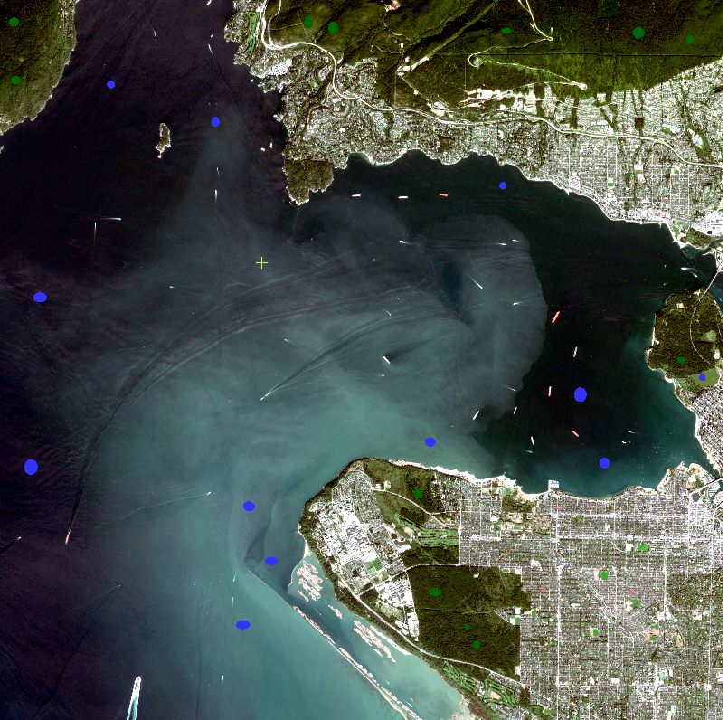

Slide 20
Supervised Classification
The numerical information in all spectral bands for the pixels comprising the training areas are used to "train" the computer to recognize spectrally similar areas for each class
Canada Centre for Remote Sensing Tutorial
http://www.ccrs.nrcan.gc.ca/ccrs/eduref/tutorial/indexe.html

Slide 21
Supervised Classification
Using the training areas’ spectral “signatures”, each pixel in the image is compared to these signatures and placed in the class it most “resembles” digitally
Canada Centre for Remote Sensing Tutorial
http://www.ccrs.nrcan.gc.ca/ccrs/eduref/tutorial/indexe.html

Slide 22
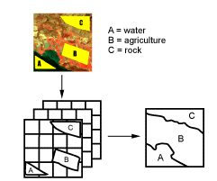
Supervised Classification
Canada Centre for Remote Sensing Tutorial
http://www.ccrs.nrcan.gc.ca/ccrs/eduref/tutorial/indexe.html

Slide 23
Classification Algorithms
Common algorithms used for classification include:
    minimum distance
    maximum likelihood
    parallelepiped
Remote Sensing Tutorial, EOS Goddard, NASA
http://rst.gsfc.nasa.gov/Sect1/Sect1_18.html

Slide 24
Classification Algorithms
Each algorithm has its own advantages and disadvantages in terms of:
    accuracy
    sensitivity
    computational resources required and
    results produced

Slide 25
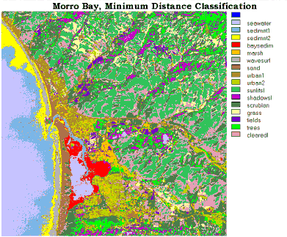
Example - Minimum Distance Classifier
Morro Bay California
Remote Sensing Tutorial, EOS Goddard, NASA
http://rst.gsfc.nasa.gov/Sect1/Sect1_18.html

Slide 26
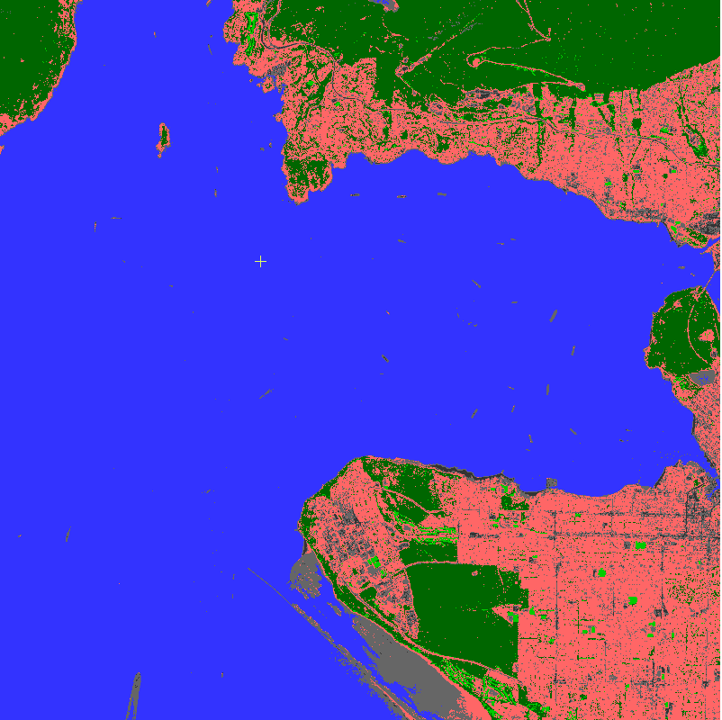

Slide 27
Post-Classification
The final step in any classification is to assess the accuracy of the classification
Most image processing programs have routines for performing accuracy assessments
Accuracy assessments generally compare the relationship between known reference data (ground truth) and the corresponding results of the automated classification
Lillesand et al., 2004. P 586-593

Slide 28
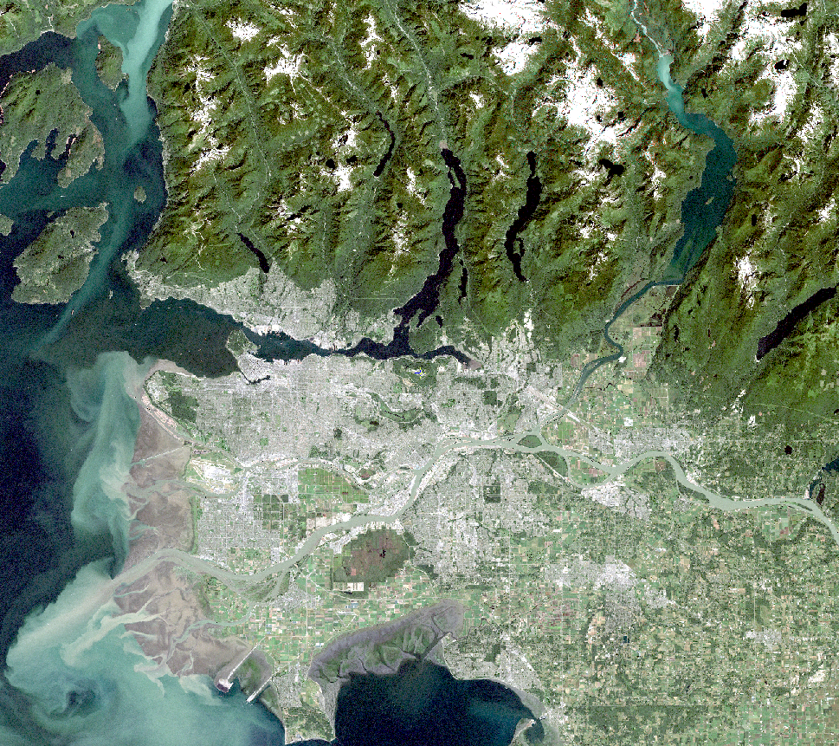

Slide 29
Course outline readings
Forsythe et al. (2012)

Slide 30
The copyright to this original work is held by Dr. Forsythe and students registered in course Geo542 can use this material for the purposes of this course but no other use is permitted, and there can be no sale or transfer or use of the work for any other purpose without explicit permission of Dr. Forsythe.

