Slide 1
The copyright to this original work is held by Dr. Forsythe and students registered in course Geo542 can use this material for the purposes of this course but no other use is permitted, and there can be no sale or transfer or use of the work for any other purpose without explicit permission of Dr. Forsythe.

Slide 2
Lab 1 due on October 6 (today)
Upload your Lab 1 submissions to D2L by 9:00pm today

Slide 3
Term Test 1
Tuesday Oct. 20 beginning at 6:10 pm via D2L
You MUST begin the Test between 6:10pm and 6:30pm
No going back on test questions
You will have 20 mins to complete the test
20 MC questions
Covers all lecture, lab and workshop material (including videos)

Slide 4
Lecture 4: Image Classification

Slide 5
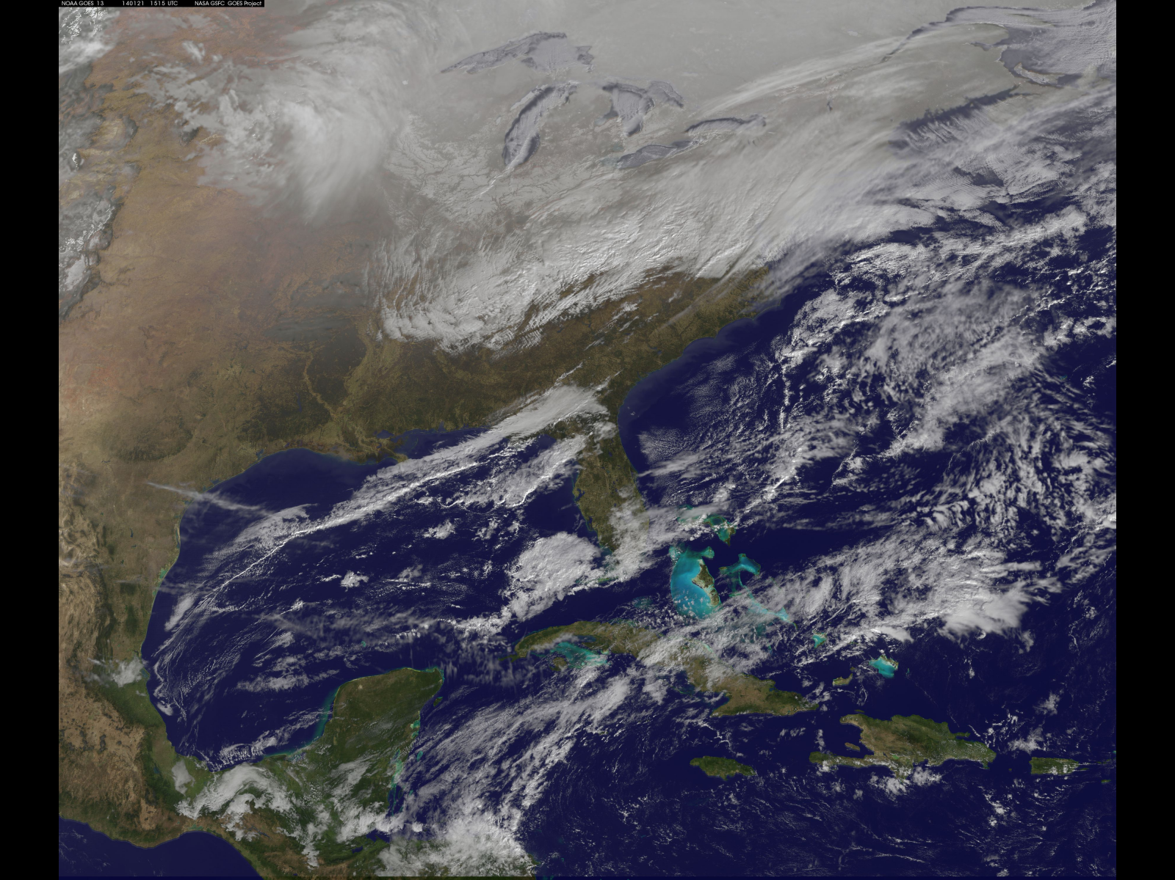
NOAA's GOES-East satellite is providing continuous coverage of the major winter storm affecting the U.S. East Coast on January 21, 2014. The National Weather Service or NWS National Prediction Center noted in their short range public discussion on January 21 that an Arctic air mass is arriving in the eastern U.S. today and snow will extend from the Mid-Atlantic to New England. https://www.nasa.gov/image-article/satellite-view-of-central-eastern-u-s-deep-freeze/

Slide 6
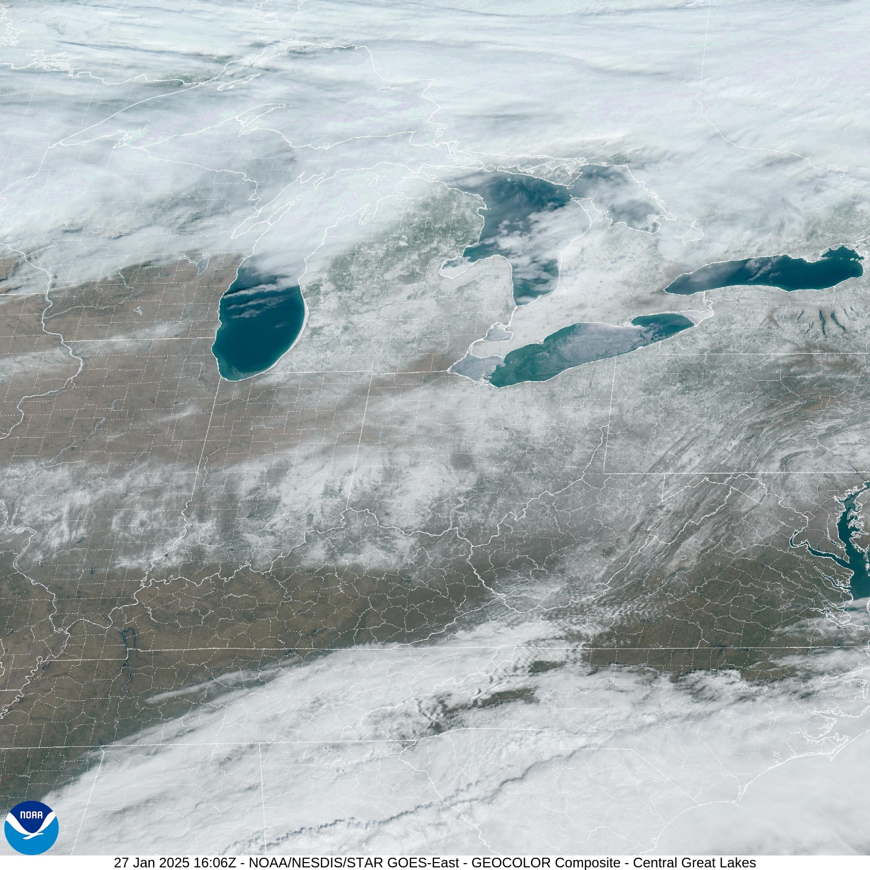
https://cdn.star.nesdis.noaa.gov/GOES16/ABI/SECTOR/cgl/GEOCOLOR/20250271606_GOES16-ABI-cgl-GEOCOLOR-2400x2400.jpg

Slide 7
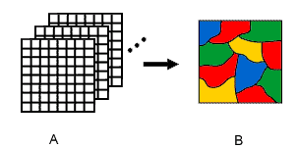
Image Classification
Digital image classification uses the spectral information represented by the digital numbers in one or more spectral bands, and attempts to classify each individual pixel based on this spectral information
Canada Centre for Remote Sensing Tutorial
http://www.ccrs.nrcan.gc.ca/ccrs/eduref/tutorial/indexe.html

Slide 8
Image Classification
This type of classification is called spectral pattern recognition
The objective is to assign all pixels in an image to particular classes or “themes”

Slide 9
Image Classification
Classes represent land cover types such as water, coniferous forest, industrial land, wheat crops, etc.)
The resulting image is a mosaic of pixels, each of which belong to a particular theme.
The classified image is essentially a thematic “map” of the original image

Slide 10
S,S,T,S,T,P,A
What are these?

Slide 11
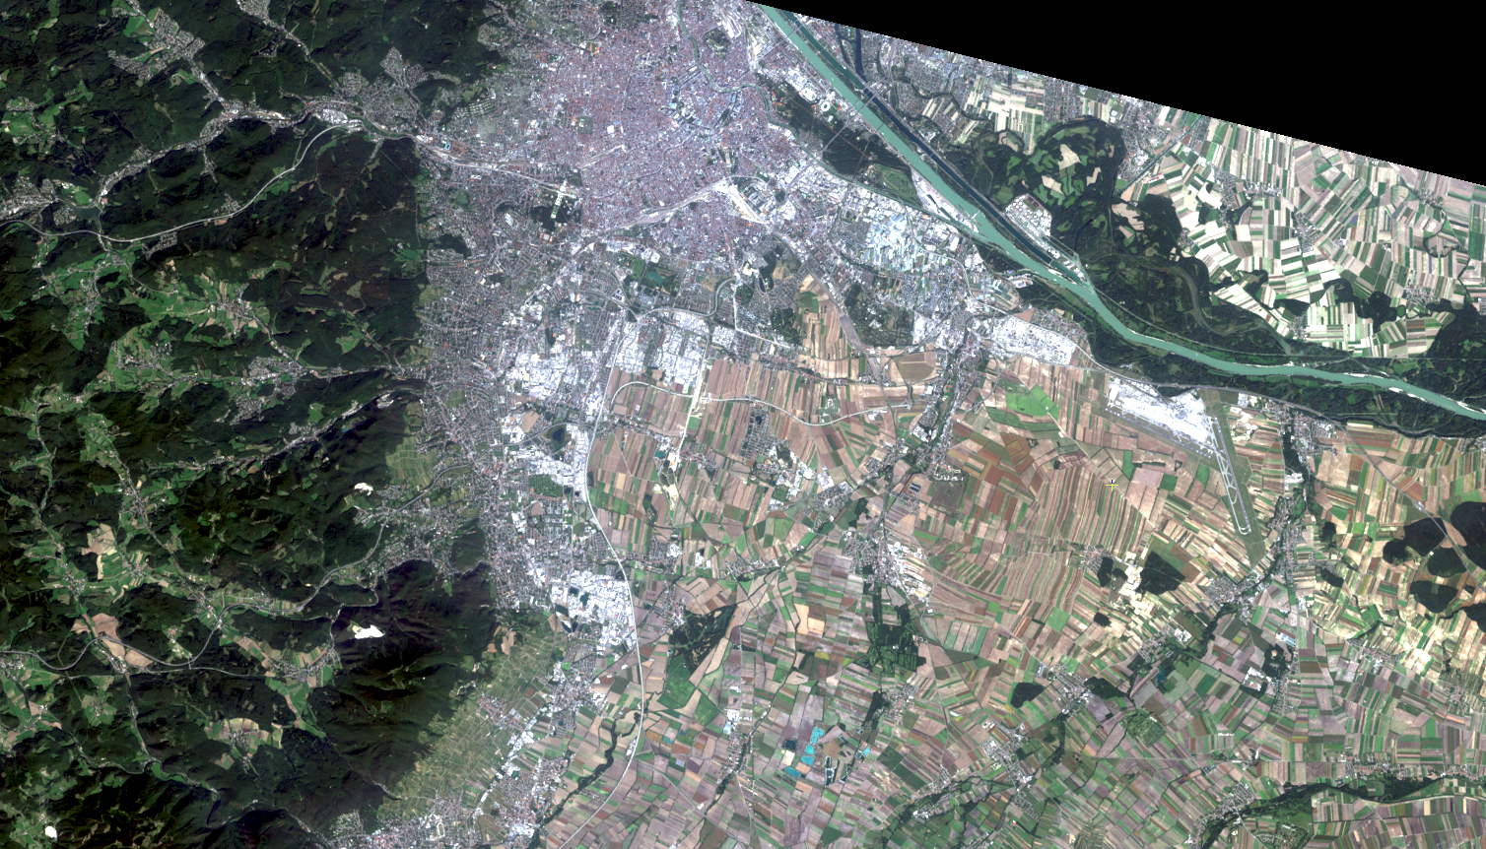

Slide 12
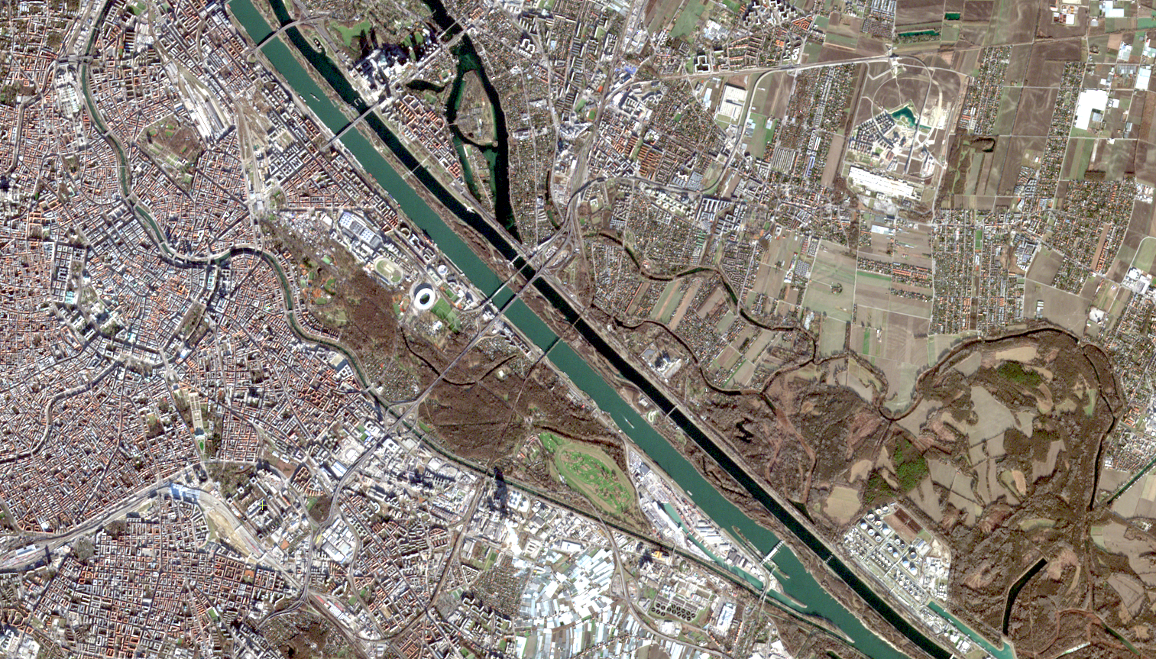

Slide 13
Image Classification
Information classes are categories of interest that an analyst is actually trying to identify
Spectral classes are groups of pixels that are uniform with respect to brightness values

Slide 14
Image Classification
The objective is to match the spectral classes in the data to the information classes of interest
Output products include hardcopy and digital land cover maps as well as summary statistics of the extent of land cover types present in an image

Slide 15
The copyright to this original work is held by Dr. Forsythe and students registered in course Geo542 can use this material for the purposes of this course but no other use is permitted, and there can be no sale or transfer or use of the work for any other purpose without explicit permission of Dr. Forsythe.

