Slide 1
The copyright to this original work is held by Dr. Forsythe and students registered in course Geo542 can use this material for the purposes of this course but no other use is permitted, and there can be no sale or transfer or use of the work for any other purpose without explicit permission of Dr. Forsythe.

Slide 2
Lab 1 due on October 6
Upload your Lab 1 submissions to D2L by 9:00pm on October 6

Slide 3
Lecture 3

Slide 4
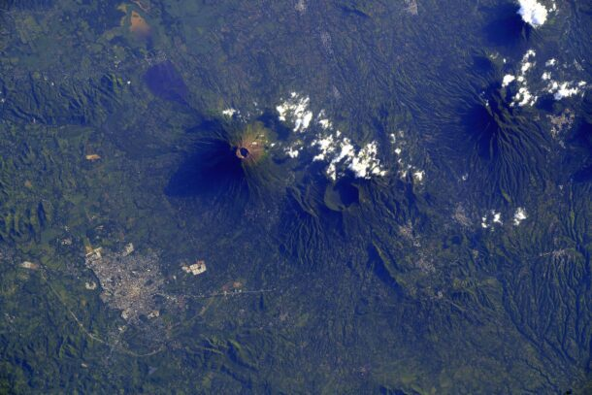
ISS Remote Sensing
San Miguel, El Salvador, captured from the International Space Station on Sept. 16, 2023, by ESA astronaut Andreas Mogensen during his Huginn Mission. When Andreas shared the picture on social media, he said:
“An exciting picture of two volcanoes in Central America. The fun, but time-consuming part, is figuring out what the picture shows using Google Earth afterward. In this case, I quickly found the city of San Miguel in El Salvador and the two volcanoes, Chinameca and San Miguel.”
Image Credit: ESA/NASA-A.Mogensen
https://eijournal.com/slider-images/el-salvador-from-above

Slide 5
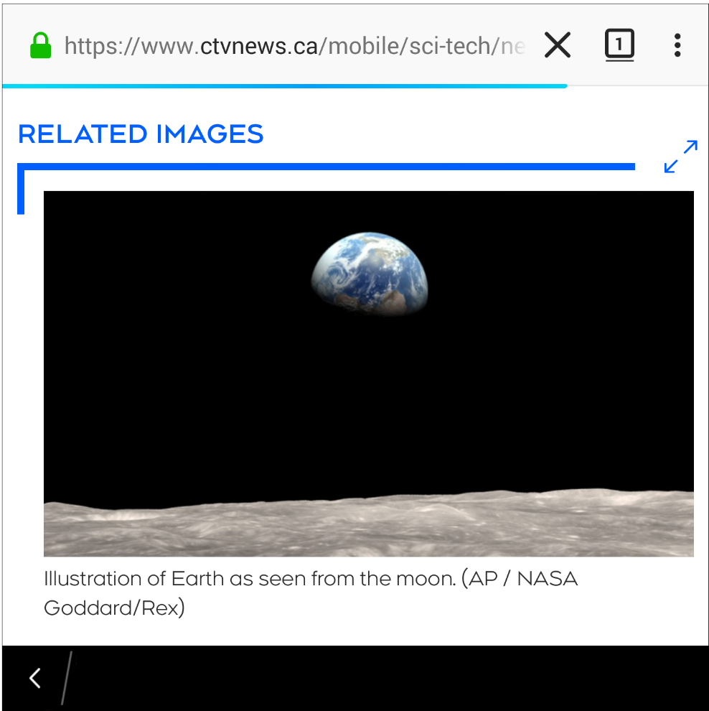
Saturday, September 26, 2020
In the news….

Slide 6
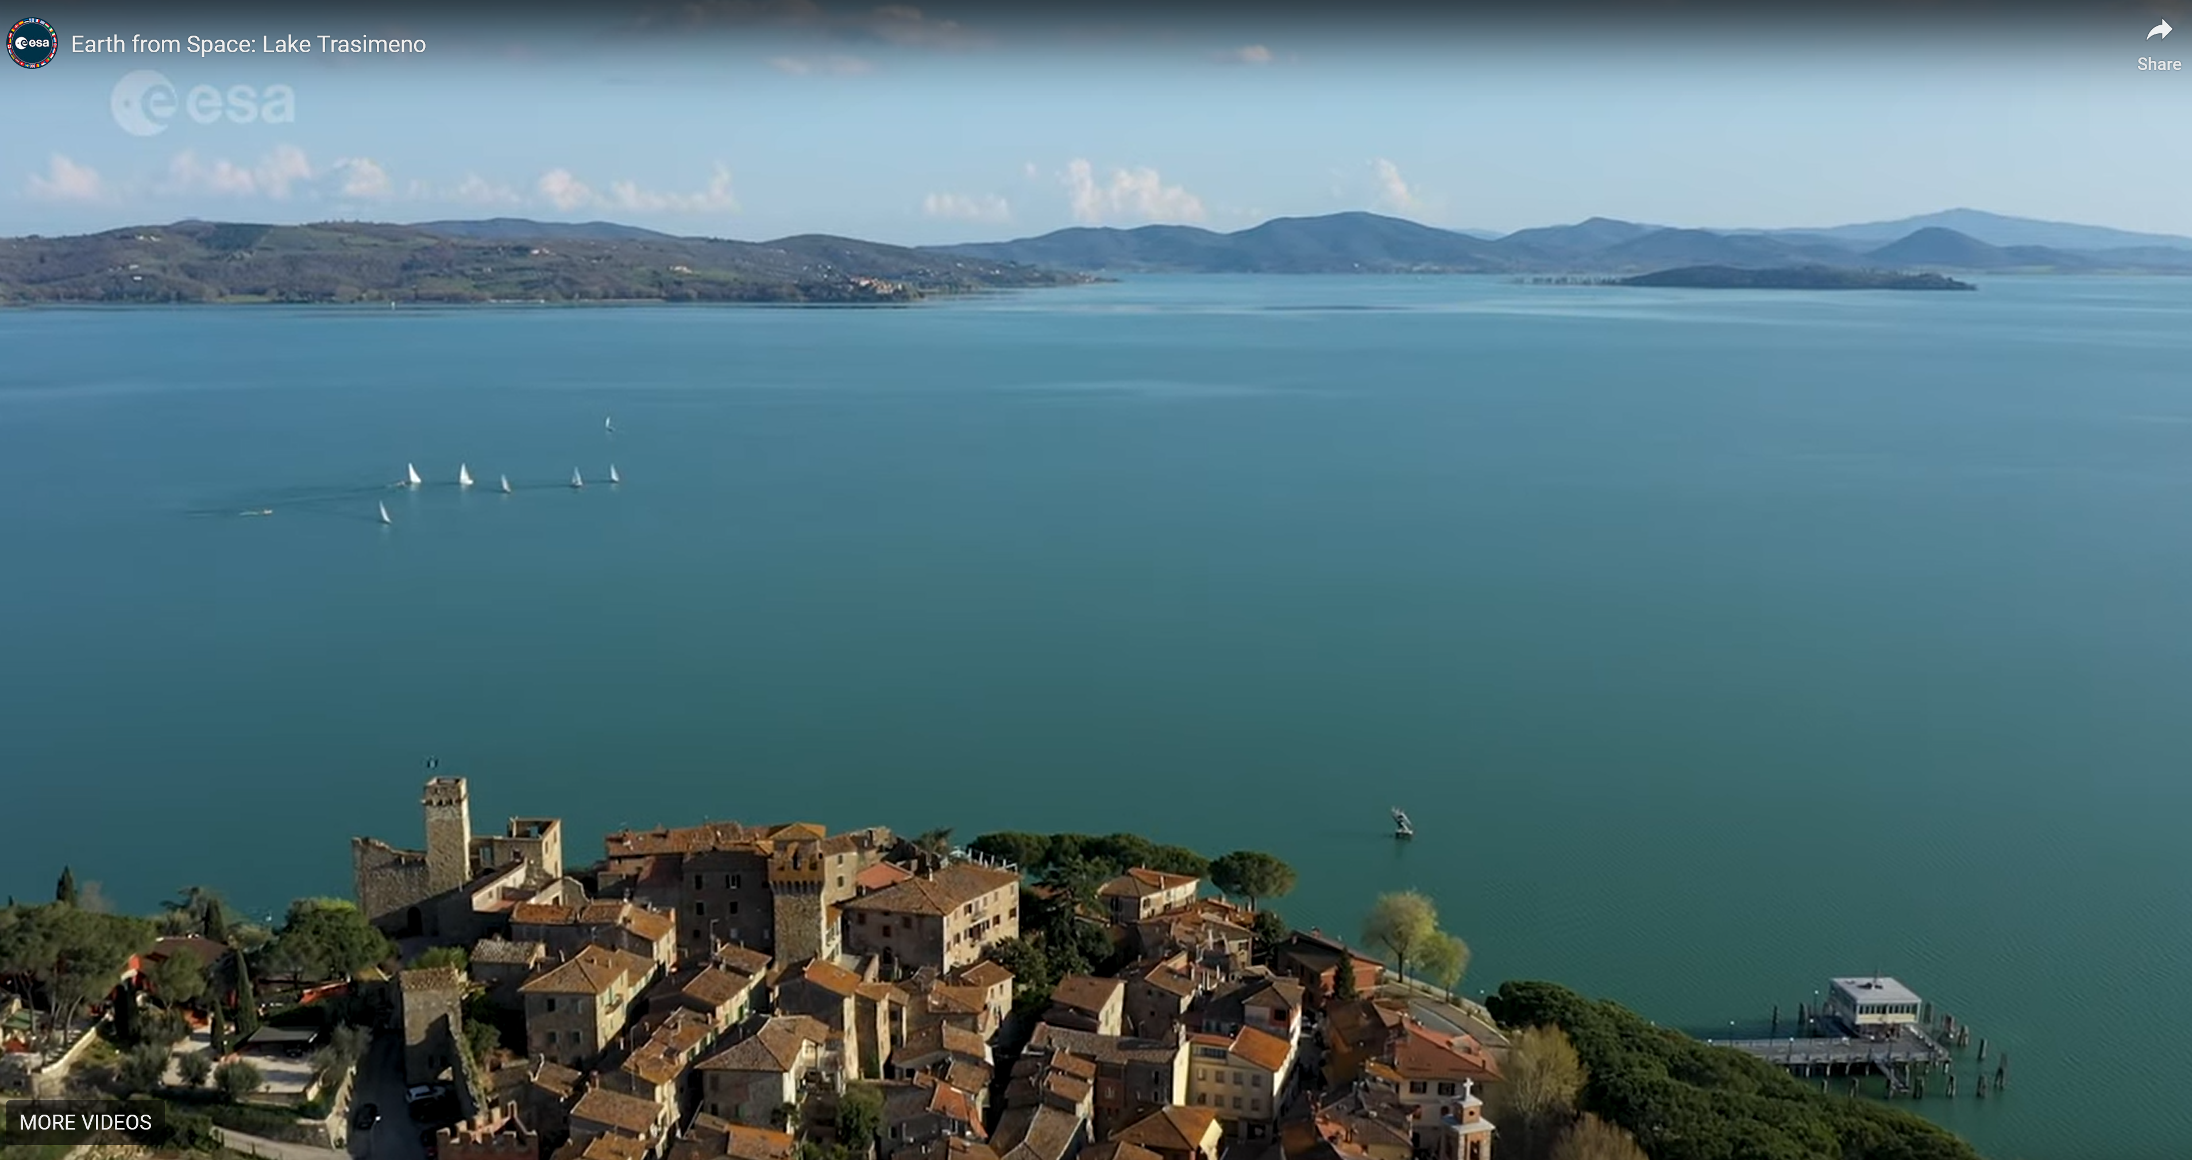
https://geospatialstream.com/earth-from-space-lake-trasimeno/

Slide 7
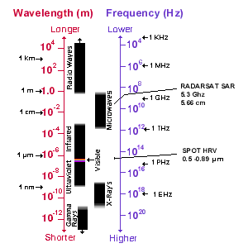
The Electromagnetic Spectrum

Slide 8
The Electromagnetic Spectrum
The visible wavelengths cover a range from approximately 0.4 to
0.7 um.
Violet: 0.4 - 0.446 um
Blue: 0.446 - 0.500 um
Green: 0.500 - 0.578 um
Yellow: 0.578 - 0.592 um
Orange: 0.592 - 0.620 um
Red: 0.620 - 0.7 um

Slide 9
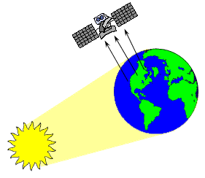
Passive Sensors

Slide 10
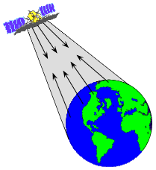
Active Sensors

Slide 11
What is a Pixel?
An image is a digital representation of equal-sized and shaped areas, called picture elements or pixels.

Slide 12
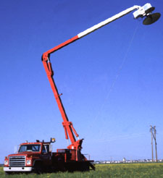
Remote Sensing Sensors
Ground-based sensors

Slide 13
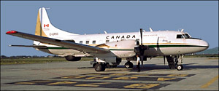
Remote Sensing Sensors
Aerial platforms

Slide 14
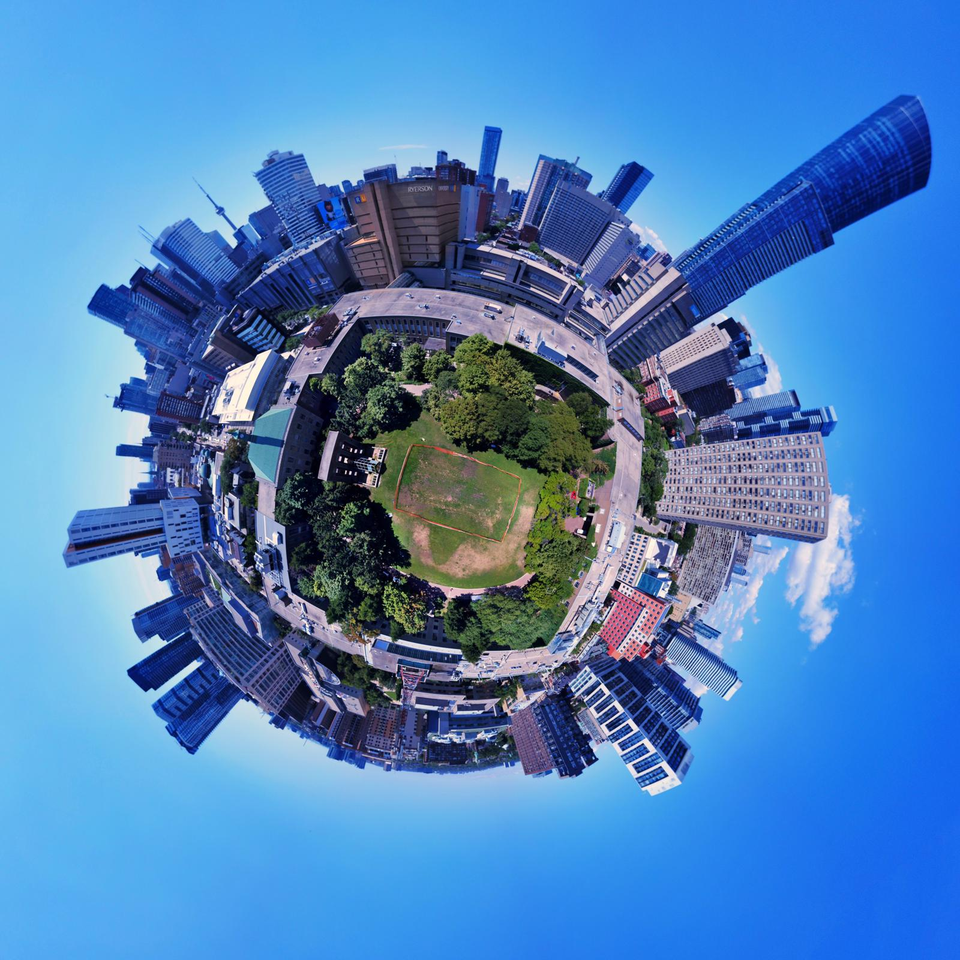
Blimps and Drones
How can they be used for remote sensing?

Slide 15
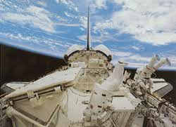
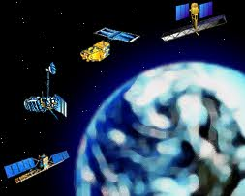
Remote Sensing Sensors
In space, remote sensing is commonly performed with satellites.

Slide 16
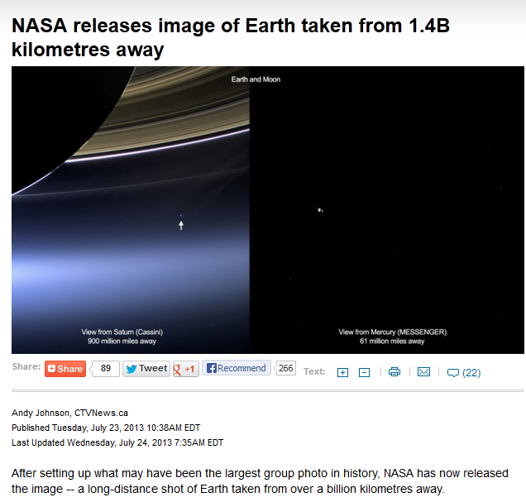
http://www.ctvnews.ca/sci-tech/nasa-releases-image-of-earth-taken-from-1-4b-kilometres-away-1.1379520

Slide 17
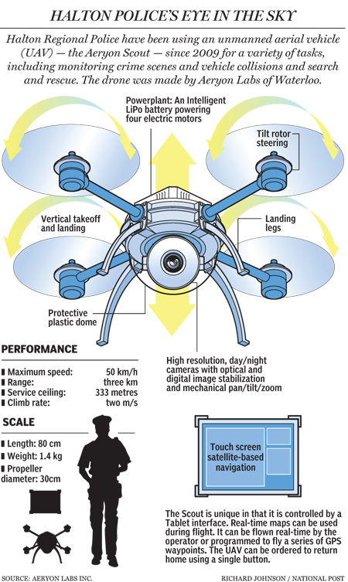
Halton police find $744K worth of drugs using high-tech pot-spotting drones
http://news.nationalpost.com/2012/09/13/halton-police-find-744k-worth-of-drugs-using-high-tech-pot-spotting-drones/ (link no longer functions)

Slide 18
Spatial Resolution
Refers to the size of the smallest possible feature that can be detected.

Slide 19
Spatial Resolution
Commercial satellites
WorldView-3 satellite

Slide 20
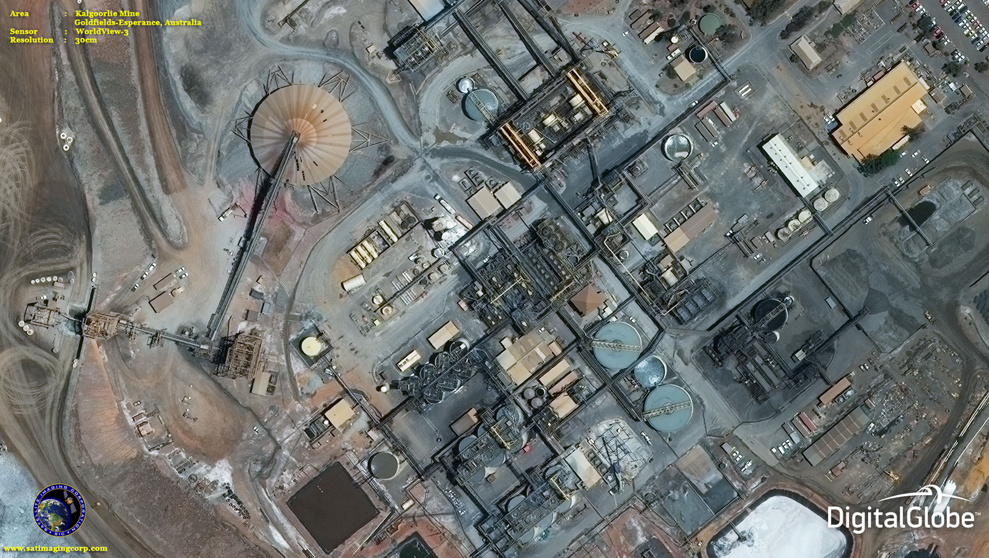

Slide 21
Spectral Resolution
wavelength intervals
multi-spectral sensors

Slide 22
Spectral Resolution
Advanced multi-spectral sensors called hyperspectral sensors

Slide 23
Radiometric Resolution
sensitivity

Slide 24
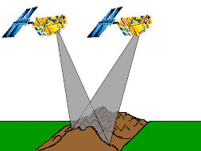
Temporal Resolution
Revisit period
Overlap in the imaging

Slide 25
Temporal Resolution
Off-nadir is important
A variety of factors

Slide 26
Term Test 1
Tuesday Oct. 20 beginning at 6:10 pm via D2L
You MUST begin the Test between 6:10pm and 6:30pm
No going back on test questions
You will have 20 mins to complete the test
20 MC questions
Covers all lecture, lab and workshop material (including videos)

Slide 27
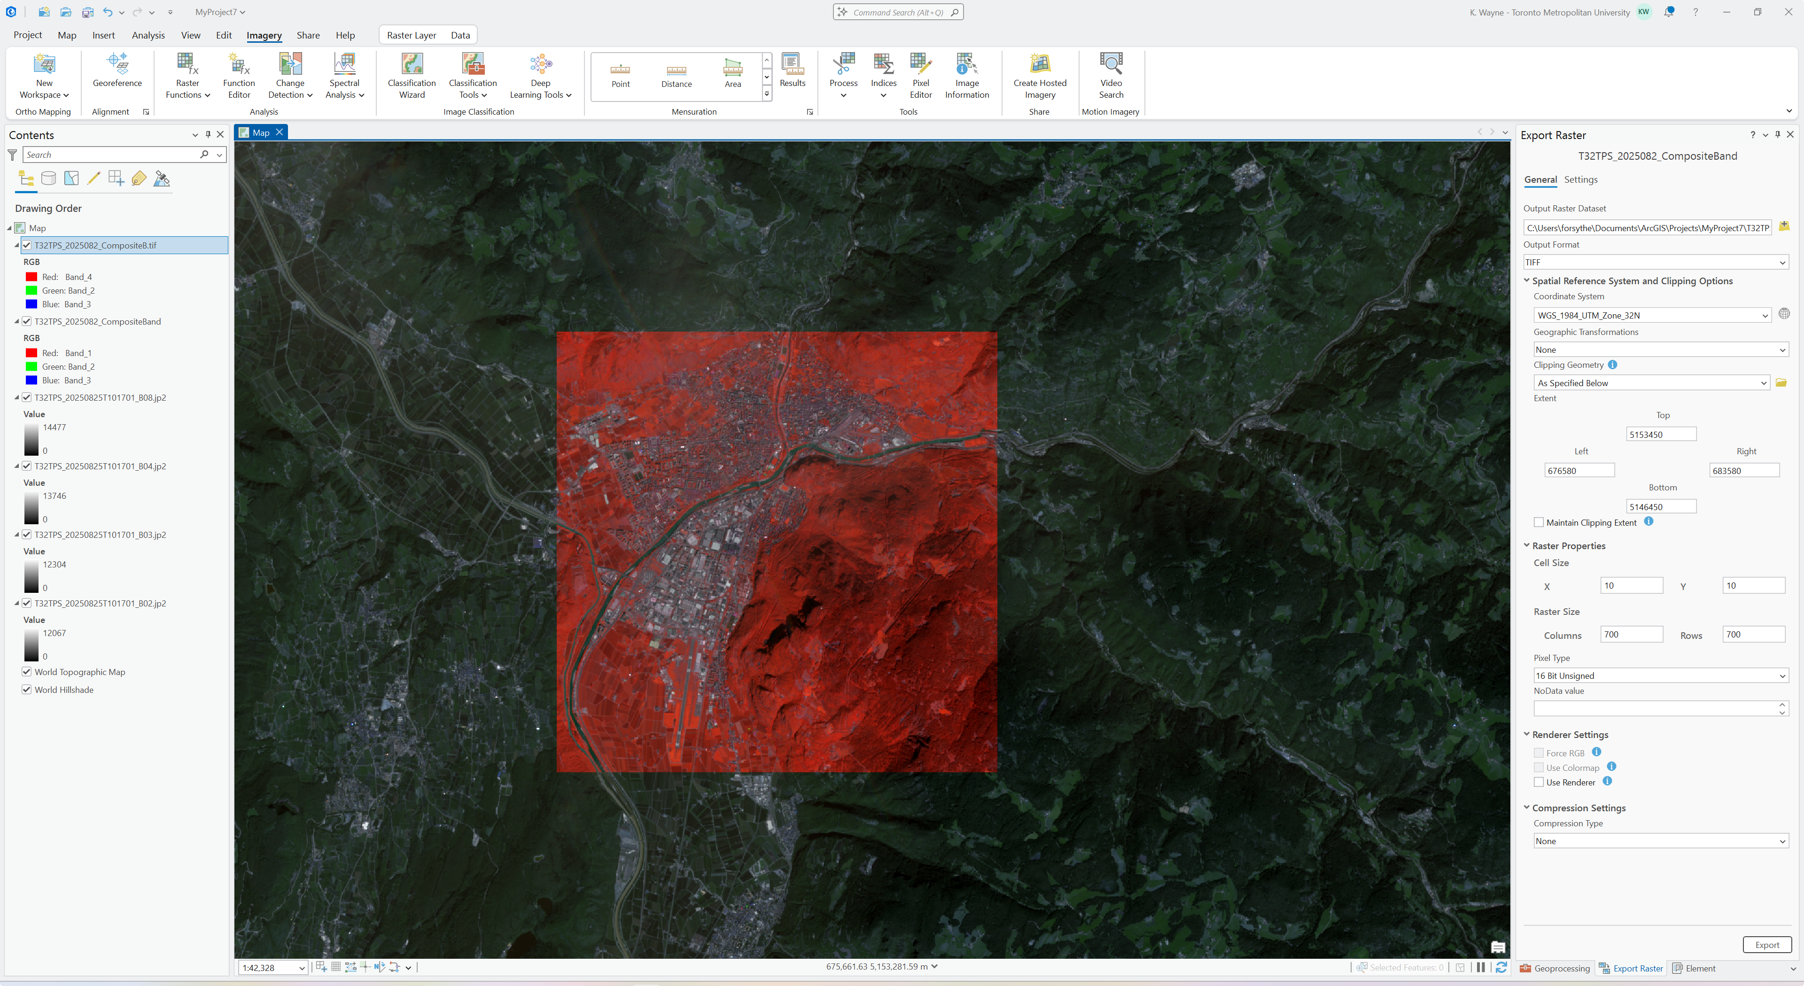
Lab 2
Will be discussed on October 27
See the course website for details

Slide 28
The copyright to this original work is held by Dr. Forsythe and students registered in course Geo542 can use this material for the purposes of this course but no other use is permitted, and there can be no sale or transfer or use of the work for any other purpose without explicit permission of Dr. Forsythe.

