Slide 1
The copyright to this original work is held by Dr. Forsythe and students registered in course Geo542 can use this material for the purposes of this course but no other use is permitted, and there can be no sale or transfer or use of the work for any other purpose without explicit permission of Dr. Forsythe.

Slide 2
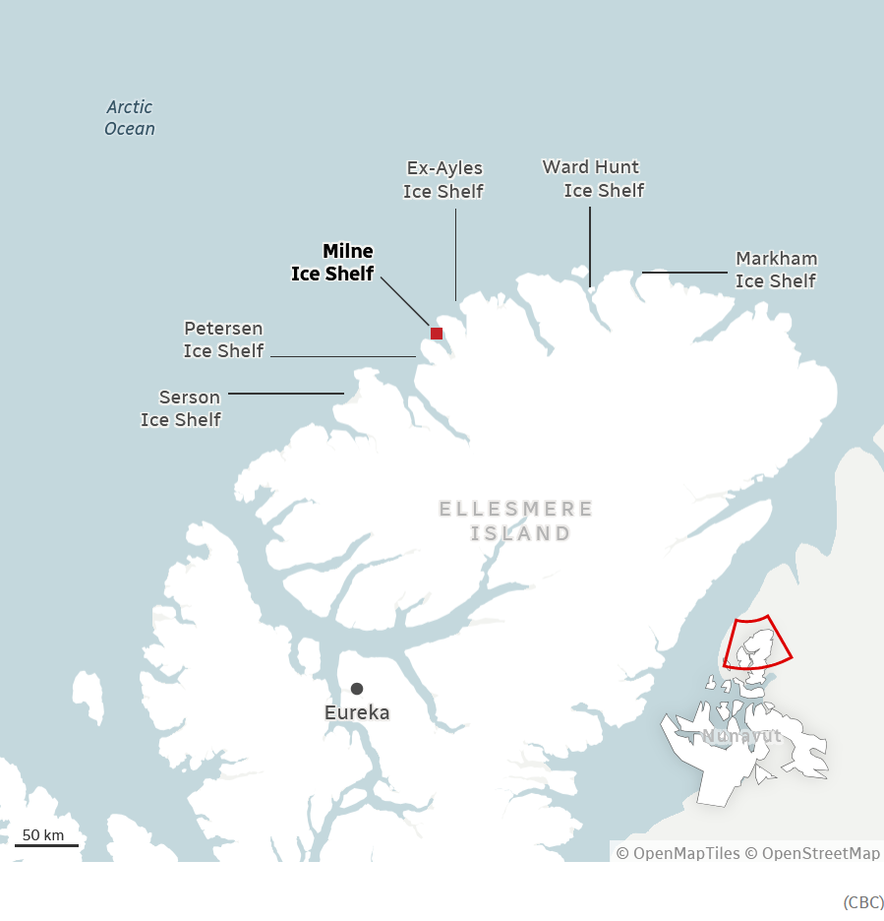
Milne Ice Shelf…
https://www.cbc.ca/news/science/epishelf-lake-9.7344715

Slide 3
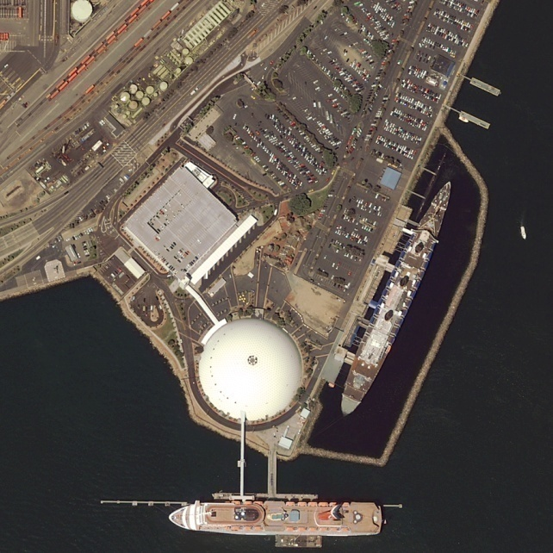
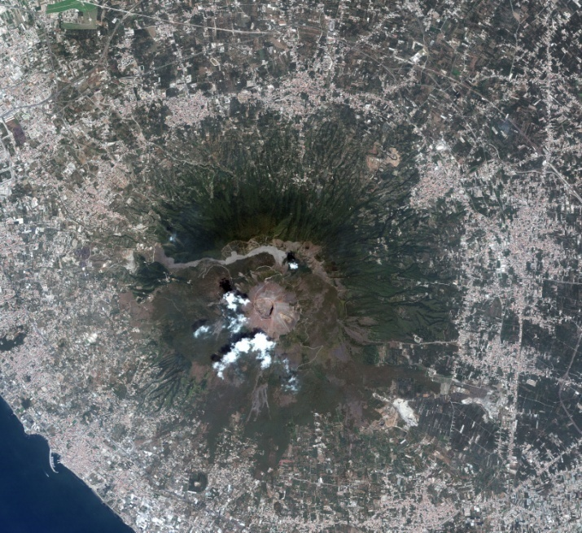
Geo542 - Introduction to Remote Sensing
Lecture 2

Slide 4
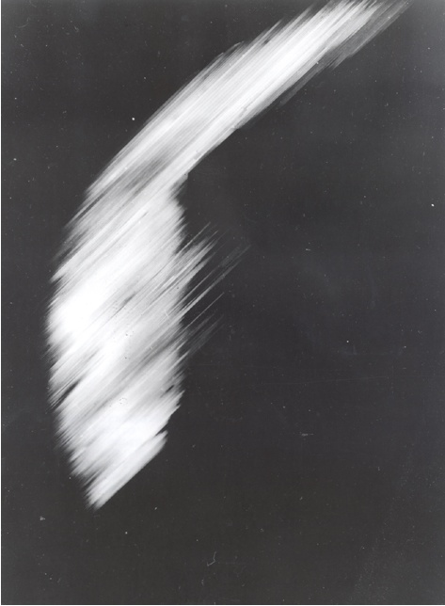
The First Image of the Earth
This is the first crude image obtained in 1959.
http://grin.hq.nasa.gov/ABSTRACTS/GPN-2002-000200.html (link no longer active)

Slide 5
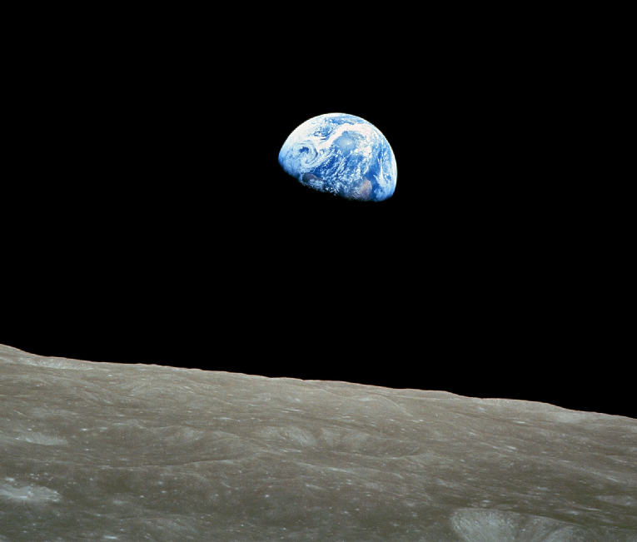
A Famous Image of the Earth
Apollo 8: Earthrise over the lunar horizon (December 24, 1968)
Credit: NASA
http://www.planetary.org/explore/topics/earth/spacecraft.html (link no longer active)

Slide 6
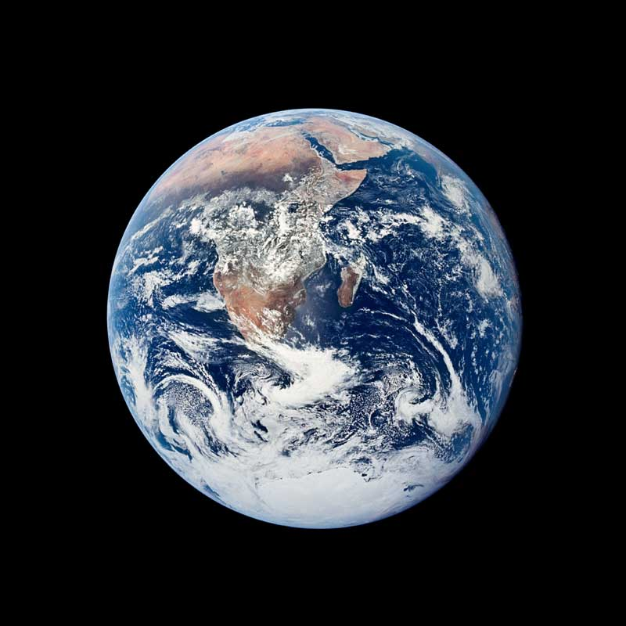
The Most Famous Image of the Earth
Apollo 17: Iconic view of Earth (December 7, 1972)
Credit: NASA
http://www.planetary.org/explore/topics/earth/spacecraft.html (link no longer active)

Slide 7
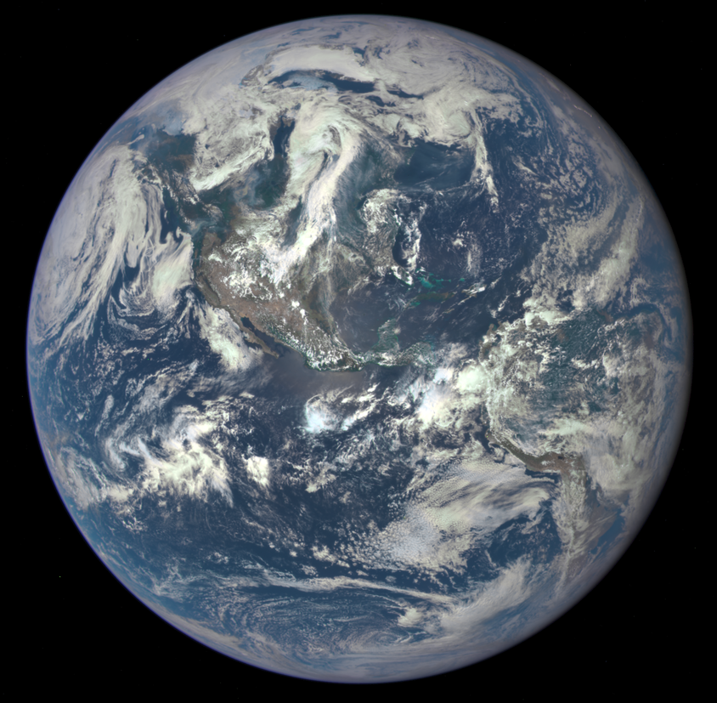
Deep Space Climate Observatory spacecraft.
Credits: NASA
http://www.nasa.gov/press-release/nasa-satellite-camera-provides-epic-view-of-earth

Slide 8
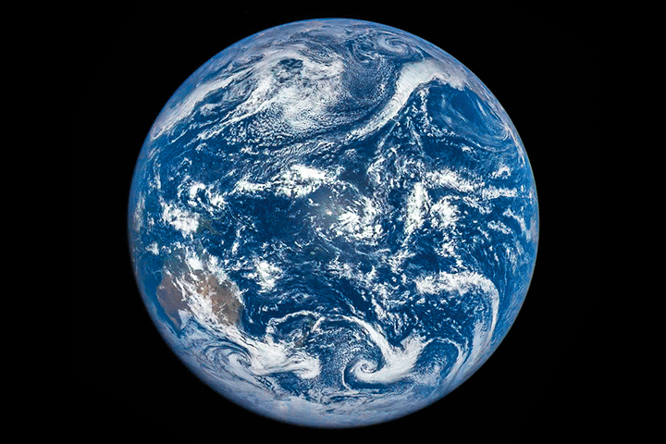
Full Disk Eclipse
http://earthobservatory.nasa.gov/IOTD/view.php?id=87675&src=iotdrss
The animation above was assembled from 13 images acquired on March 9, 2016, by NASA’s Earth Polychromatic Imaging Camera (EPIC).

Slide 9
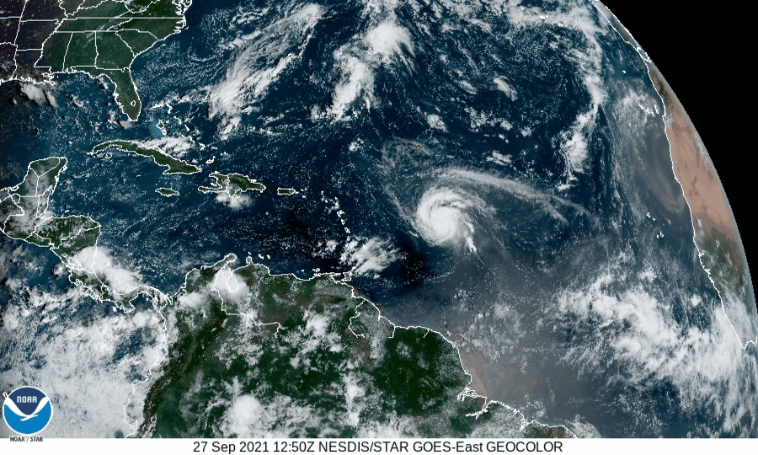
https://www.star.nesdis.noaa.gov/GOES/sector_band.php?sat=G16&sector=taw&band=GEOCOLOR&length=24

Slide 10
What is Remote Sensing?
Remote sensing is the science (and to some extent, art) of acquiring
information about the Earth's surface without actually being in contact
with it. This is done by sensing and recording reflected or emitted energy
and processing, analyzing, and applying that information (CCRS, 1999).
https://natural-resources.canada.ca/science-data/science-research/research-centres/canada-centre-remote-sensing
Thanks to the Canada Centre for Remote Sensing whose WWW site contains some very useful information, some of which is reproduced here.

Slide 11
What is really involved?
an interaction between incident radiation and the targets of interest
also involves the sensing of emitted energy (radar)

Slide 12
Remote Sensing Components and Considerations
1. Energy Source or Illumination - the first requirement
for remote sensing is to have an energy source which
illuminates or provides electromagnetic energy to the
target of interest.

Slide 13
Remote Sensing Components and Considerations
2. Radiation and the Atmosphere - as the energy travels from its source
to the target, it will come in contact with and interact with the atmosphere
it passes through. This interaction may take place a second time as the
energy travels from the target to the sensor.

Slide 14
Remote Sensing Components and Considerations
3. Interaction with the Target - once the energy makes its way to the
target through the atmosphere, it interacts with the target depending
on the properties of both the target and the radiation.

Slide 15
Remote Sensing Components and Considerations
4. Recording of Energy by the Sensor - after the energy has
been scattered by, or emitted from the target, we require a
sensor (remote - not in contact with the target) to collect and
record the electromagnetic radiation.

Slide 16
Remote Sensing Components and Considerations
5. Transmission, Reception, and Processing - the energy recorded by the sensor has to be transmitted, often in electronic form, to a receiving and processing station where the data are processed into an image (hardcopy and/or digital).

Slide 17
Remote Sensing Components and Considerations
6. Interpretation and Analysis - the processed image is interpreted,
visually and/or digitally or electronically, to extract information about
the target which was illuminated.

Slide 18
Remote Sensing Components and Considerations
7. Application - the final element of the remote sensing process is
achieved when we apply the information we have been able to extract
from the imagery about the target in order to better understand it,
reveal some new information, or assist in solving a particular problem.

Slide 19
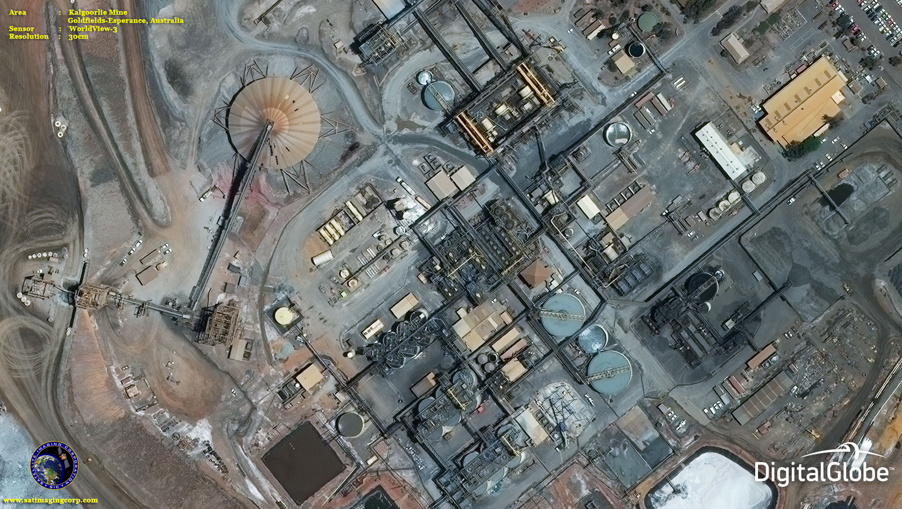

Slide 20
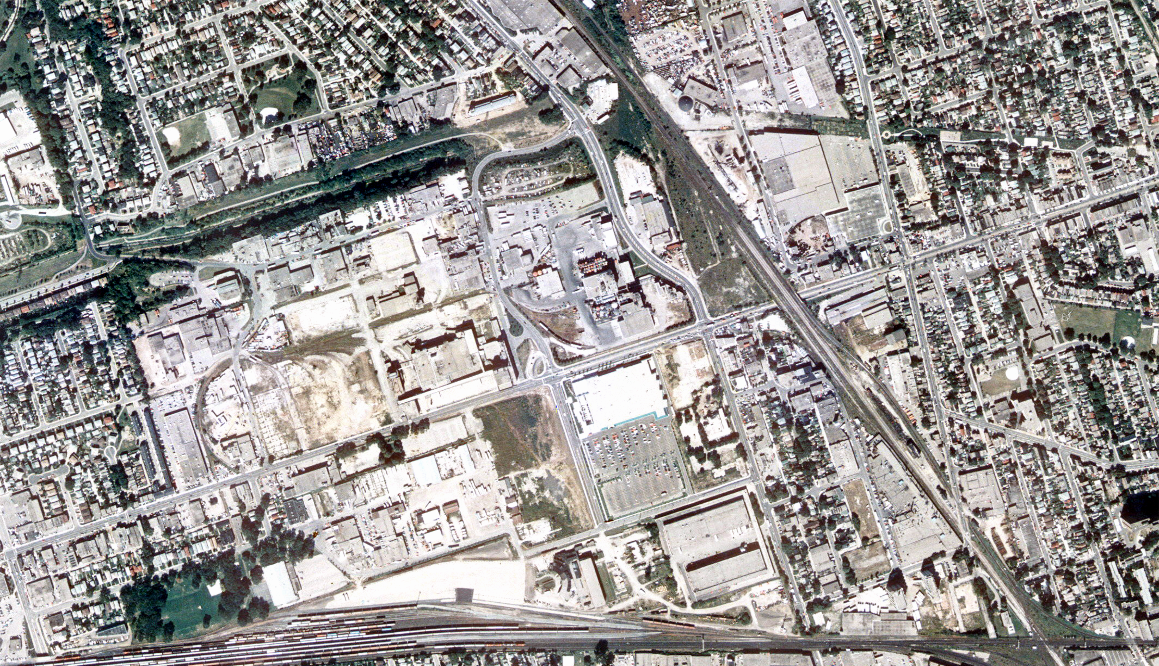
1995

Slide 21
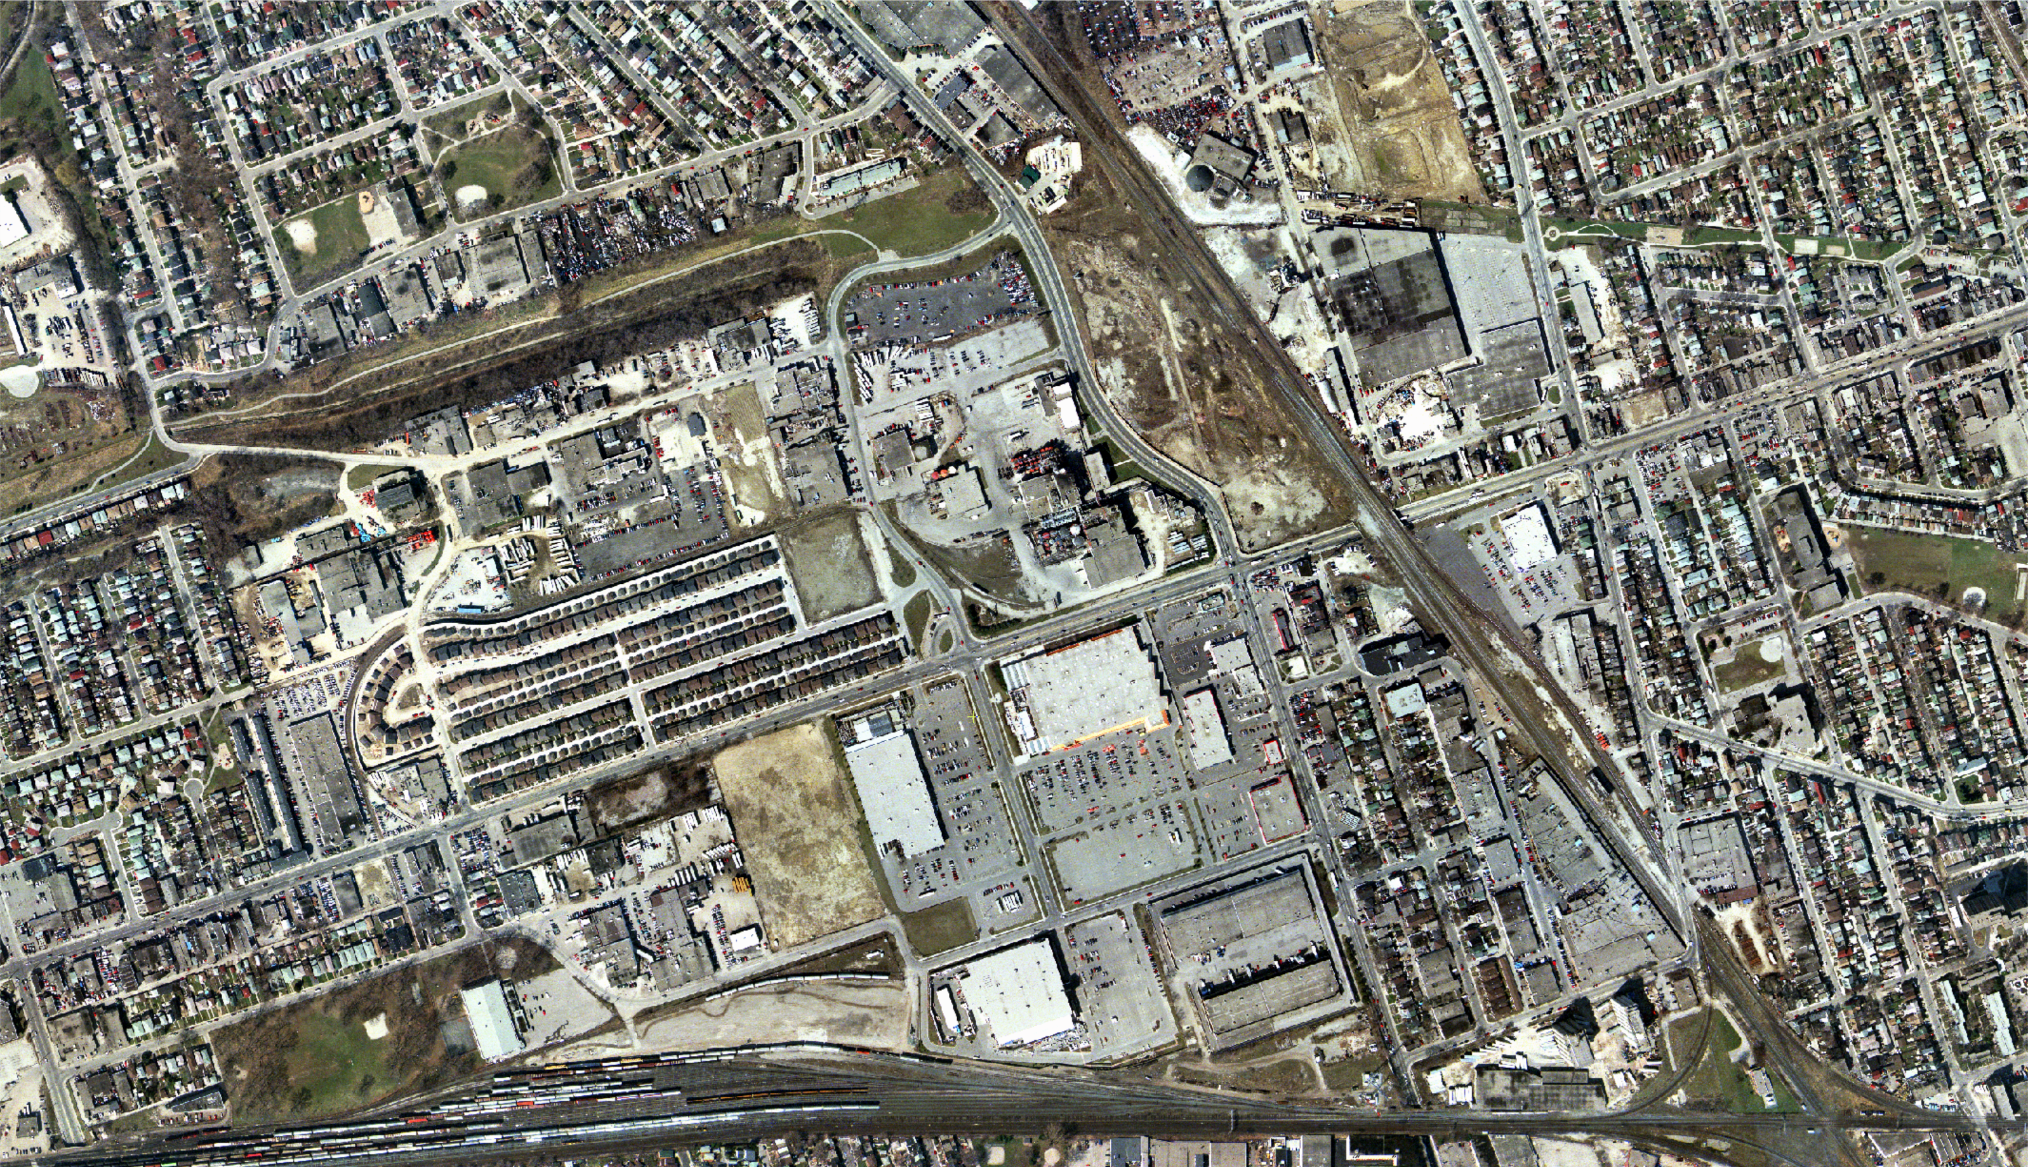
2002

Slide 22
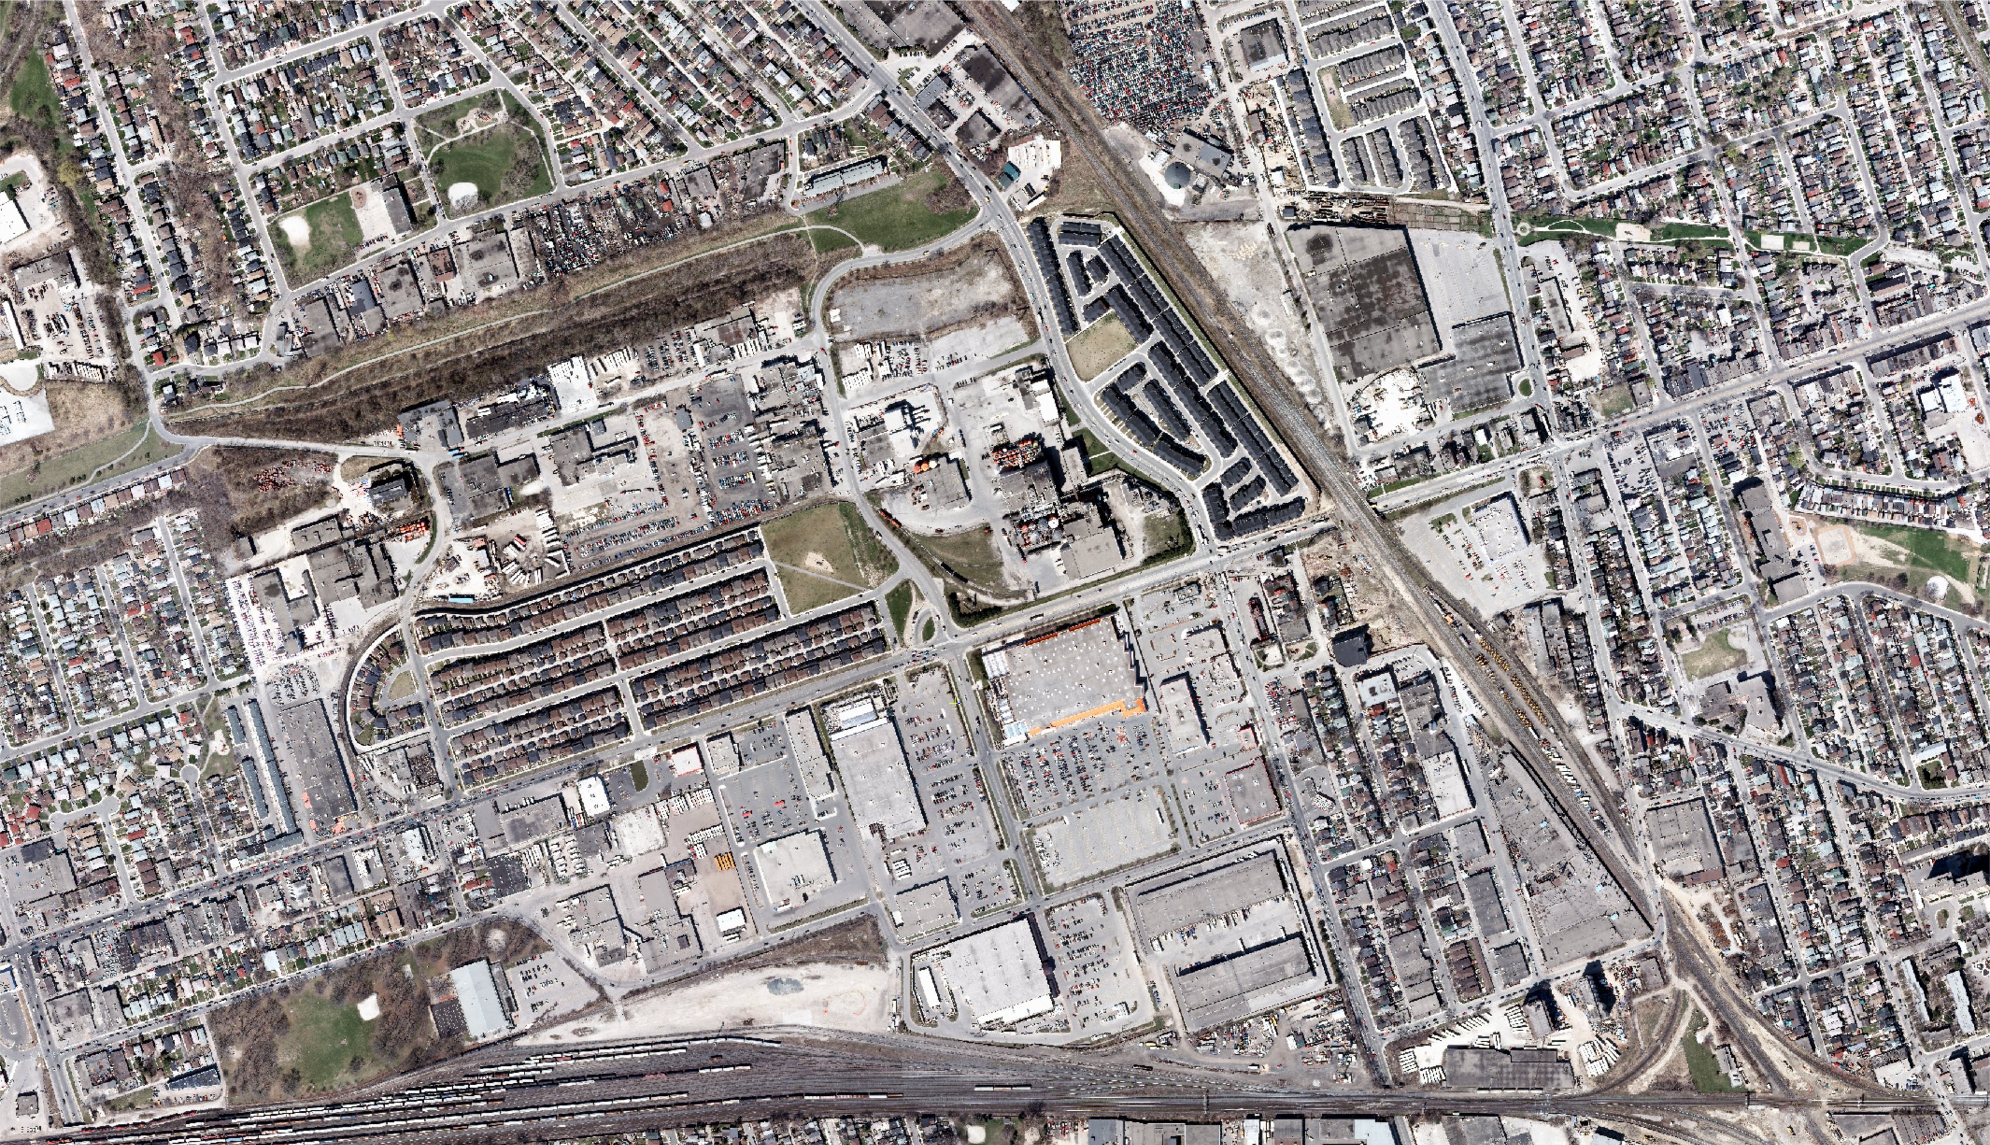
2007

Slide 23
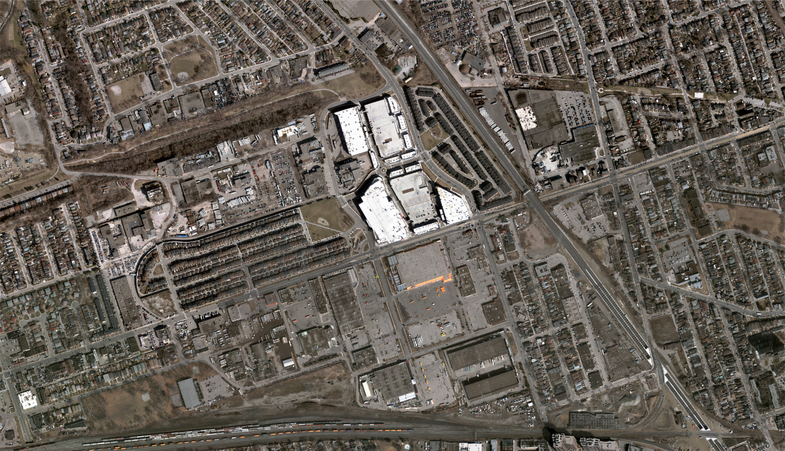
2015

Slide 24
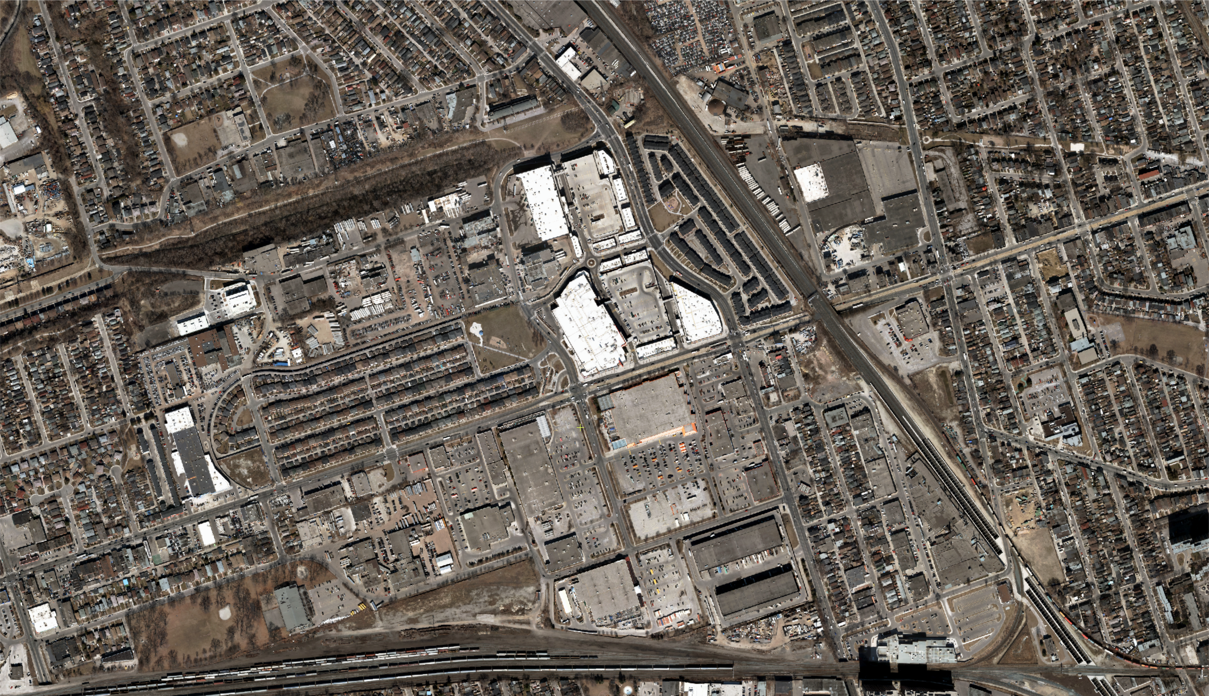
2018

Slide 25
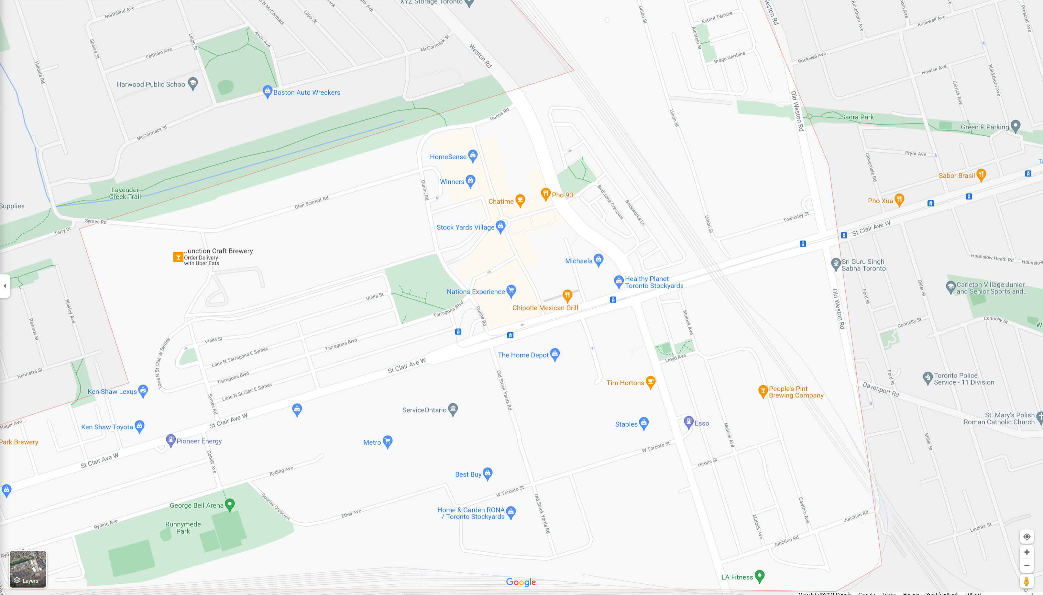
Source: Google Maps

Slide 26
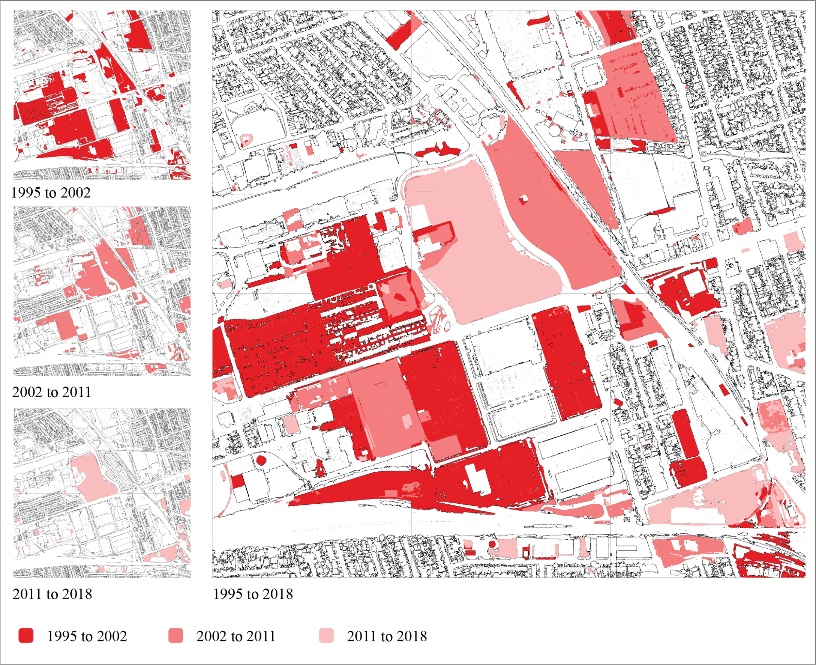

Slide 27
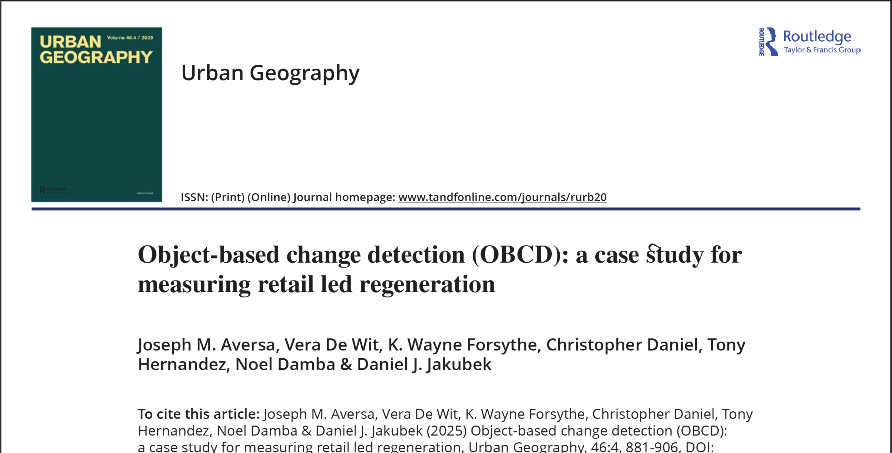

Slide 28
Lab 1 due on October 6
Upload your Lab 1 submissions to D2L by 9:00pm on October 6

Slide 29
The copyright to this original work is held by Dr. Forsythe and students registered in course Geo542 can use this material for the purposes of this course but no other use is permitted, and there can be no sale or transfer or use of the work for any other purpose without explicit permission of Dr. Forsythe.

