Slide 1
The copyright to this original work is held by Dr. Forsythe and students registered in course Geo542 can use this material for the purposes of this course but no other use is permitted, and there can be no sale or transfer or use of the work for any other purpose without explicit permission of Dr. Forsythe.

Slide 2
Drone remote sensing
  Still organizing this possibility

Slide 3
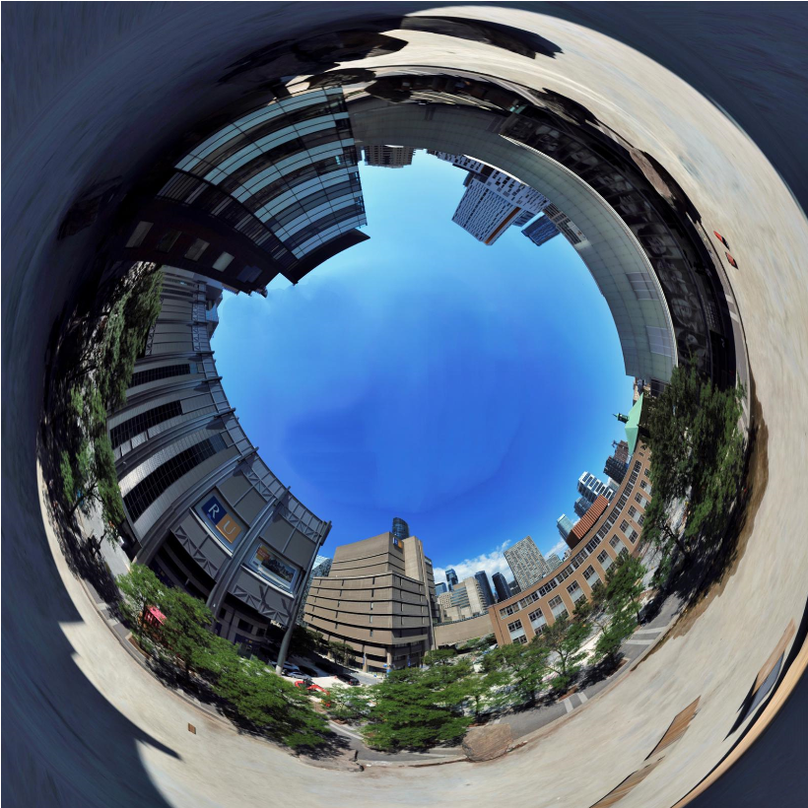

Geo542: Introduction to Remote Sensing

Slide 4


Slide 5

The benefits of note-taking by hand
Computers and phones have become the go-to note-taking method for many. But your brain benefits from an old-fashioned pen and paper.
By Hetty Roessingh, University of Calgary, 10th September 2020
https://www.bbc.com/worklife/article/20200910-the-benefits-of-note-taking-by-hand

Slide 6
California Wildfires
(NASA’s MISR Instrument Sees California Wildfire Smoke Plumes From Space)
https://eijournal.com/news/industry-insights-trends/nasas-misr-instrument-sees-california-wildfire-smoke-plumes-from-space
https://www.jpl.nasa.gov/news/nasas-misr-instrument-sees-california-wildfire-smoke-plumes-from-space

Slide 7
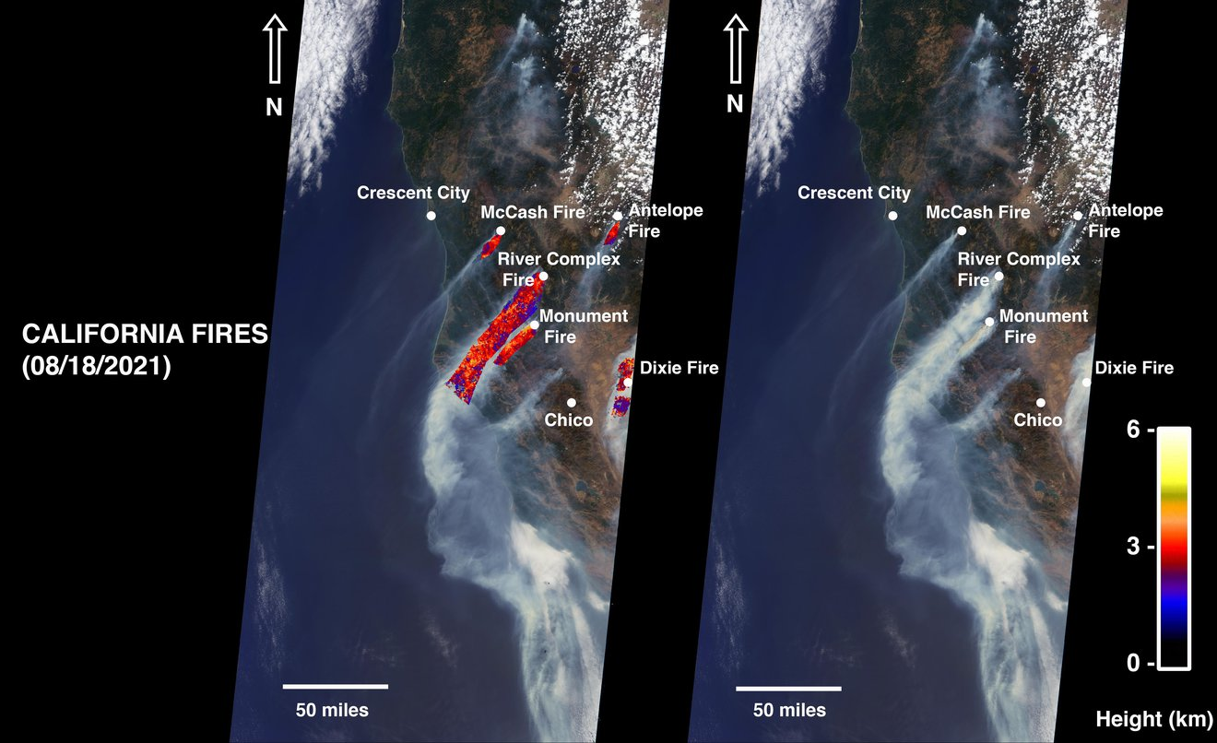
As of Aug. 24, 2021, wildfires in Northern California—including the McCash, Antelope, River Complex, Monument and Dixie fires—have scorched more than 1 million acres of land. The Dixie Fire, the state’s second-largest in history, accounts for 731,310 acres. On Aug. 18, 2021, NASA’s Multi-angle Imaging SpectroRadiometer (MISR) instrument, aboard the Terra satellite, acquired new data showing smoke from these fires.

Slide 8
Airpocalypse
Yakutia
https://asmmag.com/features/feature/31077-an-unusually-smoky-fire-season-in-sakha.html

Slide 9
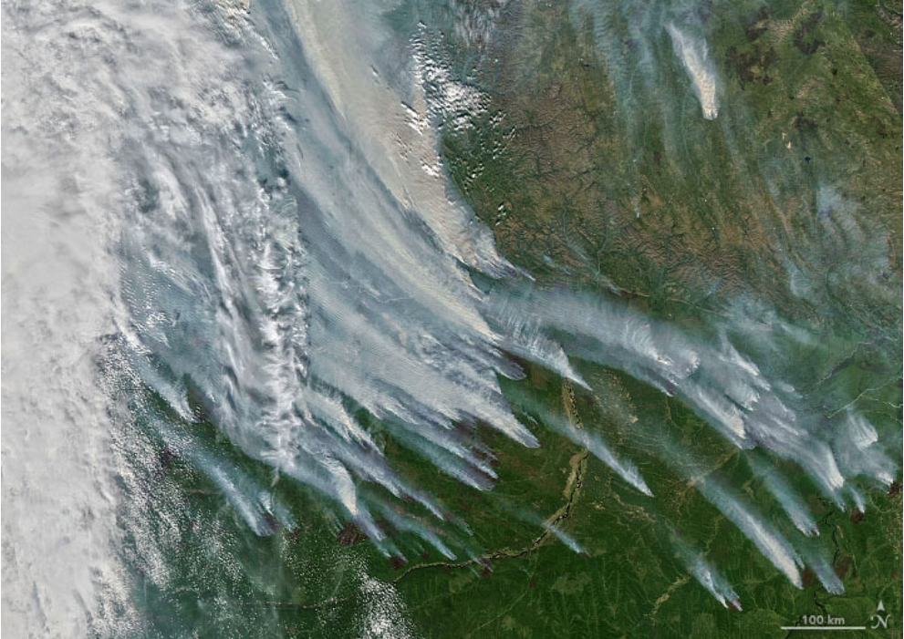
The Moderate Resolution Imaging Spectroradiometer (MODIS) on NASA’s Aqua satellite acquired this natural-color image of large clouds of smoke spreading over Sakha on Aug. 8, 2021. Plumes of this size and opacity have been common for weeks, leading to poor air quality for many of the 280,000 people who live in the nearby city of Yakutsk

Slide 10
Tokyo 2021 (2020)
Land Surface Temperatures

Slide 11
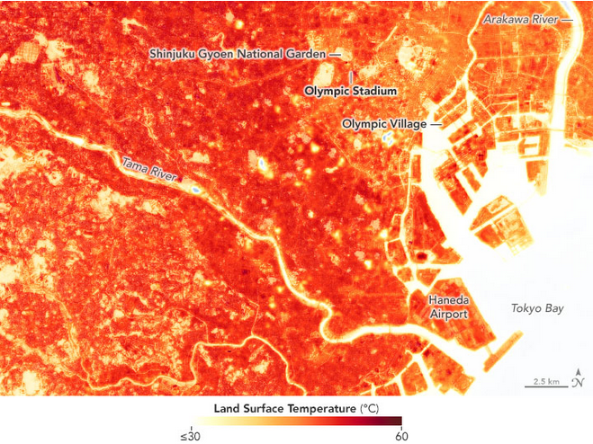
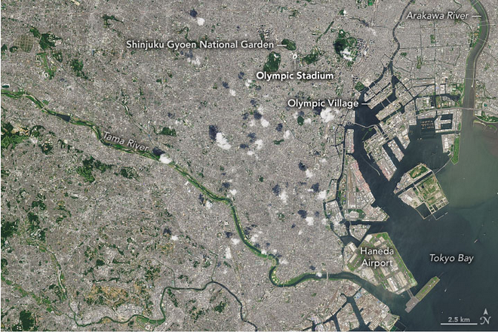
https://asmmag.com/features/feature/30956-heating-up-in-tokyo.html

Slide 12
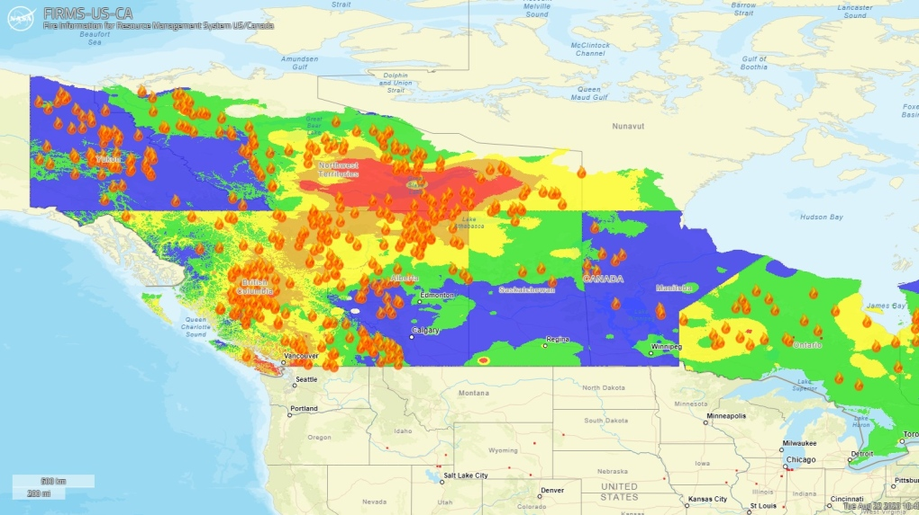
https://www.ctvnews.ca/climate-and-environment/conditions-improve-in-b-c-worsen-in-n-w-t-what-the-latest-wildfire-map-from-nasa-shows-1.6529514 (link no longer functions)
https://firms.modaps.eosdis.nasa.gov/usfs/active_fire/

Slide 13
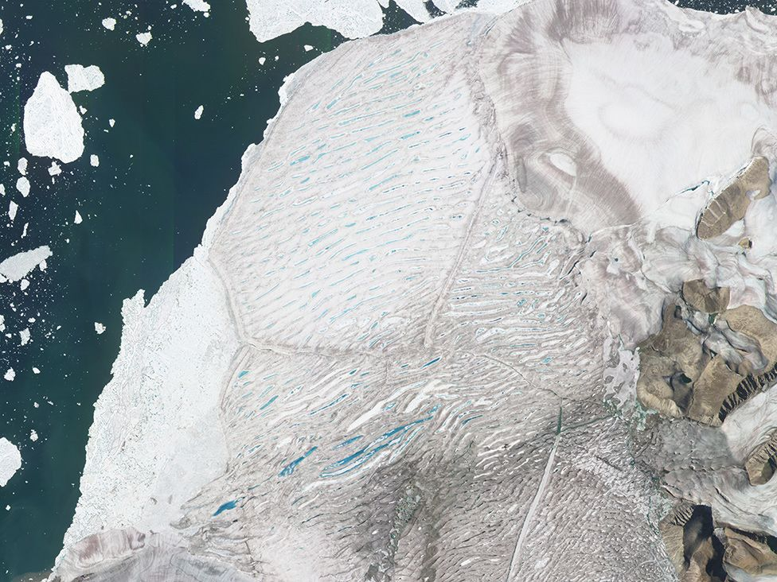
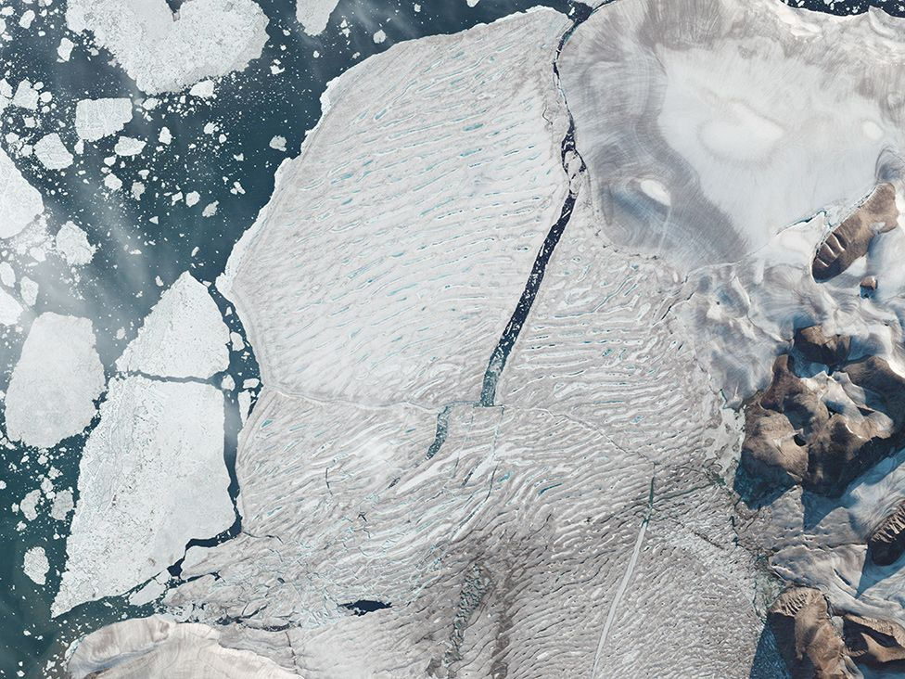
Milne Ice Shelf: Satellites capture Arctic ice split
https://www.bbc.com/news/science-environment-53737138

Slide 14
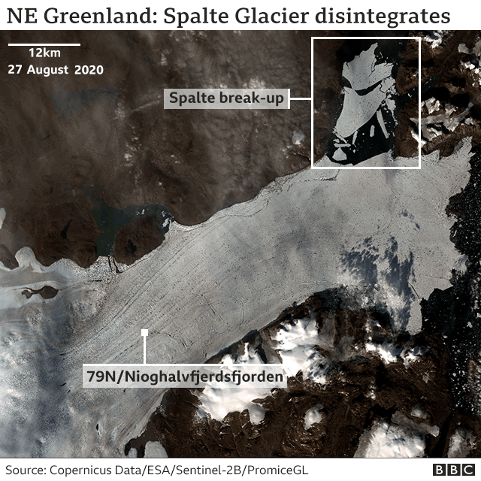
Climate change: Warmth shatters section of Greenland ice shelf
https://www.bbc.com/news/science-environment-54127279

Slide 15
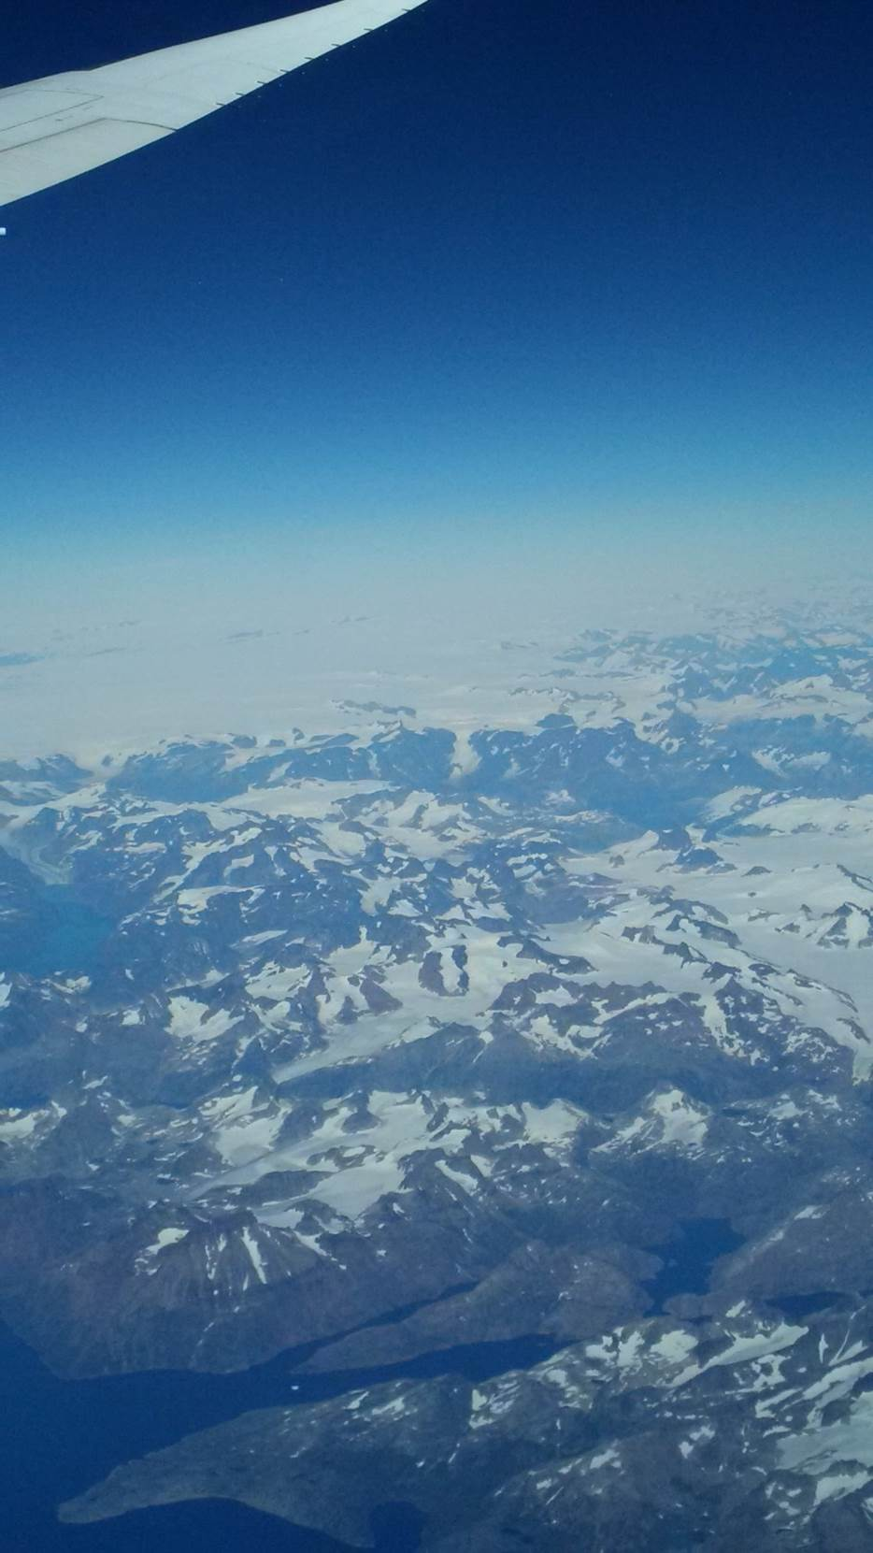
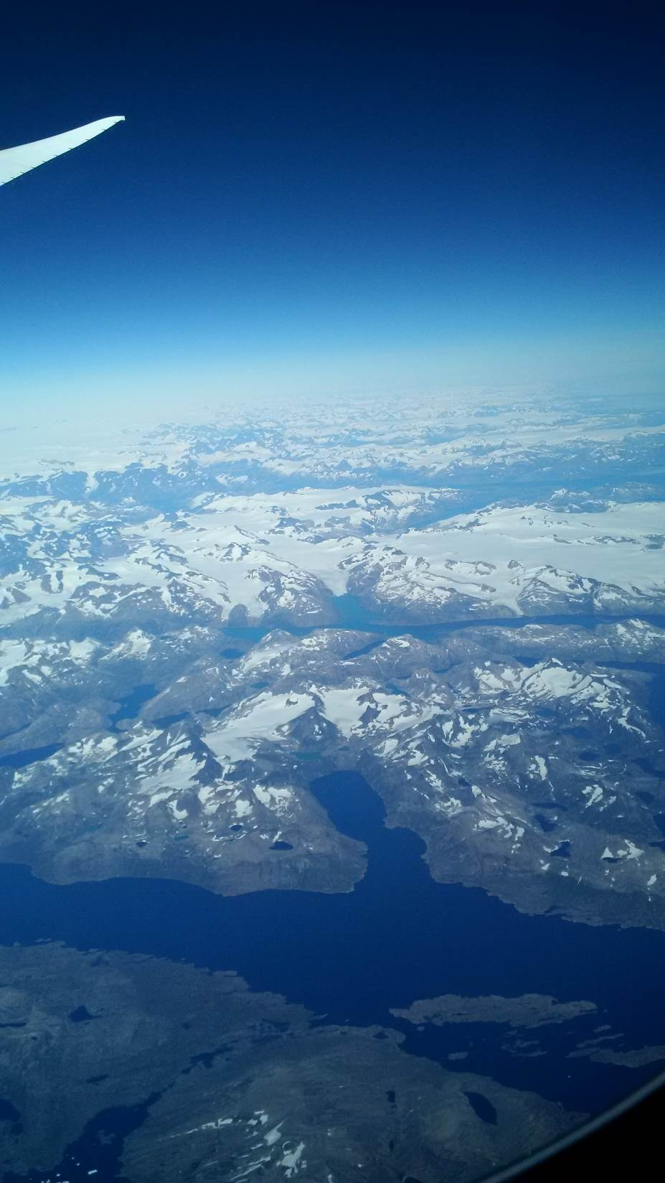

Slide 16
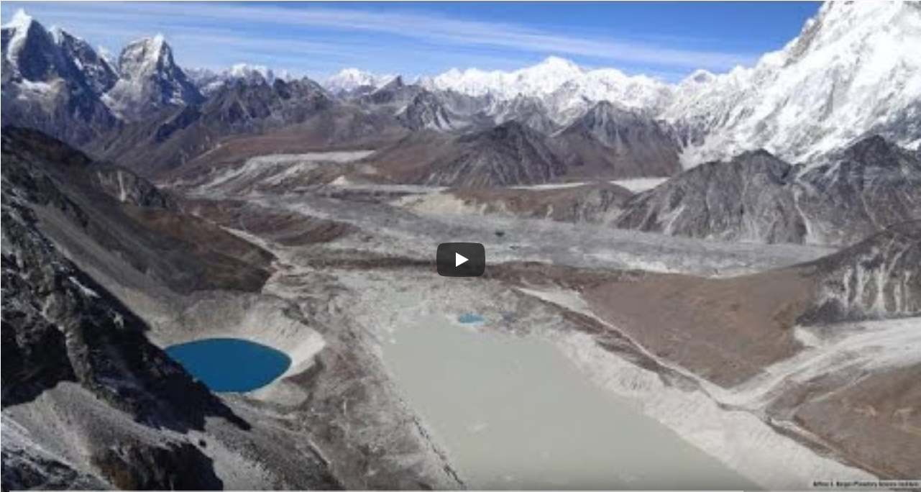
Tracking 3 Decades of Dramatic Glacial Lake Growth
https://www.youtube.com/watch?v=rvRCKgw2B8k#action=share

Slide 17
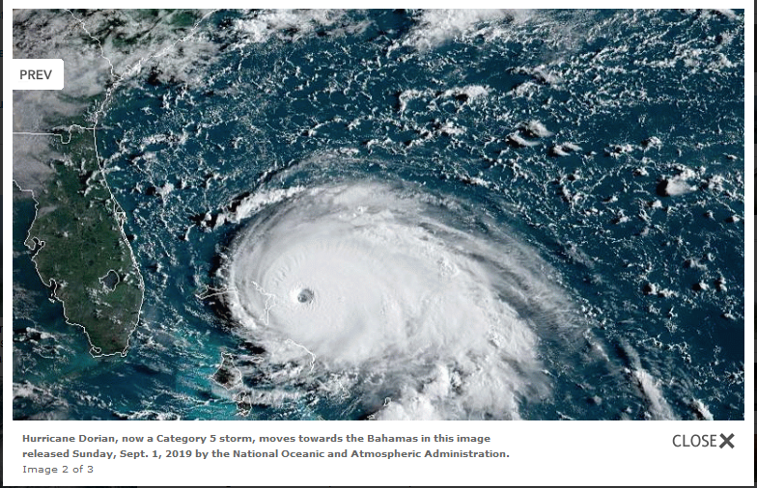

Slide 18
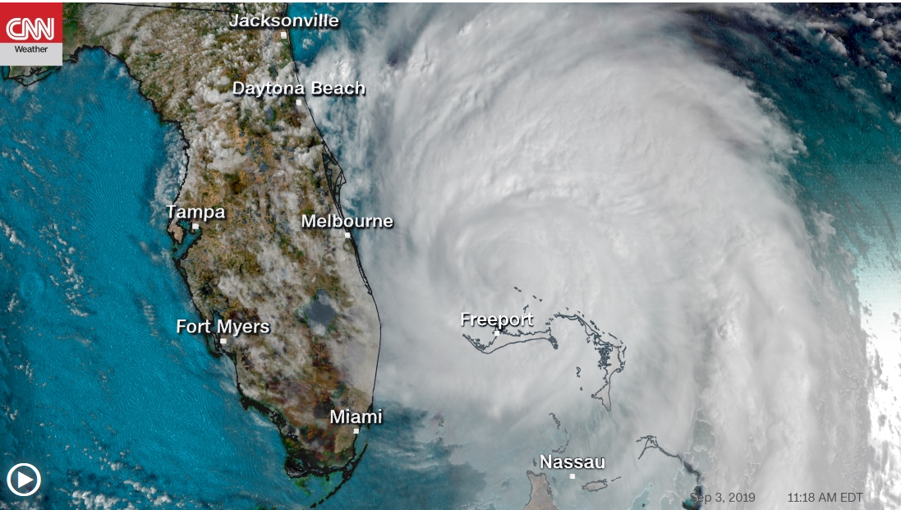

Slide 19
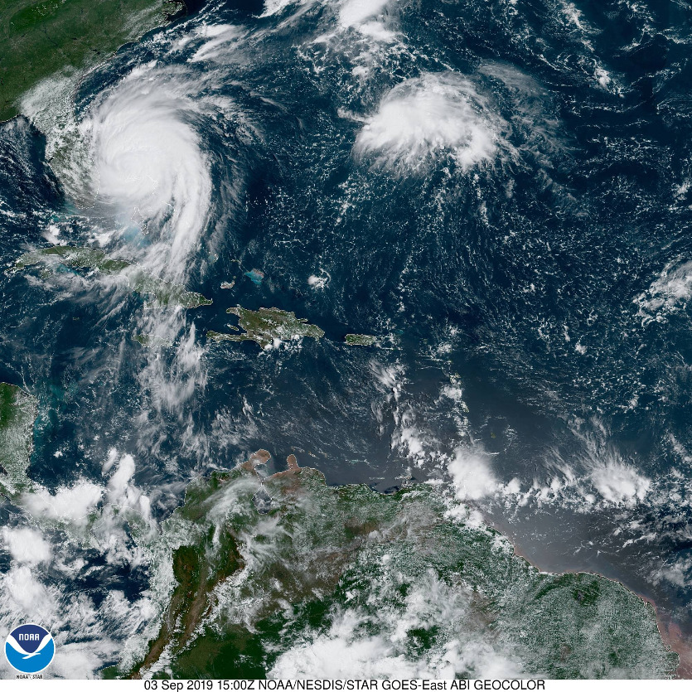
https://www.star.nesdis.noaa.gov/GOES/sector.php?sat=G16&sector=car

Slide 20
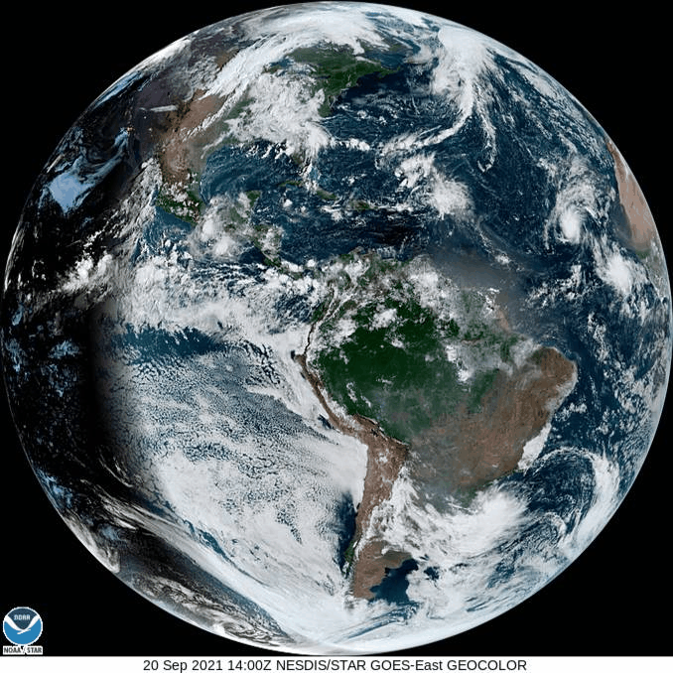
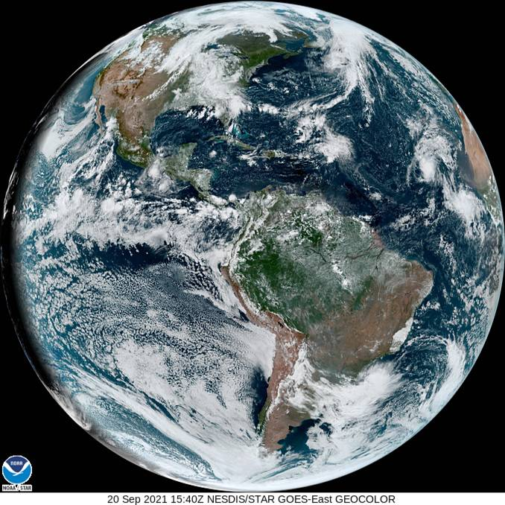
2021
https://www.star.nesdis.noaa.gov/GOES/fulldisk_band.php?sat=G16&band=GEOCOLOR&length=12

Slide 21
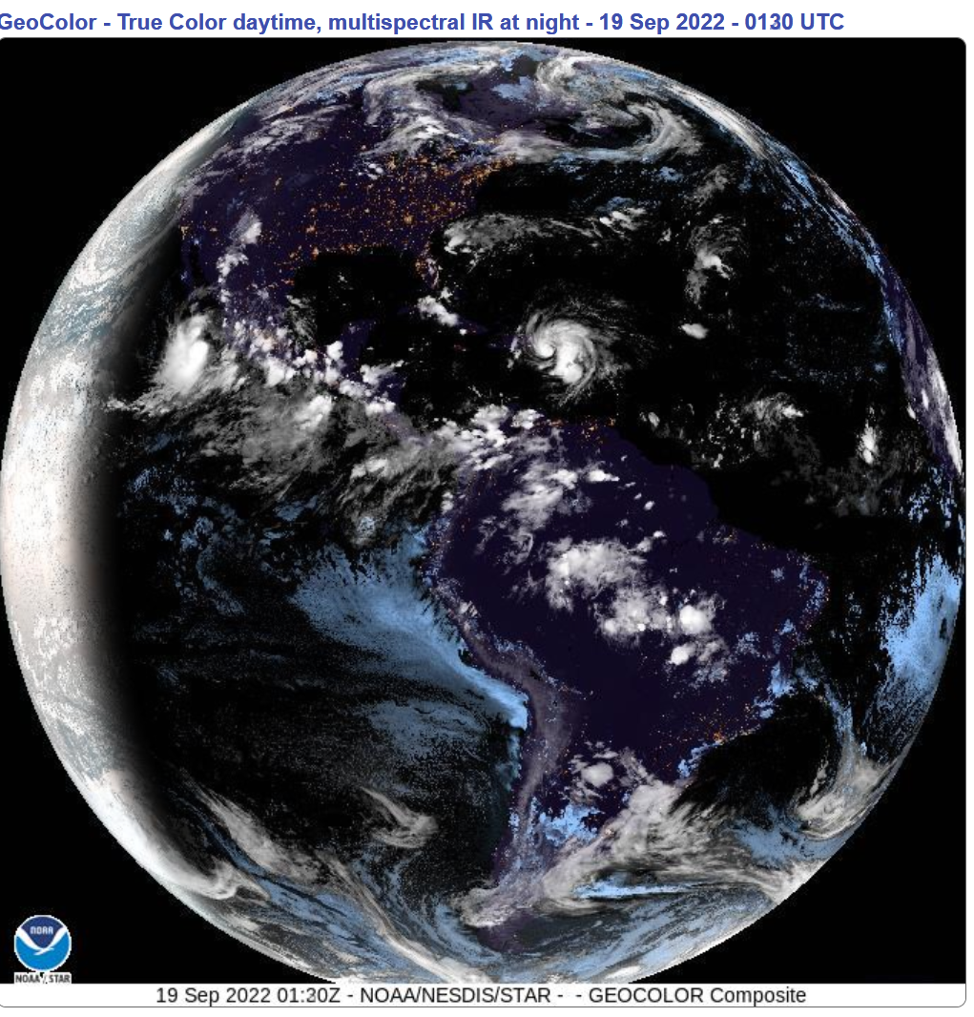
~ Four Years Ago
https://www.star.nesdis.noaa.gov/GOES/fulldisk_band.php?sat=G16&band=GEOCOLOR&length=12

Slide 22
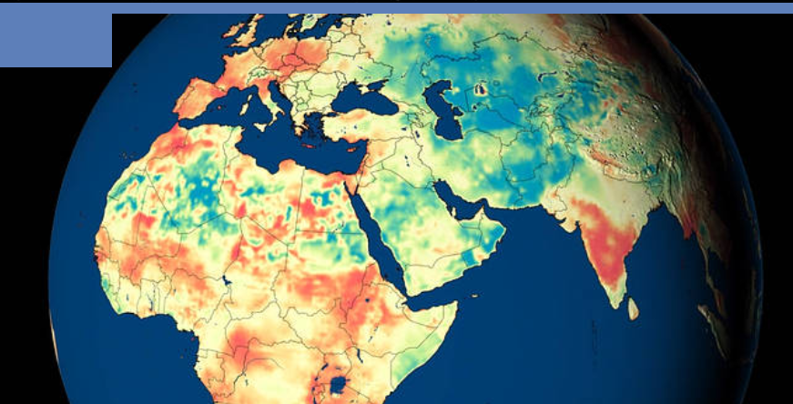
Global Groundwater maps using RS imagery
https://www.nasa.gov/feature/goddard/2020/nasa-university-of-nebraska-release-new-global-groundwater-maps-and-us-drought-forecasts/

Slide 23
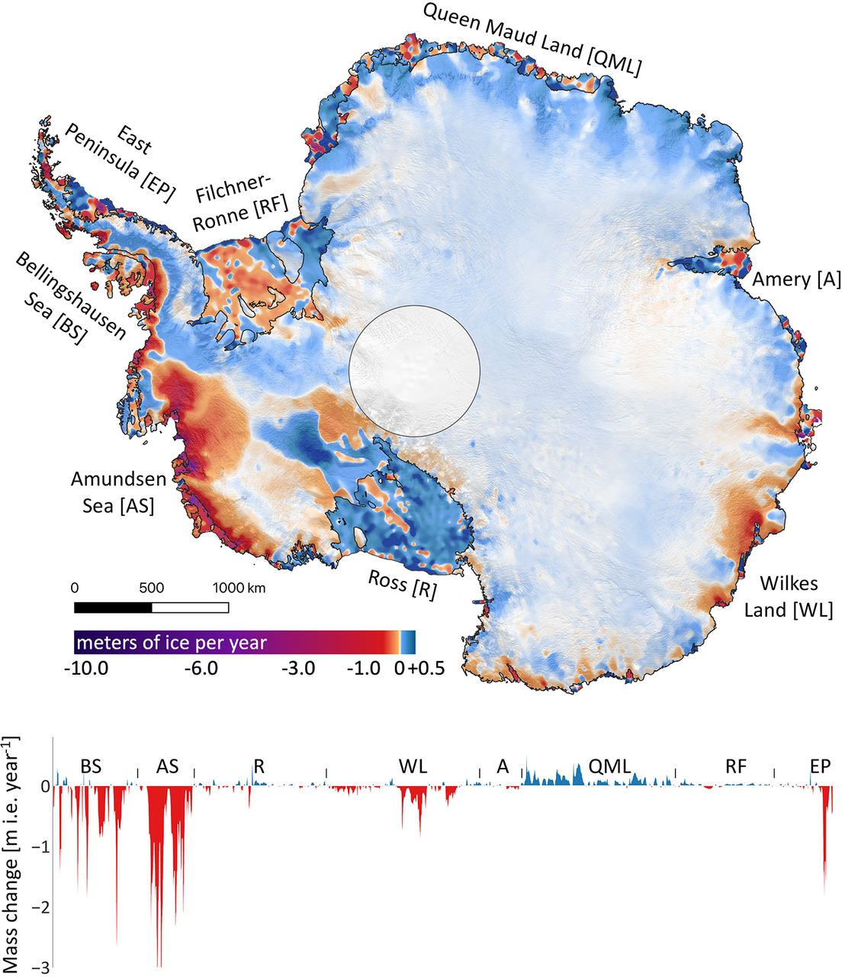
IceSat for measuring?
https://www.livescience.com/antarctica-greenland-ice-loss-map-nasa.html

Slide 24
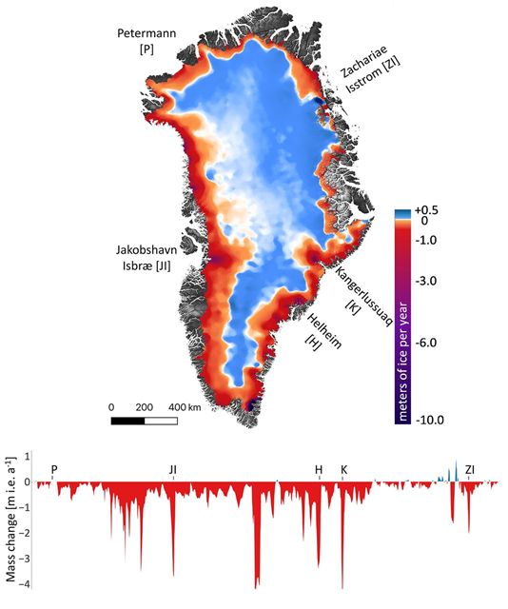
IceSat for measuring?
https://www.livescience.com/antarctica-greenland-ice-loss-map-nasa.html

Slide 25
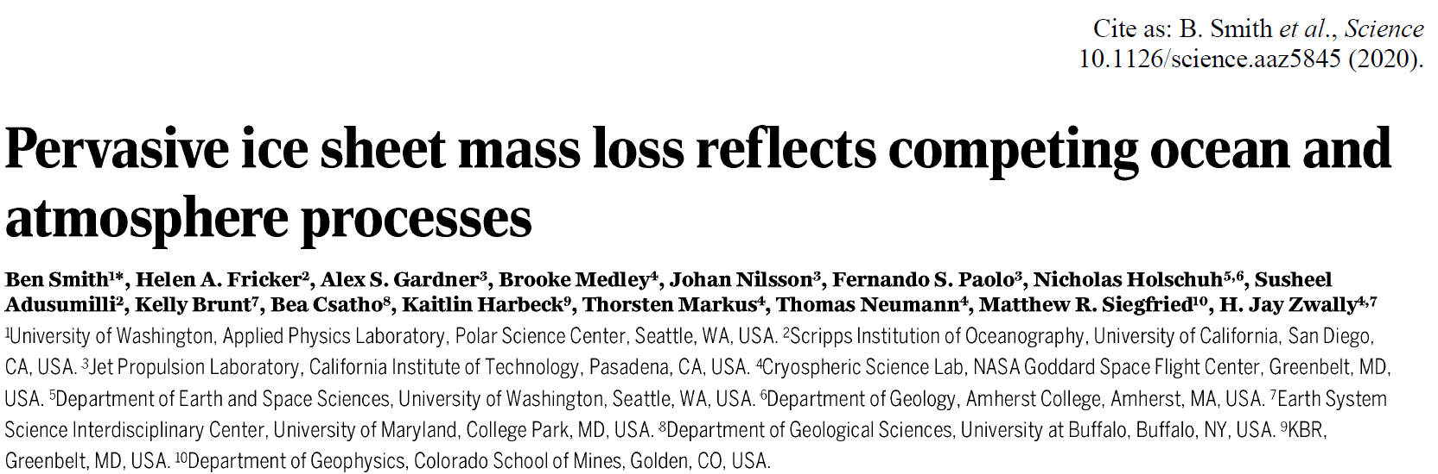

Slide 26
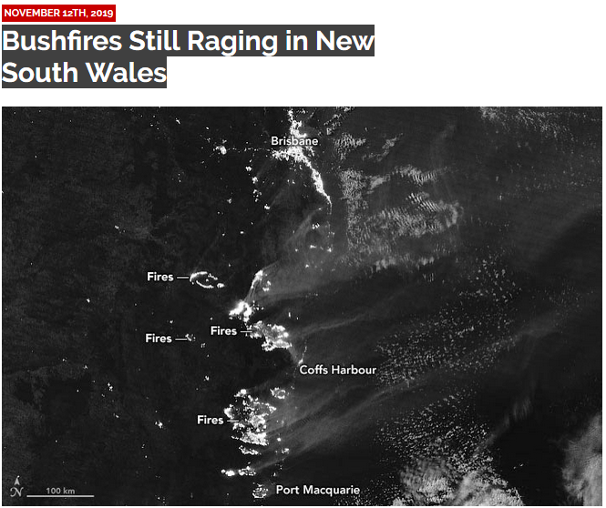
On Nov. 9, 2019, the Visible Infrared Imaging Radiometer Suite (VIIRS) on the NOAA-NASA Suomi NPP satellite got a nighttime view of the fires raging in Queensland and New South Wales. The accompanying image was acquired with the VIIRS “day-night band,” which detects light in a range of wavelengths from green to near-infrared and uses filtering techniques to observe signals such as city lights, auroras and wildfires.
https://asmmag.com/features/feature/24570-bushfires-still-raging-in-new-south-wales.html

Slide 27
NASA Visualization Studio
https://svs.gsfc.nasa.gov/

Slide 28
USGS EarthExplorer
https://earthexplorer.usgs.gov/

Slide 29
Copernicus Data Space Ecosystem
https://dataspace.copernicus.eu/

Slide 30
The copyright to this original work is held by Dr. Forsythe and students registered in course Geo542 can use this material for the purposes of this course but no other use is permitted, and there can be no sale or transfer or use of the work for any other purpose without explicit permission of Dr. Forsythe.

