Slide 1
The copyright to this original work is held by Dr. Forsythe and students registered in course Geo542 can use this material for the purposes of this course but no other use is permitted, and there can be no sale or transfer or use of the work for any other purpose without explicit permission of Dr. Forsythe.

Slide 2
Course outline readings
Forsythe and Wheate (2003)
Chmarycz and Forsythe (2021)

Slide 3
Image Ratioing – NDVI
NDVI is based upon the fact that healthy plants and biomass absorb visible light and reflect near IR

Slide 4
Image Ratioing – NDVI
little difference between the intensity of near IR and visible light reflected = ?

Slide 5
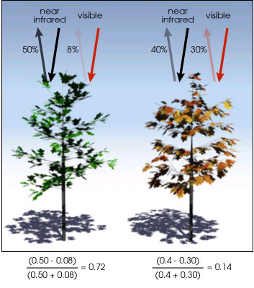
NDVI (cont.)
NDVI
= (near IR – visible)
(near IR + visible)
NASA Earth Observatory Library
http://earthobservatory.nasa.gov/Library/MeasuringVegetation/measuring_vegetation_2.html

Slide 6
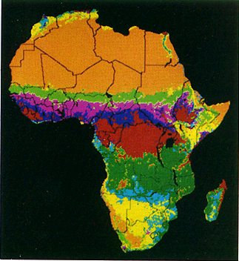
Common NDVI Formulas
AVHRR NDVI
Landsat TM NDVI

Slide 7
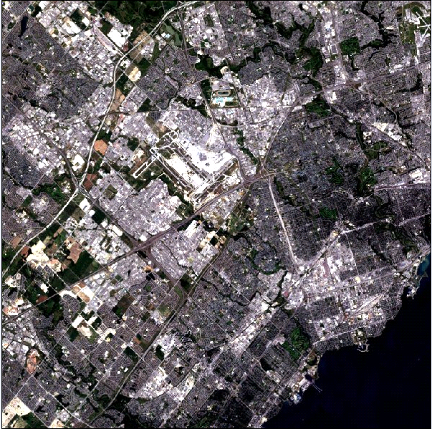
NDVI Example – Western Toronto, 2000
Natural Colour Image

Slide 8
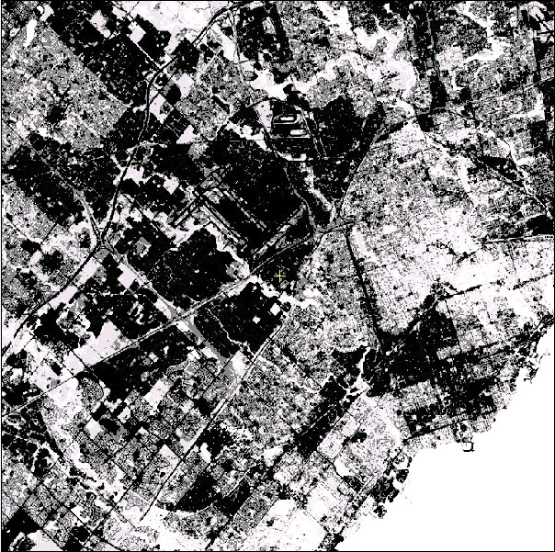
NDVI Image – Vegetation appears as white areas

Slide 9
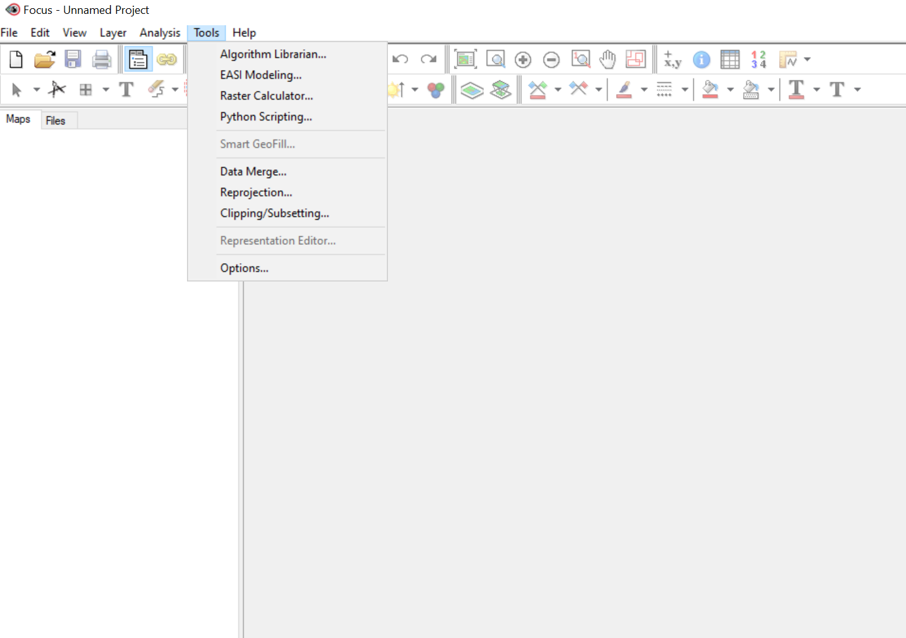

NDVI Generation – Catalyst Professional
For AVHRR data there is a built-in algorithm

Slide 10
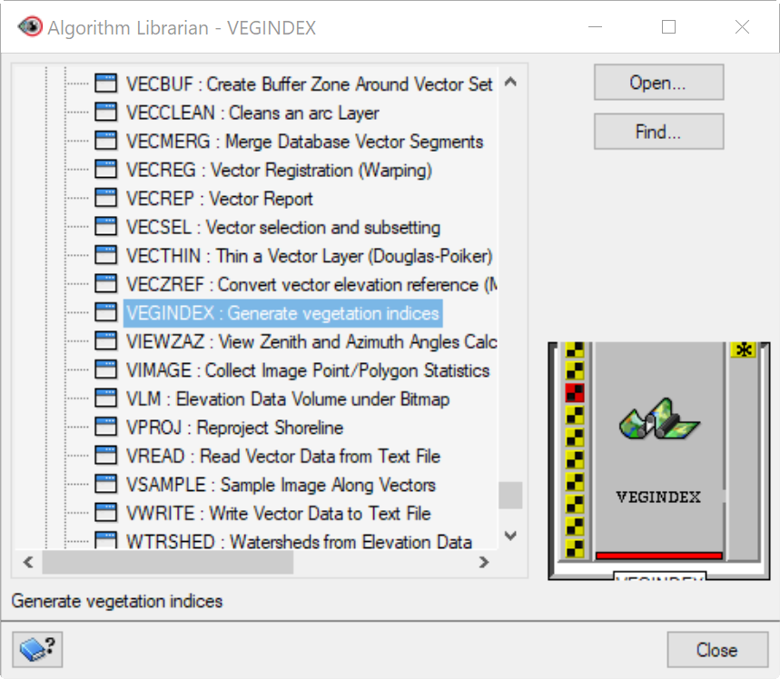
VEGINDEX
In the Algorithm Librarian

Slide 11
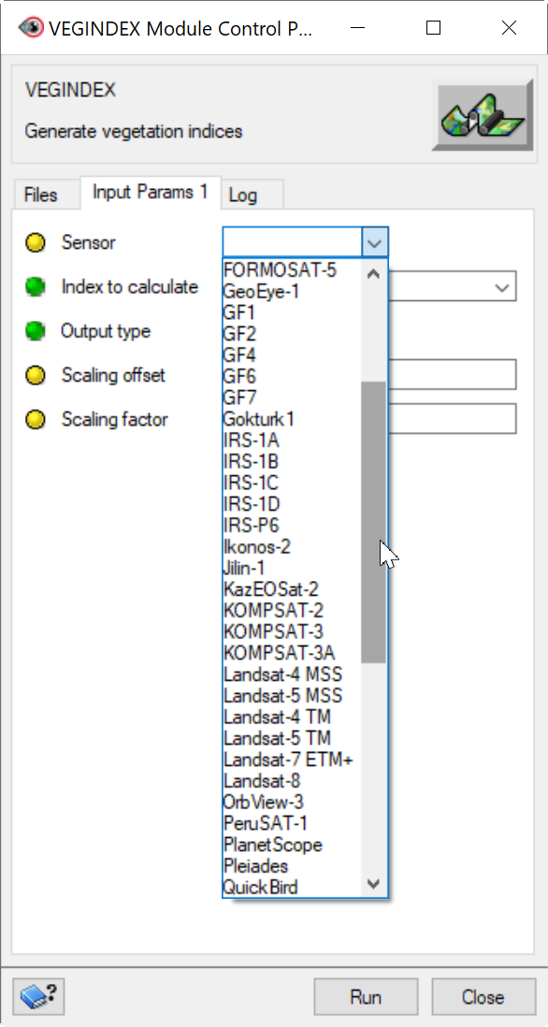
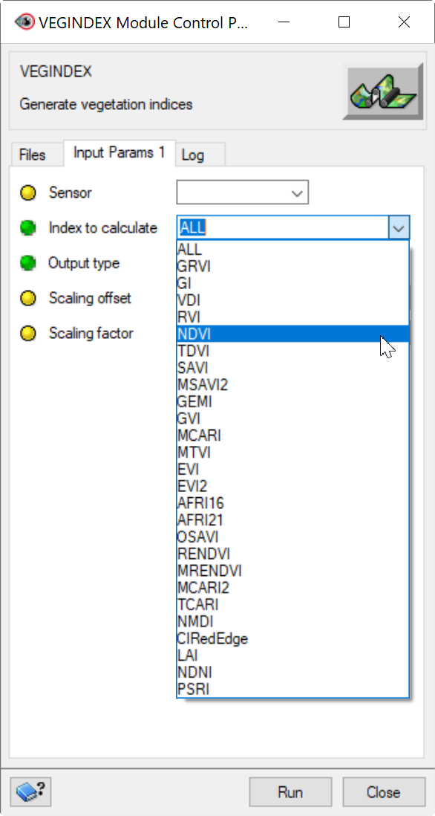

Slide 12
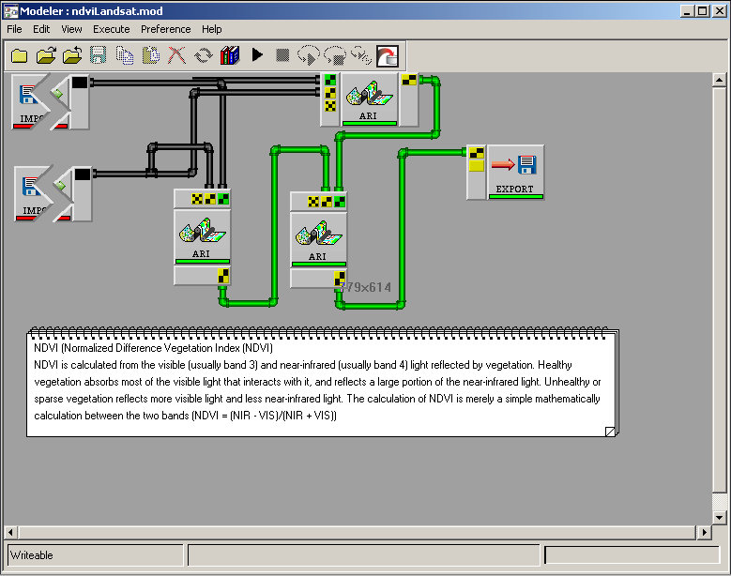
Catalyst Professional Modeller

Slide 13
Other Possibilites
NDSI
NDWI
NBR

Slide 14
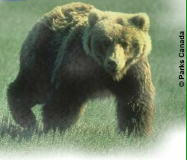
Classification of Avalanche Slopes in Yoho National Park

Slide 15
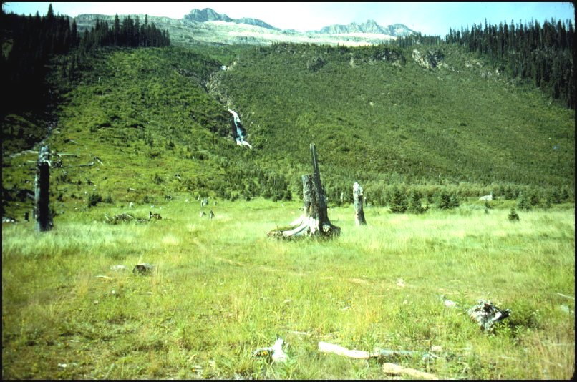
Avalanche Slope

Slide 16
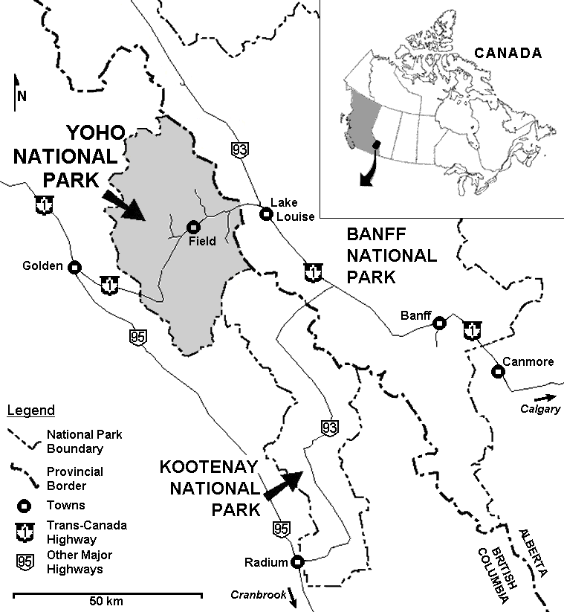
Location

Slide 17
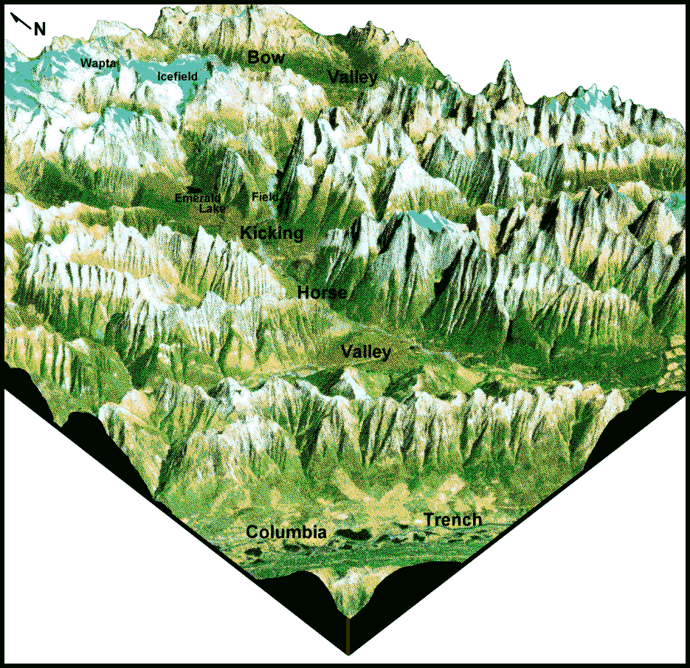
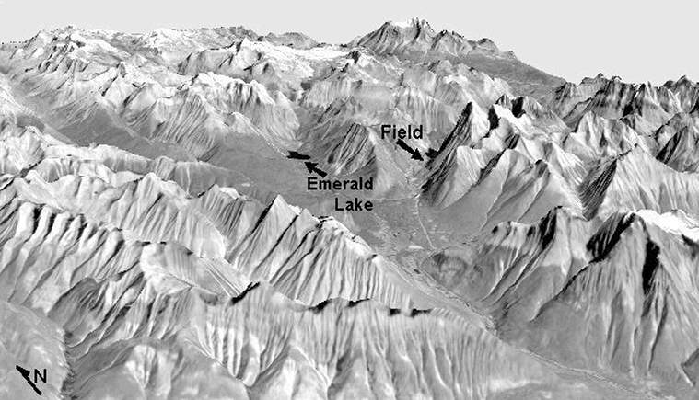
3D Interpretation

Slide 18
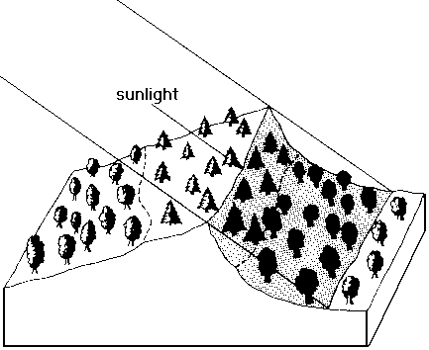
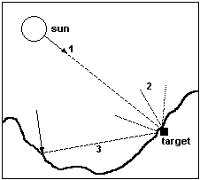
Anisotropic Reflectance
Source: modified after Kumar et al., 1997.
Source: Lillesand and Kiefer, 1987.

Slide 19
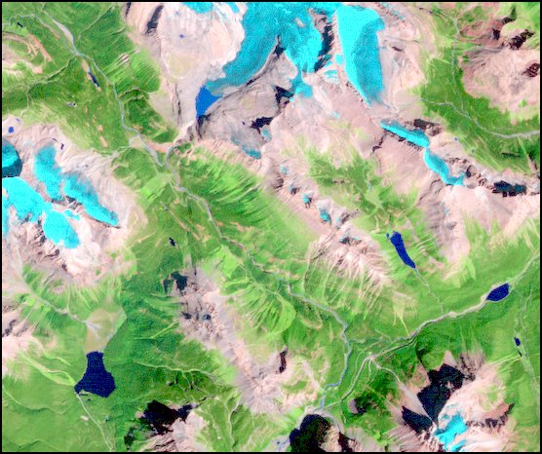
September 2, 1988

Slide 20
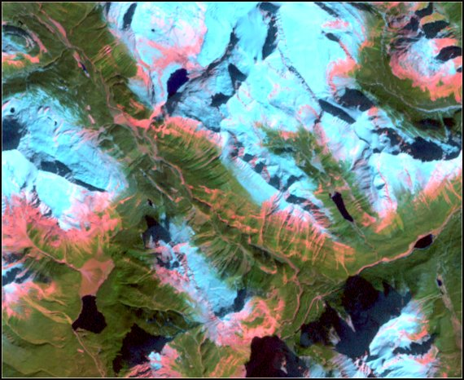
October 6, 2000

Slide 21
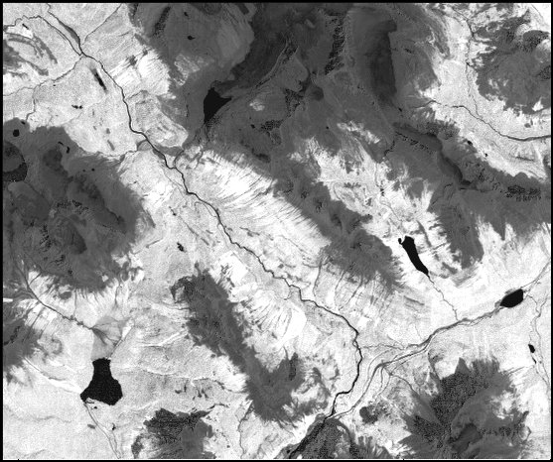
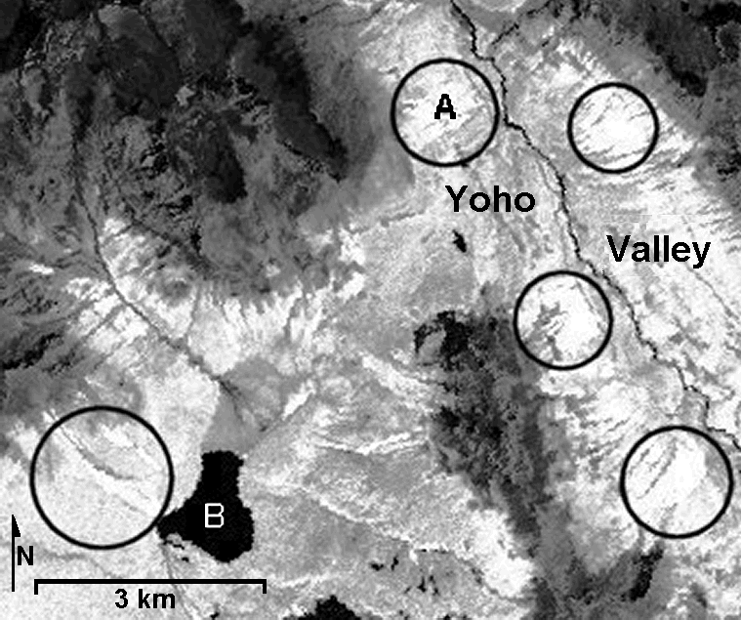
NDVI

Slide 22
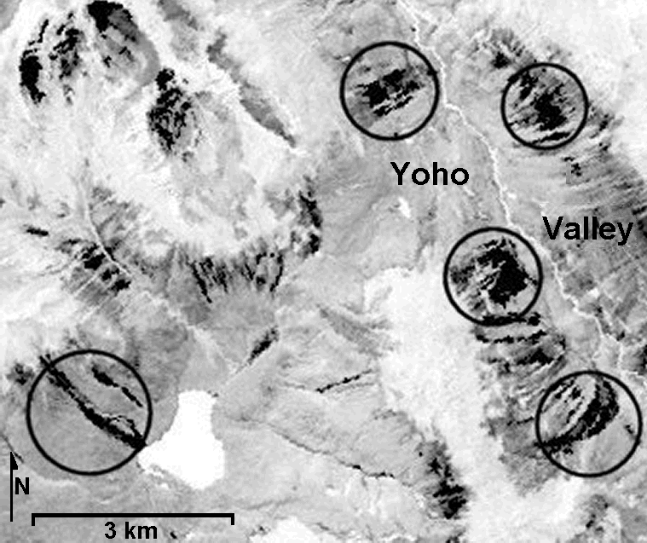
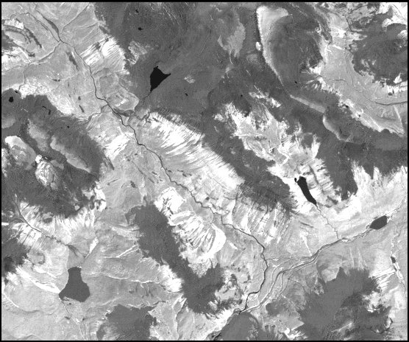
Principal Component 3

Slide 23
Classes
1) avalanche (vegetated tracks)
2) forest (deciduous and coniferous)
3) meadow (including tundra)
4) mixed (scrub vegetation of various types including burn areas)

Slide 24
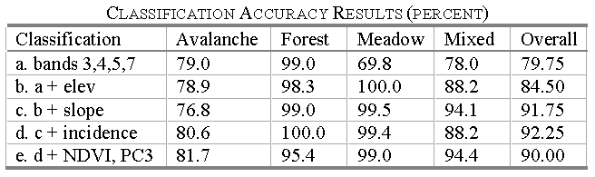
Classification Results

Slide 25
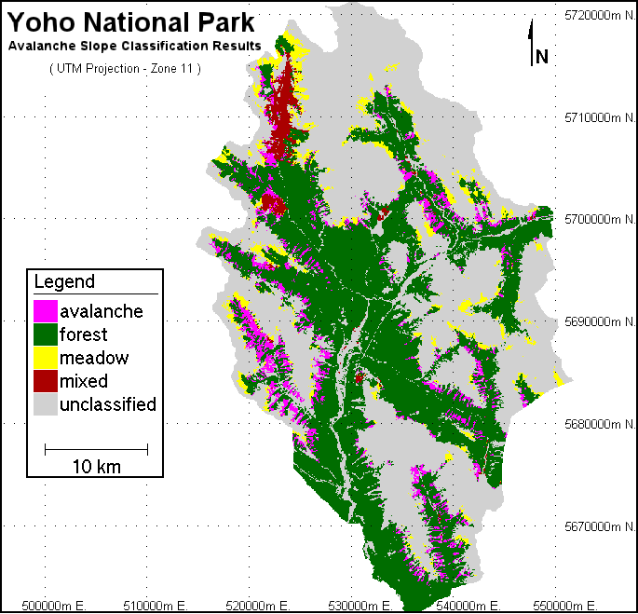

Slide 26
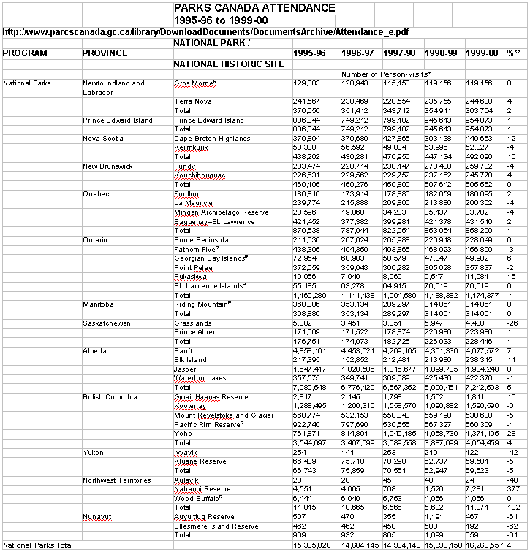

Slide 27
More Information
Forsythe, K.W. and R.D. Wheate. 2003. Utilization of Landsat TM and Digital Elevation Data for the Delineation of Avalanche Slopes in Yoho National Park (Canada). IEEE Transactions on Geoscience and Remote Sensing Vol. 41, No.11, November 2003, pp. 2678-2682.
Available from the TMU Library - Online Resources
Forsythe and Wheate (2003)

Slide 28
Calculating NDVI
Calculating NDVI, lets do it.

Slide 29
The copyright to this original work is held by Dr. Forsythe and students registered in course Geo542 can use this material for the purposes of this course but no other use is permitted, and there can be no sale or transfer or use of the work for any other purpose without explicit permission of Dr. Forsythe.

