Slide 1
The copyright to this original work is held by Dr. Forsythe and students registered in course Geo542 can use this material for the purposes of this course but no other use is permitted, and there can be no sale or transfer or use of the work for any other purpose without explicit permission of Dr. Forsythe.

Slide 2
Classification Techniques (Supervised)

Slide 3
Classification Procedures – Supervised Classification
The analyst identifies homogenous representative samples of the different surface cover types of interest
Canada Centre for Remote Sensing Tutorial http://www.ccrs.nrcan.gc.ca/ccrs/eduref/tutorial/indexe.html

Slide 4
Classification Procedures – Supervised Classification
These samples are referred to as training areas

Slide 5
Classification Procedures – Supervised Classification
The selection of training areas is based on:
the analyst’s familiarity with the geographic area and
their knowledge of actual land cover types present in the image
Canada Centre for Remote Sensing Tutorial http://www.ccrs.nrcan.gc.ca/ccrs/eduref/tutorial/indexe.html

Slide 6
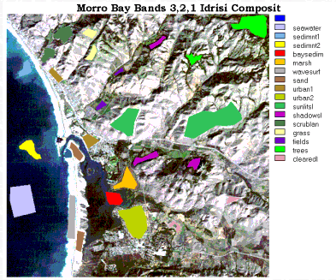
Training Areas - Morro Bay, California
Remote Sensing Tutorial, EOS Goddard, NASA
http://rst.gsfc.nasa.gov/Sect1/Sect1_17.html

Slide 7
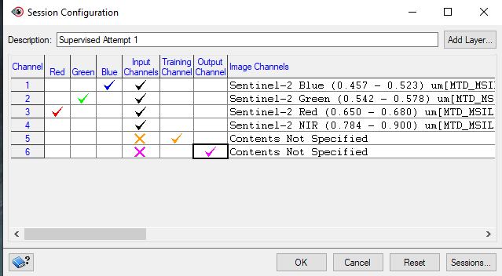
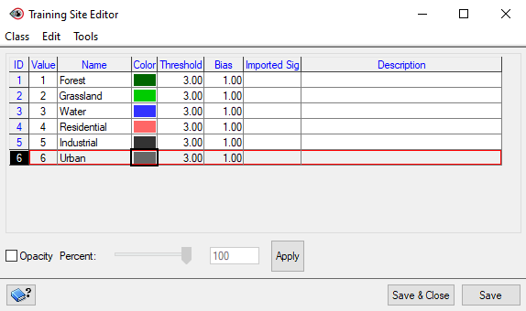

Slide 8
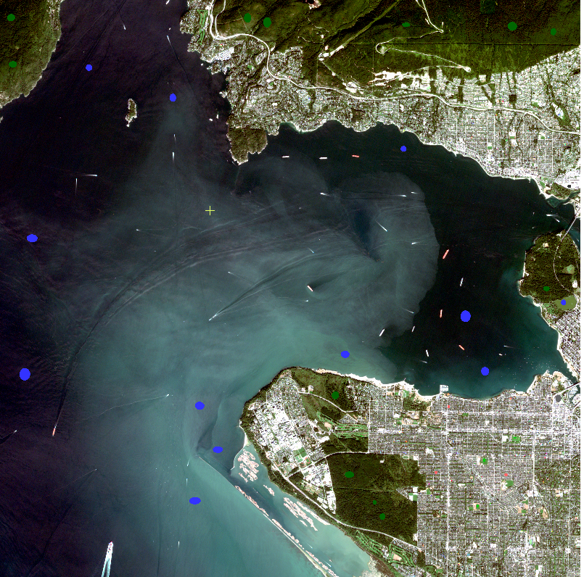

Slide 9
Supervised Classification
The numerical information in all spectral bands for the pixels comprising the training areas are used to "train" the computer to recognize spectrally similar areas for each class
Canada Centre for Remote Sensing Tutorial http://www.ccrs.nrcan.gc.ca/ccrs/eduref/tutorial/indexe.html

Slide 10
Supervised Classification
Using the training areas’ spectral “signatures”, each pixel in the image is compared to these signatures and placed in the class it most “resembles” digitally
Canada Centre for Remote Sensing Tutorial http://www.ccrs.nrcan.gc.ca/ccrs/eduref/tutorial/indexe.html

Slide 11
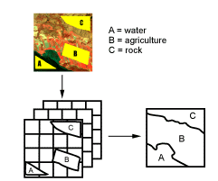
Supervised Classification
Canada Centre for Remote Sensing Tutorial http://www.ccrs.nrcan.gc.ca/ccrs/eduref/tutorial/indexe.html

Slide 12
Classification Algorithms
Common algorithms used for classification include:
minimum distance
maximum likelihood
parallelepiped
Remote Sensing Tutorial, EOS Goddard, NASA
http://rst.gsfc.nasa.gov/Sect1/Sect1_18.html

Slide 13
Classification Algorithms
Each algorithm has its own advantages and disadvantages in terms of:
accuracy
sensitivity
computational resources required and
results produced

Slide 14
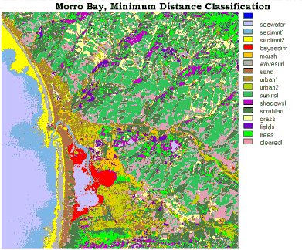
Example - Minimum Distance Classifier Morro Bay California
Remote Sensing Tutorial, EOS Goddard, NASA
http://rst.gsfc.nasa.gov/Sect1/Sect1_18.html

Slide 15
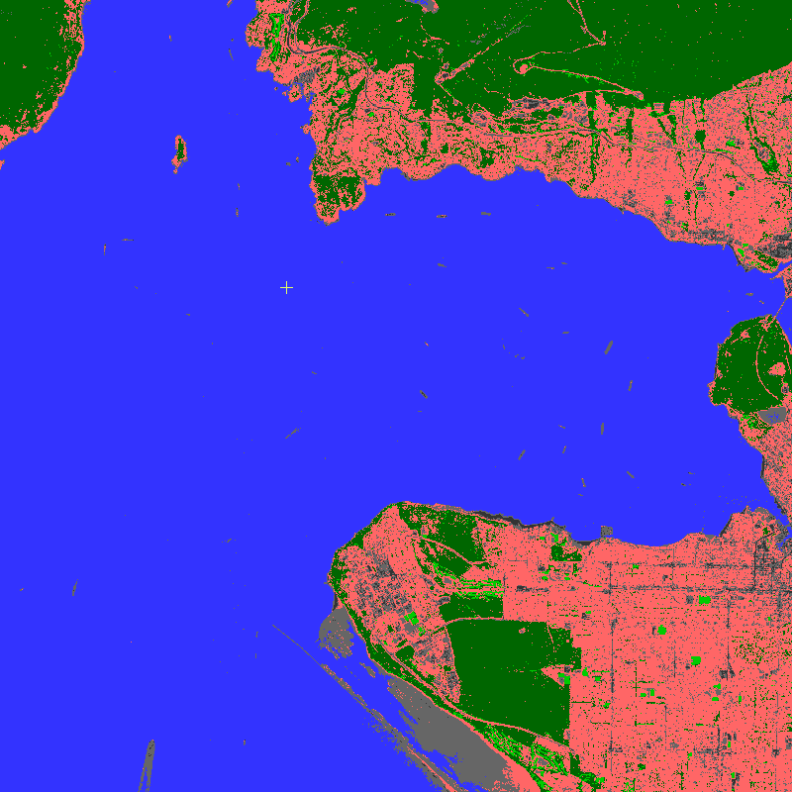

Slide 16
Post-Classification
The final step in any classification is to assess the accuracy of the classification
Most image processing programs have routines for performing accuracy assessments
Accuracy assessments generally compare the relationship between known reference data (ground truth) and the corresponding results of the automated classification
Lillesand et al., 2004. P 586-593

Slide 17
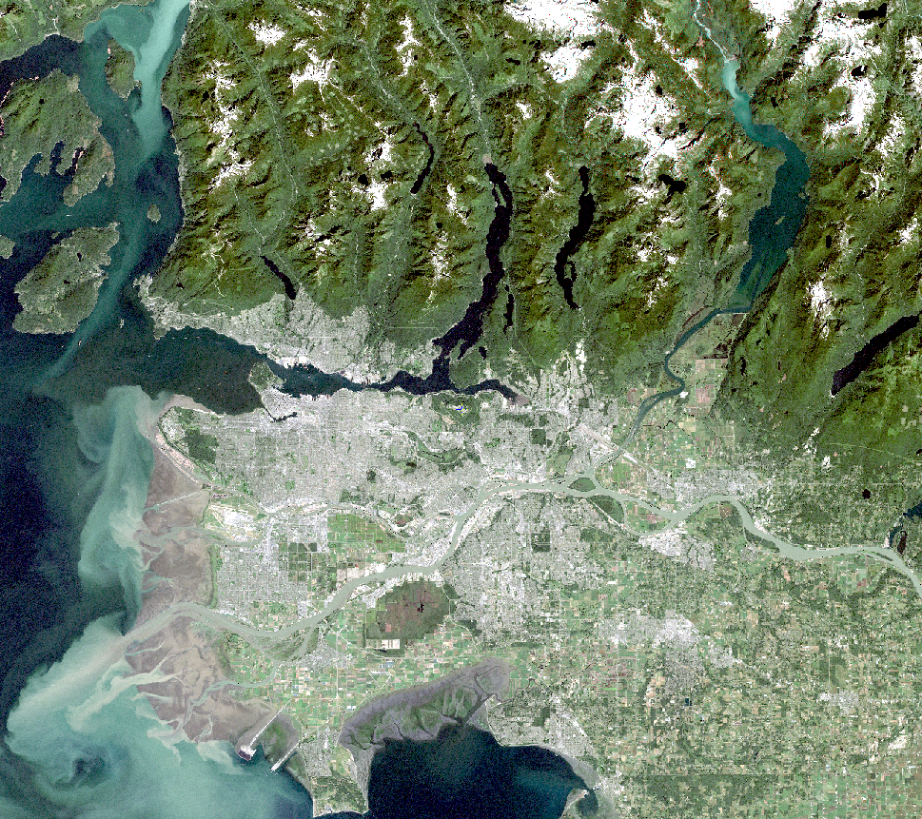

Slide 18
Course outline readings
Forsythe et al. (2012)

Slide 19
The copyright to this original work is held by Dr. Forsythe and students registered in course Geo542 can use this material for the purposes of this course but no other use is permitted, and there can be no sale or transfer or use of the work for any other purpose without explicit permission of Dr. Forsythe.

