Slide 1
The copyright to this original work is held by Dr. Forsythe and students registered in course Geo542 can use this material for the purposes of this course but no other use is permitted, and there can be no sale or transfer or use of the work for any other purpose without explicit permission of Dr. Forsythe.

Slide 2
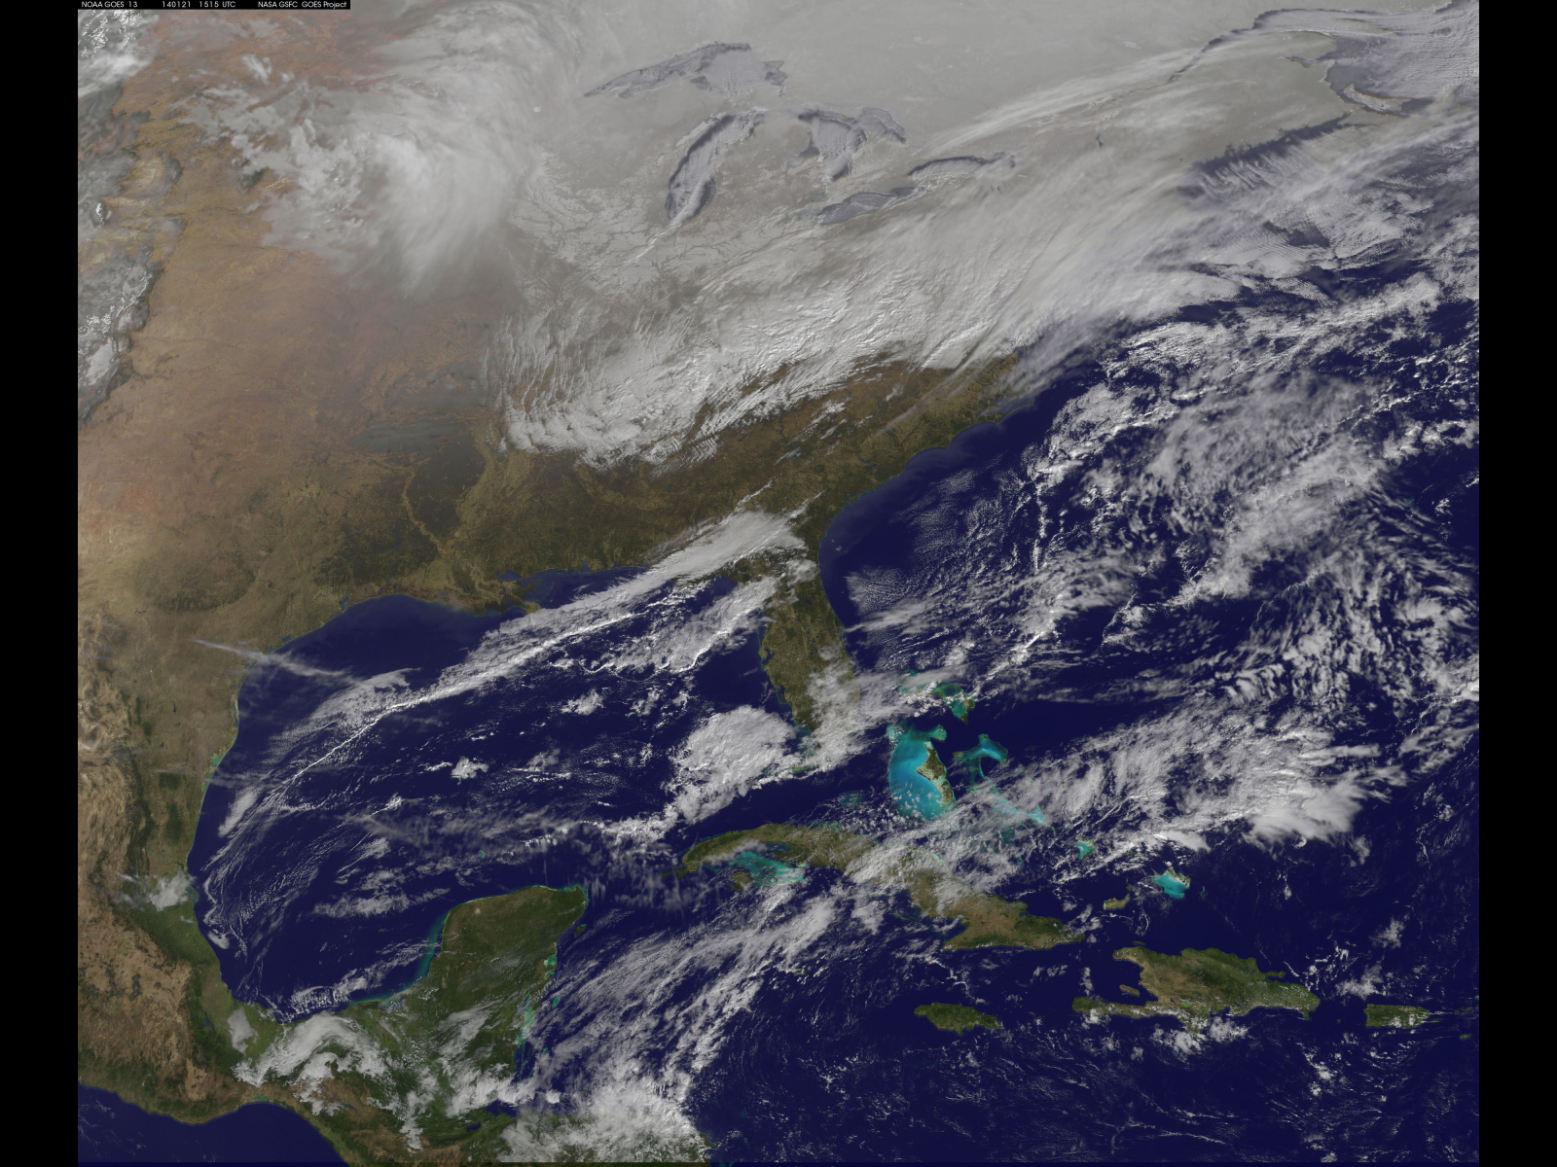
NOAA's GOES-East satellite is providing continuous coverage of the major winter storm affecting the U.S. East Coast on January 21, 2014. The National Weather Service or NWS National Prediction Center noted in their short range public discussion on January 21 that an Arctic air mass is arriving in the eastern U.S. today and snow will extend from the Mid-Atlantic to New England. https://www.nasa.gov/image-article/satellite-view-of-central-eastern-u-s-deep-freeze/

Slide 3
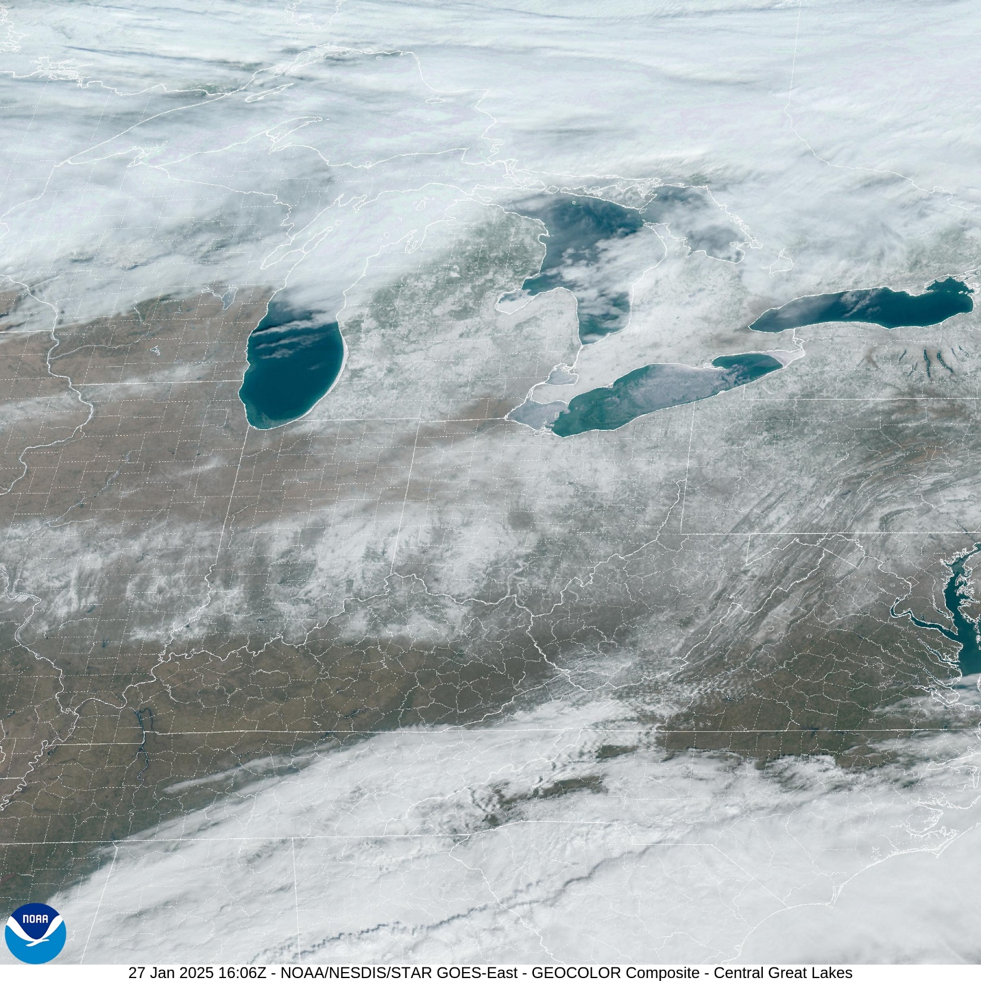
https://cdn.star.nesdis.noaa.gov/GOES16/ABI/SECTOR/cgl/GEOCOLOR/20250271606_GOES16-ABI-cgl-GEOCOLOR-2400x2400.jpg

Slide 4
Classification Techniques (Unsupervised)

Slide 5
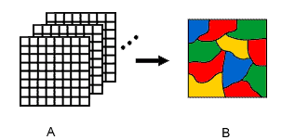
Image Classification
Digital image classification uses the spectral information represented by the digital numbers in one or more spectral bands, and attempts to classify each individual pixel based on this spectral information
Canada Centre for Remote Sensing Tutorial http://www.ccrs.nrcan.gc.ca/ccrs/eduref/tutorial/indexe.html

Slide 6
Image Classification
This type of classification is called spectral pattern recognition
The objective is to assign all pixels in an image to particular classes or “themes”

Slide 7
Image Classification
Classes represent land cover types such as water, coniferous forest, industrial land, wheat crops, etc.)
The resulting image is a mosaic of pixels, each of which belong to a particular theme.
The classified image is essentially a thematic “map” of the original image

Slide 8
S,S,T,S,T,P,A
What are these?

Slide 9
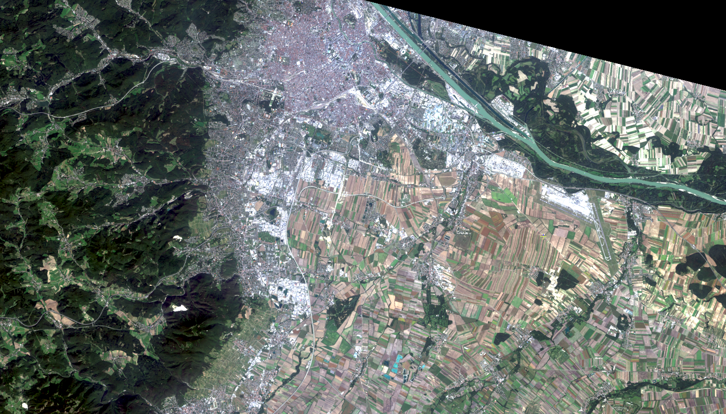

Slide 10
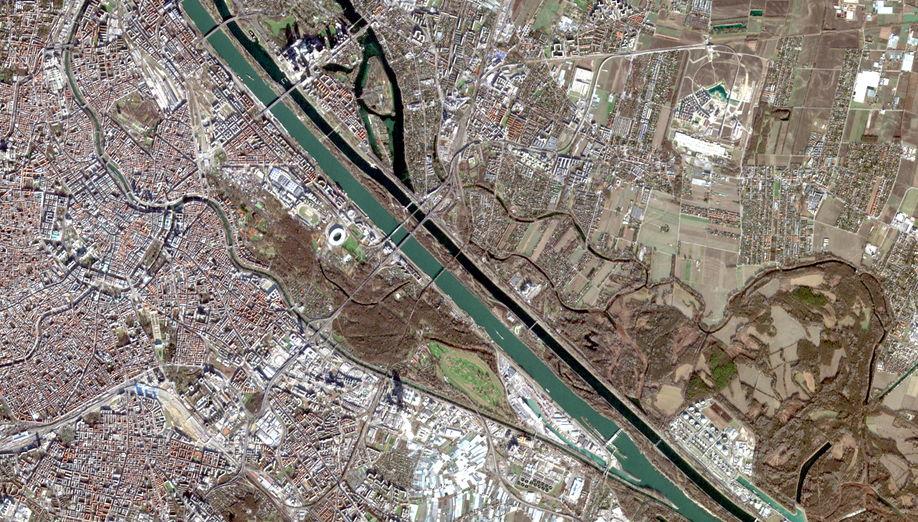

Slide 11
Image Classification
Information classes are categories of interest that an analyst is actually trying to identify
Spectral classes are groups of pixels that are uniform with respect to brightness values

Slide 12
Image Classification
The objective is to match the spectral classes in the data to the information classes of interest
Output products include hardcopy and digital land cover maps as well as summary statistics of the extent of land cover types present in an image

Slide 13
Unsupervised Classification
Clustering algorithms are used to determine the natural structures or groupings in the data
Usually, the analyst specifies the number of desired classes
Lillesand et al., 2004. P 573-577

Slide 14
Unsupervised Classification
Each of the output classes are spectral classes
After the clustering process has ended, the analyst must identify the classes derived from the algorithm
This is done by comparing with reference data
Lillesand et al., 2004. P 573-577

Slide 15
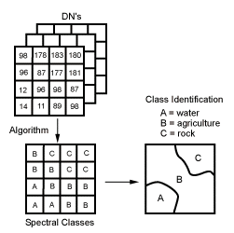
Unsupervised Classification
Canada Centre for Remote Sensing Tutorial http://www.ccrs.nrcan.gc.ca/ccrs/eduref/tutorial/indexe.html

Slide 16
The copyright to this original work is held by Dr. Forsythe and students registered in course Geo542 can use this material for the purposes of this course but no other use is permitted, and there can be no sale or transfer or use of the work for any other purpose without explicit permission of Dr. Forsythe.

