Slide 1
The copyright to this original work is held by Dr. Forsythe and students registered in course Geo542 can use this material for the purposes of this course but no other use is permitted, and there can be no sale or transfer or use of the work for any other purpose without explicit permission of Dr. Forsythe.

Slide 2
Remote Sensing and Image Processing Applications

Slide 3
Drone Remote Sensing Lecture
Proposed Date September 24
  10:00am to 12:00pm
  11:00am to 1:00pm
  12:00pm to 2:00pm
  1:00pm to 3:00pm

Slide 4
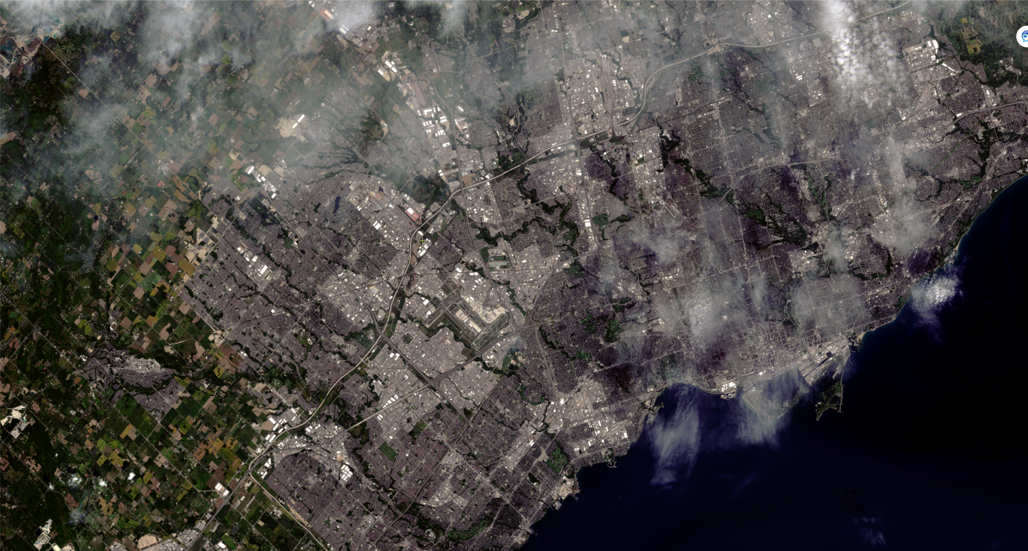
Landsat 8
September 2, 2025

Slide 5
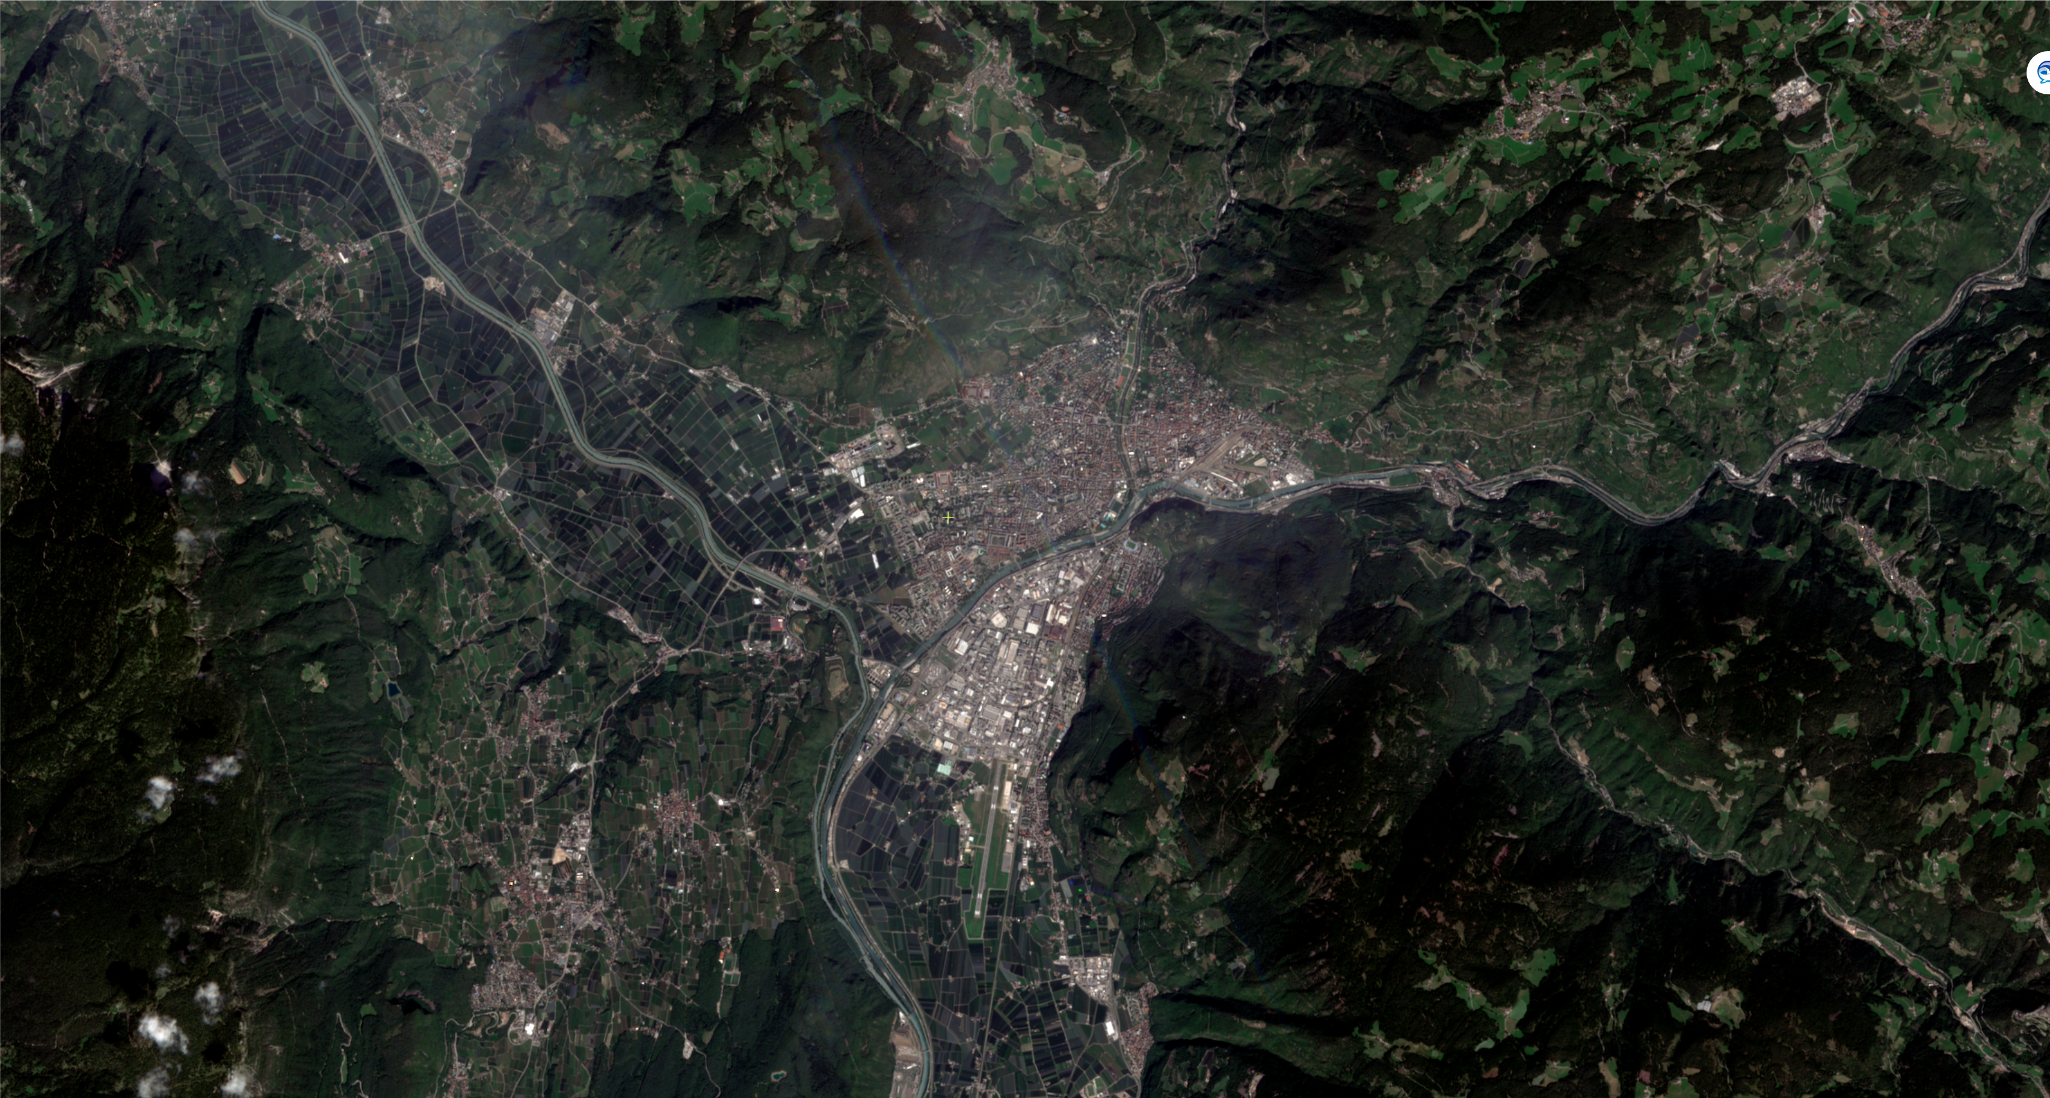
Sentinel 2
August 25, 2025

Slide 6
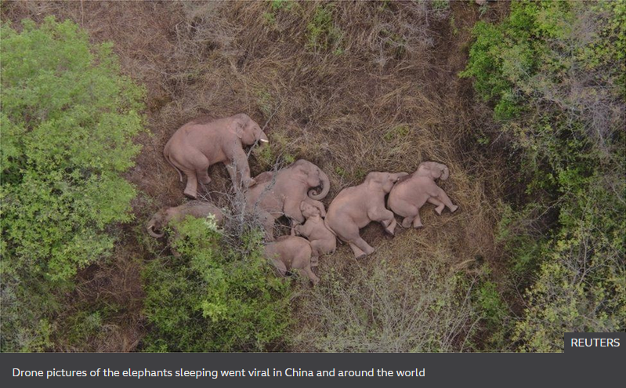
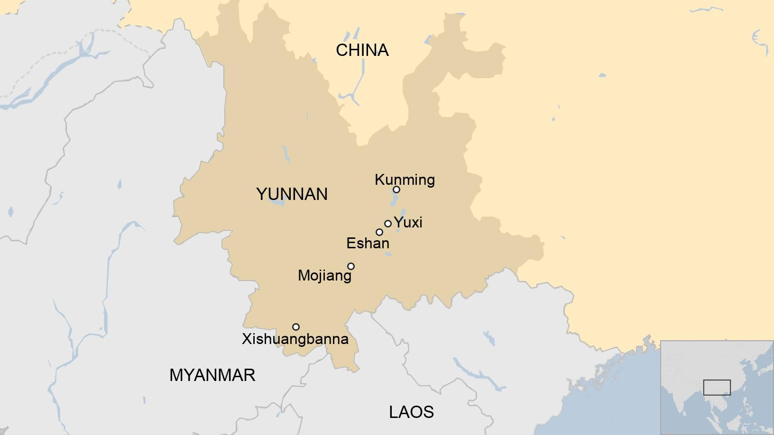
Elephant remote sensing
https://www.bbc.com/news/world-asia-china-57565514
June 23, 2021

Slide 7
Dutch tulip fields come into bloom
https://www.esa.int/ESA_Multimedia/Images/2020/04/Dutch_tulip_fields_come_into_bloom
April 23, 2022

Slide 8
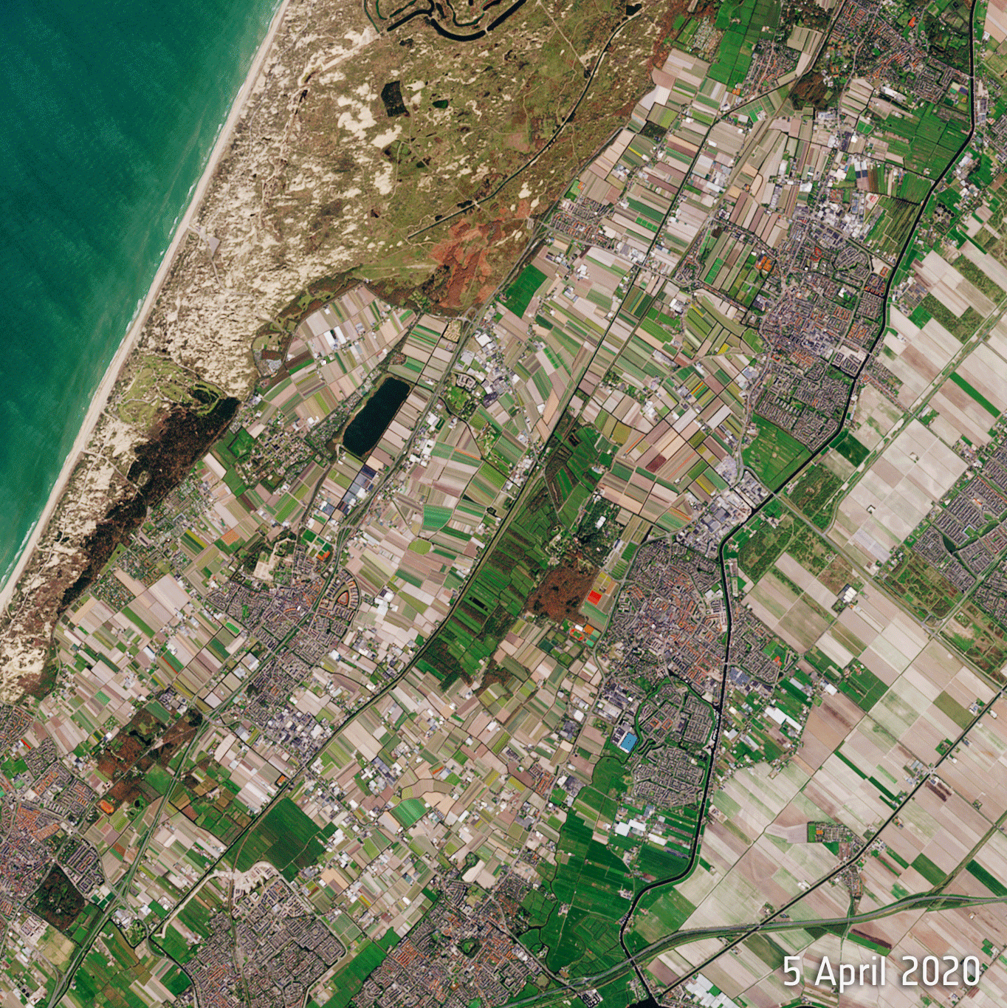

Slide 9
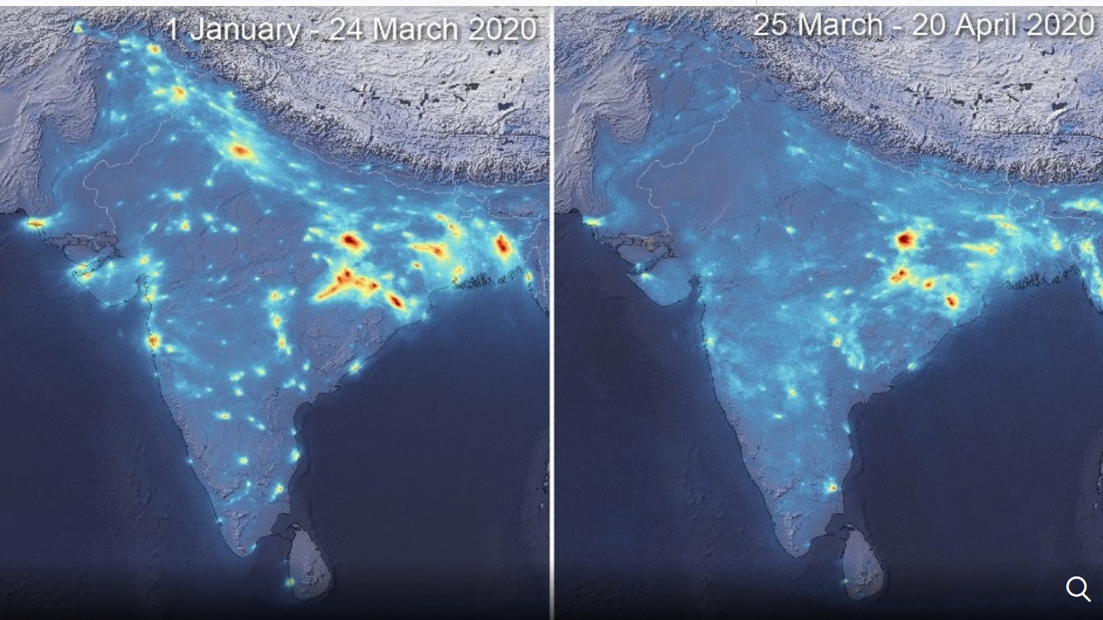
These images, using data from the Copernicus Sentinel-5P satellite, show the average nitrogen dioxide concentrations.
(ESA/Copernicus)

Slide 10
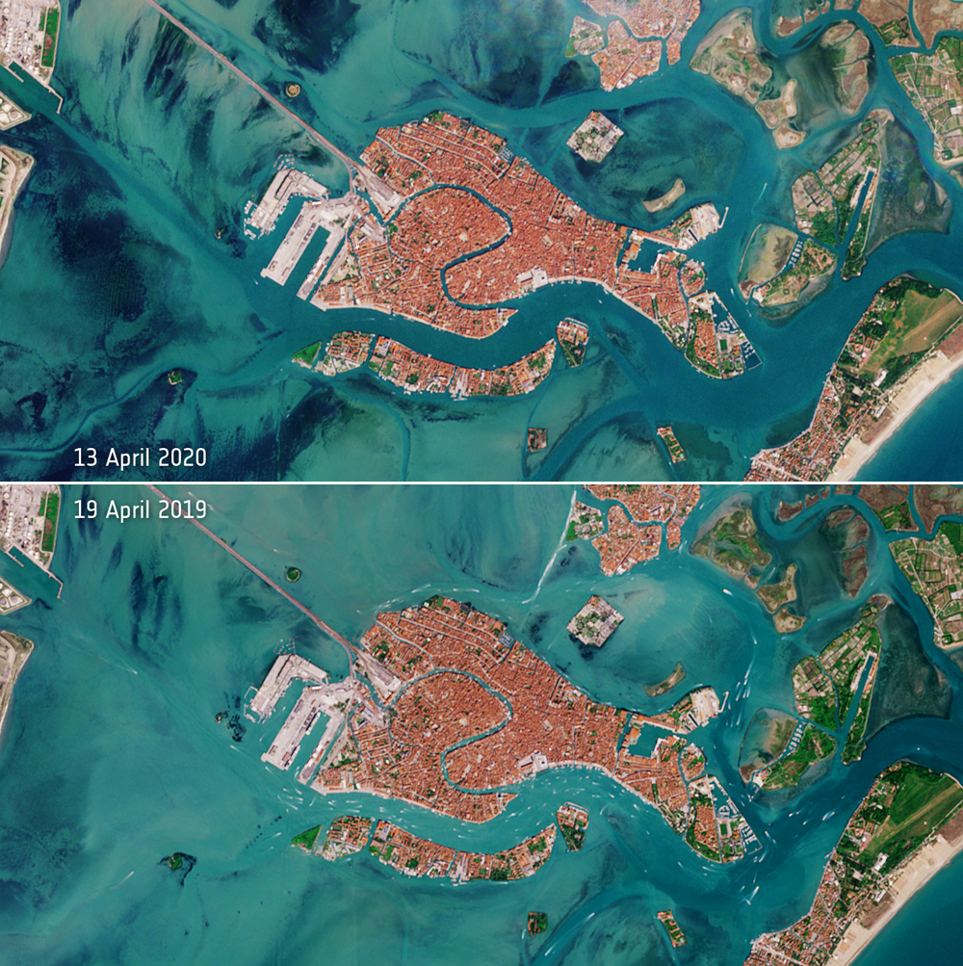
Deserted Venice Lagoon
https://www.esa.int/ESA_Multimedia/Images/2020/04/Deserted_Venetian_lagoon

Slide 11
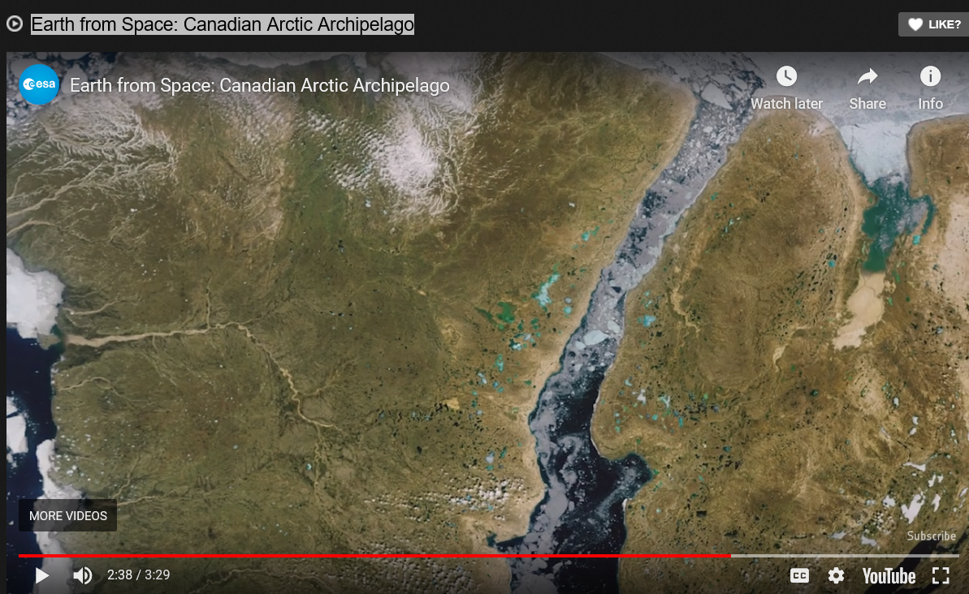
Earth from Space: Canadian Arctic Archipelago
https://geospatialstream.com/earth-from-space-canadian-arctic-archipelago/
https://youtu.be/i6VCkiAWtr0

Slide 12
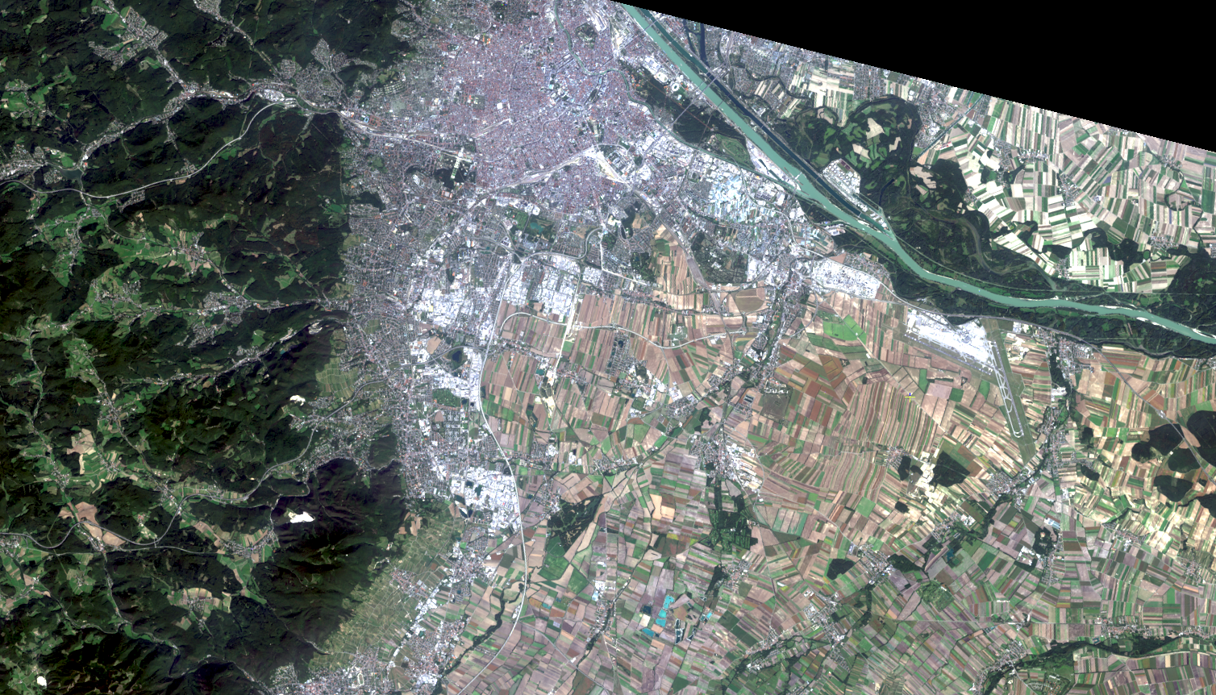

Slide 13
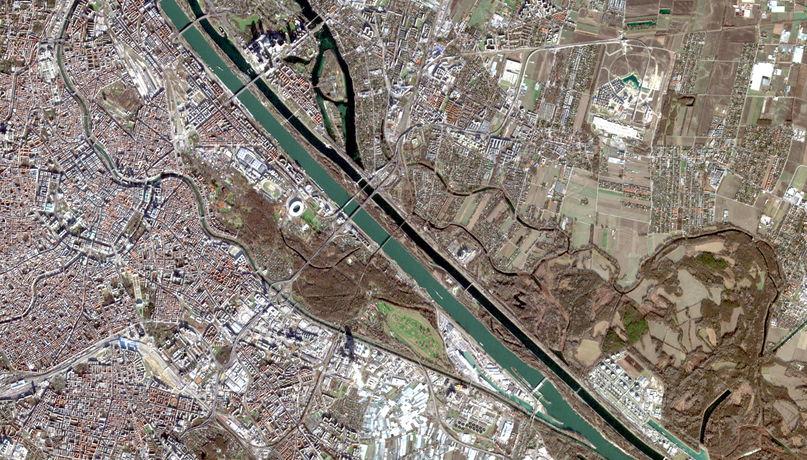

Slide 14
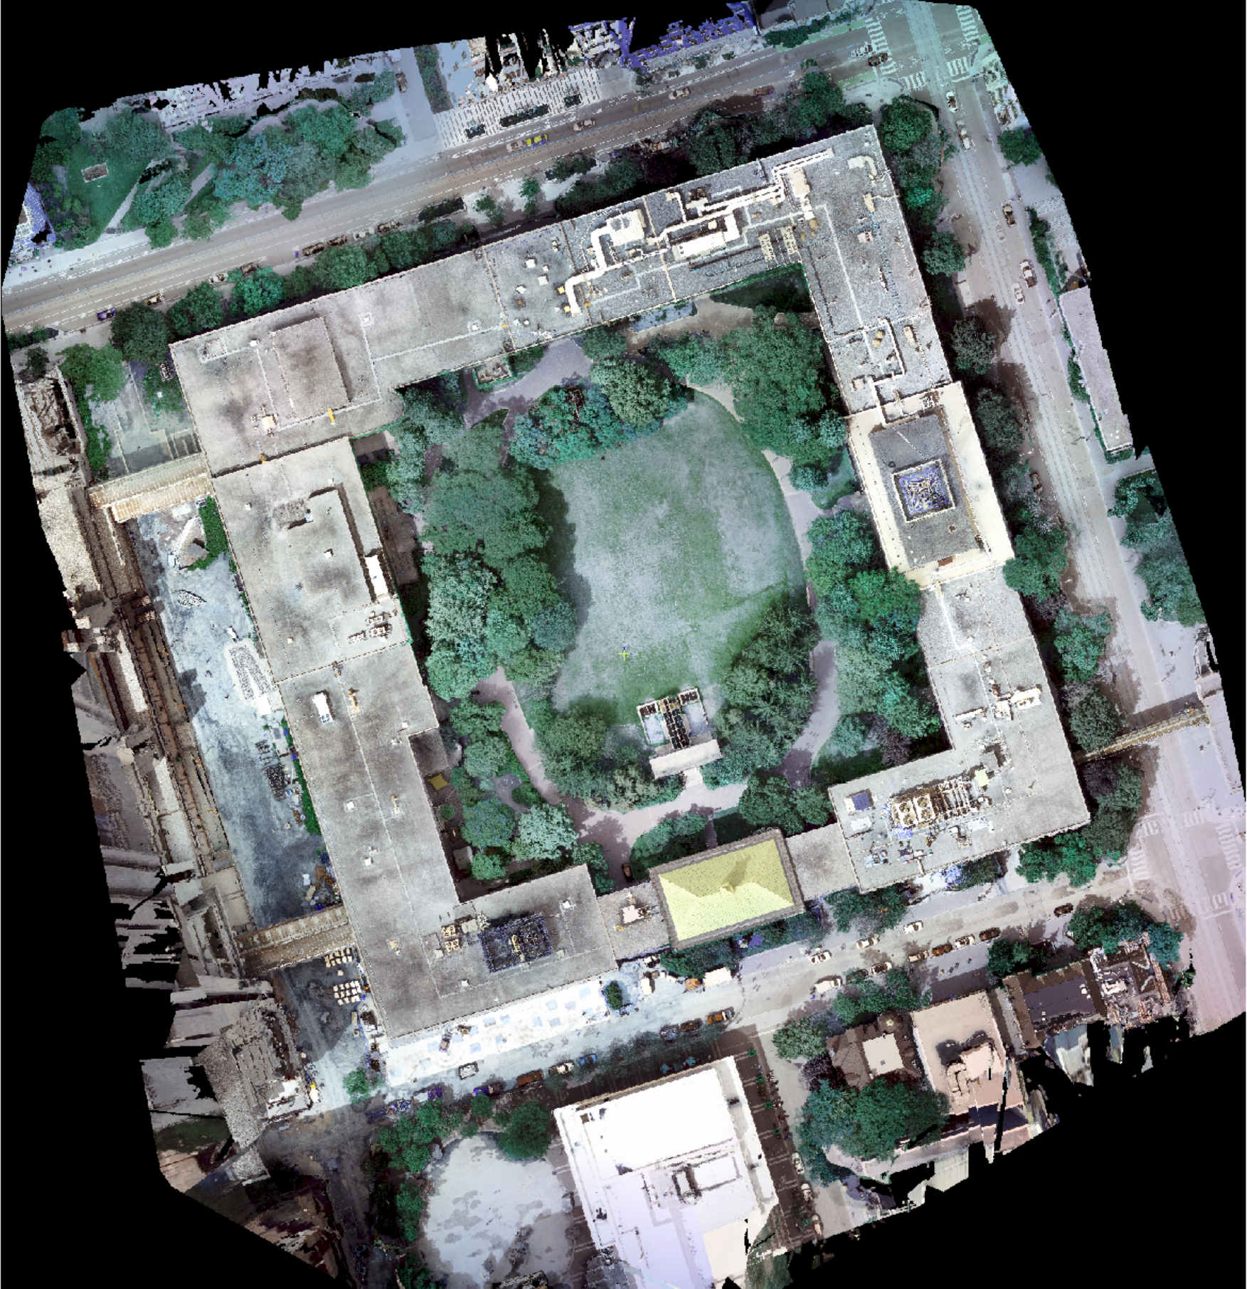

Slide 15
USGS EarthExplorer
https://earthexplorer.usgs.gov/

Slide 16
Copernicus Data Space Ecosystem
https://dataspace.copernicus.eu/

Slide 17
The copyright to this original work is held by Dr. Forsythe and students registered in course Geo542 can use this material for the purposes of this course but no other use is permitted, and there can be no sale or transfer or use of the work for any other purpose without explicit permission of Dr. Forsythe.

