Slide 1

Global
Population
and
Demographics 2
Structure and Survival

Slide 2
To Do List
Demographic Transition
Controlling death and life
Demographic transition in time and space
Population Pyramids
Population pyramids and demographic transition
Population pyramids in time and space
Demographic Dividend
Dependency
What it is and why it is important
Dependency in time and space
Survivorship
Life expectancy
Survivorship curves in time and space

Slide 3
Structural Population Change:
Demographic Transition

Slide 4
Demographic Transition
☺
40
30
20
10
0
Total
Population
growth
Rate per 1,000 population
Natural Increase/decrease
Death Rate
Birth Rate
1700 1740 1780 1820 1860 1900 1940 1980 2020
Stage 5
Decline?
U.K.
21st century
Stage 1
High Fluctuating
U.K. pre 1760
Stage 2
Early expanding
U.K. 1760-1870
Stage 3
Late expanding
U.K. 1870-1950
Stage 4
Low fluctuating
U.K. post 1950

Slide 5
How Does Demographic Transition Work?
☺
Population growth is a product of births minus deaths.
So, if death rates decline faster than birth rates even if both rates are decreasing, then population grows and this is exactly what happens in demographic transition.
Note that both rates can be declining!
Why do death rates decrease faster than birth rates?
Because death rates have a quick ‘technical’ fix – medicine & public health (e.g. clean water, sanitation, vaccinations, medications).
But birth rates have a much slower cultural control based on the economics of having kids.

Slide 6
Why Does Demographic Transition Work?
☺
Quick ‘technical’ fixes for death were principally things like vaccines, medicines, germ theory, public health (e.g. sanitation, clean water), all of which worked rapidly to decrease death from disease.
The slower cultural control of births revolves around the fact that children are both an economic asset and an economic liability and the more developed a country becomes, the longer children remain an economic liability (that is, need support).
So cultural control is keyed to child survival rates: in less developed societies, children are needed to support their parents into old age, but children also have a much higher chance of dying in less developed countries so parents have more of them.
As people and countries get wealthier, more kids survive and it is more expensive to care for them, and parents have tax supported state mechanisms to look after them so have fewer kids.

Slide 7
Controlling
Life
and
Death.
The Data

Slide 8
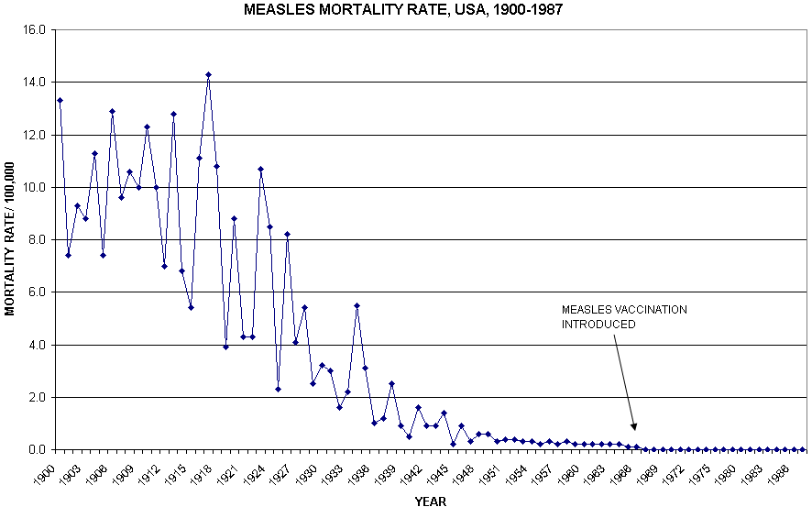
Measles Mortality Rate in the U.S. 1900-1990
Between 2000 and 2018, measles vaccinations prevented over 23 million deaths worldwide, mostly of children. However, measles deaths increased 50% between 2016 and 2019, claiming over 207,000 lives.¹
Stable high mortality 1900-1925.
Rapidly declining rates 1925-1942 with better prophylactic care.
Vaccination begins in 1964, virtually eliminating disease.
Lower rates stabilise 1942-1964.
1: https://www.cdc.gov/mmwr/volumes/69/wr/mm6945a6.htm?s_cid=mm6945a6_w

Slide 9
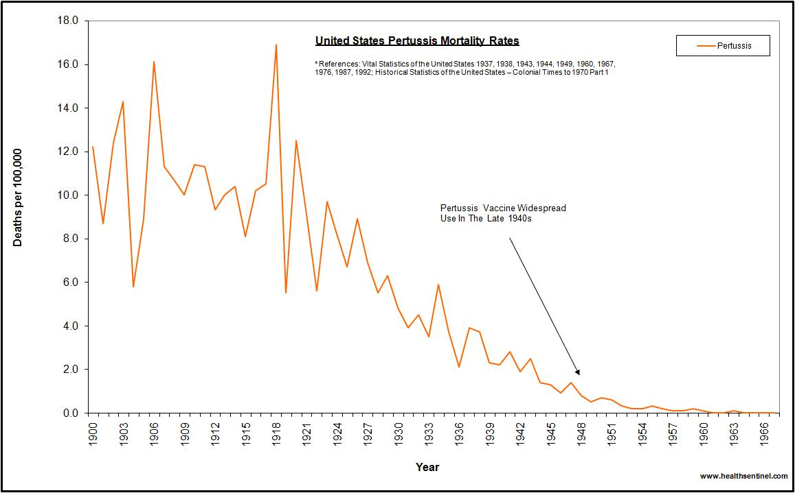
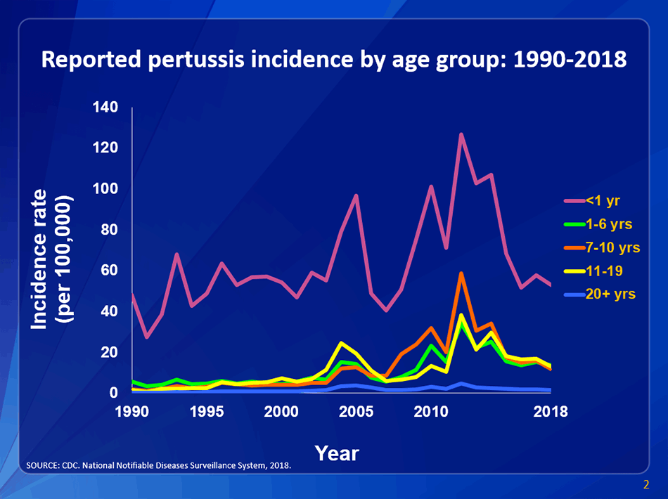
Pertussis (Whooping Cough) Death Rates 1900-1966
Between 2000 and 2018 pertussis infection rates increased back to 1938 levels in the U.S., the U.K., France, and other countries.
Stable high mortality 1900-1921.
Prophylactic care
Widespread vaccination begins late 1940s.

Slide 10
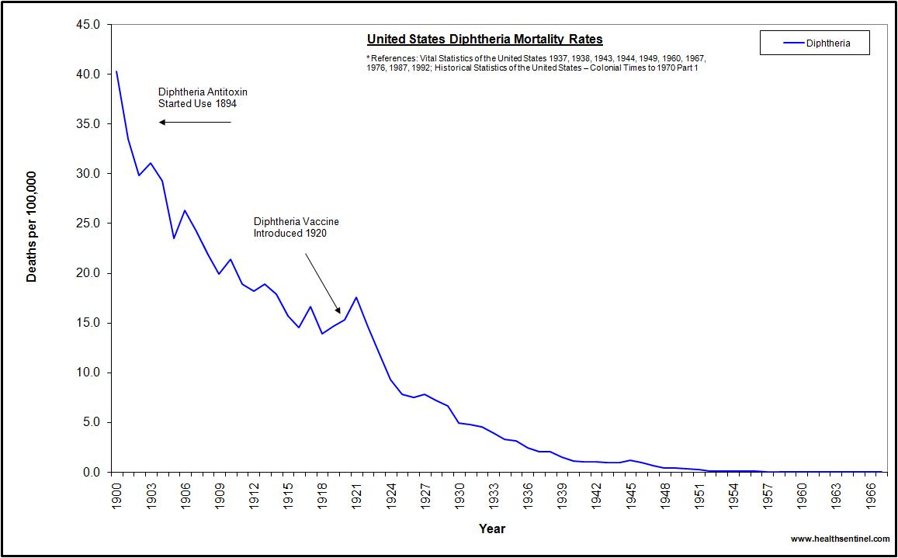
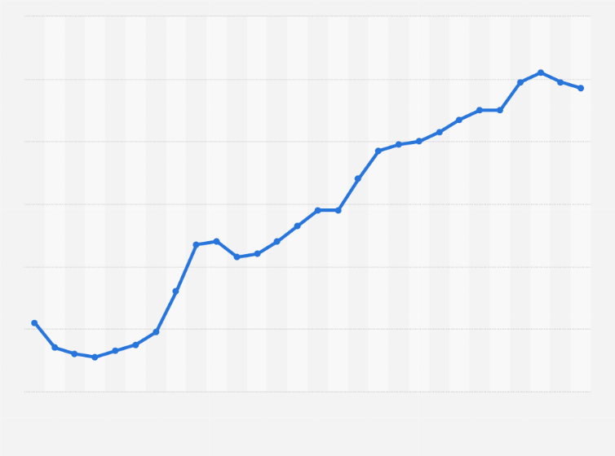
Diphtheria Death Rates 1900-1966
Use of Diphtheria antitoxin begins 1894.
Diphtheria deaths 1990-2015, U.S.
Vaccination routinely used in the 1940s.

Slide 11
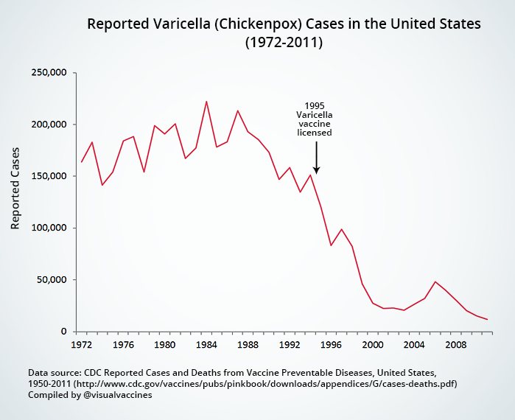

Slide 12
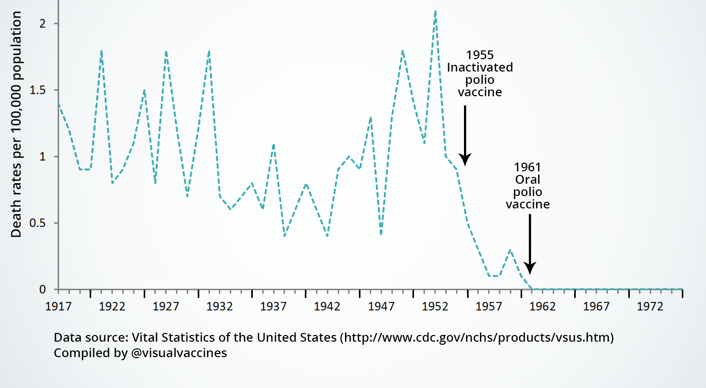
Polio Death Rate in the United States 1917-1975
Polio is one of the few success stories where eradication of wild virus (carried by humans only) has been certified for the Americas, Europe, S.E. Asia, and the Western Pacific. Global polio cases has decreased from about 350,000 cases in 1988 to just 407 in 2013.¹
Given that its only reservoir is humans, it is one of a few diseases that could be eradicated.
However, cultural and religious antivaccination opposition in Afghanistan, Pakistan, and Nigeria has seen endemic polio survive and grow.
1: https://www.cdc.gov/polio/progress/index.htm#:~:text=The%20number%20of%20worldwide%20polio,Asia%20and%20the%20Western%20Pacific.

Slide 13
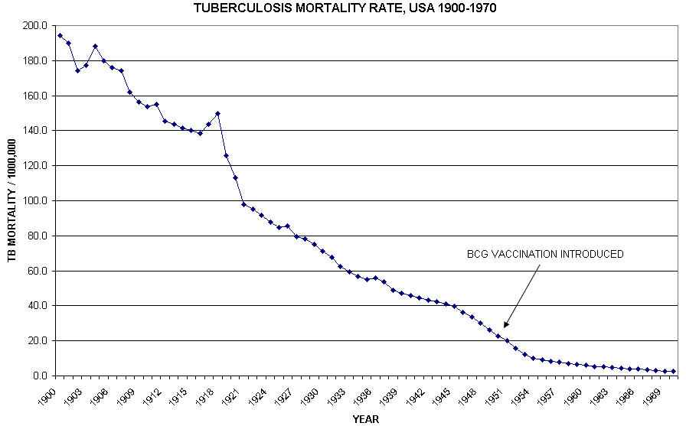
Tuberculosis Mortality Rate in the United States 1900-1970
Similar pattern to measles: declining rates due to better prophylactic care, then rapidly declining rates due to immunization in 1951. Globally 10 million people were ill, and 1.4 million died of TB in 2019. It is one of the top 10 causes of death and the leading cause from a single infectious agent.
Multi Drug Resistant TB a growing concern globally, especially for poorer countries and unvaccinated people.
BCG (Bacille Calmette-Guerin) vaccinations have been stopped (or were never done) in many developed countries including Canada.¹
1: http://www.bcgatlas.org/. BCG is available only to spatial groups based on risk, though BCG was given to all people until the early 1970s.

Slide 14

Vaccination – What Happens When You Don’t

Slide 15
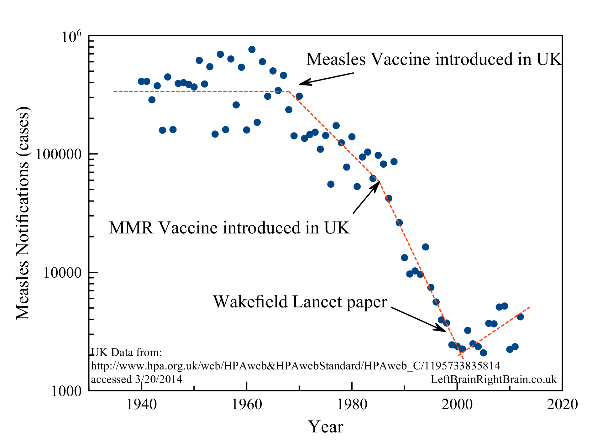
Fatal Fake News
Cases of measles show a sharp upturn after the fraudulent Wakefield paper was published.

Slide 16
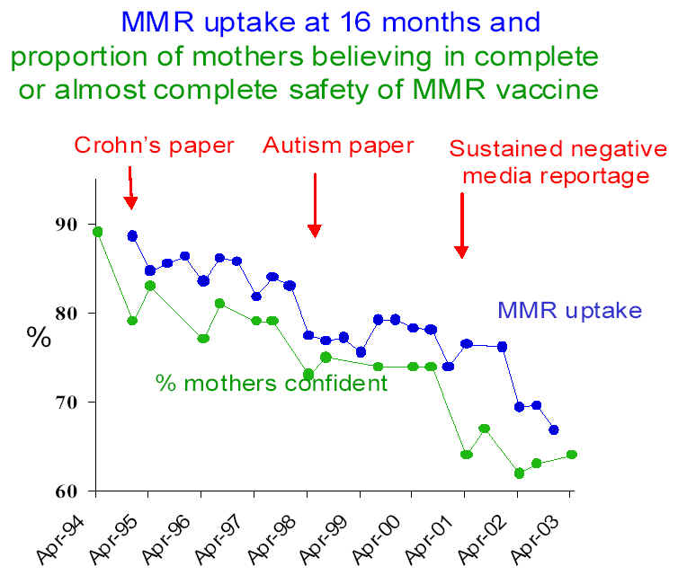
As mother’s confidence decreased so did vaccine uptake.

Slide 17
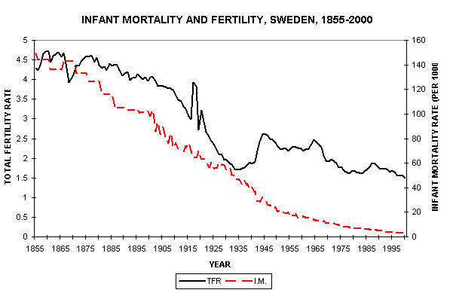
Controlling Births
Birth rates more difficult to control since it is a cultural and economic decision. Any economic gains and losses from declining death rates of children are not immediately obvious. Fertility rates decline as infant mortality declines but lagged, stabilizing at about replacement rate.
Total Fertility Rate
Replacement Rate
Infant Mortality

Slide 18
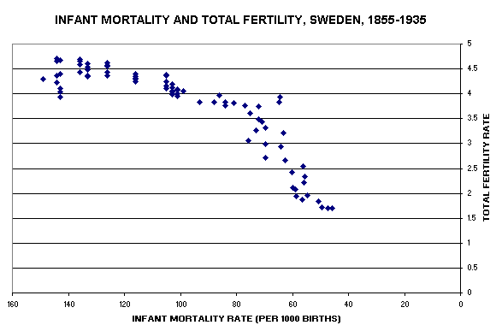
Controlling Births: IM & TFR Sweden 1855 to 1935
Once infant mortality reaches about 70 (around 1900), the fertility rate begins to decrease rapidly. This reflects the realisation that if children are not dying, a family needs fewer of them as they are expensive.

Slide 19
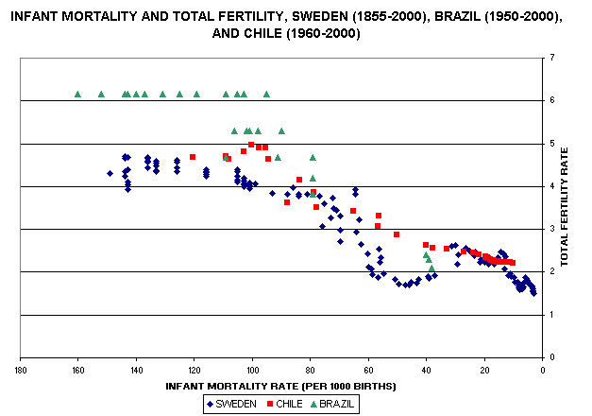
Controlling Births
In each case, the nation’s profile shows the same pattern: as infant mortality declines, so does fertility rate, this latter stabilizing around replacement rate.

Slide 20
Demographic Transition, High Income Nations
High income nations have moved through stage four and into stage “five” where they remain into 2100.
… and population change has become population decline.
Calculated from https://population.un.org/wpp/
Notes:
Source: http://esa.un.org/unup/index.asp
Could be found in Excel File under Population

Slide 21
Demographic Transition, Least Developed Nations
By 2020 the least developed are still in stage 3 with flattening death curve and still decreasing births, and will remain there until almost 2100.
Population change has been declining since 1980, and will continue to do so steadily into 2100.
Calculated from https://population.un.org/wpp/
Notes:
Source: http://esa.un.org/unup/index.asp
Could be found in Excel File under Population

Slide 22
Demographic Transition in Europe
About 2000, Europe moved into stage “five” of demographic transition where death rates exceed birth rates resulting in population decrease.
Europe facing continued population decline unless compensated by increased fertility and/or migration.
Calculated from https://population.un.org/wpp/
Notes:
Source: http://esa.un.org/unup/index.asp
Could be found in Excel File under Population

Slide 23
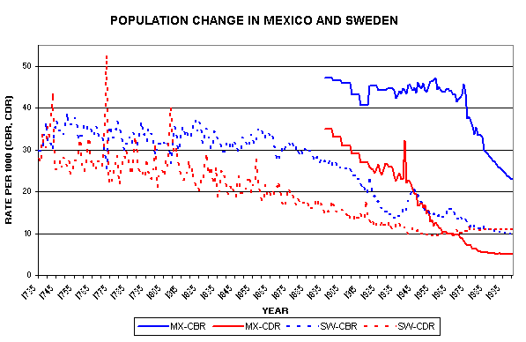
POPULATION CHANGE, MEXICO AND SWEDEN 1735-2005
Showing death rates, birth rates and demographic transition stages (orange Sweden, green Mexico).
Sweden has had over 250 years for its DT transformation.
Stage 1
Stage 2
Stage 3
Mexico has had about 100 years.
Stage 1
Stage 2
Stage 3
Stage 4
1815
1905

Slide 24
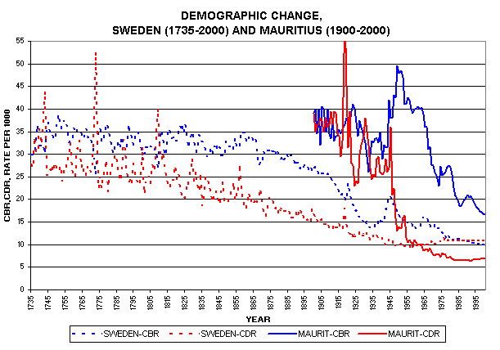
POPULATION CHANGE, MAURITIUS AND SWEDEN 1735-2005
Showing death rates, birth rates and demographic transition stages (orange Sweden, green Mauritius).
Sweden has had over 250 years for its DT transformation.
Stage 2
Stage 1
Stage 3
Mauritius had about 50 years.
Stage 1
Stage 2
Stage 3
Stage 4
Stage
5
1815
1945

Slide 25
Demographic Transition Summary
Useful model that seems to be born out by the data insofar as the patterns of births and deaths can be matched.
The reasoning is also supported by the data –control of deaths and births is supported by observation.
Model did not say much about the so called “fifth stage” phenomena.
Also, some countries controlled by strong cultural and, especially, religious biases that confound the basic premises of the model insofar as controlling births are concerned, and even control of deaths such as accepting vaccinations (e.g. disease is god’s work).

Slide 26
Structural Population Change
Population Pyramids

Slide 27
An Aging Gender Bound World
☺
Going to look at changing population structure in the world, which principally means exploring aging, gender, and dependency, and no demographic tool does this as well as population pyramids.
Underlying economic principles are that:
People are an asset when they can work.
People are a liability when they cannot.
The world is aging.
Women in the developing world are the principal earners.
Women in the developing world are the principal family support.
This leads to:
The need for a socio-economic system that can support dependents (the young and the old) and this means having an appropriate number of workers who are working and supporting families – i.e. women.¹
The need for a socio-economic system that provides the freedom for women to get educated, obtain resources, and to work is paramount.
1: https://www.sciencedirect.com/topics/social-sciences/women-and-development

Slide 28
An Age Gender Tool: Population Pyramids
☺
One of the most effective and important demographic tools for exploring the age and gender dynamics is the population pyramid.
It is a simple but subtle method for examining the current age and gender structure of a population, but also for forecasting future structure and seeing past patterns.
It can operate at geographic scales ranging from neighborhoods to the world, and can be calibrated in absolute or relative population magnitudes and from yearly age cohorts through to simple young, support and old categories.
Its patterns can reflect what has happened and will happen and what revealing future opportunities and costs and past events such as war and disease.

Slide 29
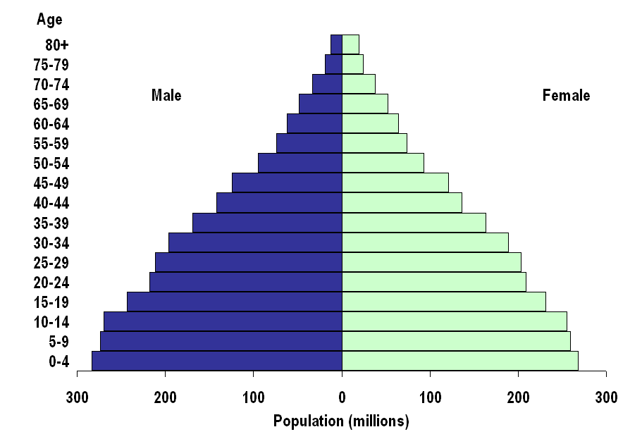
The Population Pyramid Structure
☺
Gender is split on the horizontal axis…
males
females
Each “row” shows the number or proportion of males or females in that cohort for that region/nation.
…as is population size in numbers or proportions.
Age cohorts are on the vertical axis.

Slide 30
Population Pyramid Shows Potential for Growth.
The lower cohorts become the older cohorts – e.g. the 0-4 years olds become the 30-34 years olds in 30 years.
Elderly = economic liability
Workforce
Dependent
Groups
Potential for Reproduction
Children = economic asset

Slide 31
Population Pyramids Tell Past, Present, Future
The top cohort show populations from 80+ years ago.
Using the current year (2020) the top cohorts were born in or before 1940 and thus show the past.
1940
2020
The bottom cohort shows populations now.
Using the current year (2020) the bottom cohort was born in 2020 and thus show the present.

Slide 32
Basic Population Pyramids
☺
Fewer
old
Pyramids are dynamic, changing over time from pyramid to inverted pyramid as countries develop and age.
Countries may stabilize at the middle model but only with significant net positive migration or a balanced ZPG TFR.
Many support
population
Many Old
Very few old
population
Fewer
young
Fewer support
population
Fewer
support population
Typical of developed world with migration such as Canada.
Few
young
Many young
Typical of developing world.
Typical of developed world with little migration such as Japan.

Slide 33
Population Pyramids Tell Us What to Expect
1940
Old
Old
Support
Support
1.9 TFR
1.8 TFR
1.6 TFR
2.1 TFR
2.1 TFR
2.1 TFR
Young
Young
2020
The young base of the pyramid contains the forecast trend line for the future pyramid base.
In this case, with a 1.6 TFR, the base will continue to shrink, with an increasing need for future in-migration.
In this case, with a 2.1 TFR (ZPG), the base will establish steady state growth with no need for in-migration.
2030…

Slide 34
The quick fix for declining population
☺
In-migration injects productive population directly into the support cohorts, raising the potential for positive contributions to the economy and tax base.
The positive demographic consequences of in-migration for a nation are:
It injects a working age cohort into a population.
It works quickly to offset natural decrease.
It provides demand and increases the tax base.
It decreases the median age.
Old
In-migration
Support
New births
Young
New births injects population into the bottom of the young, as yet non-contributing, cohorts where the potential for productive contributions to the economy and tax base lie 20 to 30 years in the future.

Slide 35
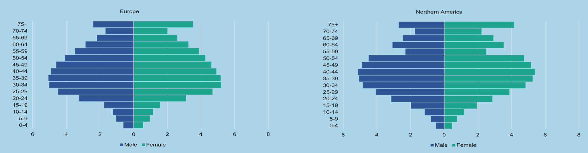
Population Pyramids of Migrants 2019
Migrants to Europe and North America are overwhelmingly in the support population cohorts and immediately bolster the economically productive portions of a population.¹
Europe
North America
1: See below for a small sample of studies on the economics of immigration:
https://www.oecd.org/migration/OECD%20Migration%20Policy%20Debates%20Numero%202.pdf
https://www.weforum.org/agenda/2017/01/beyond-the-headlines-quantifying-the-economic-contributions-of-migrants/
https://www.cbpp.org/research/poverty-and-inequality/immigrants-contribute-greatly-to-us-economy-despite-administrations
Jacob Funk Kirkegaard & Gonzalo Huertas, 2019. "The Economic Benefits of Latino Immigration: How the Migrant Hispanic Population’s Demographic Characteristics Contribute to US Growth," Working Paper Series WP19-3, Peterson Institute for International Economics.
Bridgen, Paul, Meyer, Traute and Moran, Brian , Mcgowan, Teresa (ed.) (2016) Expense turns to investment: How the welfare state supports EU migrants’ economic achievements (ESRC Centre for Population Change Briefing Papers, 34) Southampton, GB. ESRC Centre for Population Change 4pp. https://eprints.soton.ac.uk/394150/
https://psmag.com/news/research-shows-immigrants-are-not-a-drain-on-us-resources
http://pnhp.org/news/immigrants-health-care-and-the-misuse-of-the-public-charge-rule/
https://onlinelibrary.wiley.com/doi/abs/10.1111/jors.12049
https://advances.sciencemag.org/
https://www.aclu.org/other/immigrants-and-economy
https://www.forbes.com/sites/hbsworkingknowledge/2018/08/01/in-america-immigrants-really-do-get-the-job-done/#4e3cee51935f

Slide 36
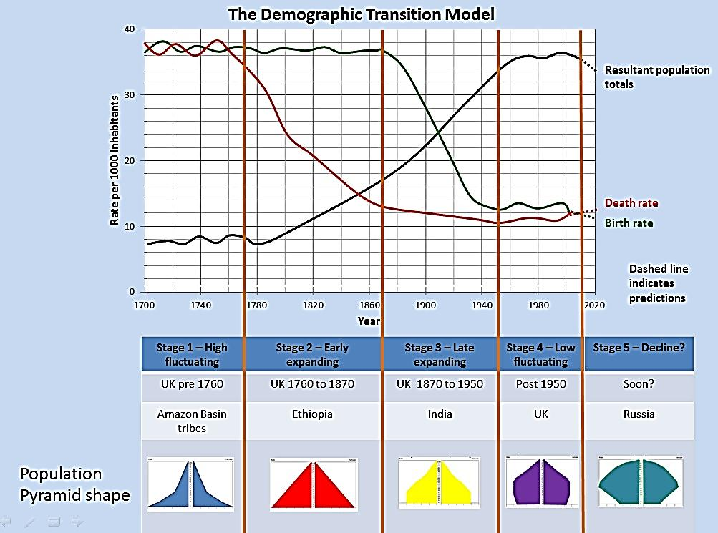





Demographic Transition and Population Pyramids
☺

Slide 37
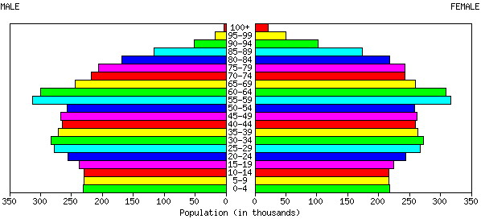
In the Developed Countries, There Are Fewer Young People, but More Elderly.
Population in millions
Source: U.S. Bureau of the Census.

Slide 38
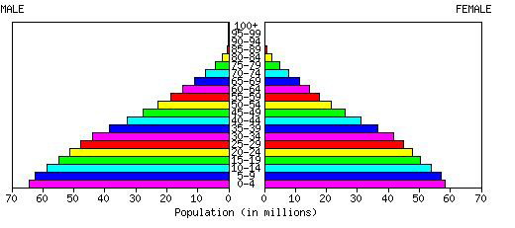
In Developing Countries the Young Population Have Greatest Potential for Population Growth.
Population in millions
Source: U.S. Bureau of the Census.

Slide 39
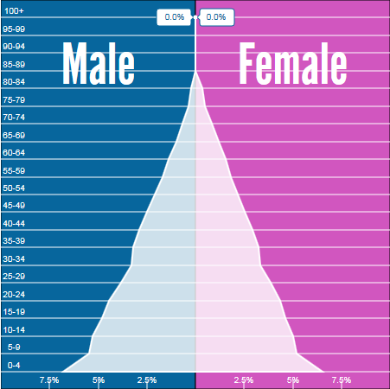
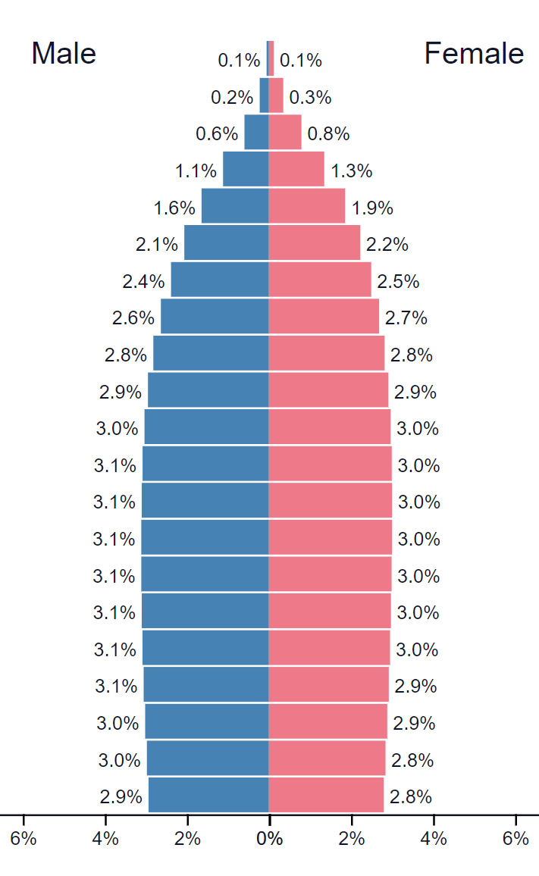
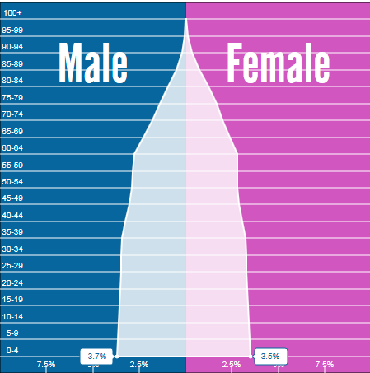
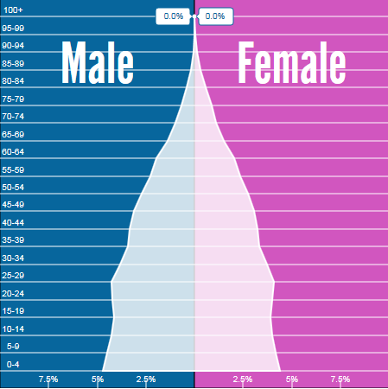
Population Pyramids, World
Population
(millions):
1950 = 2,516
2015 = 7,324
2050 =9,550
2100 = 10,875
World
1950
World
2015
World
2100
Percent change in population:
2015-2050 = 23.8%
2050-2100 = 13.6%
World
2050
https://www.populationpyramid.net/

Slide 40
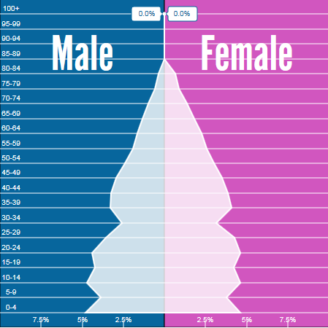
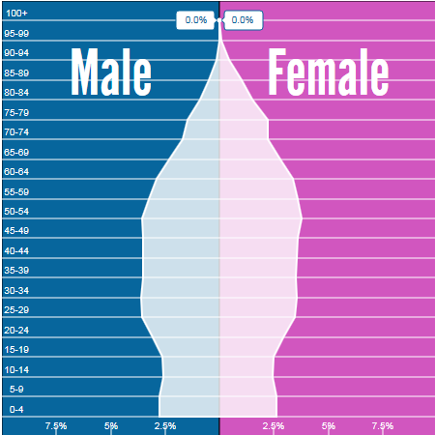
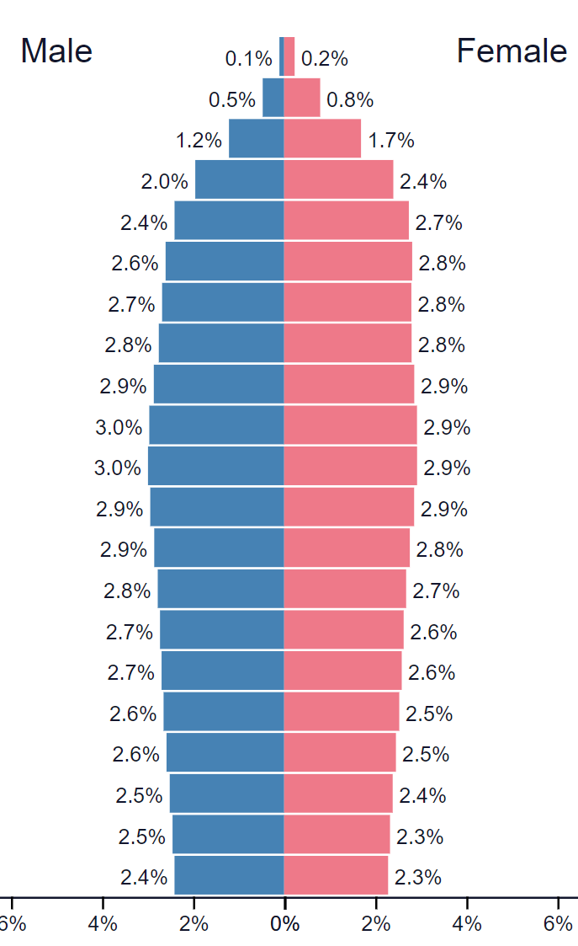
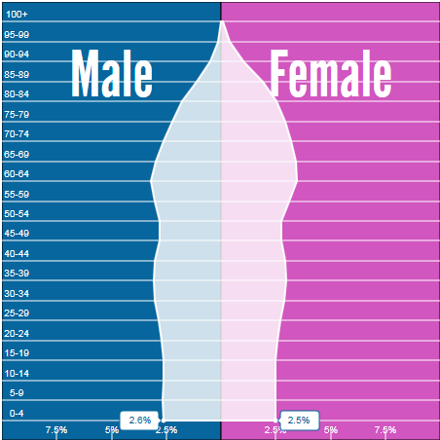
Population Pyramids, Europe
Population
(millions):
1950 = 549
2015 = 743
2050 = 710
2100 = 629
Europe 1950
Europe 2015
Europe
2100
Europe 2050
By 2100 Europe will have declined in population, by about 80 million or 15%.
https://www.populationpyramid.net/

Slide 41
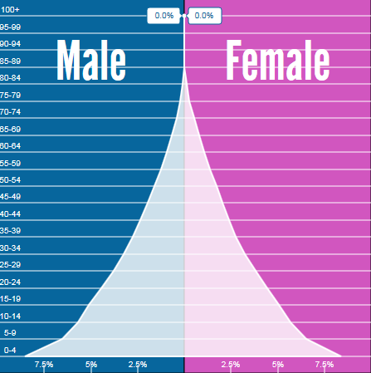
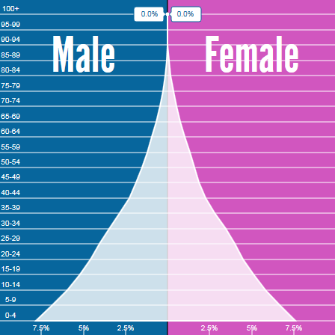
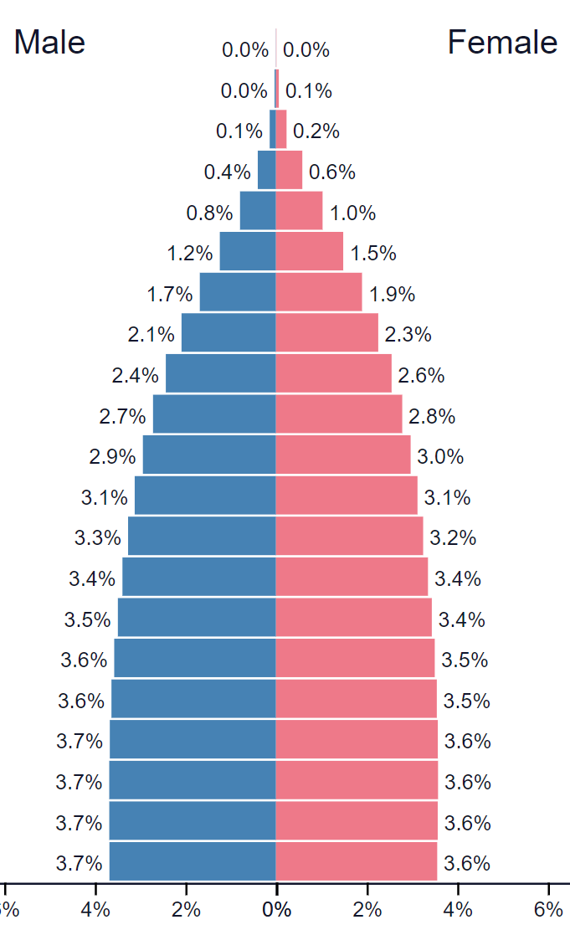
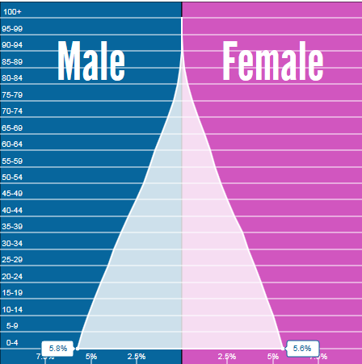
Population Pyramids, Africa
Population
(millions):
1950 = 228
2015 = 1,182
2050 = 2,489
2100 = 4,280
Africa 1950
Africa 2015
Africa
2100
By 2100 Africa will have a stable population, but be about 39% of the global total population.
Africa 2050
https://www.populationpyramid.net/

Slide 42
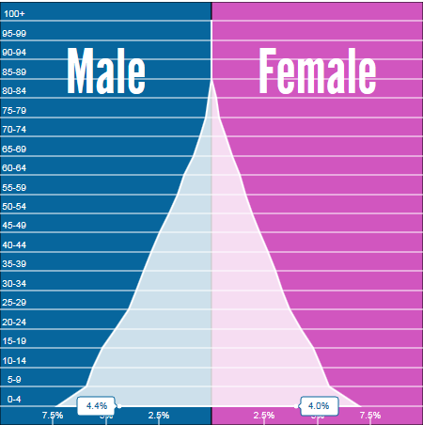
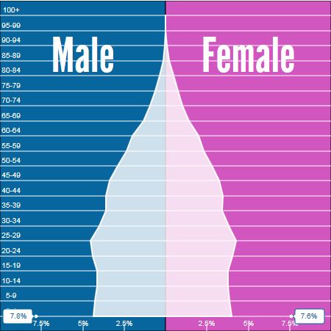
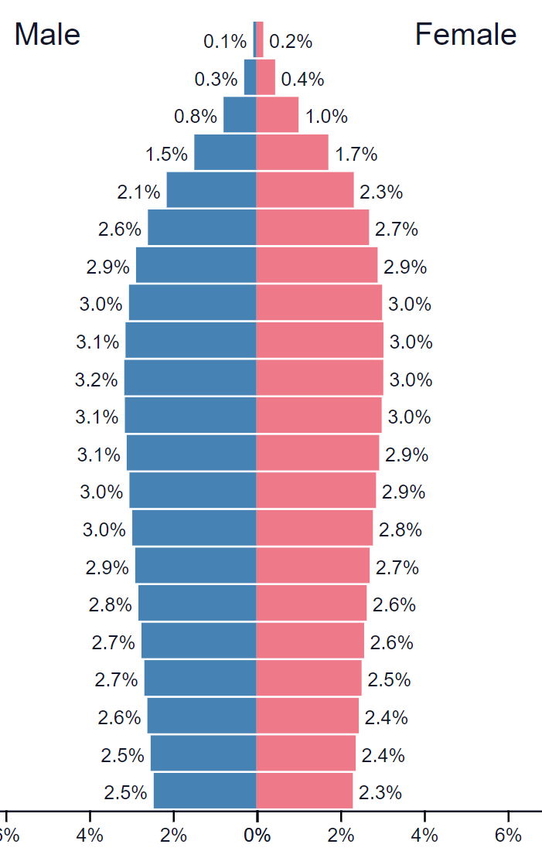
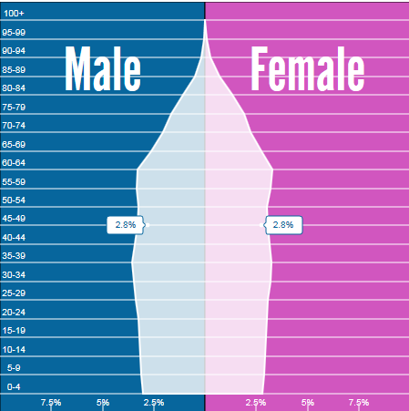
Population Pyramids, Asia
Population
(millions):
1950 = 1,359
2015 = 4,433
2050 = 5,290
2100 = 4,719
Asia 1950
Asia 2015
Asia
2100
By 2100 Asia will have a declining population but will have 42% of global total.
Asia 2050
Asia 2050
https://www.populationpyramid.net/

Slide 43
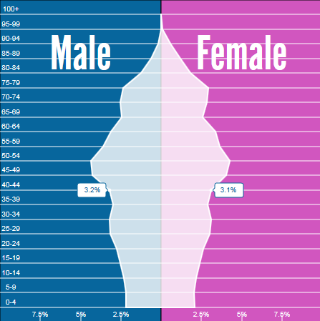
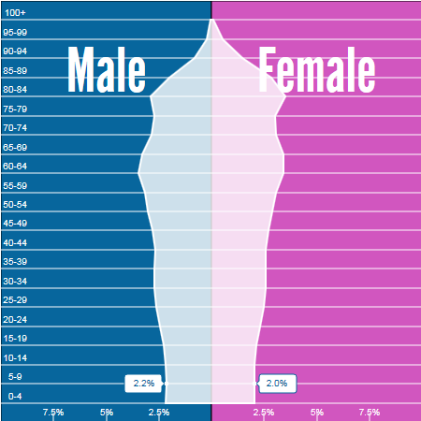
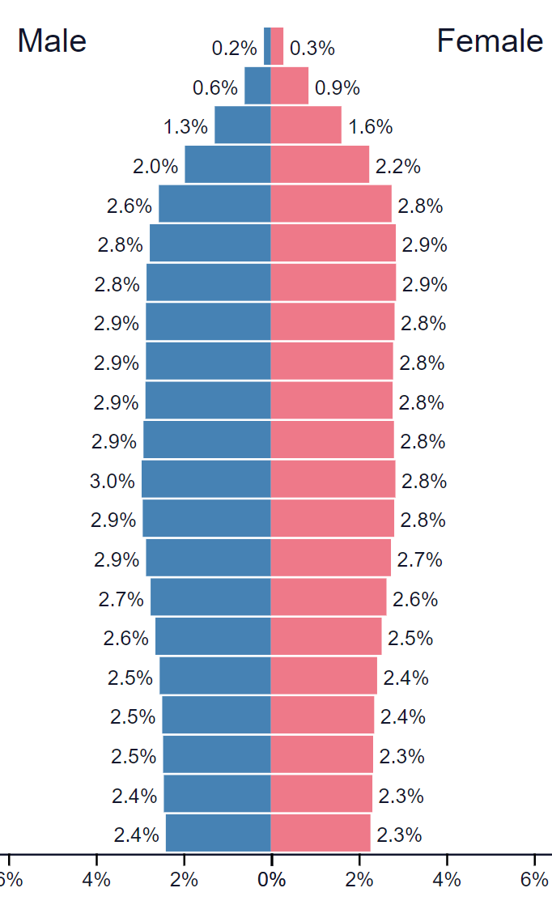
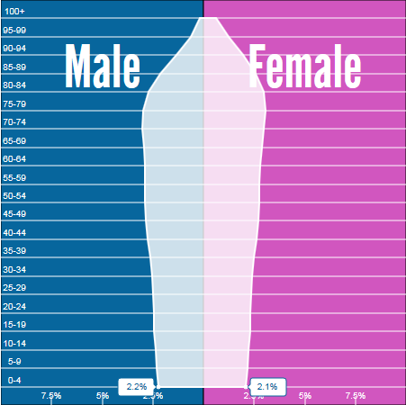
Population Pyramids, Germany
Population
(millions)
1950 = 70
2015 = 82
2050 = 80
2100 = 74
Germany
2015
Germany
2015
2100
Germany
2050
By 2100 Germany’s population will have declined almost to its post WW2 levels.
https://www.populationpyramid.net/

Slide 44
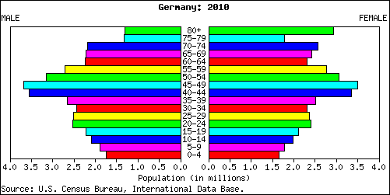
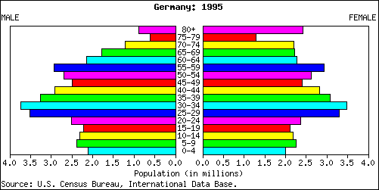
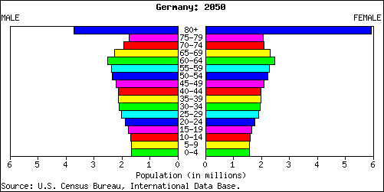
If current fertility and immigration rates continue to 2050, Germany's population will also age dramatically.
With few young people to support the aging population, by 2050 the tax base will erode and social services decline.
Population millions

Slide 45
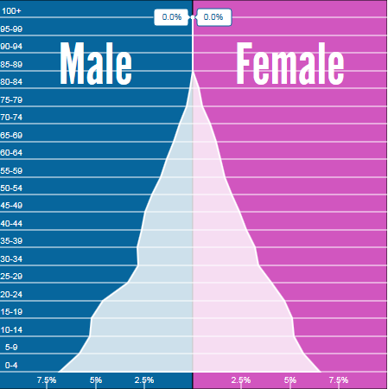
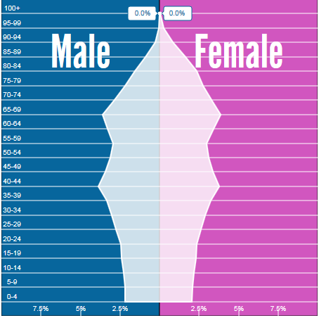
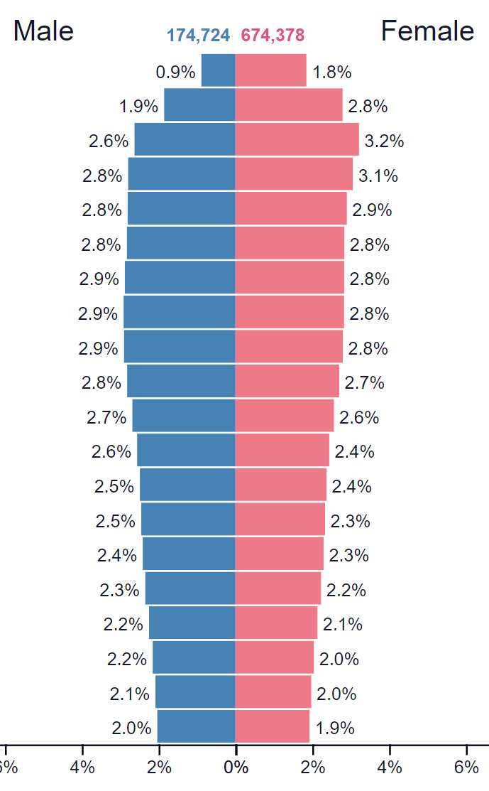
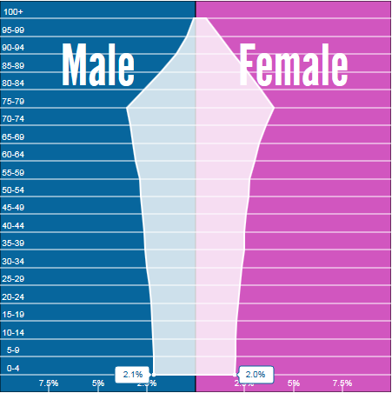
Population in Percent Share, Japan
☺
Population
(millions):
1950 = 82
2015 = 128
2050 = 106
2100 = 75
Japan1950
Japan
2015
2100
Japan
2050
By 2100 Japan will have about 10% less population that it had in 1950, and it will be old.
https://www.populationpyramid.net/

Slide 46
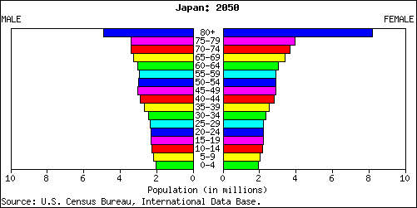
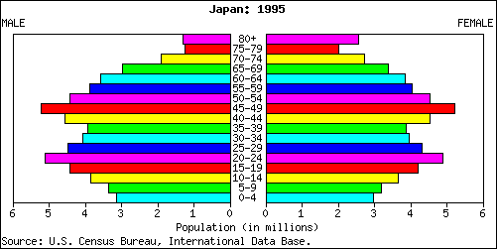
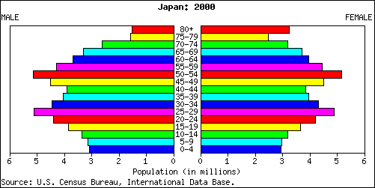





Japan: Population Pyramids, 1990 to 2050
Declining population + increasing number of elderly + highly restrictive immigration policies = pending economic disaster.
Population 2013 = 127.1 million.
Dependents
Support group

Slide 47




Population in Percent Share, Canada
☺
Population
(millions):
1950 = 14
2015 = 36
2050 = 46
2100 = 57
Canada
1950
Canada
2015
2100
Canada
2050
Canada’s population will continue to grow steadily – but from migration not natural increase.
https://www.populationpyramid.net/

Slide 48




Population in Percent Share, China
Population
(millions)
1950 = 544
2015 = 1,407
2050 = 1,402
2100 = 1, 065
China
1950
China
2015
2100
China
2050
China’s population will continue to decline steadily but by 2100 will still constitute almost 10% of the world’s people.
https://www.populationpyramid.net/

Slide 49
Aging In China: Percent Over 65 Years Old
From about 2005, the 65+ proportion of the population has been growing rapidly, and is predominantly male.
Notes:
Source: http://esa.un.org/unpp/index.asp?panel=2
Due to vast improvements in health over the past five decades, life expectancy at birth has increased by two-thirds from 40.8 to 71.5 years between 1955 and 2005.
The percent of elderly in China is projected to triple from 8 percent to 24 percent between 2006 and 2050.
Because chronic health problems become more common in old age, China’s population aging has led to increases in the country’s prevalence of chronic disease and disability.

Slide 50
Notes:
Source: http://esa.un.org/unpp/index.asp?panel=2
The figure above depicts what demographers refer to as the feminization of aging. Although women make up half of world population, by the end of the next quarter century, they will account for more than half (54 percent) of people ages 60 and older, and 63 percent of very old people (80 and older).

Slide 51
Population Ages 65 and Older
Percent
3.6%
6.4%
0.9%
4.2%
4.8%
World is getting old (red columns).
But some regions getting older quicker.
Notes:
Source: http://esa.un.org/unpp/index.asp?panel=2
By 2025, over 20 percent of the population in more developed regions will be ages 65 and older.
By 2025, one-tenth of the world’s population will be over age 65.
Asia will see the proportion of its elderly population almost double, from about 6 percent in 2000 to 10 percent in 2025. In absolute terms, this represents a stark increase in just 25 years: from about 216 million to about 480 million older people.

Slide 52

An Aging Gender Bound World…
☺
High Income
World
Low Income
In 1970, the world began to get older. The median age then was about 21 years. In 2020 it was almost 31. By 2050 it will be almost 40, and some of the consequences will be fewer workers, more dependents, increased health costs, changing demand habits, changing political views.
https://population.un.org/wpp/DataQuery/

Slide 53
Comprised of Aging Gender Bound Regions
Europe
Asia
North America
Africa
Different regions, same story.
https://population.un.org/wpp/DataQuery/

Slide 54

Global Median Ages
https://www.pri.org/stories/2014-09-08/these-maps-show-where-world-s-youngest-and-oldest-people-live

Slide 55

Germany
https://www.pri.org/stories/2014-09-08/these-maps-show-where-world-s-youngest-and-oldest-people-live

Slide 56

Uganda
Malawi
Zambia
https://www.pri.org/stories/2014-09-08/these-maps-show-where-world-s-youngest-and-oldest-people-live

Slide 57

https://www.pri.org/stories/2014-09-08/these-maps-show-where-world-s-youngest-and-oldest-people-live

Slide 58

https://www.pri.org/stories/2014-09-08/these-maps-show-where-world-s-youngest-and-oldest-people-live

Slide 59

https://www.pri.org/stories/2014-09-08/these-maps-show-where-world-s-youngest-and-oldest-people-live

Slide 60

https://www.pri.org/stories/2014-09-08/these-maps-show-where-world-s-youngest-and-oldest-people-live

Slide 61


Slide 62
Median Age Hall of Fame?
 | 2020 | 2100
Youngest | Niger 15.2 | Angola 29.5
Oldest | Japan 48.4 Italy 47.3 Portugal 46.2 | Albania 61.5 South Korea 54.6 Japan 53.8
World | 30.9 | 41.9
https://population.un.org/wpp/DataQuery/

Slide 63


Canada Population Pyramids 1921 and 2011

Slide 64
The Silver Economy
That all parts of the world are aging is recorded fact, but for developed economies it has led to what is being termed “The Silver Economy”.¹
There are currently about 1 billion people 60+ years of age in the world, by 2050 there will be about 2 billion, and by 2100 about 3 billion; those numbers amount to 12.5%. 20.0%, and 27.3% of the respective global populations of those same years.
Seventy-six percent of the 60+ group belong to the global consumer class (defined as those who spend more than $11/day), and while they may not spend as much on consumer goods because they generally have all they need, by 2030 it’s estimated that they will be spending about $15 trillion.
And most of it will be on health care.
1: https://www.brookings.edu/blog/future-development/2021/01/14/the-silver-economy-is-coming-of-age-a-look-at-the-growing-spending-power-of-seniors/?utm_campaign=Brookings%20Brief&utm_medium=email&utm_content=106762349&utm_source=hs_email

Slide 65

And what happens to the (not so) old folks?
Boomers have largest pension fund reservoir in history, estimated in 2017 at $36.4 trillion or 62% of their nation’s aggregate GDP,¹, but…
… the value was about 28% higher before the 2008 crash and the very low interest rates of the “recovery’s” monetary policy have since crippled its ability to recover.
Canada has $1.575 trillion - @102.8% of GDP.
¹ For Australia, Brazil, Canada, Chile, China, Finland, France, Germany, Hong Kong, India, Ireland, Italy, Japan, Malaysia, Mexico, Netherlands, South Africa, South Korea, Spain, Switzerland, U.K., U.S.
Source: https://www.willistowerswatson.com/-/media/.../global-pensions-asset-study-2017.pdf

Slide 66

Six of the 22 countries in the survey have pension assets greater than their respective country's GDP.
https://www.willistowerswatson.com/-/media/.../global-pensions-asset-study-2017.pdf

Slide 67

Pension Asset Value and GDP 2006 to 2016
Pension assets had recovered their 2007 levels by 2010.
Losses from 2008 financial crisis amounted to about US$8 trillion, or about 28% of their 2007 valuation.
28% loss
https://www.willistowerswatson.com/-/media/.../global-pensions-asset-study-2017.pdf

Slide 68
The Demographic Dividend
☺
The advantage gained from having a young population.
When a country has a large reservoir of young, it can achieve what is called the demographic dividend.
This is the potential economic growth that may result from having a large number of young who move into the 15 to 64 year old cohorts – or into the support group on a population pyramid.
But the dividend only occurs if a decline in a nation’s birth and death rates – especially those of infants and children – also occurs.

Slide 69
The Demographic Dividend
☺
Dividend requires that the TFR decreases significantly, leading to fewer births and thus a decline in the ratio of the young to the support cohorts of the economy.
Even then, the right social and economic policies must be developed and the right investments made:
Investment in child survival and health programs.
Commitment to voluntary family planning.
Investment in the reproductive health and education for youth.
Prioritize education, especially for women.
Prioritize income earning, especially for women.
The following hidden slides give an example of the poster nation for successful demographic dividend, South Korea, and an overview of global regional demographic dividend situations.

Slide 70
The Demographic Dividend – South Korea
South Korea made a rapid transition from high to low fertility, while at the same time experiencing an annual growth in per capita gross domestic product of 6.7 percent between 1960 and 1990.
South Korea's success was the result of addressing population issues, while also investing in reproductive health programs, education, and economic policies to create infrastructure and manufacturing.
The following population pyramids illustrate how quickly the fertility transition in South Korea took place.

Slide 71



Population in Percent Share, S. Korea
Korea’s population declined rapidly after the Korean war and the nation realized its demographic dividend.
Population (millions)
1950 = 19
1980 = 40
2015 = 50
S. Korea
1950
TFR = 5.4
S. Korea
1980
TFR = 2.9
But now Korea faces the same population declines as most western countries due to its low TFR and migration. Its migrant stock proportion is only 2.6%
S. Korea
2015
TFR = 1.2
Source: http://populationpyramid.net

Slide 72
Global Demographic Dividends: The Record
China has done quite well controlling its population, though through draconian birth control policies, and in freeing its economy, but it now faces the same anti-trade/globalisation forces affecting he rest of the world.
Western nations face the opposite dilemma – rapidly aging and declining populations and the consequent dependency issues – and the same backlash against migration, trade, and globalisation forces.
Most Latin and South America nations have not leveraged their demographic dividends well, generally through their inability to control the fiscal structure of their economies – and through political mismanagement and corruption.

Slide 73
Global Demographic Dividends: The Record
The Middle East as a whole does not have much of a demographic dividend to leverage. Some countries in the region have young populations, but many have very lopsided male heavy pyramids. As a region, it has also been unable to leverage its oil wealth into a diversified economy due to gross inequalities in wealth distribution, political power and social (especially gender) development that is crippled by religious orthodoxy.
Sub Saharan African nations appear powerless to realize their enormous demographic dividend potential, for the most part due to political and economic corruption and mismanagement, in part due to western corporate exploitation of resources and the foreign policy objectives of western nations, China and Russia. But if they can, they may become the powerhouse nations of this century.

Slide 74
Global Demographic Dividends: The Record
India is realizing its DD for several areas within the country such as Kerala and the Punjab, but for others such as Orissa and Bihar it is not.
Other Asian countries such as Indonesia and the Philippines are realizing their demographic dividend potential, but it has been slow and now may be stalled due to the aftermath of the Asian Meltdown in 1997 followed less than a decade later by the 2008 crisis. As well, the current anti-trade/anti-globalisation fervor threatens to stifle recovery.

Slide 75
Dependency

Slide 76
Dependency Ratios
Dependency ratios refer to the number of workers in a population to the number of dependents.
Inverse dependency ratios refer to the number of a support group in a population to the number of dependents.
Estimates the degree of tax burden on the economy or the cost of supporting children and the elderly.
The young dependent group are seen as an economic asset because they will eventually become members of the support group.
The elderly dependent group are seen as an economic liability because they have left the support group and require increasing levels of expensive care.

Slide 77
Dependency Ratios
☺
Dependency ratios refer to the number of workers in a population to the number of dependents.
It is the ratio of the 15 to 64 age cohort to the 0 to 14 and 65+ age cohorts.
Estimates the degree of tax burden on the economy or the cost of supporting children and the elderly.
Total Dependency Ratio = Number of people 0-14 + 65+
Number of people 15-64
The total dependency ratio can also be broken down into an elderly component and a child component, and can be calculated using proportions:

Slide 78
Dependency Ratios
☺
Total Dependency Ratio = (Number of people 0-14 + 65>)
Number of people 15-64
For example – Canada, dependency ratio
Pop 65+ = 4,945,000 (14.8%)
Pop <=14 = 5,607,345 (16.7%)
Pop 15-64 = 23,930,434 (68.5%)
Calculated:
By Proportion: (16.7%+14.8%)/68.5% = 0.46
By Population: (4,945,000+5,607,345)/23,930,434 = 0.44
Low dependency ratios mean a low level of dependence, so low numbers are good.
Notes:
http://www12.statcan.gc.ca/census-recensement/2011/as-sa/98-311-x/98-311-x2011001-eng.cfm#a2
Highlights
The number of seniors aged 65 and over increased 14.1% between 2006 and 2011 to nearly 5 million. This rate of growth was higher than that of children aged 14 and under (0.5%) and people aged 15 to 64 (5.7%).
Seniors accounted for a record high of 14.8% of the population in Canada in 2011, up from 13.7% five years earlier.
In 2011, the proportion of seniors in Canada was among the lowest of the G8 countries.
The population of children aged 4 and under increased 11.0% between 2006 and 2011. This was the highest growth rate for this age group since the 1956 to 1961 period during the baby boom.
In 2011, there were 5,825 centenarians in Canada, up 25.7% since 2006. This was the second most rapidly growing age group among all age groups after those aged 60 to 64.
In 2011, the working-age population (those aged 15 to 64) represented 68.5% of the Canadian population. This proportion was higher than in any other G8 country, except Russia.
Among the working-age population, 42.4% were in the age group 45 to 64, a record high proportion. Almost all people aged 45 to 64 in 2011 were baby boomers.
In 2011, census data showed for the first time that there were more people aged 55 to 64, typically the age group where people leave the labour force, than aged 15 to 24, typically the age group where people enter it.
In 2011, the proportion of seniors was the highest in the Atlantic provinces, Quebec and British Columbia.
For the first time in 50 years, the number of children aged 4 and under increased between 2006 and 2011 in all provinces and territories.

Slide 79
Inverse Dependency Ratios
☺
Inverse dependency ratios tell you how many support people (or workers) you have for every dependent.
Using the Canadian population ratio calculated in the last slide:
(4,945,000+5,607,345)/23,930,434 = 0.44
We take the inverse of the ratio:
1/0.44 = 2.27
which tells us that there are 2.27 support people for every dependent.
High inverse dependency ratios mean a high level of support so high numbers are good.
Notes:
http://www12.statcan.gc.ca/census-recensement/2011/as-sa/98-311-x/98-311-x2011001-eng.cfm#a2
Highlights
The number of seniors aged 65 and over increased 14.1% between 2006 and 2011 to nearly 5 million. This rate of growth was higher than that of children aged 14 and under (0.5%) and people aged 15 to 64 (5.7%).
Seniors accounted for a record high of 14.8% of the population in Canada in 2011, up from 13.7% five years earlier.
In 2011, the proportion of seniors in Canada was among the lowest of the G8 countries.
The population of children aged 4 and under increased 11.0% between 2006 and 2011. This was the highest growth rate for this age group since the 1956 to 1961 period during the baby boom.
In 2011, there were 5,825 centenarians in Canada, up 25.7% since 2006. This was the second most rapidly growing age group among all age groups after those aged 60 to 64.
In 2011, the working-age population (those aged 15 to 64) represented 68.5% of the Canadian population. This proportion was higher than in any other G8 country, except Russia.
Among the working-age population, 42.4% were in the age group 45 to 64, a record high proportion. Almost all people aged 45 to 64 in 2011 were baby boomers.
In 2011, census data showed for the first time that there were more people aged 55 to 64, typically the age group where people leave the labour force, than aged 15 to 24, typically the age group where people enter it.
In 2011, the proportion of seniors was the highest in the Atlantic provinces, Quebec and British Columbia.
For the first time in 50 years, the number of children aged 4 and under increased between 2006 and 2011 in all provinces and territories.

Slide 80
Interpreting Dependency Ratios
☺
Dependency ratios are about the number of dependents.
Inverse dependency ratios are about the amount of support.
Effects on an Economy
 | High | Low
Dependency Ratio | Not good (Too many dependents, not enough workers) | Good (Not too many dependents for the number of workers)
Inverse Dependency Ratio | Good (Enough workers to support the dependents) | Not good (Not enough workers to support the dependents)
Notes:
http://www12.statcan.gc.ca/census-recensement/2011/as-sa/98-311-x/98-311-x2011001-eng.cfm#a2
Highlights
The number of seniors aged 65 and over increased 14.1% between 2006 and 2011 to nearly 5 million. This rate of growth was higher than that of children aged 14 and under (0.5%) and people aged 15 to 64 (5.7%).
Seniors accounted for a record high of 14.8% of the population in Canada in 2011, up from 13.7% five years earlier.
In 2011, the proportion of seniors in Canada was among the lowest of the G8 countries.
The population of children aged 4 and under increased 11.0% between 2006 and 2011. This was the highest growth rate for this age group since the 1956 to 1961 period during the baby boom.
In 2011, there were 5,825 centenarians in Canada, up 25.7% since 2006. This was the second most rapidly growing age group among all age groups after those aged 60 to 64.
In 2011, the working-age population (those aged 15 to 64) represented 68.5% of the Canadian population. This proportion was higher than in any other G8 country, except Russia.
Among the working-age population, 42.4% were in the age group 45 to 64, a record high proportion. Almost all people aged 45 to 64 in 2011 were baby boomers.
In 2011, census data showed for the first time that there were more people aged 55 to 64, typically the age group where people leave the labour force, than aged 15 to 24, typically the age group where people enter it.
In 2011, the proportion of seniors was the highest in the Atlantic provinces, Quebec and British Columbia.
For the first time in 50 years, the number of children aged 4 and under increased between 2006 and 2011 in all provinces and territories.

Slide 81
Interpreting Dependency Ratios - Children versus Elderly
☺
Developed nations are weighted heavily towards the elderly (old nations = old people.)
Developing nations are weighted heavily towards children (young nations = young people).
Effects on an Economy
 | High contribution to ratio | Low contribution to ratio
Elderly cohort component (economic liability) | Not good (Too many elderly requiring support without future benefit.) | Good (Few elderly requiring support.)
Children cohort component (economic asset) | Better (Children require support but will eventually become workers.) | Not good (Children require support and not enough of them to become workers.)
Notes:
http://www12.statcan.gc.ca/census-recensement/2011/as-sa/98-311-x/98-311-x2011001-eng.cfm#a2
Highlights
The number of seniors aged 65 and over increased 14.1% between 2006 and 2011 to nearly 5 million. This rate of growth was higher than that of children aged 14 and under (0.5%) and people aged 15 to 64 (5.7%).
Seniors accounted for a record high of 14.8% of the population in Canada in 2011, up from 13.7% five years earlier.
In 2011, the proportion of seniors in Canada was among the lowest of the G8 countries.
The population of children aged 4 and under increased 11.0% between 2006 and 2011. This was the highest growth rate for this age group since the 1956 to 1961 period during the baby boom.
In 2011, there were 5,825 centenarians in Canada, up 25.7% since 2006. This was the second most rapidly growing age group among all age groups after those aged 60 to 64.
In 2011, the working-age population (those aged 15 to 64) represented 68.5% of the Canadian population. This proportion was higher than in any other G8 country, except Russia.
Among the working-age population, 42.4% were in the age group 45 to 64, a record high proportion. Almost all people aged 45 to 64 in 2011 were baby boomers.
In 2011, census data showed for the first time that there were more people aged 55 to 64, typically the age group where people leave the labour force, than aged 15 to 24, typically the age group where people enter it.
In 2011, the proportion of seniors was the highest in the Atlantic provinces, Quebec and British Columbia.
For the first time in 50 years, the number of children aged 4 and under increased between 2006 and 2011 in all provinces and territories.

Slide 82

Growth in Canada’s Dependent Groups
The dependency ratio has decreased since 1921 but the proportion of elderly has increased substantially.
1921
Proportion of dependents = 39.2%
Dependency ratio (1/x) = 0.65 (1.6)
Proportion of elderly dependents of all dependents = 12.2%
2011
Proportion of dependents = 31.5%
Dependency ratio (1/x) = 0.46 (2.2)
Proportion of elderly dependents of all dependents = 46.8%

Slide 83

☺
Regional Proportions of Dependent Age Cohorts, World Population 2014
Developed countries have over 4 times the proportion of elderly while African countries have over twice as many young.
45%
34%
34%
32%
35%
33%
33%
Under 15 years
Over 64 years

Slide 84
Age Cohorts, Canada 2012

Slide 85
All income regions have experienced growth in the proportion of elderly since 1960, especially high income areas, increasing dependency concerns.
High Income Nations
World
Middle Income Nations
Low Income Nations
World Bank staff estimates based on age/sex distributions of United Nations Population Division's World Population Prospects.

Slide 86
Low Income Nations
Middle Income Nations
World
High Income Nations
All income regions have experienced decline in the proportion of young since 1960, especially high income areas, increasing dependency concerns.
World Bank staff estimates based on age/sex distributions of United Nations Population Division's World Population Prospects.

Slide 87

Dependency Rates, Selected Nations, 2005 and 2050
☺
As these nations age, ratios increase dramatically. Japan has an especially difficult time ahead due to its highly restrictive immigration policy.

Slide 88
Survivorship
Staying Alive in the 21st Century

Slide 89

Staying Alive
Its one thing to control births and deaths but quite another to stay alive in between.
How good that life might be is also worth exploring, so we will look at a few life variables such as survivorship, life expectancy and aging.
Survivorship is very amusing – it looks at your chances of reaching your next birthday.
Yours are better than mine:
Male 20 year old cohort = 99.939%
Female 20 year old cohort = 99.978%
Me = 98.99

Slide 90
Survivorship Curves
Survivorship is a demographic technique that computes the probability that a given age cohort will live until their next birthday.
Basically, it tracks the fate of a given age cohort – newborns, 10 year olds, 81 year olds, etc.
They are fundamental to actuarial science and to population projection models for all species.
Survivorship curves plot the overall survival profile for a population
The basic curves are thus:

Slide 91
Human Survivorship Curves
☺
Percentage of population surviving
High survivorship
Rapid die off in older years
More developed countries
Steady survivorship
Constant die off across all years
Developing countries
Shift in curves as development occurs
Low survivorship
Rapid die off in younger years
Least developed countries
Age of population

Slide 92

Survivorship Curves, India, Niger, U.K. (1999), 17th Century England
U.K. 1999
India
Niger
17th Century England

Slide 93
Canadian Female and Male Survivorship Curves 1831 and 2011
In 1831 the probability of surviving your first 5 years of life were as low as those of surviving your 55th to 60th year of life.
Female survivorship rates are higher than those of males.
Overall, survivorship rates have increased over the period, but moreso for females.
Source: Calculated from Statistics Canada.

Slide 94
After your 1st birthday, survivorship gradually increases until after your 10th birthday when it starts to decline – but by very tiny amounts.
Probability of surviving your:
1st year = M99.489%, F99.560%
(then almost half a percent decrease in chance of dying)
2nd year = M99.970%, F99.983%
9th year = M99.992%, F99.993%
10th year = 99.991%, F99.992%
http://www.statcan.gc.ca/pub/84-537-x/2013005/tbl/tbl7a-eng.htm

Slide 95
Canadian Female and Male Survivorship Curves
0-1 Age Cohort 1831 to 2011
These are infant mortality rates.
Survival rates of infants have improved by almost 20 percentage points over the period, and males have closed the gap with females.
Source: Calculated from Statistics Canada.

Slide 96
Canadian Female and Male Survivorship Curves
85-90 Age Cohort 1831 to 2011
Survival rates of the elderly have improved by almost 45 percentage points over the period, but the gap between males and females has grown.
Source: Calculated from Statistics Canada.

Slide 97

After your 60th birthday, things get interesting, with the male-female gap widening considerably, reaching over 3% at 93 years of age, then narrowing again.

Slide 99

Global Life Expectancy has increased 1.4 times since 1960, or increased by 38%, or by about 20 years, or by about 4 months per year.
This is a profound change in less than 60 years.
2018:
72.6
1960:
52.6
https://data.worldbank.org/indicator/SP.DYN.LE00.IN?view=chart

Slide 100
Life Expectancy 2018
Highest Life Expectancy (Years) |  | Lowest Life Expectancy (Years)
San Marino | 85 | Central African Republic | 53
Hong Kong | 85 | Lesotho | 54
Japan | 84 | Chad | 54
Macao | 84 | Sierra Leone | 54
Switzerland | 84 | Nigeria | 54
Italy | 83 | Somalia | 57
Singapore | 83 | Cote d’Ivoire | 57
Liechtenstein | 83 | South Sudan | 58
Channel Islands | 83 | Guinea Bissau | 58
Iceland | 83 | Equatorial Guinea | 58
Israel | 83 | Mali | 59
Norway | 83 | Cameroon | 59
Average | 83 | Average | 56
https://data.worldbank.org/indicator/SP.DYN.LE00.IN?most_recent_value_desc=false&view=chart
On average, people in the most developed nations live 1.5 times as long as people in the least developed countries.
Notes:
Source: https://www.cia.gov/library/publications/the-world-factbook/rankorder/2102rank.html

Slide 101
What’s Hidden in Life Expectancy Values
Like many things in demographics, much is hidden and much is subtle, including life expectancy and its relationship to:
GDP
Health
ethnicity
voting patterns
political persuasion
And especially the regionality of all these.
And then there is life (un)expectancy!

Slide 102

Unexpected Life Expectancy Reversals
Life expectancy has decreased in several EU countries and the U.S., but continues to increase in most other OECD countries, including Japan, Canada and Australia.¹
However, increases have been slowing in all developed countries.
https://www.economist.com/united-states/2018/01/04/life-expectancy-in-america-has-declined-for-two-years-in-a-row
1: https://data.oecd.org/healthstat/life-expectancy-at-birth.htm#indicator-chart

Slide 103

Life Expectancy Unexpectedly Slows
Increases in life expectancy slowed by about a half in the 2010 to 2016 period compared to the 2004 to 2010 period, for most developed countries.¹ In some countries life expectancies have decreased (see next slide).
Reasons include a mix of:
Increasingly difficult to treat top killers (cancer and heart disease).
Populations getting older and there’s no cure for death by old age.
Social services nets for poor and elderly being eroded by income inequality.
Opioid epidemics, especially in the U.S., killing younger cohorts with disproportionate effect on LE.
https://www.bbc.com/news/health-45096074
1: https://data.oecd.org/healthstat/life-expectancy-at-birth.htm#indicator-chart

Slide 104


Unexpected Life (Un)Expectation
Life expectancy decreases in the United States are to a significant extent attributed to opioid use, including prescription painkillers.¹
But erosion of social services, and income inequality also play a role.²
https://www.cdc.gov/nchs/products/databriefs/db294.htm
Life expectancy arithmetic is affected by which age cohorts have increased death rates, and with the opioid crisis it is younger age cohorts and this influences expectations downwards.
1: https://www.poison.org/articles/opioid-epidemic-history-and-prescribing-patterns-182
2: https://www.equalitytrust.org.uk/
https://www.cdc.gov/nchs/products/databriefs/db294.htm

Slide 105

Dying Healthy and Living Sick
“There’s dead and then there’s mostly dead.” Miracle Max, The Princess Bride
Life expectancy begs the question “what kind of life?”
Health Adjusted Life Expectancy (HALE) is defined as the number of years a new born can expect to live in full health after accounting for disease and/or injury.
Thus it measures the quality of your life expectancy which is always shorter than the quantity of your life expectancy.
This chart shows HALE for OECD countries.
https://www.oecd.org/els/family/CO_1_2_Life_expectancy_at_birth.pdf
Notes:
Life expectancy at birth, defined as the average number of years a new-born child would live if prevailing patterns of mortality at the time of its birth were to stay the same throughout their life.
• Health-adjusted life expectancy (HALE) at birth, defined as the average number of years that a new-born child can expect to live in "full health" after taking into account years expected to be lived in less than full health due to disease and/or injury.
• Healthy life years (HLY) at birth, a measure used across the EU and defined as the average number of years that a new-born child can expect to live in a healthy condition and free from disability (also called disability-free life expectancy).

Slide 106

Living Healthy and Living Sick
“But I’m not dead yet!” ”Yes you are.” “No I’m not!” “Well, you soon will be.”
Monty Python and the Holy Grail
Healthy Life Years (HLY) is an EU measure and is the number of years a new born can expect to live in a healthy condition free from disability.
This span of your HLY is even smaller than HALE depending on the country in question.
https://www.oecd.org/els/family/CO_1_2_Life_expectancy_at_birth.pdf
Notes:
Life expectancy at birth, defined as the average number of years a new-born child would live if prevailing patterns of mortality at the time of its birth were to stay the same throughout their life.
• Health-adjusted life expectancy (HALE) at birth, defined as the average number of years that a new-born child can expect to live in "full health" after taking into account years expected to be lived in less than full health due to disease and/or injury.
• Healthy life years (HLY) at birth, a measure used across the EU and defined as the average number of years that a new-born child can expect to live in a healthy condition and free from disability (also called disability-free life expectancy).

Slide 107



What‘s Hidden in Life Expectancy: OECD Comparisons
U.S. versus OECD Average
Of the principal U.S. ethnic groups, Hispanics have the longest life expectancies – but even here they are shorter than the OECD average.
https://www.healthsystemtracker.org/chart-collection/u-s-life-expectancy-compare-countries/#item-le_the-u-s-has-seen-slower-growth-in-life-expectancy-than-comparable-countries_2019

Slide 108



What‘s Hidden in Life Expectancy: Politics and the Despair Gap
Death rates have increased in almost every U.S. State, and are particularly high in the “fly-over” states who support Trump and the Republicans.
The increases are particularly high in the working-age cohort, largely as a result of “deaths of despair”: drugs, suicides, and alcohol.
https://twitter.com/paulkrugman/status/1200782901996077057. https://www.nytimes.com/2019/12/02/opinion/life-expectancy-united-states.html. https://www.nytimes.com/2019/11/26/health/life-expectancy-rate-usa.html?auth=login-email&login=email.

Slide 109




Source of maps is website hut from this report. Trust for America’s Health and the Robert Wood Johnson Foundation, “The State of Obesity,” stateofobesity.org, 2018
Obesity Rates 1990 to 2017
1990
2000
2010
2017
https://obesity.procon.org/us-obesity-levels-by-state/#us-obesity-maps.Trust for America’s Health and the Robert Wood Johnson Foundation, ”The State of Obesity.” stateofobesity.org

Slide 110
Sobering Comparisons
Males in the east end of Glasgow have a life expectancy of 54 years – 9 years less than a 54 year old man from India.
A 30 year old black male in Harlem has a much greater risk of dying than a 30 year old male Bangladeshi – and not from violence or drugs but from heart disease, cancer, stroke, and diabetes.
Income highly correlates with life expectancy; of two people one rich one poor who eat, exercise, sleep the same the poorer one will die 10-15 years earlier.
A randomly selected US male 45-54 years of age is twice as likely to die from any cause as 45-54 year old Swede.
On virtually any measure of medical well being, the US is at or near the bottom of the list of rich countries despite the fact that it spends 2.5 times more than any other rich nation on health costs.

Slide 111
Fake News and The Correlates of Life Expectancy
The detail hidden at the regional level among the various correlates of reduced life expectancy is startling, but even more startling is the inconsistent diagnosis of the evidence with the arguments of conservative orthodoxy.
Recently, William Barr, no less than the Attorney General of the United States and against all the evidence, attributed the basic reasons for decreased life expectancy – drugs, suicide, violence – with “The secularist assault on traditional values.”
The facts that (1) the reasons are concentrated in States that voted for Trump and are thus not secular, and (2) European nations, which are far more secular than the U.S. have not suffered similarly, are simply ignored.
Worse they are taken at face value by the very people they afflict.
https://www.washingtonpost.com/opinions/welcome-to-the-resistance-bill-barr/2019/10/14/da24cd20-eec0-11e9-8693-f487e46784aa_story.html, and https://www.motherjones.com/politics/2019/10/attorney-general-barr-rages-against-secularist-assault-on-religion/

Slide 112
Global Demography Summary
Population is the foundation on which nations, economies, cultures are built – but too many people can stifle prosperity and well being.
While population (numbers and growth rates) have been decreasing since at least the mid-1980s, population will still top 11 billion by 2100.
Two major characteristics typify the current global population – it is aging and it is gender bound.
The developed world is aging rapidly, losing population, yet resisting immigration, while the developing world still faces high population growth from having a young population.
And for half of it, females, equality and equity are still far away and, with recent populist sentiment taking control, their appears to be no end in sight.

Slide 113
Fertility
Aging
Dependency

Slide 114
Solutions?
To end on a more optimistic note, there are solutions, among them:
Increased immigration.
Universal basic education.
Universal basic income.
Universal medical care.
Equal pay for equal work.
The problem with all of these is that the solutions are not so much economic as they are political, or more specifically politically partisan, and this is especially so if one considers them as solutions on a global scale.
As we move through the rest of the course we will touch upon some of these solutions, to see whether they are pipe dreams or not.

