Slide 1
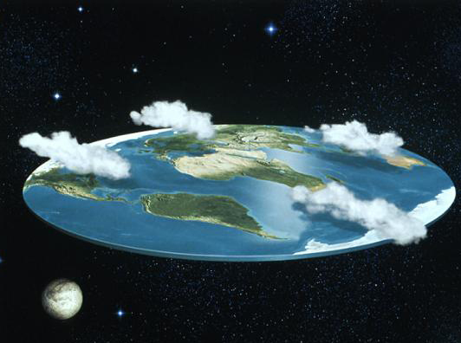
Global
Population
Dynamics
Birds, Bees and Butterflies

Slide 2
Welcome to the first of two lectures on demography
The life and death discipline!

Slide 3
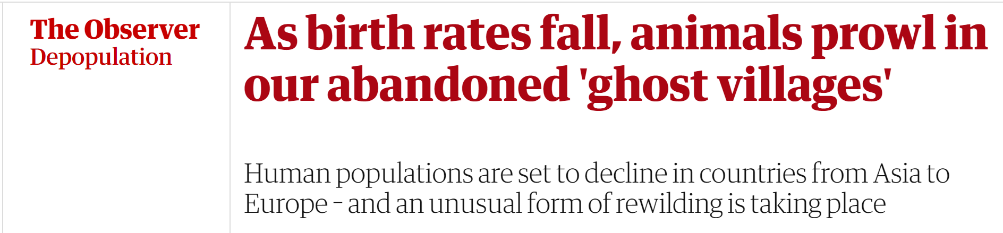
In 1968 two Stanford biologists, Paul and Anne Erhlich predicted a Malthusian end to civilisation as population outstripped food supplies and we faced mass starvation as population numbers ballooned: in the two decades between 1950 to 1970 it had grown by an astonishing 45%.¹
In the next two lectures I am going to tell you a shocking tale that is unfolding right in front of our eyes, and yet very few people outside of the demography community appear to know or care about it.
It is about nothing less than the end of western developed nations.
1: Ehrlich, Paul R. The Population Bomb. New York: Ballantine Books, 1968.
https://www.theguardian.com/world/2021/jan/24/as-birth-rates-fall-animals-prowl-in-our-abandoned-ghost-villages

Slide 4
Population and Demographics
The Erhlichs may be forgiven for having Malthusian thoughts; they certainly weren’t the only ones at that time.¹
Even today most people today think the planet is overpopulated and still on its way to an unsustainable 11 billion people by 2100, including the high estimates by the United Nations (more on this later).
But the facts are quite the opposite; fertility rates are declining precipitously, populations are aging rapidly, and population numbers are coming to a peak far faster than we thought even two decades ago, and at breakneck pace in western developed nations.²
This is not to say that we won’t face some critical issues in the next five decades – the trilemma; they are just not quite what we thought they would be five decades ago.
1: See for examples, Donella H. Meadows [and others]. The Limits To Growth; a Report for the Club of Rome's Project on the Predicament of Mankind. New York :Universe Books, 1972., Toffler, Alvin. Future Shock. New York :Random House, 1970., Mihajlo D. Mesarović, Eduard Pestel. Mankind at the Turning Point. Club of Rome. Hutchinson, 1974.
2: Fertility, mortality, migration, and population scenarios for 195 countries and territories from 2017 to 2100: a forecasting analysis for the Global Burden of Disease Study. The Lancet, VOLUME 396, ISSUE 10258, p1285-1306, October 17, 2020, https://www.thelancet.com/article/s0140-6736(20)30677-2/fulltext#%20.

Slide 5
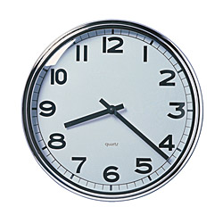
Population and Demographics
The World’s Population Clock
As of today: 7,713,468,100 people on earth
Every minute:
266 born
110 die (among them 11 infants)
146 population increase
 | Developed | Developing
# Born | 26 | 246
# Dying | 23 (0.1) | 85 (10)
Increase | 3 | 162
@ 10X
@ 3.6X (100X)
@ 54X
Notes:
See population Reference Bureau for Population clock.
http://www.prb.org/Articles/2009/worldpopulationclock2009.aspx

Slide 6
Population and Demographics
The World’s Population Clock
As of today: 6,871,496,764 people on earth
Every minute:
264 born
108 die (among them 13 infants)
156 population increase
By the time this lecture ends:
31,920 births
13,200 deaths
17,520 increase
1,320 infant deaths
 | Developed | Developing
# Born | 27 | 237
# Dying | 23 (0.2) | 85 (13)
Increase | 4 | 152
Notes:
Could give all humans on earth a square metre of Puerto Rico and still have 2,000 sq kilometres left over.

Slide 7
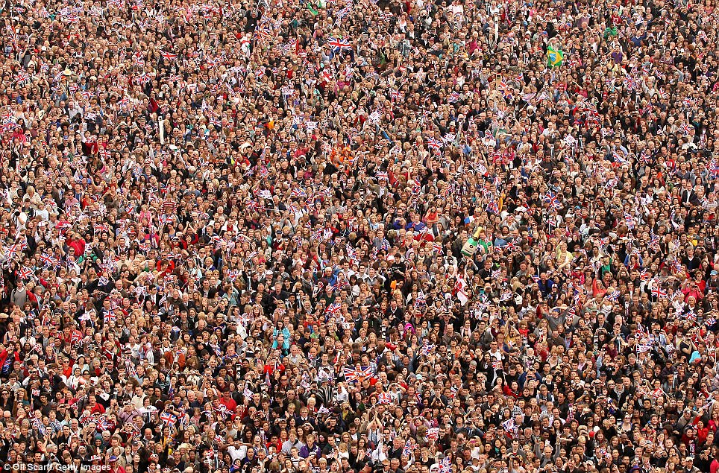
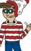

Just for fun, how many people do you think are here?
About 5,760.
I know. A lot less than you thought eh?
And standing shoulder to shoulder we would all fit into the 1,302 square kilometres of Metropolitan Los Angeles.
But people are demand and supply and labour and innovation and…
So from whence did we come?
And whither do we go?
And where’s Waldo?
(yes, he’s here).
http://www.youtube.com/watch?v=sc4HxPxNrZ0
Notes:
National Geographic 7 Billion - @3 mins.

Slide 8
Today’s To Do List
Today we’ll look at
Why are people important?
The concept of human capital.
Where does population come from?
The population model.
Less growth, more people?
Population dynamics, forecasts, doubling times.
Having babies.
The interconnection of fertility rates, gender and age.
Moving people.
Migration, migrant stock, and how to save nations from extinction.

Slide 9
Why Are People Important?
☺
Population is important as:
Economic demand
Human resource asset
Territorial security
Cultural identity
Going to look at changing population size and structure in the world, which principally means exploring demographics such as:
Population growth
(numbers, growth/decline, fertility)
Population structure
(transitions, pyramids, components – B, D, M)
Underlying economic principle is that of human capital.

Slide 10
Human Capital
☺
People are a source of ideas, skill, innovation, demand, supply, entrepreneurship, labour, capital, etc.
But it is their qualitative aspects that comprise most of their value as “capital”: being better parents, more informed voters, more appreciative of arts and culture, more willing and able to care for each other and less willing to go to war.
Nobel Laureate economist Gary Becker¹ says that:
“In a modern economy, human capital is by far the most important form of capital in creating growth” and estimates about 75% of wealth in a modern economy is its human capital.
Problem is that half of all people are considered property.
And half of it is over 30.
This is the aging gender-bound world of population.
1: Cited in Charles Wheelan, Naked Economics, p134.
Notes:
Human capital is an economic principle that sees people as a (the?) fundamental resource because they are the foundation from which economic growth and prosperity comes.
But it about much more than people being just the source of ideas, skill, innovation, demand, supply, entrepreneurship, labour.
It’s what makes us better parents, more informed voters, more appreciative of arts and culture, more able to care for each other and less willing to go to war.
Nobel Laureate economist Gary Becker¹ says that:
“In a modern economy, human capital is by far the most important form of capital in creating growth.”

Slide 11
An Aging Gender Bound World
☺
High Income
World
Low Income
In 1970, the world began to get older.
The median age then was about 21 years of age. In 2020 it was about 31. By 2100 it will be almost 42, and some of the consequences will be:
Fewer workers, more dependents, changing demand habits, changing political views.

Slide 12
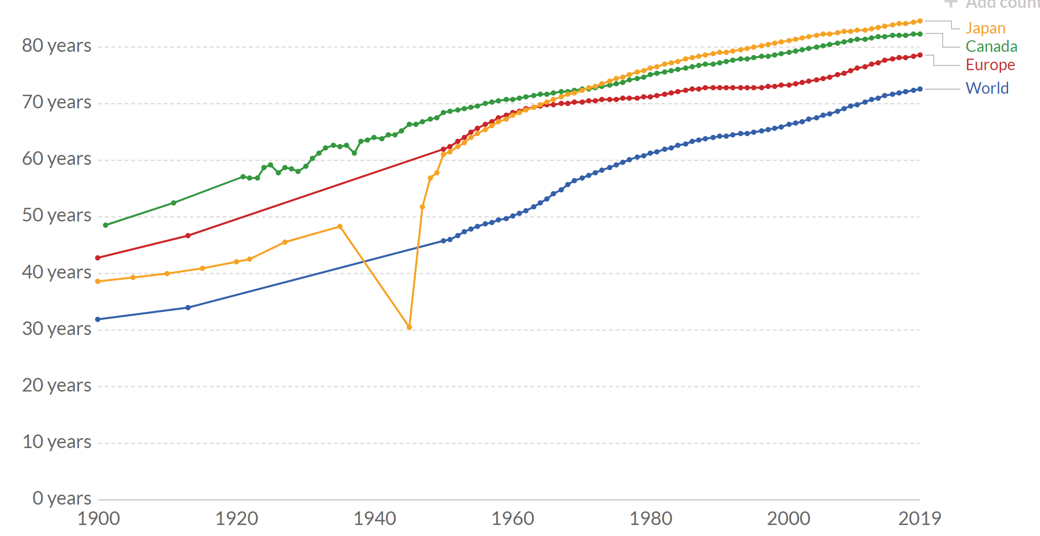

Life Expectancy 1900 to 2019, and Change in Years
Over the past century global life expectancy has increased by about 30 years, and in some countries such as Japan it has more than doubled.
38.6 Japan 84.6 = 46 years
48.6 Canada 82.4 = 33.8 years
42.7 Europe 78.6 = 37.9 years
32.0 World 72.6 = 40.6 years
Aging
https://ourworldindata.org/life-expectancy

Slide 13
The Back-End Loading of Age
The fact that the world has added over 30 years to our life expectancy since 1900 alone is extraordinary enough.
But a more profound reality is that all of those years have been added at the end of our lives; as Laura Carstensen so evocatively observes, “…only old age has gotten longer.”¹
As part of a project at Stanford, Carstensen argues that while we have gotten older we have not become wiser at allocating the extra years.²
We still use the same educate-work-retire model we have used for decades, leaving humans to eke out their last years hoping their money lasts, their health holds and life does not leave them behind.
“Long lives are not the problem. The problem is living in cultures designed for lives half as long as the ones we have.”¹
1:Laura Carstensen, https://www.washingtonpost.com/opinions/we-need-a-major-redesign-of-life/2019/11/29/a63daab2-1086-11ea-9cd7-a1becbc82f5e_story.html
2: http://longevity.stanford.edu/a-new-map-of-life/
Notes:
Laura Carstensen, Washington Post: https://www.washingtonpost.com/opinions/we-need-a-major-redesign-of-life/2019/11/29/a63daab2-1086-11ea-9cd7-a1becbc82f5e_story.html
It’s time to get serious about a major redesign of life. Thirty years were added to average life expectancy in the 20th century, and rather than imagine the scores of ways we could use these years to improve quality of life, we tacked them all on at the end. Only old age got longer.
As a result, most people are anxious about the prospect of living for a century. Asked about aspirations for living to 100, typical responses are “I hope I don’t outlive my money” or “I hope I don’t get dementia.” If we do not begin to envision what satisfying, engaged and meaningful century-long lives can look like, we will certainly fail to build worlds that can take us there.
n my view, the tension surrounding aging is due largely to the speed with which life expectancy increased. Each generation is born into a world prepared by its ancestors with knowledge, infrastructure and social norms. The human capacity to benefit from this inherited culture afforded us such extraordinary advantages that premature death was dramatically reduced in a matter of decades. Yet as longevity surged, culture didn’t keep up. Long lives are not the problem. The problem is living in cultures designed for lives half as long as the ones we have.
etirements that span four decades are unattainable for most individuals and governments; education that ends in the early 20s is ill-suited for longer working lives; and social norms that dictate intergenerational responsibilities between parents and young children fail to address families that include four or five living generations.
etirements that span four decades are unattainable for most individuals and governments; education that ends in the early 20s is ill-suited for longer working lives; and social norms that dictate intergenerational responsibilities between parents and young children fail to address families that include four or five living generations.
Last year, the Stanford Center on Longevity launched an initiative called “The New Map of Life.” We began by convening a group of experts, including engineers, climate scientists, pediatricians, geriatricians, behavioral scientists, financial experts, biologists, educators, health-care providers, human resource consultants and philanthropists. We charged them with envisioning what vibrant century-long lives would look like and then began the remapping process. How do traditional models of education, work, lifestyles, social relationships, financial planning, health care, early childhood and intergenerational compacts need to change to support long lives?
We quickly agreed that it would be a mistake to replace the old rigid model of life — education first, then family and work, and finally retirement — with a new model just as rigid. Instead, there should be many different routes, interweaving leisure, work, education and family throughout life, taking people from birth to death with places to stop, rest, change courses and repeat steps along the way. Old age alone wouldn’t last longer; rather, youth and middle age would expand, too.
We agreed that longevity demands rethinking of all stages of life, not just old age. To thrive in an age of rapid knowledge transfer, children not only need reading, math and computer literacy, but they also need to learn to think creatively and not hold on to “facts” too tightly. They’ll need to find joy in unlearning and relearning. Teens could take breaks from high school and take internships in workplaces that intrigue them. Education wouldn’t end in youth but rather be ever-present and take many forms outside of classrooms, from micro-degrees to traveling the world.
Work, too, must change. There’s every reason to expect more zigzagging in and out of the labor force — especially by employees who are caring for young children or elderly parents — and more participation by workers over 60. There is good reason to think we will work longer, but we can improve work quality with shorter workweeks, flexible scheduling and frequent “retirements.”
Financing longevity requires major rethinking. Rather than saving ever-larger pots of money for the end of life, we could pool risks in new ways. Generations may share wealth earlier than traditional bequests; we can start savings accounts at birth and allow young adults to work earlier so that compound interest can work in their favor.
Maintaining physical fitness from the beginning to end of life will be paramount. Getting children outside, encouraging sports, reducing the time we sit, and spending more time walking and moving will greatly improve individual lives.
In the year since this initial meeting, we have launched a postdoctoral program focused on deep dives into core domains of life that must change. The aim is to develop specific recommendations for governments, employers, businesses, parents and policymakers so that we can begin to lay the groundwork for cultures that support century-long lives. The challenges demand extraordinary social, scientific and educational investments. The opportunities are even more extraordinary.
Longer lives present us with an opportunity to redesign the way we live. The greatest risk of failure is setting the bar too low.

Slide 14
An Aging Gender Bound World
☺
The roles that women play or are forced to play is also critical, especially in the developing world, where they are the principal family support and the lynchpin of population growth.
Research¹ consistently shows that as education and income rise, and the emancipation of women occurs, fertility rates, infant mortality and political instability decrease.
Yet women are consistently undervalued, and prevented implicitly and explicitly from reaching their potential.
As a development policy, the freedom for women to get educated, to stay healthy, to obtain resources, to make birth choices, to vote, to work and to get paid fairly for it is demonstrably effective.
As a moral principle, it should be beyond question but isn’t.
1: See, for examples, https://www.jstor.org/stable/23001836?seq=1

Slide 15
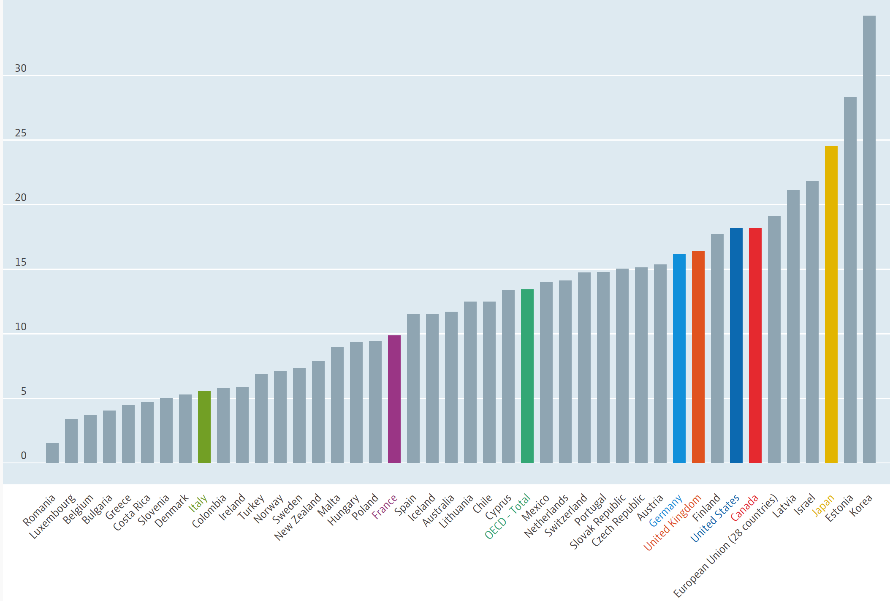
Gender Wage Gap, OECD Countries, 2018.
In developed countries, the picture is one income inequality as well. Measured as a percent of male wages for the same job, Canada ranks 7th highest in gender wage gap among OECD countries and considerably higher than the average OECD wage gap. Best in the OECD listing is Romania, and worst is South Korea.
Canada
OECD Average
https://www.oecd.org/gender/data/gender-wage-gap.htm

Slide 16
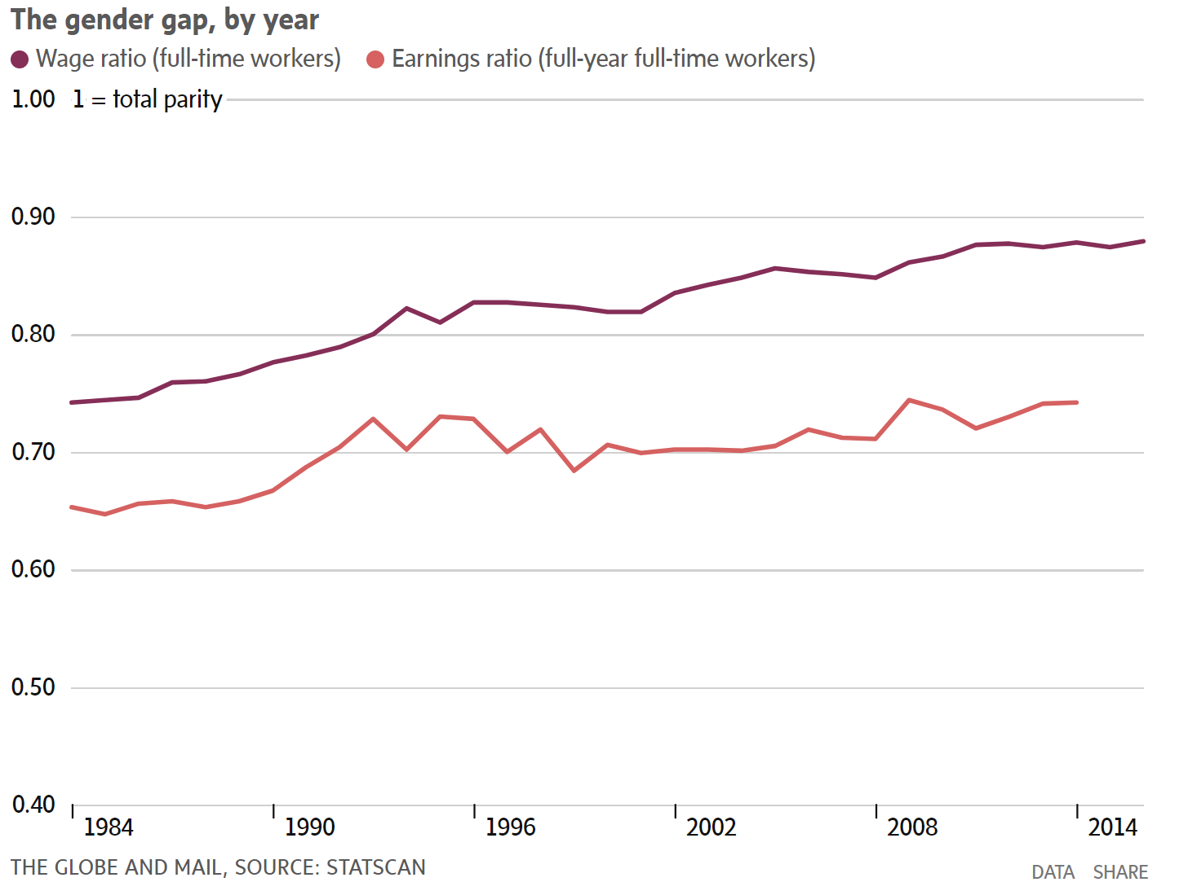
Gender Gap, Canada, 2016
2016: 88%
Income gap as measured by hourly wage rates.
Women earn 12 cents less per dollar.
1984: 74%
2014: 74%
Income gap as measured by full-year, full-time work.
1984: 65%
Women earn 26 cents less per dollar.

Slide 17
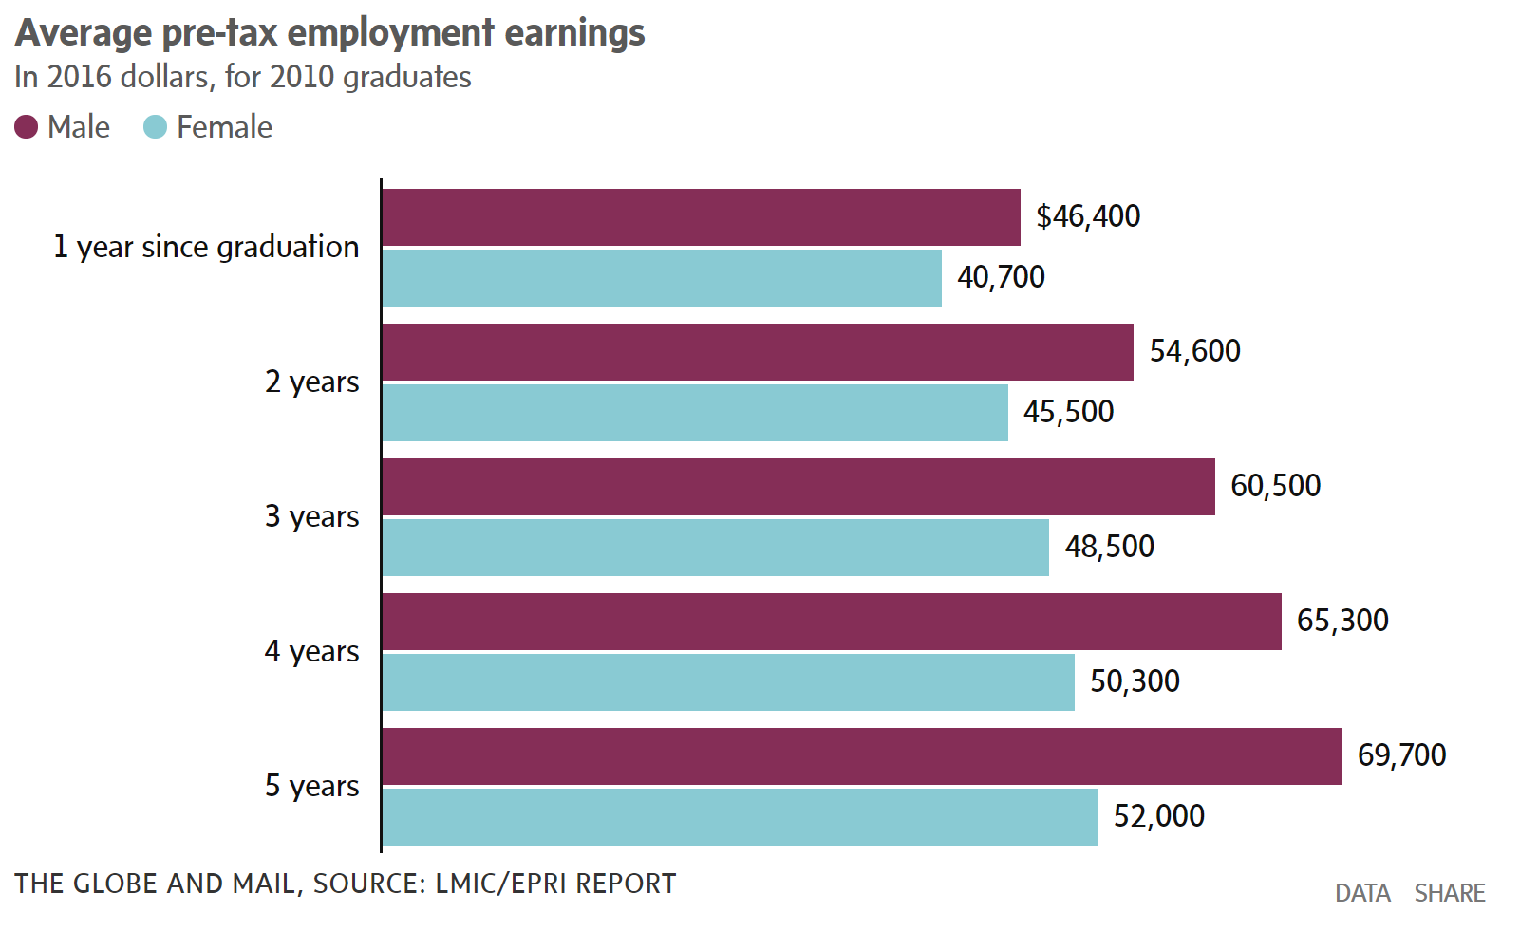
Gender Wage Gap, Canada.
This recent 2020 study¹ shows that the gender wage gap gets larger over time.
Proportion of male wage earned by females.
87.7%
Decrease in proportion after 5 years
13.1%
83.3%
80.3%
77.1%
74.6%
https://www.theglobeandmail.com/business/article-gender-earnings-gap-starts-upon-graduation-and-widens-quickly-says/
1: https://lmic-cimt.ca/wp-content/uploads/2020/01/LMIC_How-Much-Do-They-Make-Research-Report.pdf

Slide 18
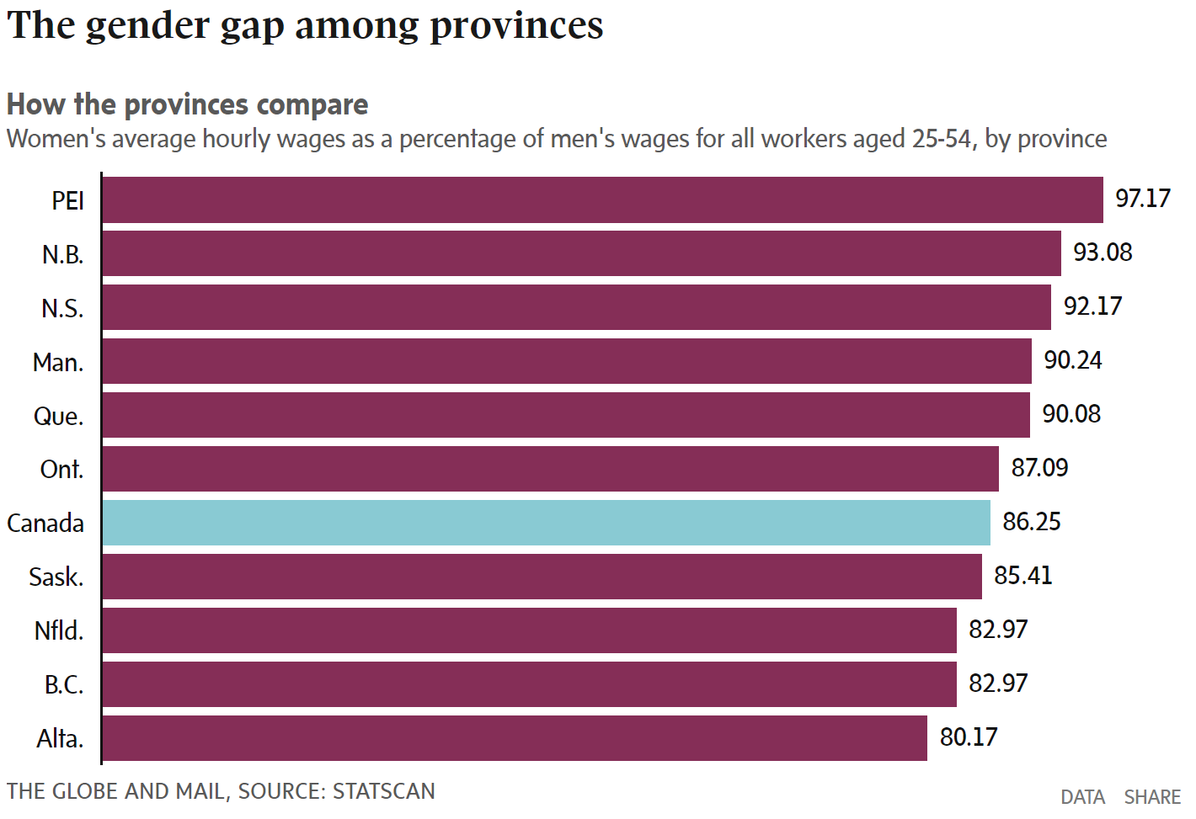

Slide 19
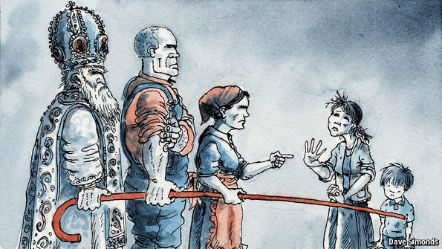
The Duma’s war on women
Why Russia is about to decriminalise wife-beating
It fits with traditional values, lawmakers say
Jan 28th 2017
And it is not just about money.

Slide 20
Population and Change
Less Growth, More People

Slide 21
Where Does Population Growth Come From?
☺
Pop growth = (Births - Deaths) + (Inmigration - Outmigration)
(Births – Deaths) = Natural Increase or Decrease
(Inmigration – Outmigration) = Net migration
Pop growth = Natural Change + Net Migration
Unavoidable implication: Natural decrease must be offset by an increase in net migration, otherwise populations will decline.
REMINDER:
Population Is Vital.
Human capital
Economic demand
Support group
Taxpayers
Human resource asset
Territorial security
Cultural identity

Slide 22
Where Does Population Growth Not Come From?
Old people.
The one incontrovertible biological fact of life is that life comes from young people.
In demographic terms, population potential comes from females 15 to 49 years of age with younger cohorts have higher potential than older cohorts.
Thus, the older a populations gets, the more this potential shrinks, and the more it shrinks the harder it is to recover.
The only certainty for the future is that without at least 2.1 children born per couple or net inmigration to make up the difference, populations will age and die.
Fertility

Slide 23
When Does Population Growth Stop and Decline Start?
Population growth stops when:
The number of children born per couple (TFR) decreases below 2.1 (ZPG).
Net migration in a population is too low to compensate.
A population’s median age exceeds 50.
The lower the fertility rate (US 1.8, Canada 1.6, the EU 1.6),…
… and the older a population becomes (US median age is 37, in Canada it is 39, and in the EU it is 42.6),…
… and the fewer the number of migrants (migration as a proportion of year-over-year population growth in US 30%, in Canada 67%, in the EU 118%)...
The faster a country’s population decreases, the faster its economy and culture decline.

Slide 24
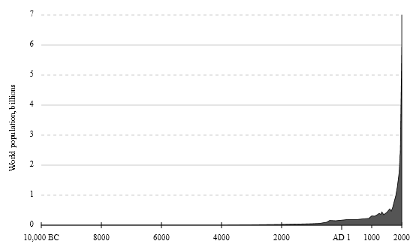
World Population Growth Through History
Linear Scales
WORLD POPULATION BILLIONS
Much is hidden by the time scale and slow early population growth.
12,000 10,000 8,000 6,000 4,000 2,000 1,000 Now
YEARS AGO

Slide 25
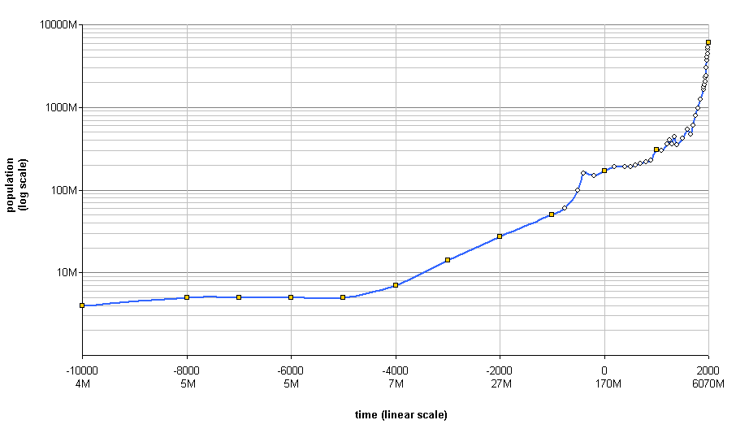
World Population Growth Through History
Log10 Population Scale
Period of urbanization:
the last 300 years
WORLD POPULATION (Log10 Scale)
7 billion
About 300 years ago, as industrial revolution takes hold, population grows exponentially.
I billion
About 8,000 years ago, as agricultural revolution takes hold and cities begin, population surges.
Period of urban growth:
9,000 to 300 years ago
12,000 10,000 8,000 6,000 4,000 2,000 1,000 Now
YEARS AGO

Slide 26
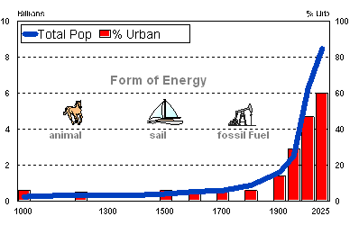
World Population History is Energy History
The history of population growth, and especially urban growth, is one of increasing energy efficiency.

Slide 27
Population numbers continue to grow.
But population percentage growth rates declining since 1965.
Population isn’t growing – but it is getting larger and these are two different things.
Source: World Bank.

Slide 28
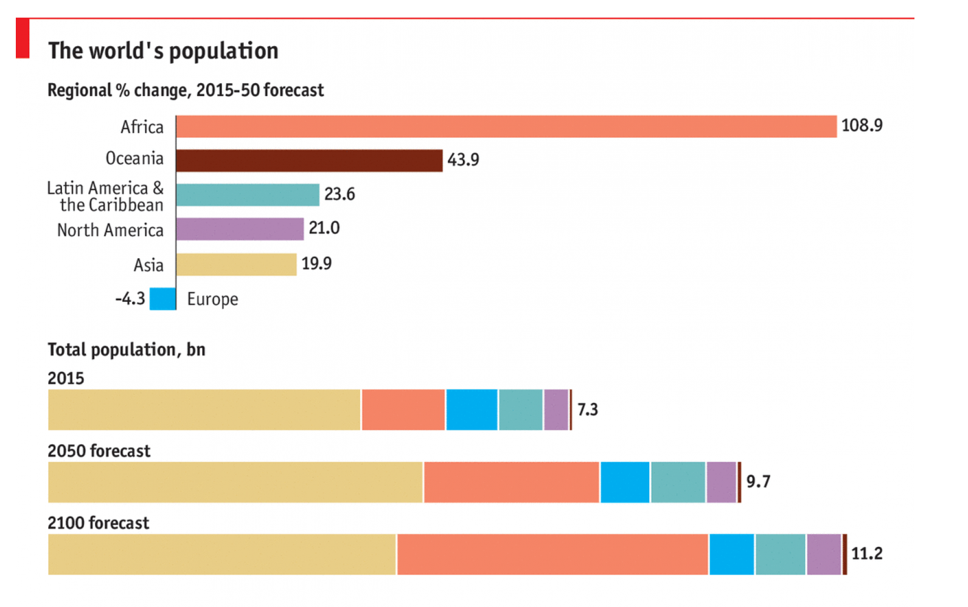
Global Population by Region 1950, 2015, 2050
By 2100 African population will have doubled while European population will have decreased in absolute terms.

Slide 29
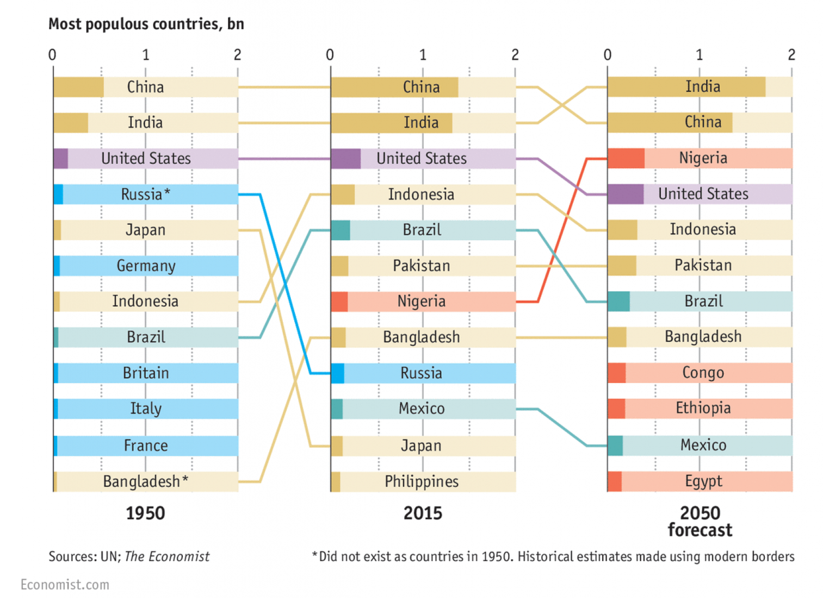
Most Populous Countries 1950, 2015, 2050

Slide 30
However, number of people being added to global population started decreasing in 1988.
But we still added almost 70 million people in 2014…
… and by 2050 it will still be 40 million every 5 years.
Source: Calculated from U.S. Bureau of the Census data.

Slide 31
All regional growth rates have been declining since the mid 1980s, with the developed world declining since the 1950s.
Developing world and Sub Saharan Africa higher than world average.
But it is not growth rates that drive increasing population; it is the age and gender composition of the population.
Many young females equals potential for large population growth despite declining fertility rates.
Developed world and Europe lower than world average, with negative rates for Europe.
Notes:
Source: http://esa.un.org/unpp/index.asp?panel=2

Slide 32
☺
Even though fertility rates (# live births per female) are decreasing (blue line), the number of women of childbearing age is increasing (red columns).
The net result is more people.
Billions of Women 15-49
The number of women of childbearing age more than doubled between 1950 and 1990.
DEMOGRAPHICS - POPULATION GROWTH
Notes:
Source: http://esa.un.org/unpp/index.asp?panel=2
The number of women in their childbearing years has increased since the 1950s and is projected to continue to increase to 2050.
The number of children per woman has declined since the 1950s from an average of five children born per woman in the 1950s to below three in 2000 and is projected to continue to decline.
Even though women have on average fewer children than their mothers, the absolute number of babies being born continues to increase because of the increases in the total number of women of childbearing age.

Slide 33
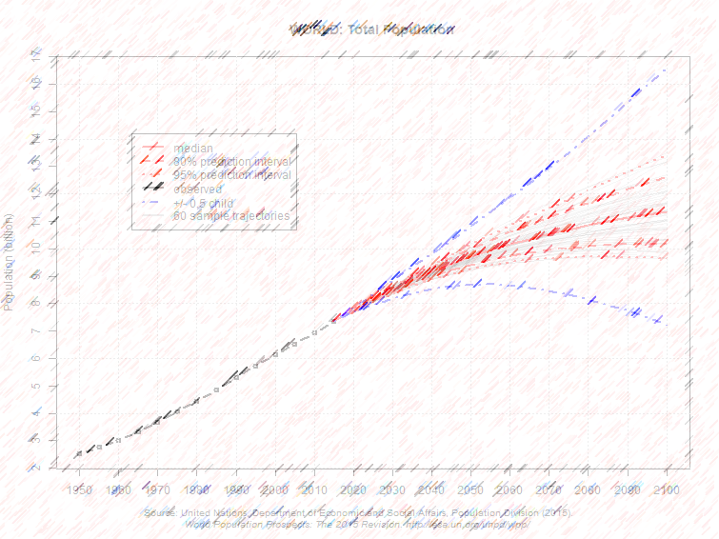
And the forecasts?

Slide 34
Predicting Population
Recent (2014) modeling by the UN and others suggest a future where there will be between 9.6 and 12.3 billion people by 2100, up from 6.2 to 11.2 in 2006.
The problem is Sub Saharan Africa – its fertility rates are no longer decreasing as fast as they were (but are still decreasing) and its population, especially of females, is young.
Africa has the highest rates of population growth and is expected to account for more than half of all growth between 2015 and 2050.
The population of more than 20 countries are expected to double, and by 2100 the populations of ten African countries is expected to increase by a factor of five.
The biggest cause is the oppressed role of females, who have little economic and birth choice.
https://esa.un.org/unpd/wpp/Graphs/
Notes:
This is the UN forecast simulator: https://esa.un.org/unpd/wpp/Graphs/
This is an extinction simulator: https://www.ined.fr/en/everything_about_population/population-games/tomorrow-population/

Slide 35
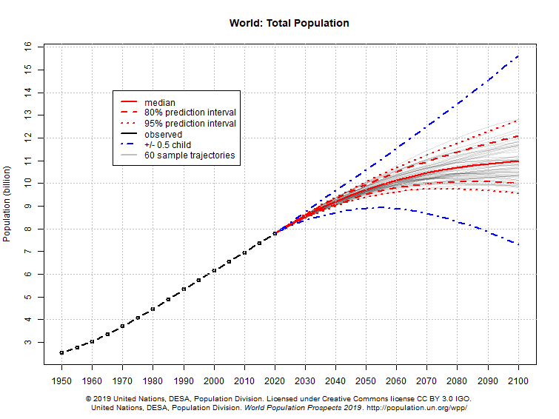
World Population Forecasts to 2100
Forecasts revised in 2019 paint a less optimistic picture.
Forecast in 2006
By 2100 with 80% confidence between 6.2 and 11.2 billion with a median of 8.4 billion.
Forecast in 2019
By 2100 with 80% confidence: between 10.0 and 12.0 billion with a median of 11.0 billion.
https://population.un.org/wpp/Graphs/Probabilistic/POP/900
Notes:
Explanation: These charts show estimates and probabilistic projections of the total population for countries or areas, geographical aggregates and World Bank income groups as defined in Definition of Regions. The population projections are based on the probabilistic projections of total fertility and life expectancy at birth, based on estimates of the 2015 Revision of the World Population Prospects. These probabilistic projections of total fertility and life expectancy at birth were carried out with a Bayesian Hierarchical Model. The figures display the probabilistic median, and the 80 and 95 per cent prediction intervals of the probabilistic population projections, as well as the (deterministic) high and low variant (+/- 0.5 child) of the 2015 Revision of the World Population Prospects.

Slide 36
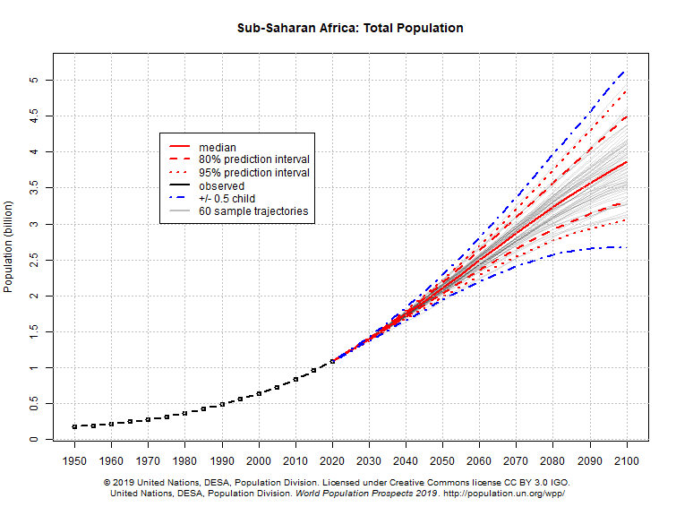
Sub Saharan Africa Population Forecasts to 2100
By 2100:
With 80% confidence: between 3.4 and 4.5 billion.
With 95% confidence: between 3.1 and 4.9 billion.
Reason:
Sub Saharan Africa population expectations have changed.
Median will be 3.9 billion.
https://population.un.org/wpp/Graphs/Probabilistic/POP/TOT/947

Slide 37
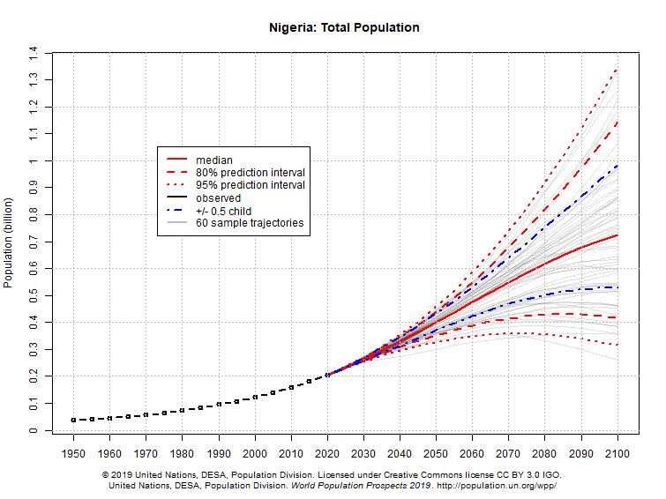
Nigeria Population Forecasts to 2100
By 2100:
With 80% confidence: between 0.41 and 1.15 billion.
With 95% confidence: between 0.31 and 1.34 billion.
Reason:
A few SSA countries such as Nigeria are contributing unexpected population growth due to a slowing of decreases in TFR.
Median will be 0.71 billion.
https://population.un.org/wpp/Graphs/Probabilistic/POP/TOT/566

Slide 38
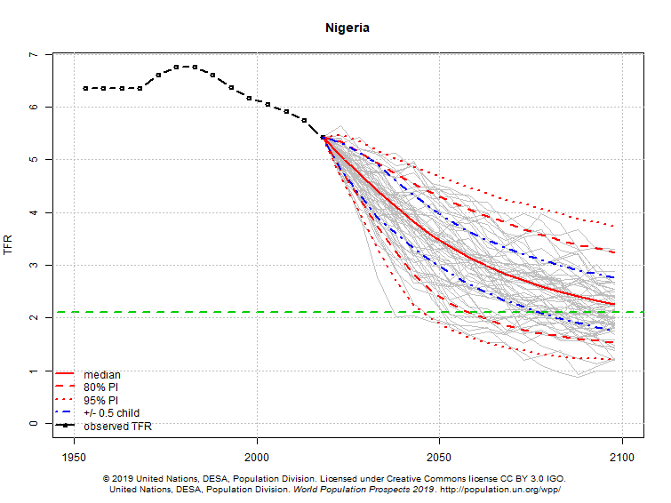
Nigeria Total Fertility Rate Forecasts to 2100
Reason:
recent flattening of the downward trend in TFR for some SS African nations.
Replacement rate (ZPG)
By 2100:
With 80% confidence: between 1.7 and 3.2.
With 95% confidence: between 1.1 and 3.8.
But the median TFR will still be above ZPG.
https://population.un.org/wpp/Graphs/Probabilistic/FERT/TOT/566

Slide 39
A Gender Bound World
Largest influence on TFR is the oppressed role of females.
In Africa and many other nations of the world, women:
Are not allowed to work.
Are not allowed to earn a living.
Are not allowed to earn as much as a man when they do.
Are not allowed to get an education.
Are not allowed to run a business.
Are not allowed to vote.
Are not allowed to run for government.
Are not allowed to make decisions about their own bodies.
Are property to be traded by parents or husbands.
Are property to be married off at their parents wish.
But the fact that it would require acts of government to make such fundamental rights available to 50% of the world’s population and even then it is opposed, is inexcusable.¹
1: https://www.equalrightsamendment.org/era-ratification-map

Slide 40
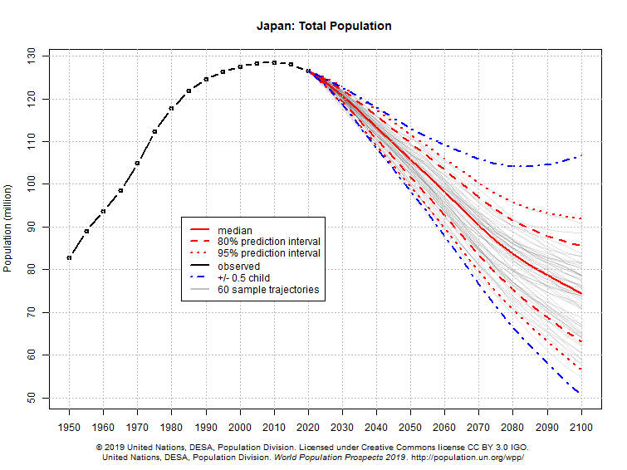
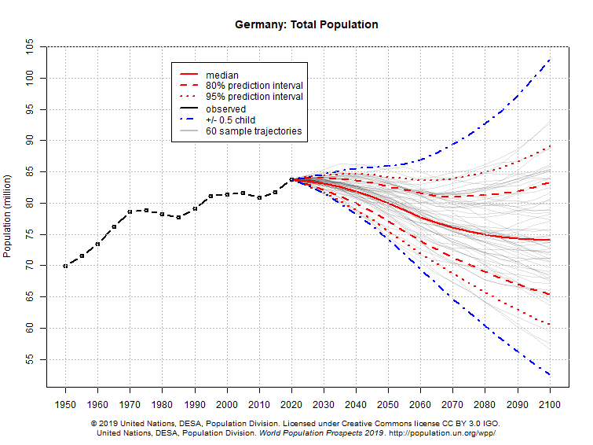
In developed nations, the population situation is the opposite – one of significant decline.
Japan’s population by 2100 could be 60 million less than its current population and even 5 million less than it was in 1950! Worst case scenarios have population at about 40% of current levels!
☺
https://population.un.org/wpp/Graphs/Probabilistic/POP/TOT/392
Germany’s median size could be about 10 million less than its current population, with worst case scenarios have population at about 59% of current levels.
https://population.un.org/wpp/Graphs/Probabilistic/POP/TOT/276

Slide 41
Fertility Rate Projections

Slide 42
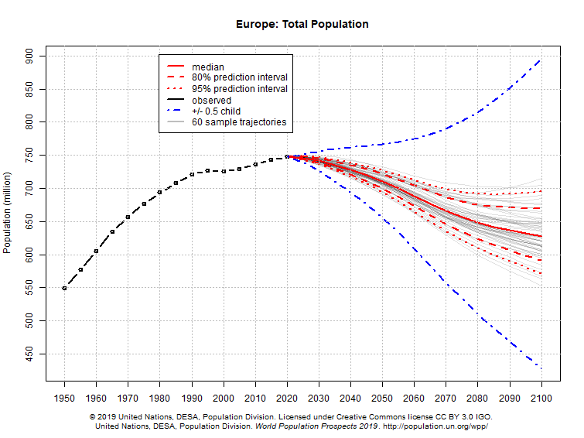
What would it take to prevent all this (assuming increasing population is a good thing)? The blue dotted line is an increase of 0.5 in TFR.
2100 median population level
Europe as a whole could see a decrease of about 120 million from its current level. Even the most optimistic projections still predict a 2100 population less than its current one.

Slide 43
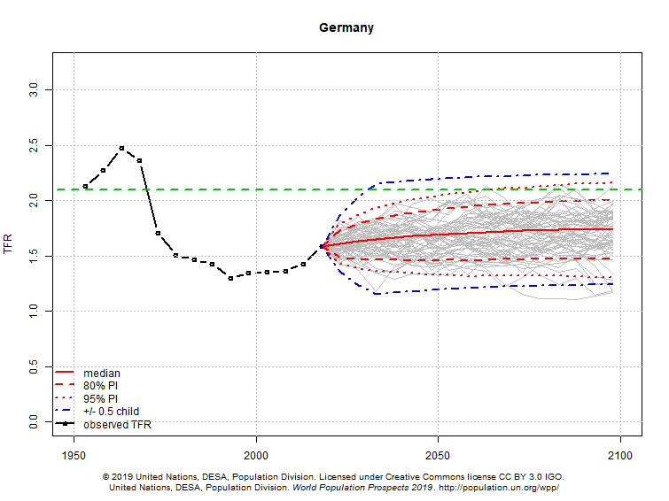
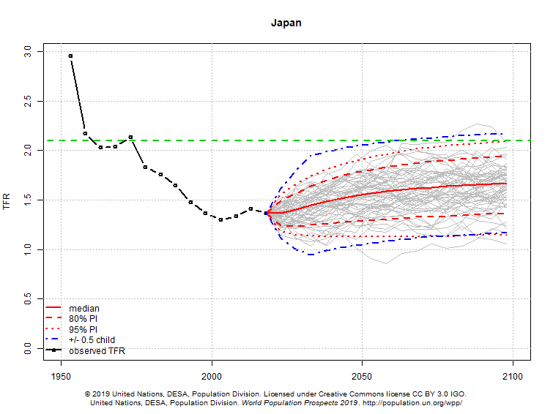
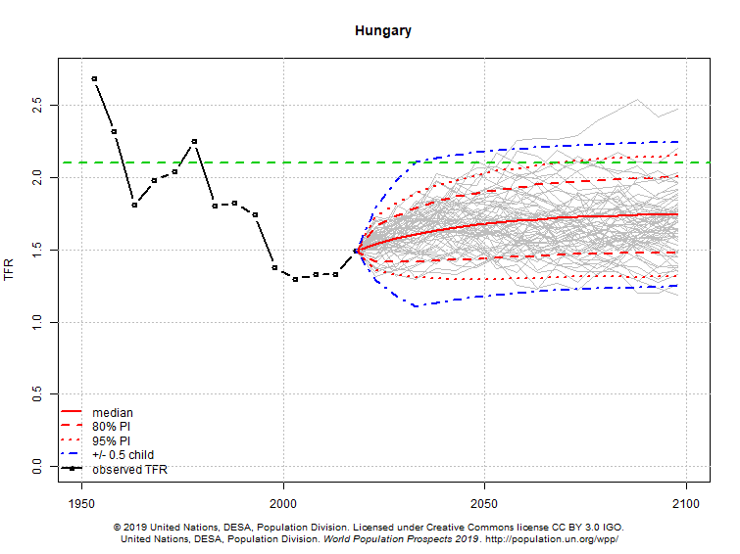
Germany TFR
The problem again is fertility rate – this time too low. Even the most optimistic projections predict TFRs only slightly above replacement rate (i.e. ZPG).
The median TFRs are considerably below ZPG.
Japan TFR
Hungary TFR

Slide 44
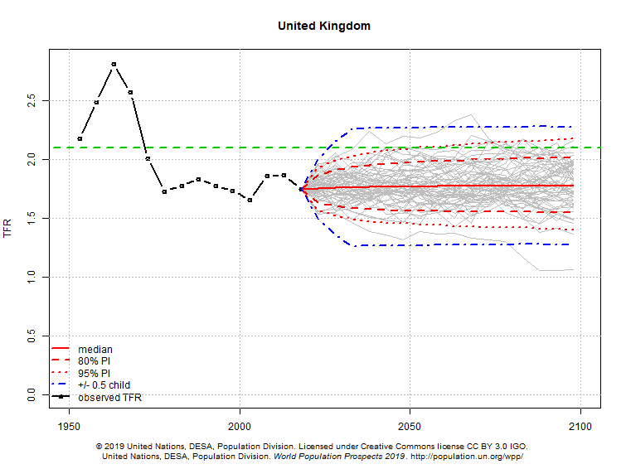
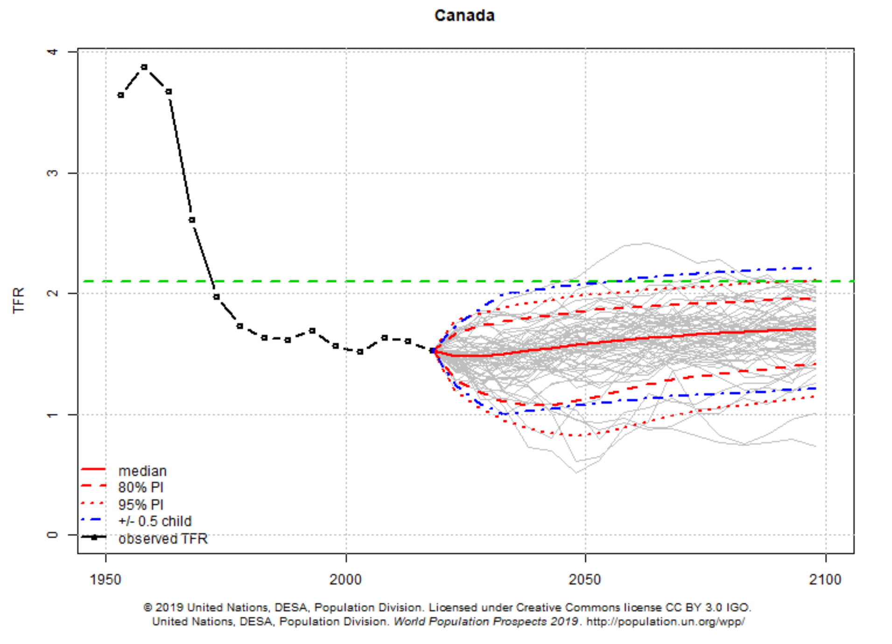
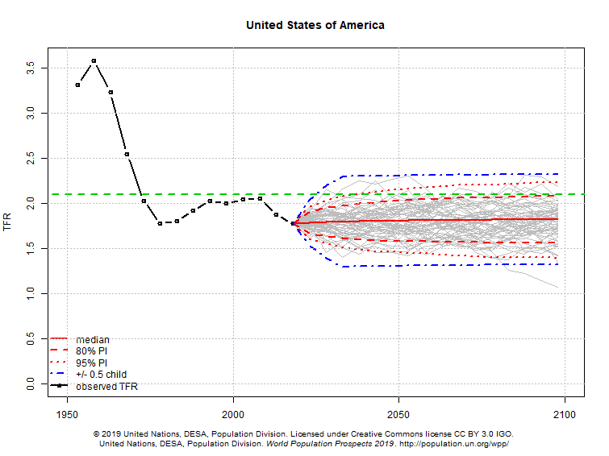
United Kingdom TFR
CanadaTFR
And for Canada, the US, and the UK?
About the same TFR projections as for Europe, and all below ZPG.
Without migration, population will flat line by 2100 and be old. Trump and all those ignorant of the facts should take note.
United States TFR

Slide 45
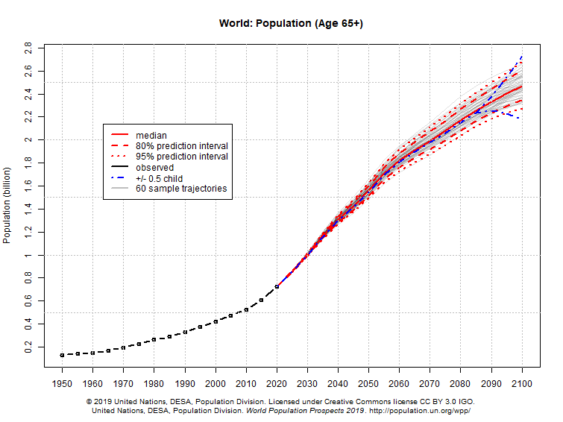
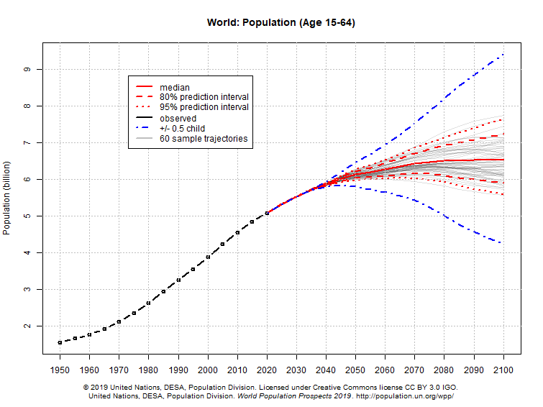
Global median forecasts for 65+ cohort will increase by 257% by 2100.
Dependency
But it’s not just total population that’s a problem. It is also the population’s components.
Global median forecasts for working cohort are almost flat lined by 2100, increasing by only 6%.
If overall trends continue the economic consequences are grave, with social welfare costs rising faster than the ability to pay for them.

Slide 46
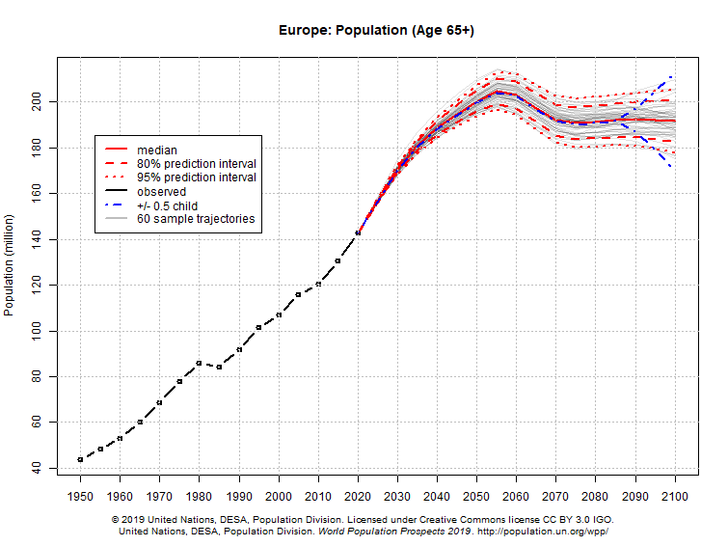
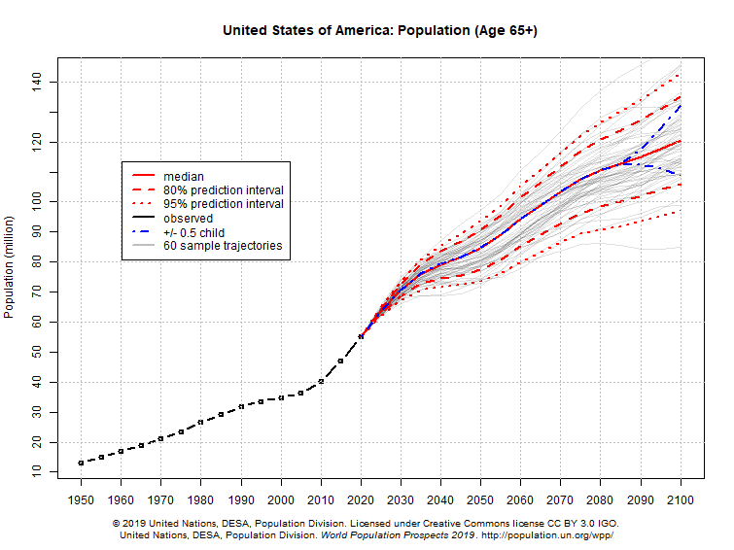
Dependency
Europe’s 65+ population will be 50% higher than currently and its share of total population will increase from 19% to 33%.
U.S. 65+ population will be 85% higher than currently, and its share of total population will increase from 17% to 27%.
Europe median forecasts for elderly cohort are increasing fast by 2100.
U.S. median forecasts for working cohort are increasing fast by 2100 and beyond.
These patterns are especially a problem in developed countries, where increasing levels of elderly and decreasing levels of support cohort create yet another bomb.
Dependency

Slide 47
Structural Population Change
Having Babies

Slide 48
Not the Birds and the Bees
The total fertility rate (TFR) is the average number of children being born to females of child bearing age in a given society and is governed by social and economic decisions.
Fertility rates depend on age structure; specifically the number of women of child bearing years by age cohort.
TFR should not be confused with fecundity, which refers to the biological capacity of a female to bear offspring.¹
All females have the same fecundity, but women of different nations might have quite different fertility rates.
Even low TFRs can result in population growth if there are many females 15-49, especially in younger cohorts – e.g.:
4m women at TFR 2 = 8m kids
1.6m at TFR 5 = 8m kids.
1: Biologically it is measured as ovulation rates or the number of viable female eggs produced in some measure of time (lifespan or monthly) in some population, and male motile sperm counts in the same population.

Slide 49
Relationship Between TFR and Population Size
☺
The volatility of population growth is shown in the table below, with 3 of the 4 scenarios producing high to very high growth rates. Even when female population is low, high TFRs can produce high growth rates. The same is true of high female populations and low TFRs.
 |  | TFR
 |  | HIGH | LOW
FEMALE POPULATION 15-45 | HIGH | Population growth rate very high. | Population growth rate high.
 | LOW | Population growth rate high. | Population growth rate very low.

Slide 50
Even though fertility rates (# live births per female) are decreasing (blue line), the number of women of childbearing age is increasing (red columns).
The net result is more people.
Billions of Women 15-49
The number of women of childbearing age more than doubled between 1950 and 1990.
DEMOGRAPHICS - POPULATION GROWTH
Notes:
Source: http://esa.un.org/unpp/index.asp?panel=2
The number of women in their childbearing years has increased since the 1950s and is projected to continue to increase to 2050.
The number of children per woman has declined since the 1950s from an average of five children born per woman in the 1950s to below three in 2000 and is projected to continue to decline.
Even though women have on average fewer children than their mothers, the absolute number of babies being born continues to increase because of the increases in the total number of women of childbearing age.

Slide 51
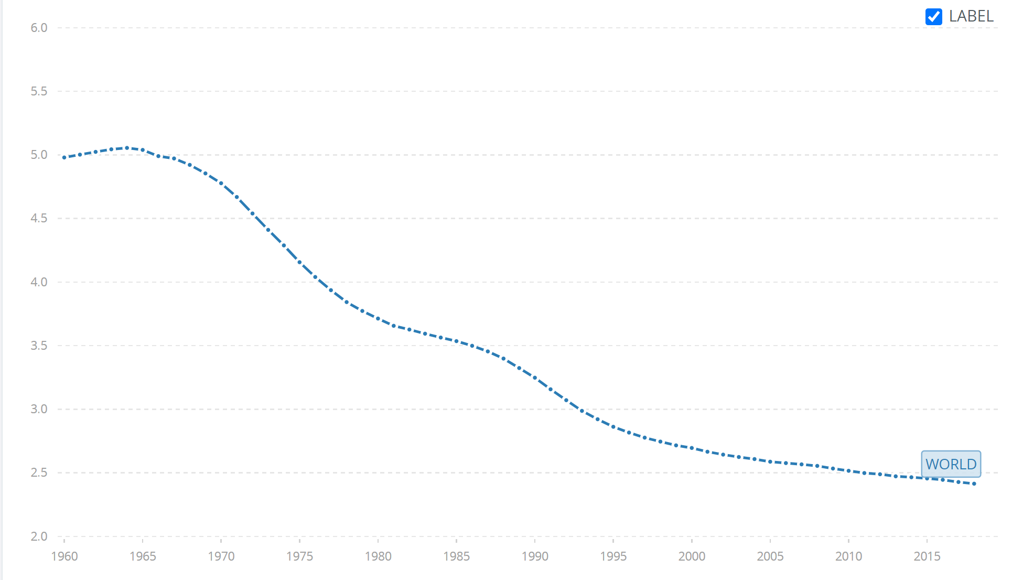
World Total Fertility Rate (TFR) 1960 to 2018
☺
The TFR is dependent on many things, most of which affect a woman’s health, education, prosperity and reproductive freedom of choice to name four. If these things are high, then fertility will generally be low.
1960
4.979
A TFR of 2.1 is considered necessary to achieve zero population growth. This is called the replacement rate.
TFR rates lower than 2.1 lead to population decline while higher rates mean population growth.
2018
2.415
https://data.worldbank.org/indicator/SP.DYN.TFRT.IN?view=chart

Slide 52
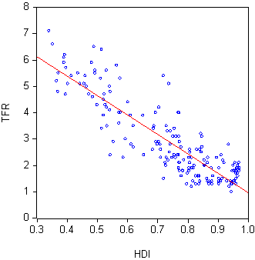
Relationship Between Fertility and Human Development Index
There is a clear and strong relationship between total fertility rate and the U.N.’s Human Development Index: the more developed a nation is the lower its TFR will be.
A 2016 study¹ of HDI and various health outcomes included TFR found a strong negative correlation between HDI and TFR (r = -0.831, 95% CI: -0.872, -0.778, P = 0.001).
http://report.hdr.undp.org/part-3.html 2020 (United Nations Development Program).
1: Almasi-Hashiani A, Sepidarkish M, Vesali S, Omani-Samani R. The Correlation of Human Development Index on Fertility and Mortality Rate: a Global Ecological Study. Int J Pediatr 2016; 4(12): 1795-1802. DOI: 10.22038/ijp.2016.7680

Slide 53
Association Between Fertility and Infant Mortality
☺
Strong direct relationship between infant mortality and fertility rate
As infant mortality increases, fertility rate increases.
Source: Derived from World Bank Data

Slide 54
Association Between Fertility and Education
☺
Strong inverse relationship between education attainment and fertility rate
As education increases fertility rates decrease.

Slide 55
Association Between Fertility and Poverty, 2011
☺
Strong direct relationship between poverty and fertility rate
As poverty increases, fertility rates increase.

Slide 56
Development and Health Indicators
☺
The conclusion is clear: higher levels of development lead to better outcomes for women and children particularly, and have overall better outcomes for countries as a whole.
A 2016 study¹ revealed clear and strong relationships between the U.N. Human Development Index (HDI) and health outcomes for women and children:²
HDI and Infant mortality = -0.878
HDI and Neo-natal mortality rate = -0.870
HDI and Child (<5) mortality rate = -0.858
HDI and Maternal mortality rate = -0.807
HDI and Total fertility rate = -0.831
Each of these negative correlations reveal that as HDI increases the dependent variables (the deaths of children and women) decrease.
1: Almasi-Hashiani A, Sepidarkish M, Vesali S, Omani-Samani R. The Correlation of Human Development Index on Fertility and Mortality Rate: a Global Ecological Study. Int J Pediatr 2016; 4(12): 1795-1802. DOI: 10.22038/ijp.2016.7680.
2: Full statistical results are: HDI and IMR (r = -0.878, P = 0.001), NMR (r = -0.870, 95% CI: -0.902, -0.828, P = 0.001), <5MR (r = -0.858, 95% CI: -0.893, -0.813, P = 0.001), MMR (r = -0.807, 95% CI: -0.853, -0.747, P = 0.001) and TFR (r = -0.831, 95% CI: -0.872, -0.778, P = 0.001).

Slide 57
Structural Population Change
Migration

Slide 58
Where Does Population Growth Come From?
Another Reminder
The Butterfly Effect
(demography style)
Pop growth =(Births - Deaths) + (In-migration - Out-migration)
(Births – Deaths) = Natural Increase or Decrease
(In-migration – Out-migration) = Net migration
Pop growth = Natural Increase or Decrease + Net Migration
Low rates of natural increase must be offset by increases in net migration, otherwise populations will decline and age, leading to dependency issues.
Population Is Vital
Human capital
Economic demand
Human resource asset
Territorial security
Cultural identity
So if you don’t have births you need migrants.

Slide 59
Migrant Stock
☺
Migrant stock refers to the number of people in a population who are foreign born as of a given date.
For example, if you were born in Canada but your parents were not, your parents would be counted as part of the Canada’s migrant stock but you would not.
When a country has a net inflow of migrants it is called a destination country, and when it has a net outflow of migrants it is called a diaspora country.
Countries can have large inflows and outflows thus making their net level of migrant stock low, as is the case of Russia, and this usually indicates countries with a large migrant workforce.

Slide 60
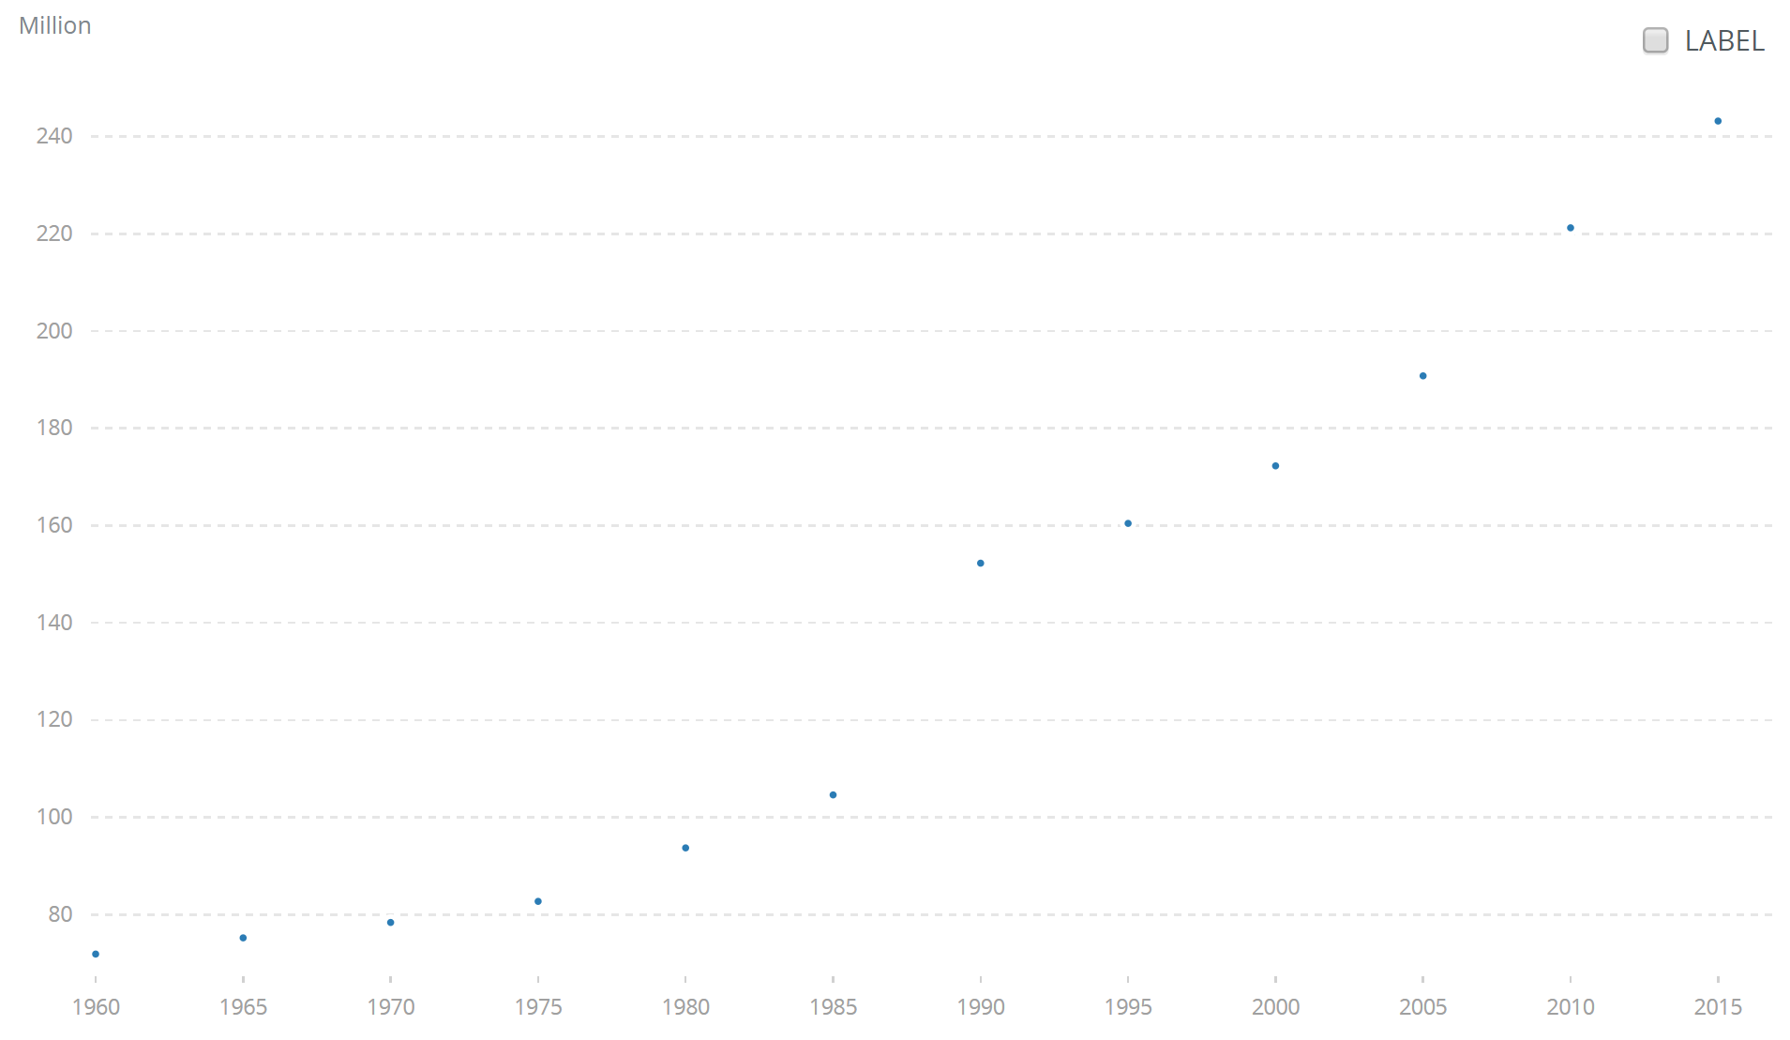
Global Migrant Stock 1960 to 2015
2015 =243 million
Global migrant stock has increased steadily since 1960 from about 70 million to over 240 million people by 2015.
1960=70 million
Source: World Bank Development Indicators 2016

Slide 61
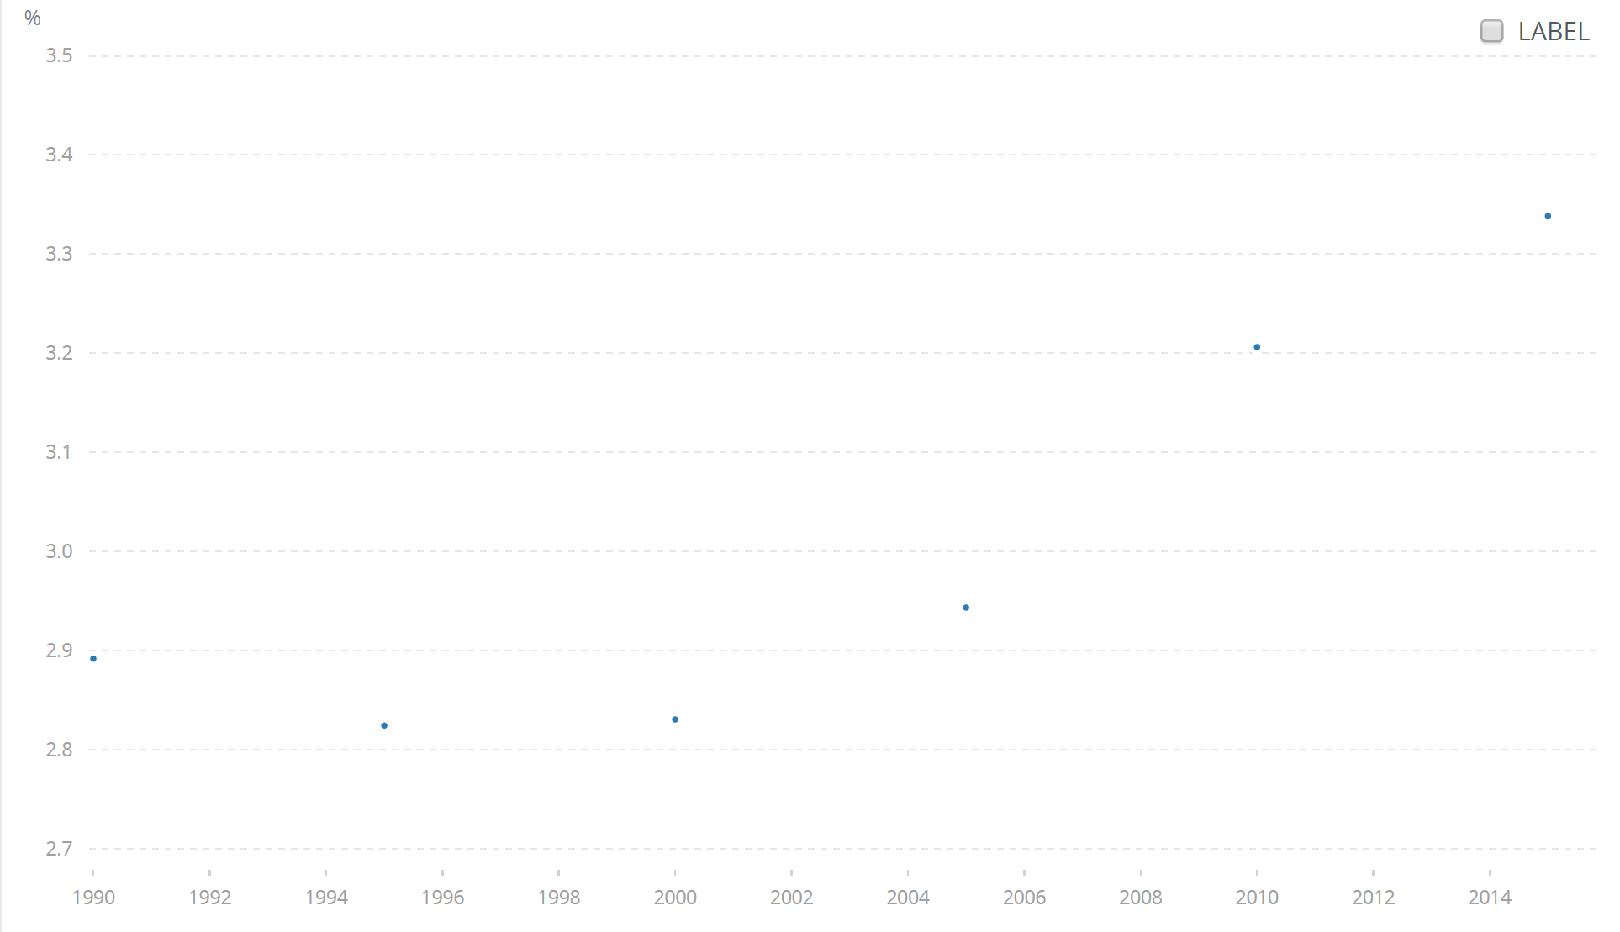
Migrant Stock
Percentage of Global Population 1960 to 2015
2015 = 3.3%
Growth rates have increased from about 2.7% in 1960 to over 3.3% by 2015 - about three times that of annual population growth in general.
2015 = 2.7%
Source: World Bank Development Indicators 2016

Slide 62
The U.S. has the largest level of migrant stock and the largest net migrant stock (people who came minus people who left). Russia has the 3rd largest level of migrant stock but a very high outflow too.
☺
Top Ten Destination Nations as of 2015
Country | Migrants Who Entered The Country | Rank as a Destination Country | Migrants Who Left The Country | Rank as a Diaspora Country | Net Migration
U.S. | 46,627,000 | 1 | 3,024,000 | 48 | 43,603,000
Germany | 12,006,000 | 2 | 4,045,000 | 14 | 7,961,000
Russia | 11,643,000 | 3 | 10,577,000 | 3 | 1,066,000
Saudi Arabia | 10,186,000 | 4 | 270,000 | 124 | 9,916,000
U.K. | 8,534,000 | 5 | 4,917,000 | 10 | 3,617,000
UAE | 8,095,000 | 6 | 137,000 | 146 | 7,958,000
Canada | 7,836,000 | 7 | 1,286,000 | 48 | 6,550,000
France | 7,784,000 | 8 | 2,146,000 | 28 | 5,638,000
Australia | 6,764,000 | 9 | 20,000 | 186 | 6,744,000
Spain | 5,853,000 | 10 | 1,251,000 | 49 | 4,602,000
Source: www.un.org/en/development/desa/population/migration/data/estimates2/estimates15.shtml.

Slide 63
India has the largest level of out-migrant stock making it the highest ranking diaspora country. Russia has the 3rd largest level of out-migrant stock making it a large flow-through country.
☺
Top Ten Diaspora Nations as of 2015
Country | Migrants Who Left The Country | Rank as a Diaspora Country | Migrants Who Entered The Country | Rank as a Destination Country | Net Migration
India | 15,576,000 | 1 | 5,241,000 | 12 | (10,335,000)
Mexico | 12,339,000 | 2 | 1,193,000 | 42 | (11,146,000)
Russia | 10,577,000 | 3 | 11,643,000 | 3 | 1,066,000
China | 9,546,000 | 4 | 978,000 | 48 | (8,568,000)
Bangladesh | 7,205,000 | 5 | 1,432,000 | 36 | (5,773,000)
Pakistan | 5,935,000 | 6 | 3,629,000 | 15 | (2,306,000)
Ukraine | 5,826,000 | 7 | 4,835,000 | 13 | (991,000)
Philippines | 5,316,000 | 8 | 212,000 | 104 | (5,104,000)
Syria | 5,012,000 | 9 | 875,000 | 49 | (4,137,000)
UK | 4,917,000 | 10 | 8,534,000 | 5 | 3,617,000
Source: www.un.org/en/development/desa/population/migratio/data/estimates2/estimates15.shtml.

Slide 64
Migrant Stock as a % of Population
Holy See | 100.0
United Arab Emirates | 88.4
Qatar | 75.5
Kuwait | 73.6
Sint Maarten (Dutch part) | 70.4
Liechtenstein | 62.6
Andorra | 59.7
Macao, China | 58.3
British Virgin Islands | 57.5
Monaco | 55.8
Falkland Islands (Malvinas) | 54.1
United States Virgin Islands | 53.4
Bonaire, Sint Eustatius & Saba | 52.3
Isle of Man | 51.5
Bahrain | 51.1
Australia | 28.2
Canada | 21.8
United States | 14.5
United Kingdom | 13.2
Japan | 1.6
Just for fun, here are the top 15 political units by migrant stock.
About 3.3% of the world’s population are migrants.
Canada and Australia, two high migration nations, have high comparative migrant stock levels.
The U.S. and U.K., quick to complain about immigrants, have less than 15% of their population as migrant stock.
Eastern Europe, where populations are declining rapidly, have migrant stock levels of only 6.7%.
But Japan is the poster place for the disappearing nation – only 1.6% of their population are immigrants.

Slide 65
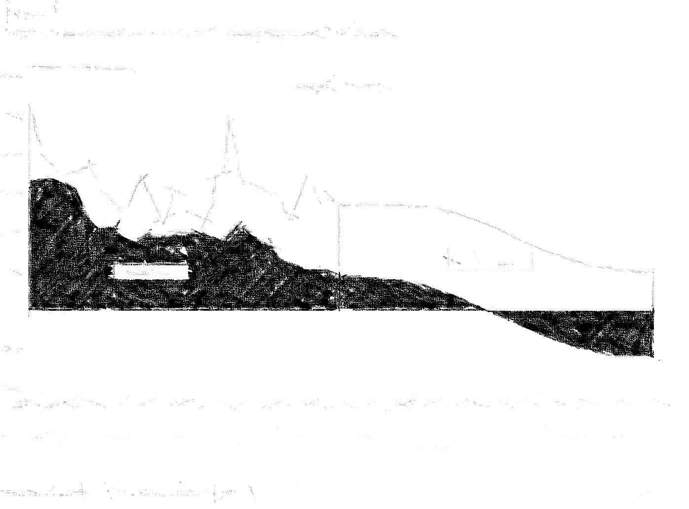

Oh Canada!
Canadian Population Growth

Slide 66
COMPONENTS OF CANADIAN POPULATION GROWTH 1851 TO 2001
PERIOD | NATURAL INCREASE (NI) | NET MIGRATION | POP GROWTH | NM as a % of Pop Growth | NI as a % of Pop Growth
1851-1861 | 611,000 | 182,000 | 793,000 | 22.95% | 77.05%
1861-1871 | 610,000 | -150,000 | 460,000 | -32.61% | 132.61%
1871-1881 | 690,000 | -54,000 | 636,000 | -8.49% | 108.49%
1881-1891 | 654,000 | -146,000 | 508,000 | -28.74% | 128.74%
1891-1901 | 668,000 | -130,000 | 538,000 | -24.16% | 124.16%
1901-1911 | 1,025,000 | 810,000 | 1,835,000 | 44.14% | 55.86%
1911-1921 | 1,270,000 | 311,000 | 1,581,000 | 19.67% | 80.33%
1921-1931 | 1,360,000 | 230,000 | 1,590,000 | 14.47% | 85.53%
1931-1941 | 1,222,000 | -92,000 | 1,130,000 | -8.14% | 108.14%
1941-1951 | 1,972,000 | 169,000 | 2,141,000 | 7.89% | 92.11%
1951-1956 | 1,473,000 | 598,000 | 2,071,000 | 28.87% | 71.13%
1956-1961 | 1,675,000 | 482,000 | 2,157,000 | 22.35% | 77.65%
1961-1966 | 1,518,000 | 259,000 | 1,777,000 | 14.58% | 85.42%
1966-1971 | 1,090,000 | 463,000 | 1,553,000 | 29.81% | 70.19%
1971-1976 | 936,000 | 695,000 | 1,631,000 | 42.61% | 57.39%
1976-1981 | 977,000 | 493,000 | 1,470,000 | 33.54% | 66.46%
1981-1986 | 987,000 | 400,000 | 1,387,000 | 28.84% | 71.16%
1986-1991 | 987,000 | 951,000 | 1,938,000 | 49.07% | 50.93%
1991-1996 | 912,000 | 780,000 | 1,692,000 | 46.10% | 53.90%
1996-2001 | 616,000 | 841,000 | 1,457,000 | 57.72% | 42.28%
 | 21,253,000 | 7,092,000 | 28,345,000 | 25.02% | 74.98%
Period | Average net migration share of pop growth
1931-2001 | 29.44%
1941-2001 | 32.85%
1951-2001 | 35.35%
1961-2001 | 37.78%
1971-2001 | 42.98%
1981-2001 | 45.43%
1991-2001 | 51.91%
1996-2001 | 57.72%
2010-2011 | 60.5%
2011-2012 | 59.1%
2012-2013 | 60.3%
2013-2014 | 60.7%
2014-2015 | 58.8%
2015-2016 | 67.4%
Since 1851 natural increase has provided about 75% of Canada’s population growth.
But migration has been providing an ever increasing share of population growth.
Between 2001 and 2016 migration share of total growth has averaged 61%.
Notes:
Stats Canada http://www.statcan.gc.ca/cgi-bin/sum-som/fl/saveas-eng.cgi

Slide 67
Natural Increase and Migration Canada, 1851-2001
☺
Natural increase dominant growth component in pre-Confederation to pre-WW2 period.
Migration dominant as major growth component in post WW2 period.
http://www5.statcan.gc.ca/cansim/a26

Slide 68
Natural Increase and Migration as a Share of Population Growth
Canada, 1851-2012
☺
Migration increasingly dominant as population growth component.
Natural increase
Migration
Migration outstrips natural increase
Source: Calculated from previous Statistics Canada data.

Slide 69
Components of Canada's Population Growth, 1971-2016
From about 2000, net migration outstrips natural increase as the engine of population growth.
By 2016 the ratio of migrants to births has increased from 0.27 to 2.07.

Slide 70
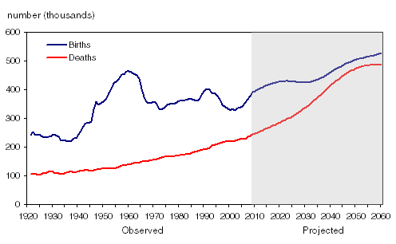
Births and Deaths Canada 1920 to 2060
Births and deaths first diverge (population growth)
then converge (population decline), and after 2010 deaths increase exponentially.
https://www12.statcan.gc.ca/census-recensement/2011/as-sa/98-310-x/2011003/fig/fig3_1-3-eng.cfm

Slide 71
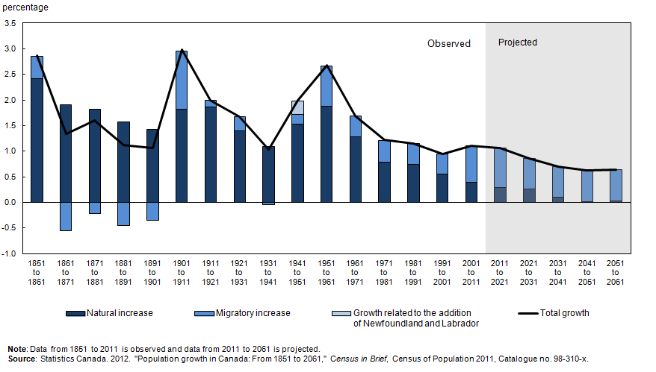
Components of Population Change Canada 1851 to 2060
Natural increase as a proportion of population growth declines rapidly after 1971, and migration increases to replace some of it, but population growth declines.
https://www150.statcan.gc.ca/n1/pub/11-630-x/11-630-x2014001-eng.htm

Slide 72
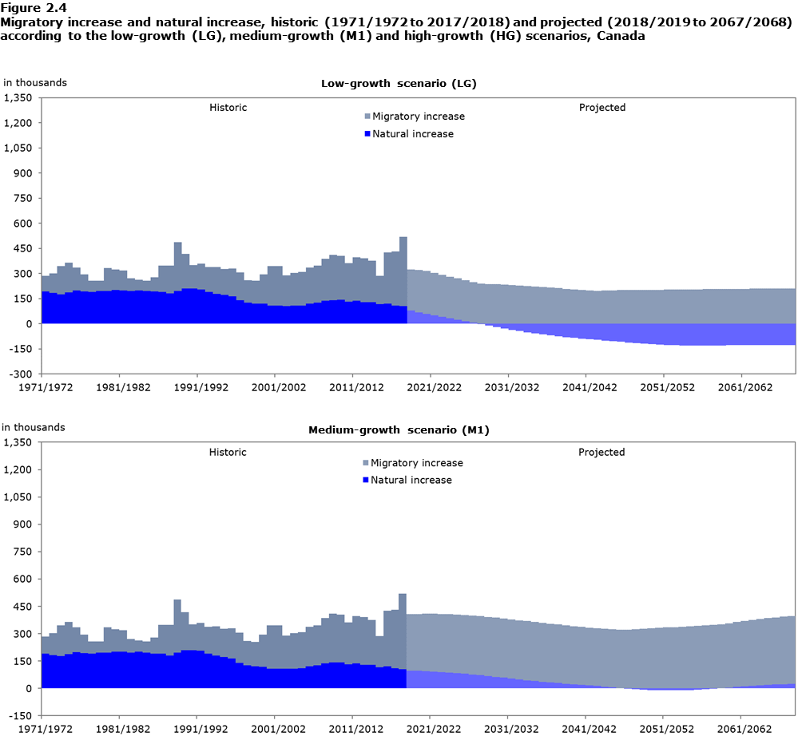
Population growth has depended increasingly on migration since 1971, and in In the low growth scenario, by 2030, will depend entirely on it. But overall population increase will decline. Natural increase will decrease to zero by 2030 and thereafter become natural decrease.
In the medium growth scenario, natural increase will decrease to zero by about 2050 and any population growth Canada sees will come from migration alone.
https://www150.statcan.gc.ca/n1/pub/91-520-x/2019001/sect02-eng.htm

Slide 73
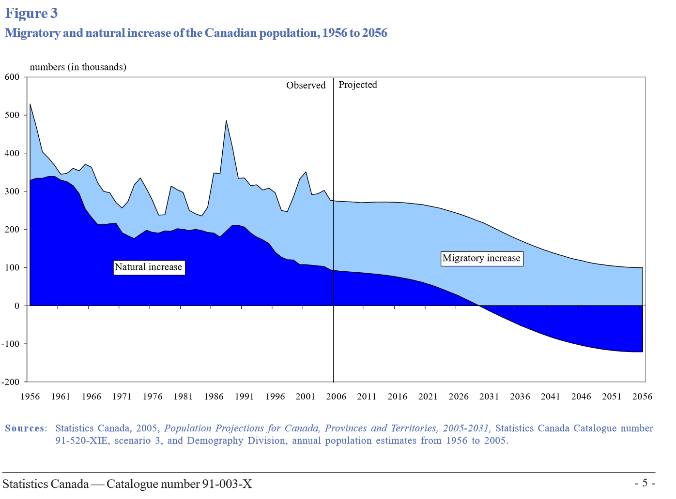
Natural Increase and Migration Canada, 1956 to 2056
Population growth will depend increasingly on migration, and, by 2030, entirely on it. But overall population growth will decline.
Natural increase will decrease to zero by 2030 and thereafter become natural decrease.

Slide 74
Immigration Change in Canada 1820 to 2000
New immigrants have shifted significantly from Europeans to Asian and Latin American populations. Immigration as a % of population growth:
Canada = 57.7%
US = 59.7%
Immigration to Canada by Ethnicity, 1900 to 2010
1900-1920 |  | 1921-1945 |  | 1946-1980 |  | 2010
Country | Percent | Country | Percent | Country | Percent | Country | Percent
UK | 39.9 | UK | 39.1 | UK | 23.0 | Philippines | 13.0
US | 33.7 | US | 22.7 | Italy | 10.1 | India | 10.8
Italy | 3.7 | Germany | 5.4 | US | 9.8 | China | 10.8
Poland | 3.3 | Ukraine | 4.6 | W. Germany | 6.8 | UK | 3.4
Russia | 2.9 | Jewish | 3.8 | Netherlands | 3.8 | US | 3.3
Jewish | 2.2 | Poland | 3.6 | West Indies | 3.8 | France | 2.5
Ukraine | 1.8 | Czech | 2.4 | Portugal | 3.0 | Iran | 2.4
China | 1.2 | Hungary | 2.3 | Greece | 2.7 | UAE | 2.4
Germany | 1.1 | Finland | 2.1 | France | 2.6 | Morocco | 2.1
Austria | 0.9 | Italy | 1.9 | Poland | 2.3 | S. Korea | 2.0
TOTAL | 50.8 | TOTAL | 48.8 | TOTAL | 67.9 | TOTAL | 52.7

Slide 75
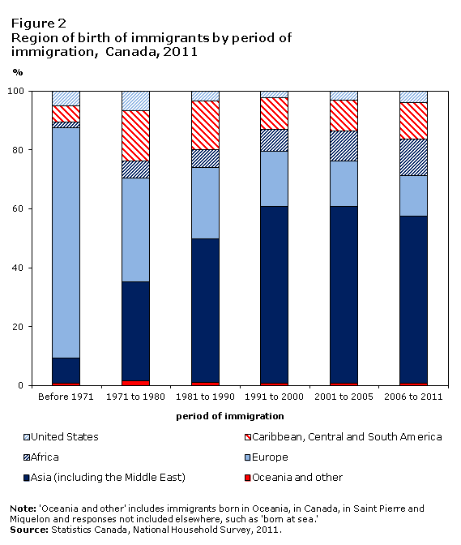
The Changing Face of Immigration to Canada
Immigration origins have changed in the past 50 years from mainly Europe to mainly Asia and the Middle East, with a growing percentage from African nations.
Mainly European
Mainly Asian
https://www12.statcan.gc.ca/nhs-enm/2011/as-sa/99-010-x/2011001/c-g/c-g02-eng.cfm

Slide 76
Oh (no) Canada!
Canadian Population Growth

Slide 77
COMPONENTS OF CANADIAN POPULATION GROWTH 1851 TO 2001
☺
PERIOD | NATURAL INCREASE (NI) | NET MIGRATION | POP GROWTH | NM as a % of Pop Growth | NI as a % of Pop Growth
1851-1861 | 611,000 | 182,000 | 793,000 | 22.95% | 77.05%
1861-1871 | 610,000 | -150,000 | 460,000 | -32.61% | 132.61%
1871-1881 | 690,000 | -54,000 | 636,000 | -8.49% | 108.49%
1881-1891 | 654,000 | -146,000 | 508,000 | -28.74% | 128.74%
1891-1901 | 668,000 | -130,000 | 538,000 | -24.16% | 124.16%
1901-1911 | 1,025,000 | 810,000 | 1,835,000 | 44.14% | 55.86%
1911-1921 | 1,270,000 | 311,000 | 1,581,000 | 19.67% | 80.33%
1921-1931 | 1,360,000 | 230,000 | 1,590,000 | 14.47% | 85.53%
1931-1941 | 1,222,000 | -92,000 | 1,130,000 | -8.14% | 108.14%
1941-1951 | 1,972,000 | 169,000 | 2,141,000 | 7.89% | 92.11%
1951-1956 | 1,473,000 | 598,000 | 2,071,000 | 28.87% | 71.13%
1956-1961 | 1,675,000 | 482,000 | 2,157,000 | 22.35% | 77.65%
1961-1966 | 1,518,000 | 259,000 | 1,777,000 | 14.58% | 85.42%
1966-1971 | 1,090,000 | 463,000 | 1,553,000 | 29.81% | 70.19%
1971-1976 | 936,000 | 695,000 | 1,631,000 | 42.61% | 57.39%
1976-1981 | 977,000 | 493,000 | 1,470,000 | 33.54% | 66.46%
1981-1986 | 987,000 | 400,000 | 1,387,000 | 28.84% | 71.16%
1986-1991 | 987,000 | 951,000 | 1,938,000 | 49.07% | 50.93%
1991-1996 | 912,000 | 780,000 | 1,692,000 | 46.10% | 53.90%
1996-2001 | 616,000 | 841,000 | 1,457,000 | 57.72% | 42.28%
 | 21,253,000 | 7,092,000 | 28,345,000 | 25.02% | 74.98%
Period | Average net migration share of pop growth
1931-2001 | 29.44%
1941-2001 | 32.85%
1951-2001 | 35.35%
1961-2001 | 37.78%
1971-2001 | 42.98%
1981-2001 | 45.43%
1991-2001 | 51.91%
1996-2001 | 57.72%
2010-2011 | 60.5%
2011-2012 | 59.1%
2012-2013 | 60.3%
2013-2014 | 60.7%
2014-2015 | 58.8%
2015-2016 | 67.4%
Since 1851 natural increase has provided about 75% of Canada’s population growth.
But migration has been providing an ever increasing share of population growth.
Between 2001 and 2016 migration share of total growth has averaged 61%.
Notes:
Stats Canada http://www.statcan.gc.ca/cgi-bin/sum-som/fl/saveas-eng.cgi

Slide 78
Natural Increase and Migration Canada, 1851-2001
☺
Natural increase dominant growth component in pre-war period.
Migration dominant as major growth component in post war period.
Net migration outstrips natural increase.
http://www5.statcan.gc.ca/cansim/a26

Slide 79
Natural Increase and Migration as a Share of Population Growth
Canada, 1851-2012
☺
Migration increasingly dominant as growth component.
Natural increase
Migration
Migration outstrips natural increase
Source: Calculated from previous Statistics Canada data.

Slide 80
☺
Migration exceeded natural increase in 1991, and by 2015 there are 2 net in-migrants for every birth.

Slide 81
☺
By 2016 there were over twice as many in-migrants as births.
From about 2000, net migration outstrips natural increase as the engine of population growth.

Slide 82
☺
By 2015 there are two in-migrants for every birth.
1971 2015

Slide 83
Natural Increase and Migration Canada, 1956 to 2056
Population growth will depend increasingly on migration, and, by 2030, entirely on it. But overall population growth will decline.
Natural increase will decrease to zero by 2030 and thereafter become natural decrease.

Slide 84
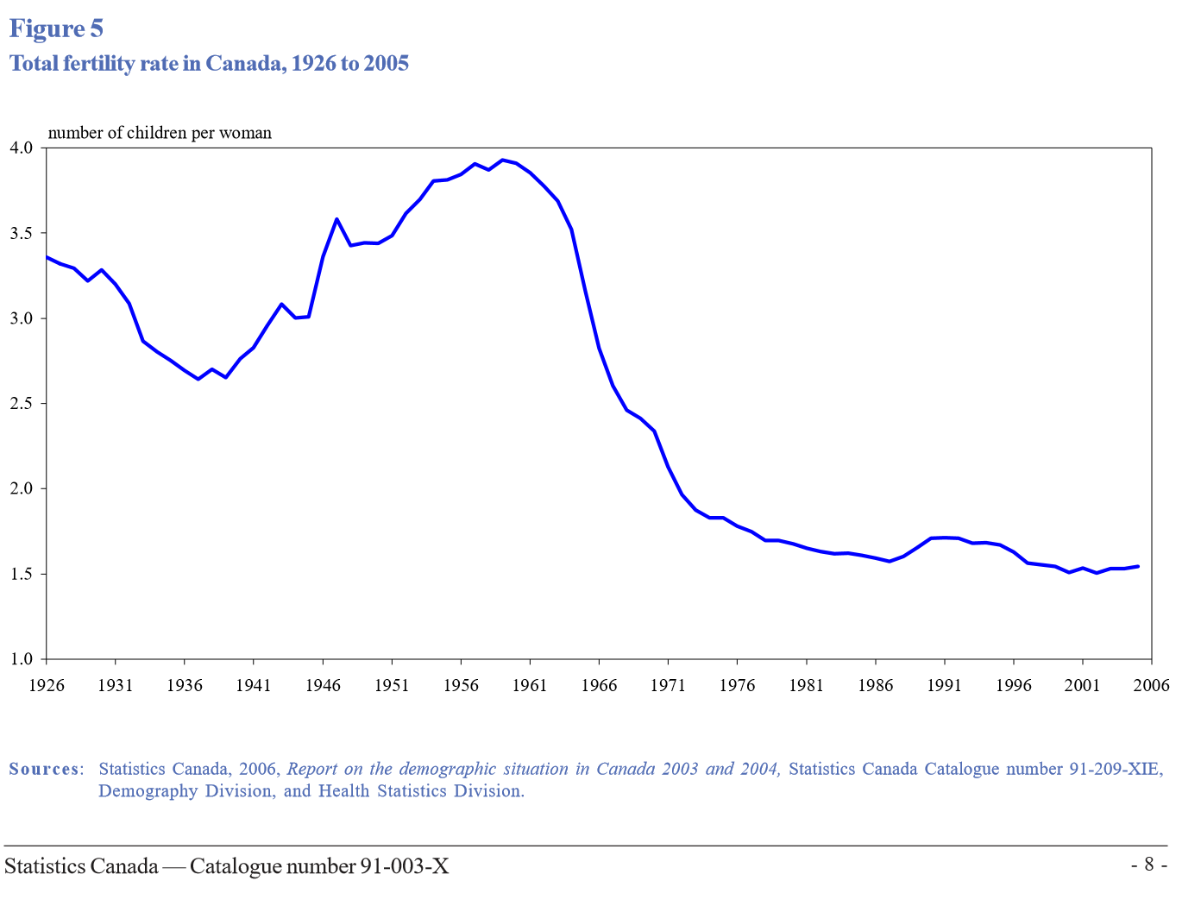
Canadian TFR has decreased precipitously since its late 1950s high of almost 4 to the 1.6 it was in 2016.
Replacement rate.

Slide 85
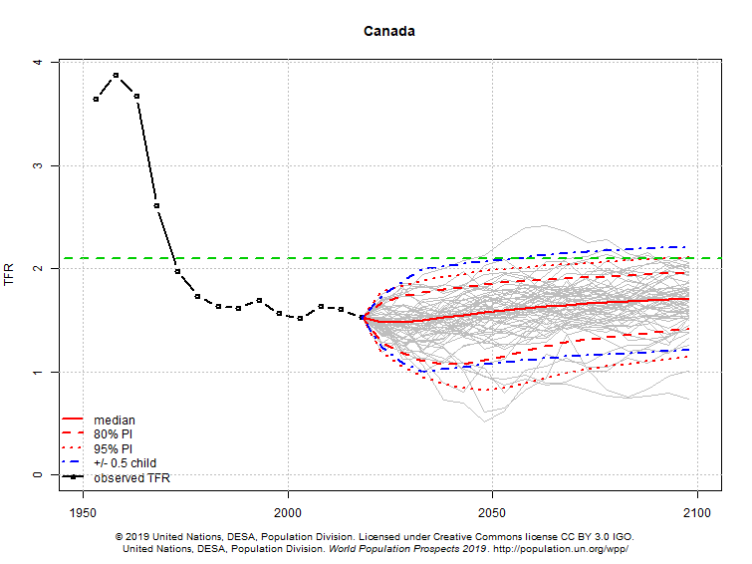
At its current TFR alone, and without in-migration, Canada’s population would decrease from its present 36.6 million to 19 million by 2100 – a 48% decline - and get older faster.¹
1:https://www.centuryinitiative.ca/3scenarios/

Slide 86
Canada Without Migration
By 2034, immigration will account for 100 per cent of population growth as the death rate in Canada exceeds the birth rate.
At its current TFR alone, and without in-migration, Canada’s population would decrease from its present 36.6 million to 19 million by 2100 – a 48% decline - and get older faster.¹
In a no-immigration world, 26.9% of the population would be 65 and over by 2040.
According to a recent Conference Board of Canada analysis, Canada’s potential economic growth would slow from 1.9% to an average of 1.3 per cent annually without immigration.²
The sobering reality is that any country will suffer the same fate, which begs the question: from where are the immigrants going to come?
There aren’t that many Norwegians.
1:https://www.centuryinitiative.ca/3scenarios/ 2: https://www.conferenceboard.ca/e-library/abstract.aspx?did=9678

Slide 87

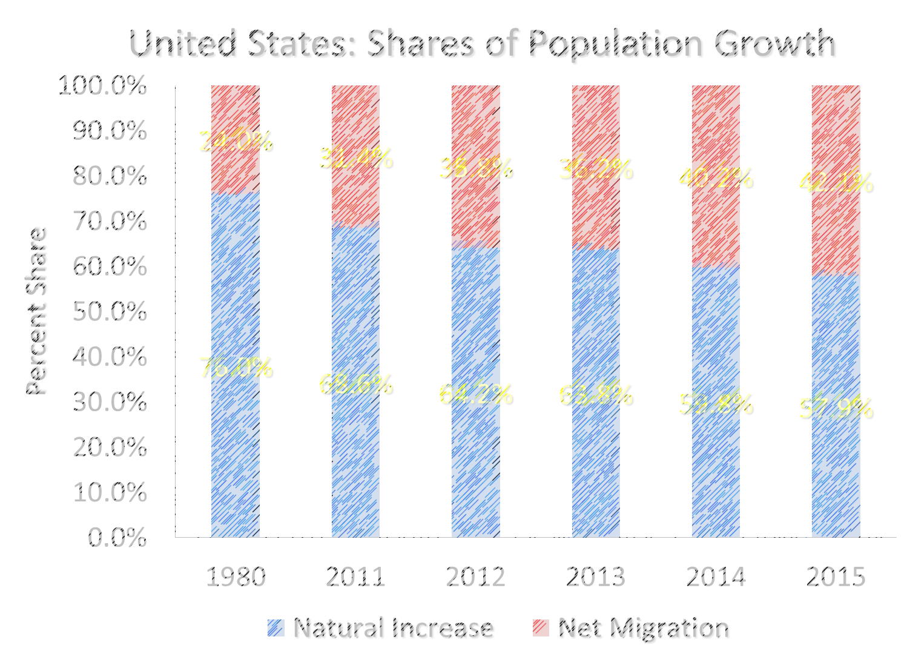
I know. Let’s Build Walls!
United States Population “Growth”

Slide 88
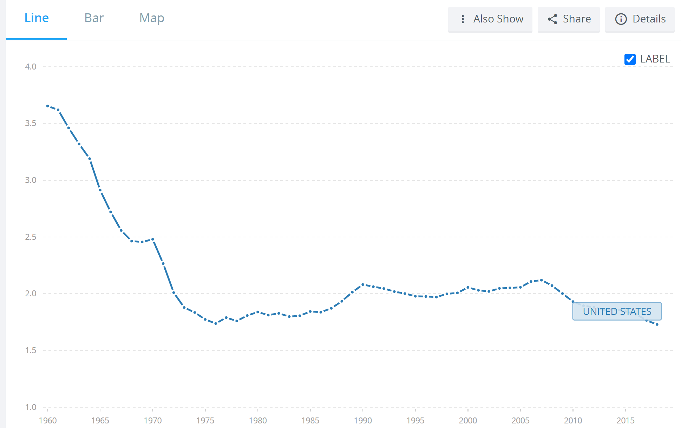
United States: Fertility Rate 1960 to 2018
1960 = 3.6
U.S. population is below replacement rate and has been since the early 1970s.
Without immigration population would have declined.
At its current TFR alone, and without in-migration, the US population would decrease from its existing 327.2 million to 281.5 million by 2100 – a decrease of over 24% - and get older faster.
Replacement rate.
2018 = 1.73
http://data.worldbank.org/indicator/SP.DYN.TFRT.IN?locations=US

Slide 89
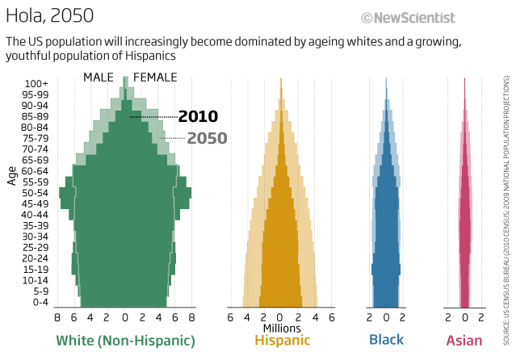
US Ethnic Population Structure 2010 and 2050
Black and Asian populations are aging, with few young for future growth. Hispanic populations are growing and young with significant future growth potential.
Source: New Scientist, September 2012
Notes:
America 2050: population change threatens the dream
18:00 19 September 2012 by Peter Aldhous
Magazine issue 2883. Subscribe and save
For similar stories, visit the Finance and Economics and US national issues Topic Guides
Our exclusive analysis reveals huge inequalities between young Hispanics and ageing whites – only by working together today can the US protect its future
Versión en español: "El sueño americano hoy depende de la educación de los jóvenes latinos"
The US is at a crossroads. Its future depends on the interwoven fates of two main groups: an ageing population of European extraction and a growing and mostly youthful population of Latin American ancestry. Unless they help each other out, warn leading demographers, the economic success that underpins the American dream may be under threat.
New Scientist's analyses of US Census Bureau data reveal large and stubbornly persistent disparities in wealth and educational achievement. If these are not narrowed, predicted population change could undermine the US's future prosperity. But the nation may yet avoid a cycle of decline – if it improves educational opportunities for young Hispanics.
At this year's Democrat and Republican conventions, the presidential candidates talked a lot about how voters were making a choice for a better future. They did not say much about the challenges posed by demography, however.
Perhaps they should have attended the annual meeting of the Population Association of America, held in San Francisco in May. The association's president, Daniel Lichter of Cornell University in Ithaca, New York, delivered a sobering address, warning: "Our failure to effectively address policy questions of persistent racial and ethnic economic inequality… may lead to new cultural and economic fragmentation."
Some researchers believe that Lichter paints an unduly pessimistic picture. But even the optimists agree that today's decisions will have far-reaching consequences. "We're really at a watershed moment in American society," says Richard Alba, a sociologist at the City University of New York.
Demographic transition is now under way (see diagram). In illustrating the US Census Bureau projections for 2050, New Scientist chose a scenario with relatively low rates of future immigration. Yet despite the political heat surrounding this issue, a similar picture will emerge whatever happens at the US border.
See our interactive graphic: "The changing face of America"
Immigration, especially from Mexico, has been the main driver of growth in the US Hispanic population so far. But net movement across the US-Mexico border is currently close to zero. Even if the US economy picks up, immigration will not return to its 1990s peak. Family planning policies mean that Mexico's birth rate has plummeted, so there will be fewer people leaving to find work.
With most groups in the US population reproducing at less than the rate needed to replace their numbers, higher fertility rates among Hispanics in the US should be sufficient to drive the transition towards a population increasingly characterised by young Hispanics and older, non-Hispanic whites.
A question of degrees
If US Hispanics enjoyed similar success to their counterparts of European extraction, there would be little to fear from this shift. But they don't. The US Census Bureau data analyses, run for New Scientist by Richard Fry of the Pew Research Center in Washington DC, reveal stark inequalities (see "Inequality in the US").
Hispanics earn less, on average, than whites, and the gap is even wider for accumulated household wealth, a key measure because it can protect against unemployment and other temporary reversals of fortune. This gap is likely to be exacerbated in the future by a concentration of wealth in the hands of older Americans – who will be predominately white.
Elsewhere in the world, such marked disparities might lead to unrest – but the lure of the American dream is expected to exert a calming influence. "One of the surprising characteristics of our society is the extent to which even highly disadvantaged, disenfranchised groups look towards the future of how they are going to 'make it'," says sociologist John Logan at Brown University in Providence, Rhode Island.
If more young Hispanics are to make it in the US, education will be key. Again, the numbers don't look good. Older immigrants with no higher education drag down the overall statistics on Hispanic educational attainment, so Fry compared US-born Hispanics with other groups, looking at the percentage of people in their late 20s with a college degree. Since the mid-1990s, there has been no narrowing of the gap between whites and Hispanics.
Findings like this leave Lichter worried. "There's a lot of built-in demographic momentum for future poverty and inequality," he says.
If he's right, that's bad news for the nation as a whole. The National Academies have warned that the US needs to invest heavily in science education if it is to retain the technological leadership on which future economic success may depend.
Demographic trends mean that the academies' recommended benchmarks are unlikely to be reached without an unprecedented rise in Hispanic students getting degrees in science, mathematics and engineering. "We need to triple or even quadruple the number," says Freeman Hrabowski, president of the University of Maryland, Baltimore County, and lead author of a 2011 National Academies report on expanding minority participation in science and technology.
While the numbers look bleak, some researchers take an optimistic view. "One has to be cautious about simply projecting the patterns of the recent past into the future," says Alba, who believes intermarriage between Hispanics and whites will narrow the gap between the two (see "How important is the melting pot?"). Alba also expects US universities to take steps to enrol more Hispanic students.
But that depends on elementary and high schools preparing Hispanic students for college in the first place. With those schools funded largely through local taxation, the issue becomes whether those who hold disproportionately more of the wealth, namely older whites, are willing to pay for the education of children from another ethnic group.
The latest research is not encouraging. David Figlio of Northwestern University in Evanston, Illinois, and Deborah Fletcher of Miami University in Oxford, Ohio, have found that where there is a large racial mismatch between the school-age population and the elderly, spending on schooling is lower (Journal of Public Economics, doi.org/fqwkgg).
No one likes to pay taxes without seeing the benefit, so ageing whites may need to be convinced that investing in the education of young Hispanics is vital for their own future. There's a direct connection, argues Dowell Myers, a demographer at the University of Southern California in Los Angeles, as retirees not only need a vibrant and wealthy workforce to pay their retirement benefits, but also to buy their homes if it becomes time to sell.
So there's a deal that older white Americans could strike with young Hispanics: we'll pay for your education if you pay for our retirement. Myers believes this may need to be phrased simply in terms of old and young, so that the charged politics of race don't get in the way.
One encouraging sign is that the Democrat and Republican conventions both featured a prominent speech from a Hispanic politician. This suggests that the political elite is waking up to the fact that more of tomorrow's voters will be of Latin American extraction. The big question: will those voters get to share the American dream?

Slide 90
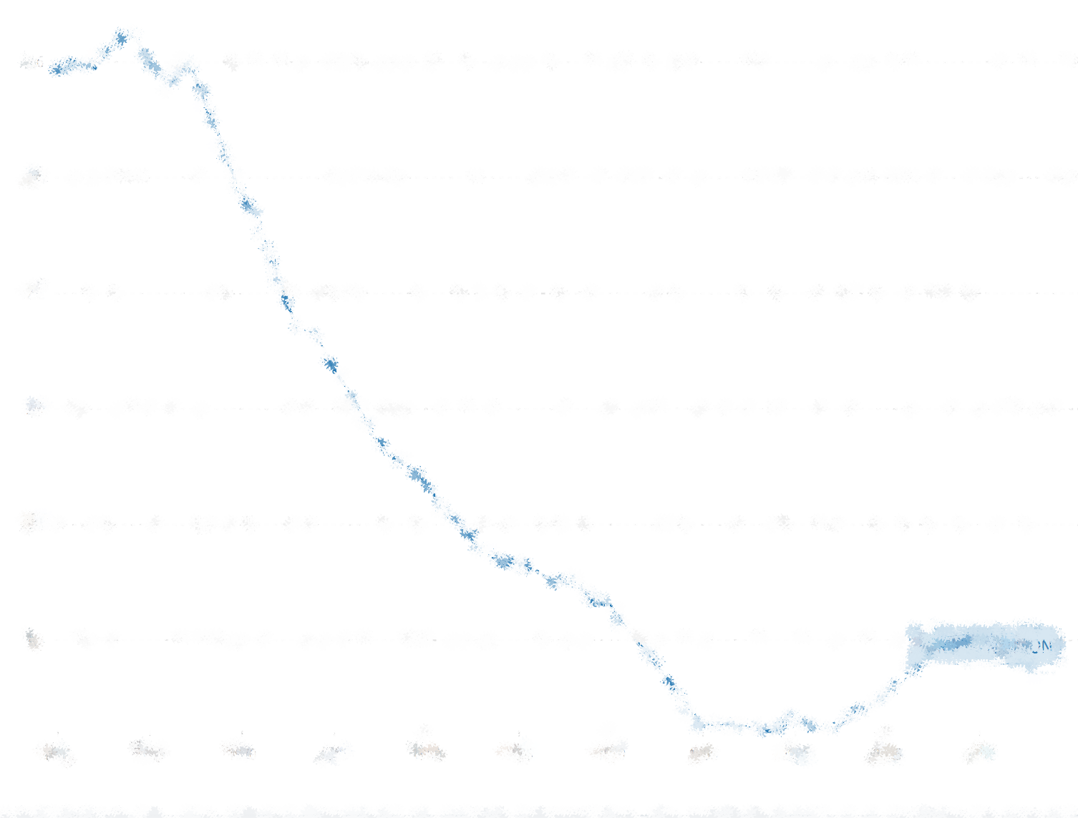

Decline and Fall
European Union Population Growth

Slide 91

E.U. Total Fertility Rates 1960 to 2018
1960 = 2.6
Fertility rates in the E.U. are some of the lowest in the world, and have been lower than ZPG since the mid 1970s. This, along with anti-migration sentiment, will result in declining populations.
Replacement rate.
At its current TFR alone, and without in-migration, Europe’s population would decrease from its existing 736.6 million to 375.5 million by 2100 – a decline of almost 50% - and get older faster.
2018 = 1.5

Slide 92

E.U. 27 Migration and Natural Increase
Transformation of just who it is that is responsible for population growth in Europe since the 1990s - migrants.

Slide 93

But population will decline by 2050 if baseline (current) trends hold.
Without migration population will decline by over 20 million.
Baseline
No migration
2000
2050

Slide 94

U.K. and E.U. Total Fertility Rates 1960 to 2018
Fertility rates in the U.K., while slightly higher, are below replacement rate. At its current TFR alone, and without in-migration, the UK’s population would decrease 16% from its existing 65.6 million to 55.3 million by 2100 and get older faster.
Over the next 10 years, 27% of UK population growth will come from natural increase and 73% from net international migration.
UK: 1964 = 2.9
EU: 1960 = 2.6
Replacement rate.
UK: 2018 = 1.7
EU: 2018 = 1.5
The UK’s anti-migration sentiment as reflected in the recent Brexit vote, and it’s relatively small migrant stock, will result in a declining and aging population.
https://data.worldbank.org/indicator/SP.DYN.TFRT.IN?view=chart&locations=GB-EU

Slide 95

Japan Total Fertility Rates 1960 to 2018
Japan’s TFR rates are extremely low, but not the lowest. Korea, Portugal and Hong Kong are about 1.2.
At its current TFR alone, and without in-migration, Japan’s population would decrease 62% from its existing 125.1 million to 48 million by 2100 and get older faster.
Replacement rate.
In 2005 the Japanese government took action to raise the TFR.
2005 = 1.26
1960 = 2.0
2018 = 1.42
1966 = 1.58
Hinoe-Uma - Year of the Fire Horse.
https://data.worldbank.org/indicator/SP.DYN.TFRT.IN?view=chart&locations=JP
Notes:
Increased induced abortion rate in 1966, an aspect of a Japanese folk superstition.
Kaku K.
Abstract
Adecrease of about 463 000 live births occurred in Japan in 1966, constituting a sharp departure from the linear trend before and after. This was partly caused by contraception and partly by induced abortion. The induced abortion rate, 43.1 per 1000 births in the year (a total of 65 000), was significantly higher than the 30.6 expected (46.200 total) from the regression trend computed from the years 1963 to 1969. No epidemics were reported in 1966 which might have caused the increase in abortion. It is more likely to be due to observance of Hinoe-Uma (Elder Fire-Horse), which comes round every sixty years by zodiac almanac. This event represents a superstition observed only by the Japanese, in whcih it is a bad omen for female babies to be born in the year. 1966 was the most recent year of Hinoe-Uma.

Slide 96
World Population Forecasts to 2100, 15-59 Cohort
This is the support cohort necessary for economic growth and the tax base.
Median forecasts for working cohort are almost flat lined by 2100.

Slide 97
World Population Forecasts to 2100 65+ Cohort
This is the elderly cohort who require support.
Median forecasts for elderly cohort are increasing fast by 2100.

Slide 98
Fun with Etinction
https://www.ined.fr/en/everything_about_population/population-games/tomorrow-population/
When playing with fertility rates, it’s fun to project them forward to see what year human populations could become extinct, and for your amusement here’s a few such projections run using the United Nations projection model (link above).
Projections are based on the current 2020 values for population levels, fertility rates, life expectancies and gender ratios, and also no net positive migration is assumed for the countries on the list. “Extinction” means too few and too old to breed.
South Korea: Year of Extinction 2562
Portugal: Year of Extinction 2410
Japan: Year of Extinction 2700
Canada: Year of Extinction 2700
They would also get much older much faster as they approach extinction, thus speeding up the decline as TFR decreases at a faster rate.
Notes:
This is the “extinction” modeller: https://www.ined.fr/en/everything_about_population/population-games/tomorrow-population/

Slide 99

Population Forecasts to 2100
This simulation website allows you to see the effects of declining fertility rate, including population pyramids. UN simulation based on their projections.
Click on the source box at the bottom to have even more fun with extinction.
Projected population growth rates
Actual population growth rates
Zero population growth rate
Notes:
http://www.ined.fr/en/everything_about_population/population-games/tomorrow-population/

Slide 100
Implications of Migration on Population Growth
If natural increase becomes natural decrease, populations will decline and age rapidly. So…
Equally rapid net migration increases are necessary to offset population decrease and aging to sustain demand, labour and dependency ratios.
But the implications of this are changes in:
Ethnic and cultural composition of the population.
Geopolitical behaviour and power.
Demand/supply patterns for goods and services.
Availability and skillsets of labour.
Income distribution – more inequality.
Resource consumption patterns.
And of course racism and xenophobia.

Slide 101
Chance of Dying in an Attack by a Foreign-Born Terrorist, 1975–2015
Visa category | Terrorism Deaths | Chance of being killed. | In words!
All | 3,024 | 1 in 3,609,709 | That’s 1 in 3.6 million
Tourist | 2,834 | 1 in 3,851,715 | That’s 1 in 3.8 million
Student | 158.2 | 1 in 68,869,156 | That’s 1 in 69 million
Fiance(e) Visa | 14 | 1 in 779,697,234 | That’s 1 in 779 million
Lawful permanent resident | 8 | 1 in 1,364,470,160 | That’s 1 in 1.36 billion.
Asylum Seeker | 4 | 1 in 2,728,940,320 | That’s 1 in 2.73 billion.
Refugee | 3 | 1 in 3,638,587,094 | That’s 1 in 3.61 billion.
Illegal immigrant | 1 | 1 in 10,915,761,281 | That’s 1 in 10.9 billion.
Unknown | 1.5 | 1 in 7,277,174,187 | That’s 1 in 7.28 billion.
Visa Waiver Program | 0 | 0 | That’s zero, nada, zilch
Sources: John Mueller, ed., Terrorism Since 9/11: The American Cases; RAND Database of Worldwide Terrorism Incidents; National Consortium for the Study of Terrorism and Responses to Terrorism Global Terrorism Database; U.S. Census Bureau, “American Community Survey”; Disaster Center, “United States Crime Rates 1960–2014”; and author’s calculations. Note: Nonwhole numbers for deaths result from dividing the number of victims among multiple terrorist perpetrators.
“The annual chance of being murdered from 1975 through the end of 2015 was 253 times as great as dying in an attack committed by a foreign-born terrorist on U.S. soil.” (Nowrasteh, Alex. Terrorism and Immigration: A Risk Analysis. Cato Institute (2016).

Slide 102
Dependency

Slide 103
Dependency Ratios
Dependency ratios refer to the number of workers in a population to the number of dependents.
Inverse dependency ratios refer to the number of a support group in a population to the number of dependents.
Estimates the degree of tax burden on the economy or the cost of supporting children and the elderly.
The young dependent group are seen as an economic asset because they will eventually become members of the support group.
The elderly dependent group are seen as an economic liability because they have left the support group and require increasing levels of expensive care.

Slide 104
Calculating Dependency Ratios
☺
Total Dependency Ratio = (Number of people 0-14 + 65>)
Number of people 15-64
For example – Canada, dependency ratio
Pop 65+ = 4,945,000 (14.8%)
Pop <=14 = 5,607,345 (16.7%)
Pop 15-64 = 23,930,434 (68.5%)
Calculated:
By Proportion: (16.7%+14.8%)/68.5% = 0.46
By Population: (4,945,000+5,607,345)/23,930,434 = 0.44
Low dependency ratios mean a low level of dependence, so low numbers are good.
Notes:
http://www12.statcan.gc.ca/census-recensement/2011/as-sa/98-311-x/98-311-x2011001-eng.cfm#a2
Highlights
The number of seniors aged 65 and over increased 14.1% between 2006 and 2011 to nearly 5 million. This rate of growth was higher than that of children aged 14 and under (0.5%) and people aged 15 to 64 (5.7%).
Seniors accounted for a record high of 14.8% of the population in Canada in 2011, up from 13.7% five years earlier.
In 2011, the proportion of seniors in Canada was among the lowest of the G8 countries.
The population of children aged 4 and under increased 11.0% between 2006 and 2011. This was the highest growth rate for this age group since the 1956 to 1961 period during the baby boom.
In 2011, there were 5,825 centenarians in Canada, up 25.7% since 2006. This was the second most rapidly growing age group among all age groups after those aged 60 to 64.
In 2011, the working-age population (those aged 15 to 64) represented 68.5% of the Canadian population. This proportion was higher than in any other G8 country, except Russia.
Among the working-age population, 42.4% were in the age group 45 to 64, a record high proportion. Almost all people aged 45 to 64 in 2011 were baby boomers.
In 2011, census data showed for the first time that there were more people aged 55 to 64, typically the age group where people leave the labour force, than aged 15 to 24, typically the age group where people enter it.
In 2011, the proportion of seniors was the highest in the Atlantic provinces, Quebec and British Columbia.
For the first time in 50 years, the number of children aged 4 and under increased between 2006 and 2011 in all provinces and territories.

Slide 105
Calculating Inverse Dependency Ratios
☺
Inverse dependency ratios tell you how many support people (or workers) you have for every dependent.
Using the Canadian population ratio calculated in the last slide:
(4,945,000+5,607,345)/23,930,434 = 0.44
We take the inverse of the ratio:
1/0.44 = 2.27
which tells us that there are 2.27 support people for every dependent.
High inverse dependency ratios mean a high level of support so high numbers are good.
Notes:
http://www12.statcan.gc.ca/census-recensement/2011/as-sa/98-311-x/98-311-x2011001-eng.cfm#a2
Highlights
The number of seniors aged 65 and over increased 14.1% between 2006 and 2011 to nearly 5 million. This rate of growth was higher than that of children aged 14 and under (0.5%) and people aged 15 to 64 (5.7%).
Seniors accounted for a record high of 14.8% of the population in Canada in 2011, up from 13.7% five years earlier.
In 2011, the proportion of seniors in Canada was among the lowest of the G8 countries.
The population of children aged 4 and under increased 11.0% between 2006 and 2011. This was the highest growth rate for this age group since the 1956 to 1961 period during the baby boom.
In 2011, there were 5,825 centenarians in Canada, up 25.7% since 2006. This was the second most rapidly growing age group among all age groups after those aged 60 to 64.
In 2011, the working-age population (those aged 15 to 64) represented 68.5% of the Canadian population. This proportion was higher than in any other G8 country, except Russia.
Among the working-age population, 42.4% were in the age group 45 to 64, a record high proportion. Almost all people aged 45 to 64 in 2011 were baby boomers.
In 2011, census data showed for the first time that there were more people aged 55 to 64, typically the age group where people leave the labour force, than aged 15 to 24, typically the age group where people enter it.
In 2011, the proportion of seniors was the highest in the Atlantic provinces, Quebec and British Columbia.
For the first time in 50 years, the number of children aged 4 and under increased between 2006 and 2011 in all provinces and territories.

Slide 106
Interpreting Dependency Ratios
☺
Dependency ratios are about the number of dependents.
Inverse dependency ratios are about the amount of support.
Effects on an Economy
 | High | Low
Dependency Ratio | Not good (Too many dependents, not enough workers) | Good (Not too many dependents for the number of workers)
Inverse Dependency Ratio | Good (Enough workers to support the dependents) | Not good (Not enough workers to support the dependents)
Notes:
http://www12.statcan.gc.ca/census-recensement/2011/as-sa/98-311-x/98-311-x2011001-eng.cfm#a2
Highlights
The number of seniors aged 65 and over increased 14.1% between 2006 and 2011 to nearly 5 million. This rate of growth was higher than that of children aged 14 and under (0.5%) and people aged 15 to 64 (5.7%).
Seniors accounted for a record high of 14.8% of the population in Canada in 2011, up from 13.7% five years earlier.
In 2011, the proportion of seniors in Canada was among the lowest of the G8 countries.
The population of children aged 4 and under increased 11.0% between 2006 and 2011. This was the highest growth rate for this age group since the 1956 to 1961 period during the baby boom.
In 2011, there were 5,825 centenarians in Canada, up 25.7% since 2006. This was the second most rapidly growing age group among all age groups after those aged 60 to 64.
In 2011, the working-age population (those aged 15 to 64) represented 68.5% of the Canadian population. This proportion was higher than in any other G8 country, except Russia.
Among the working-age population, 42.4% were in the age group 45 to 64, a record high proportion. Almost all people aged 45 to 64 in 2011 were baby boomers.
In 2011, census data showed for the first time that there were more people aged 55 to 64, typically the age group where people leave the labour force, than aged 15 to 24, typically the age group where people enter it.
In 2011, the proportion of seniors was the highest in the Atlantic provinces, Quebec and British Columbia.
For the first time in 50 years, the number of children aged 4 and under increased between 2006 and 2011 in all provinces and territories.

Slide 107
Interpreting Dependency Ratios - Children versus Elderly
☺
Developed nations are weighted heavily towards the elderly (old nations = old people.)
Developing nations are weighted heavily towards children (young nations = young people).
Effects on an Economy
 | High contribution to ratio | Low contribution to ratio
Elderly cohort component (economic liability) | Not good (Too many elderly requiring support without future benefit.) | Good (Few elderly requiring support.)
Children cohort component (economic asset) | Good (Children require support but will eventually become workers.) | Not good (Children require support and not enough of them to become workers.)
Notes:
http://www12.statcan.gc.ca/census-recensement/2011/as-sa/98-311-x/98-311-x2011001-eng.cfm#a2
Highlights
The number of seniors aged 65 and over increased 14.1% between 2006 and 2011 to nearly 5 million. This rate of growth was higher than that of children aged 14 and under (0.5%) and people aged 15 to 64 (5.7%).
Seniors accounted for a record high of 14.8% of the population in Canada in 2011, up from 13.7% five years earlier.
In 2011, the proportion of seniors in Canada was among the lowest of the G8 countries.
The population of children aged 4 and under increased 11.0% between 2006 and 2011. This was the highest growth rate for this age group since the 1956 to 1961 period during the baby boom.
In 2011, there were 5,825 centenarians in Canada, up 25.7% since 2006. This was the second most rapidly growing age group among all age groups after those aged 60 to 64.
In 2011, the working-age population (those aged 15 to 64) represented 68.5% of the Canadian population. This proportion was higher than in any other G8 country, except Russia.
Among the working-age population, 42.4% were in the age group 45 to 64, a record high proportion. Almost all people aged 45 to 64 in 2011 were baby boomers.
In 2011, census data showed for the first time that there were more people aged 55 to 64, typically the age group where people leave the labour force, than aged 15 to 24, typically the age group where people enter it.
In 2011, the proportion of seniors was the highest in the Atlantic provinces, Quebec and British Columbia.
For the first time in 50 years, the number of children aged 4 and under increased between 2006 and 2011 in all provinces and territories.

Slide 108

Regional Proportions of Dependent Age Cohorts, World Population 2014
☺
Even though Africa’s dependency rate is high, it is weighted heavily with children who can potentially move into the support group, leveraging the demographic dividend.
In Europe? There are more elderly.
45%
34%
34%
32%
35%
33%
33%
Under 15 years
Over 64 years

Slide 109

Dependency Rates, Selected Nations, 2005 and 2050
☺
As these nations age, ratios increase dramatically. Japan has an especially difficult time ahead due to its highly restrictive immigration policy.

Slide 110
Important Population Dynamics Concepts - Reprise
We have examined the population model and its components:
Births, Deaths, Natural increase.
In-migration, Out-migration, Net migration.
Forecasting.
Fertility rates.
And the implications of that model:
Population will decline when TFRs are below 2.1.
Population will age as it declines.
Need for in-migration to sustain numbers and age structure.
Next lecture we will look at the structural attributes of population and return to these implications and the problems that will arise.
We will also look at possible solutions for them.

Slide 111
Global Demography Summary
Population is the foundation on which nations, economies, cultures are built – but too many people can stifle prosperity and well being.
While population growth rates have been decreasing since at least the mid-1980s, population numbers will still top 11 billion by 2100.
Two major characteristics typify the current global population – it is aging, and it is gender bound.
The developed world is aging rapidly, losing population, yet resisting immigration, while the developing world still faces high population growth from its young population.
And for half of it, females, equality and equity are still far away, and, with recent populist sentiment taking control, their appears to be no end in sight.

