Slide 1

URBAN
SOCIAL
ECOLOGY

Slide 2
People Make Place
In this course, I have tried to make the case that the built environment around us – urban environments - are turned into place by the perceptions, cognition, and behaviour of humans.
The built environment is given meaning by humans, to the point where we even have a word for it: “civilisation”, the roots of which derive from the Latin civitas or city and civis or citizen.
Before cities we were as a species many things, but we were not “civilised” – a term that has come to mean “The stage of human social and cultural development and organization that is considered most advanced.”¹
But while people may have made the built environment, giving it meaning, and turning it into “place”, it has been the movement of people that has made cities grow and urbanise, and as you know from the past two lectures these are different things.
1: https://www.lexico.com/definition/civilization

Slide 3
People Moving Make Dynamic Places
By “movement” of people I mean (1) the movement of people through time as we grew in size, then concentrated in space, and (2) increasingly it means movement in space as we migrate.
Social geography, as we shall see, is about ecology; it’s about how communities evolve and change, regroup, combine and mix - sometimes easily and other times not - as new populations arrive and reshape environments.
Today we will look at the social geography of cities and where people are, who they are, and possibly why they are.
But to do this we need to look at one of the most important concerns of our present and of your future: the demographic dilemma, which, along with climate change and inequality threatens our survival.

Slide 4
Urban Social Ecology
The Demographic Dynamic Dilemma
The Population Model
The Survival Dilemma
Urban Ecology
The Assimilation Model
Social Area Analysis (SAA
SAA Methodology
Criticisms of SAA
Factorial Ecology
Factorial Ecology Methodology
Results of Factorial Ecology Analysis
Spatial Patterns to Social Dimensions
Metro Toronto’s Social Areas
Changing Urban Ecologies
Problems with Factorial Ecologies
Linking Social Space to Housing Space: Rees Community Space

Slide 5
The Ecological Approach

Slide 6
☺
Land Use and Using Land
Cities are not just about land use; they are about how people use the land.
Those “uses” have many driving factors including income, culture, ethnicity, religion, even type of structure – house or condo? Rent or buy?
All of these factors can be labelled as “social influences”, and how they shape a landscape is called social geography.
Social geography changes land use into use of land; it transforms the built environment into communities.
Today’s lecture is about this transformation and the social geography of the city that often hides in plain sight.

Slide 7
☺
Building Built Environments
Louis Wirth who we have seen briefly before in discussing neighborhoods, understood that urbanism was an amalgam of the built environment and humans - because you cannot have a “built” environment without “builders”.
So urban environments are ever and always social environments because people bring their ‘social’ with them wherever they go.
This point, the idea that people go places; that they move, and migrate, within and between places, regions, nations, is such a fundamental attribute of the human world that it was adopted by social geography as the “ecological approach”.

Slide 8
☺
Social Geographical Approaches
Three principal approaches, all growing out of the ecological approach.
The ecological approach of the 1930s, which borrowed concepts from ecology to describe and explain urban processes.
Social area analysis (SAA) of the 1940s and 1950s, that attempted to measure and map urbanisation processes with data based dimensions and form.
Factorial urban ecology (since the 1960s) that used multivariate statistical methods to explore and explain “social dimensions” of urban areas – how, in Kenneth Boulding’s words “growth creates form and form limits growth.”

Slide 9
☺
Urban Ecology
This approach used concepts from natural ecology such as communities, ecotones, succession, dominance, which was starting at that time.
Two most important points:
It concentrated on the characteristics of people in certain places (communities or neighbourhoods) and the tensions and conflicts at the boundaries (ecotones) of those communities, that gave rise to succession and dominance among the groups, thus changing the nature of the places.
It applied to groups of people, rather than individuals, and hence could rely on census data collected for small areas across many geodemographic and socio-economic variables.
One model of this process is the assimilation model.

Slide 10
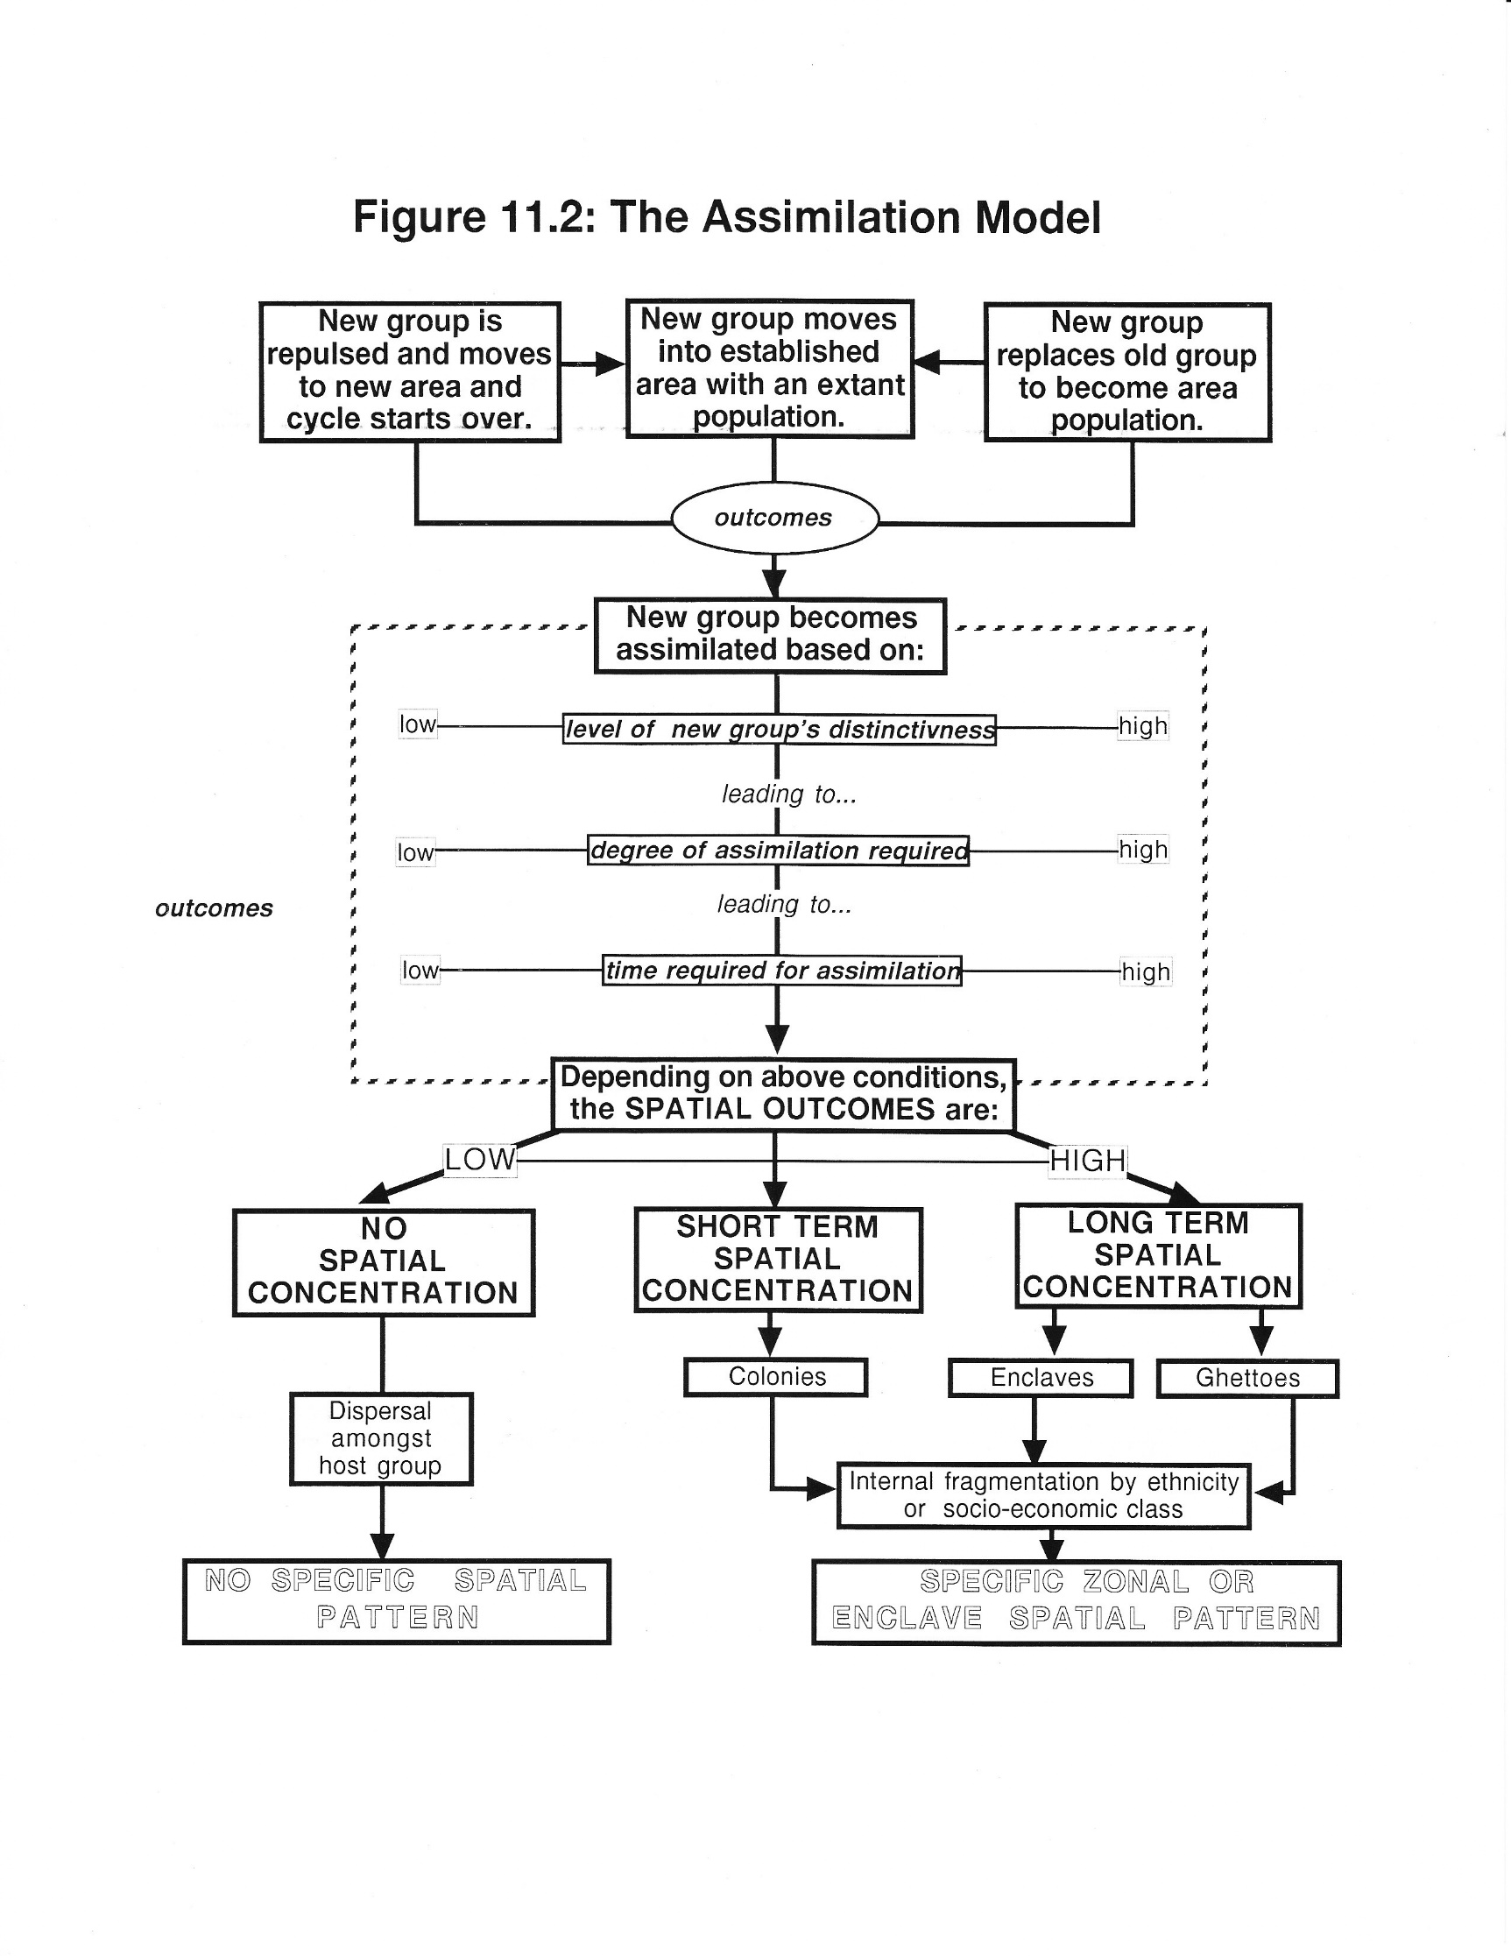
Assimilation Model
☺
Arrival of new population group
Degree of assimilation
Spatial outcomes
Spatial forms

Slide 11
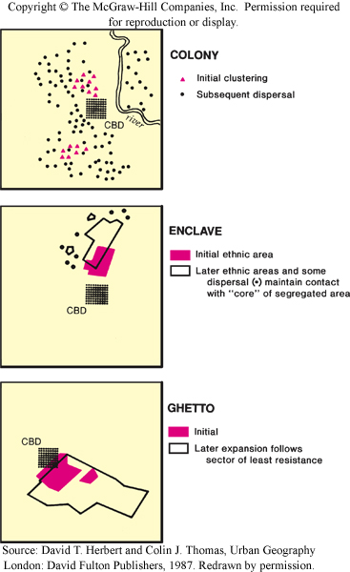
☺
Colonies
Initially cluster, then disperse among host population within same generation. E.G. U.K., South African, Australian immigrants to Toronto.
Enclave
Initially cluster, then disperse among host population in the next generation. Subsequent new groups occupy original cluster areas or create new ones. E.G. Italian immigrants to Toronto integrate by second generation and new groups forming Little Italies at various locales
Ghetto
Initially cluster, but find it difficult to disperse into host population in any generation due to prejudice, culture/language barriers. Subsequent new groups occupy original cluster areas.

Slide 12
Birds, Bees, and Butterflies

Slide 13
Population Dynamics
The assimilation model deals specifically with what happens to migrant populations moving into a city, and this is the classic ecological succession process.
But it is also implicitly about migration and population change; the heart of how and why urban environments transform, and transform in the most complex way: through social, economic and cultural blending - and resistance to that blending.
For the next few slides I will become a missionary, by which I mean to introduce a demographic certitude that all of you as “the future human population” will carry forward.
It is also, in my opinion, the least known but most threatening aspect of that future, your future, and it’s all about the birds, the bees, and - the butterflies.

Slide 14
Where Does Population Growth Come From?
☺
Pop growth = (Births - Deaths) + (In-migration - Out-migration)
(Births – Deaths) = Natural Increase or Decrease
(In-migration – Out-migration) = Net migration
Pop growth = Natural Change + Net Migration
Therefore, natural decrease must be offset by an increase in net migration, otherwise populations will decline.
Population Is Vital.
Human capital
Economic demand
Support group
Taxpayers
Human resource asset
Territorial security
Cultural identity

Slide 15

Where Does Population Growth Not Come From?
Old people.
The one incontrovertible biological fact of human life is that life comes from young people.
And in demographic terms, population potential (for reproducing population) comes from females 15 to 49 years of age, and the younger the cohort the higher the potential.
Thus, the older a population gets, the more this potential shrinks, and the more it shrinks the harder it is to re-establish population growth.
The only certainty for the future is that without at least 2.1 children born per couple, or net inmigration to make up the difference, populations will age and die.
Fertility

Slide 16
When Does Population Growth Stop and Decline Start?
This is an easy question to answer: population growth stops when:
The number of children born per couple decreases below 2.1.¹
Net inmigration in a population is too low to compensate.
A population’s average age exceeds 50.
The lower the fertility rate…
… and the fewer the number of migrants...
… then the older a population becomes, …
…the faster a country’s population decreases,…
… and the faster its economy and culture decline.
This is not a matter of opinion; it is a matter of fact.
It does not matter on which side the political spectrum you stand, this fate is the same for all species.
1: This is called replacement rate. It refers to the number of children required per procreating couple, to replace that couple. The number is slightly above 2 to compensate for infant mortality which, alas, occurs no matter how advanced a society is.

Slide 17
Where Does Population Growth Come From?
Another Reminder
The Butterfly Effect
(Demography style)
Pop growth =(Births - Deaths) + (In-migration - Out-migration)
(Births – Deaths) = Natural Increase or Decrease
(In-migration – Out-migration) = Net migration
Pop growth = Natural Increase or Decrease + Net Migration
Low rates of natural increase must be offset by increases in net migration, otherwise populations will decline and age, leading first to dependency issues, then to economic issues, including health costs.
Population Is Important
Human capital
Economic demand
Human resource asset
Territorial security
Cultural identity

Slide 18
Consequences and Truth.
☺
Fertility rates in the developed world are significantly lower than they were in the 1950s (les than half), and they are significantly below where they need to be to sustain population growth through natural increase.
Populist anti-immigration sentiment among extant populations, and policies driven by it in the developed world, are also significantly higher than in the 1950s.
Yet, like fertility, migration rates are significantly below where they need to be to sustain population growth.
The implications derive from basic population model arithmetic, yet surprisingly, we seem intent on doing the opposite of what the model demands we do to survive.

Slide 19
What to do, what to do??? Hmmmm?
☺
The answer to the dilemma is easy peasy:
Have more babies and/or immigrate more people.
To repeat the obvious, it’s basic population model arithmetic, yet surprisingly, we seem intent on doing the opposite.
Is it more complicated than this?
No, not the arithmetic.
Yes, absolutely in the sociological/political implications.
This is not a course on demographics, nor is it even a lecture on the topic, but given the importance of the issue we will spend a few more slides looking at the data.
What follows is not my opinion; this is fact.

Slide 20
Migrant Stock
☺
Migrant stock refers to the number (or proportion) of people in a population who are foreign born as of a given date.
For example, if you were born in Canada but your parents were not, your parents would be counted as part of the Canada’s migrant stock but you would not.¹
When a country has a net inflow of migrants it is called a destination country, and when it has a net outflow of migrants it is called a diaspora country.
Countries can have large inflows and outflows thus making their net level of migrant stock low.
1: If this were a normal class I would at this point ask everyone not born in Canada but who is a resident or citizen to put up their hands (mine would be among them). We would be part of Canada’s the “migrant stock”.

Slide 21
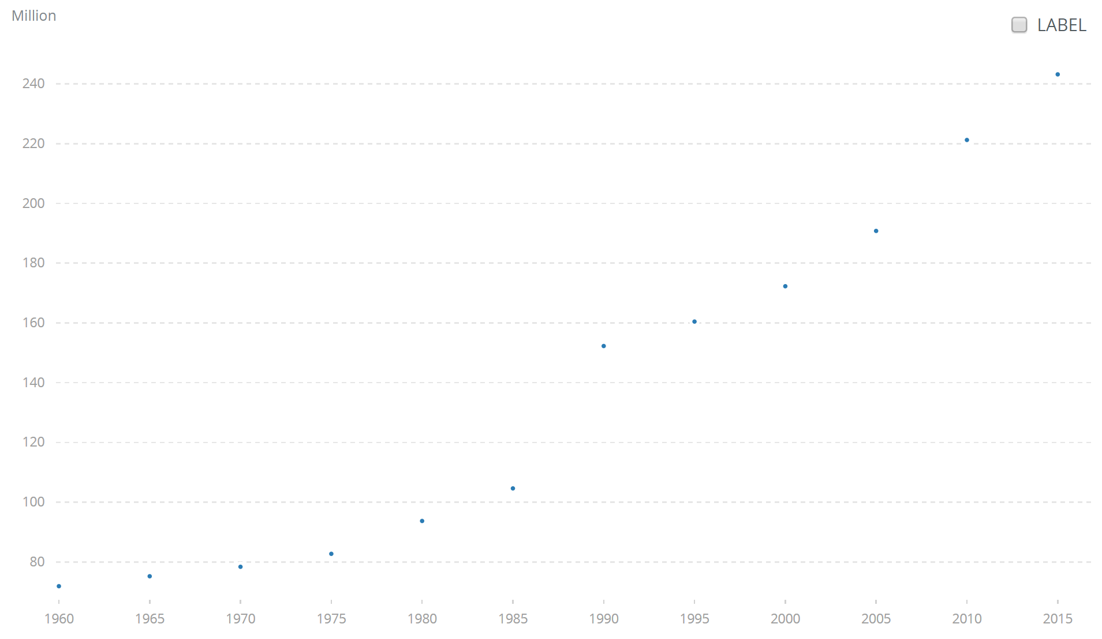
Global Migrant Stock 1960 to 2015
2015 =243 million
Global migrant stock has increased steadily since 1960 from about 70 million to over 240 million people by 2015.
1960=70 million
Source: World Bank Development Indicators 2016

Slide 22
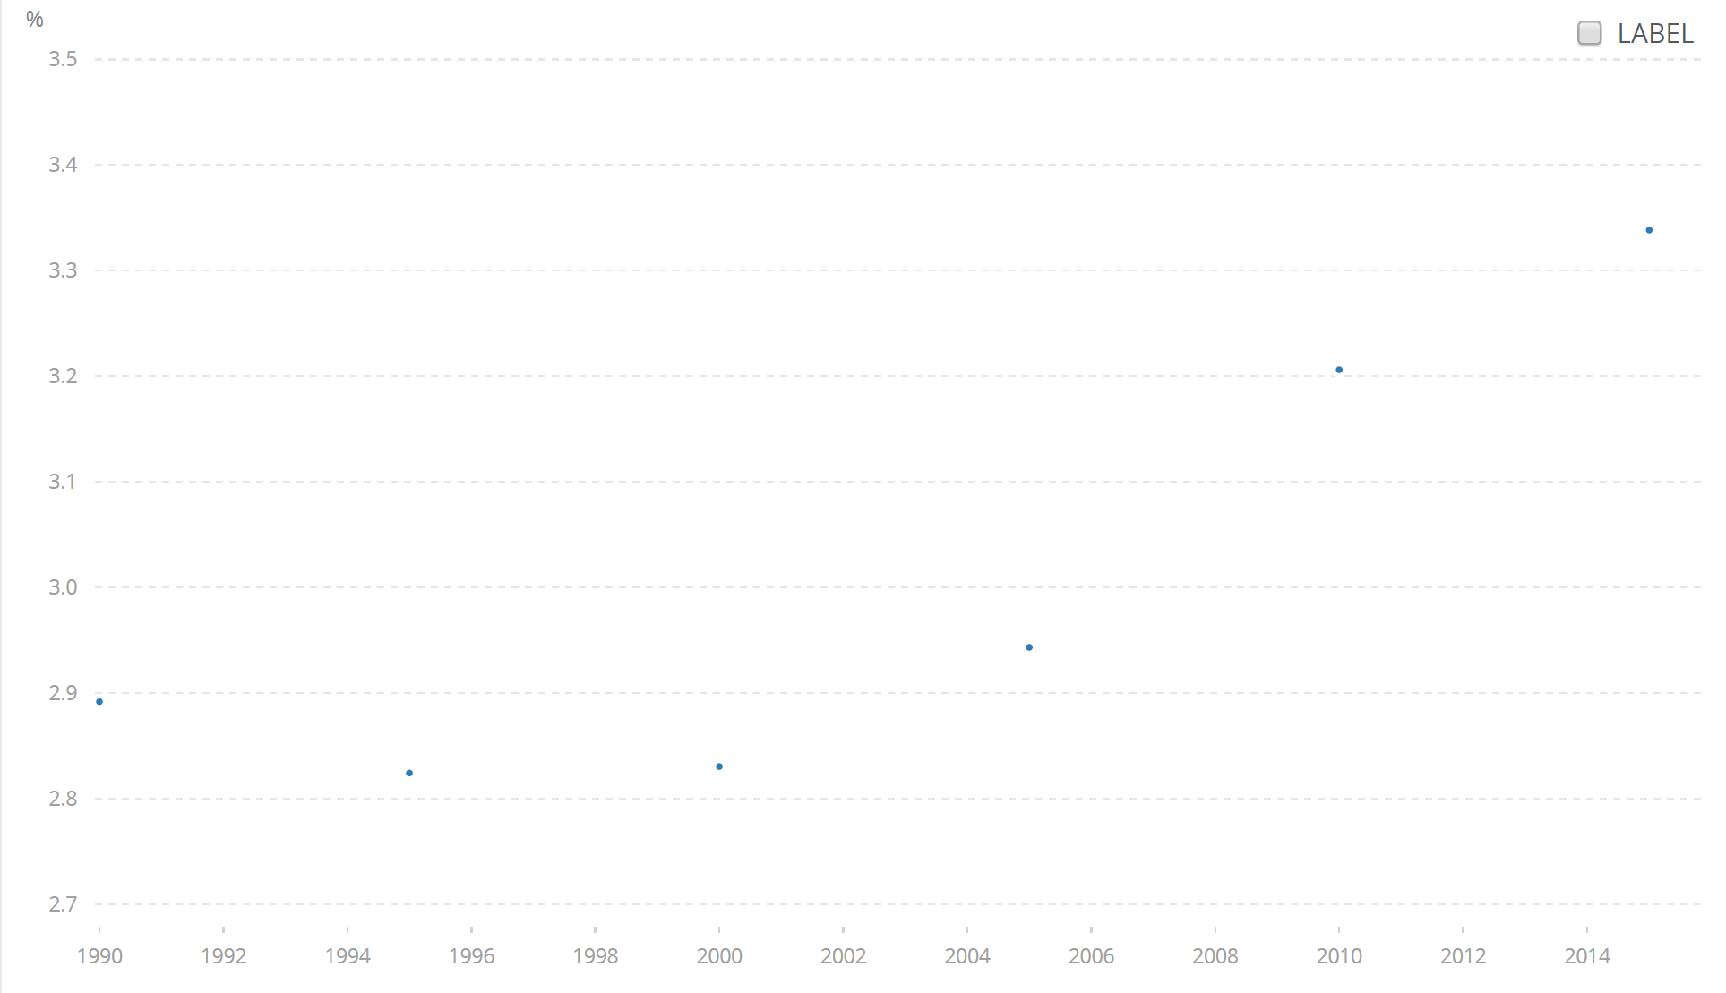
Migrant Stock
Percentage of Global Population 1960 to 2015
2015 = 3.3%
Growth rates have increased from about 2.7% in 1960 to over 3.3% by 2015 - about three times that of annual population growth in general.
But overall, migrant stock in the world is a very small proportion of global “citizenry”, which makes anti-migrant sentiment even more puzzling.
2015 = 2.7%
Source: World Bank Development Indicators 2016

Slide 23
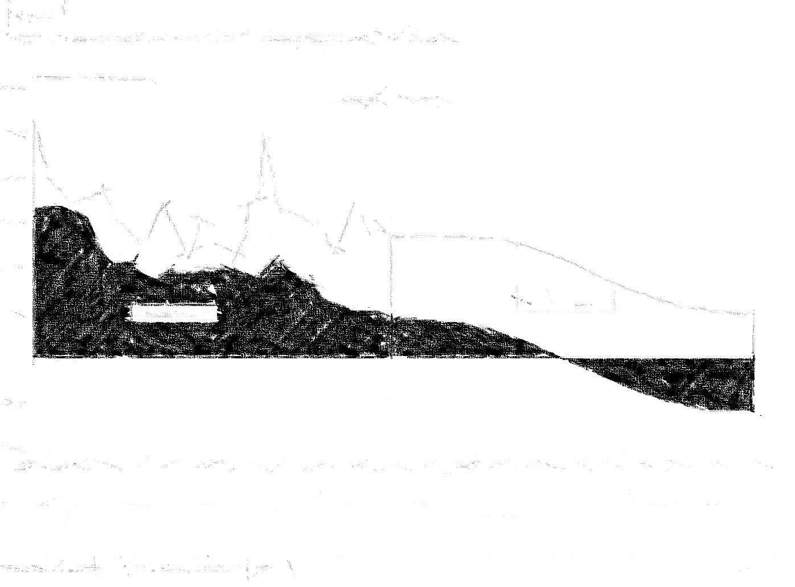

Oh Canada!
Canadian Population Growth

Slide 24
COMPONENTS OF CANADIAN POPULATION GROWTH 1851 TO 2001
PERIOD | NATURAL INCREASE (NI) | NET MIGRATION | POP GROWTH | NM as a % of Pop Growth | NI as a % of Pop Growth
1851-1861 | 611,000 | 182,000 | 793,000 | 22.95% | 77.05%
1861-1871 | 610,000 | -150,000 | 460,000 | -32.61% | 132.61%
1871-1881 | 690,000 | -54,000 | 636,000 | -8.49% | 108.49%
1881-1891 | 654,000 | -146,000 | 508,000 | -28.74% | 128.74%
1891-1901 | 668,000 | -130,000 | 538,000 | -24.16% | 124.16%
1901-1911 | 1,025,000 | 810,000 | 1,835,000 | 44.14% | 55.86%
1911-1921 | 1,270,000 | 311,000 | 1,581,000 | 19.67% | 80.33%
1921-1931 | 1,360,000 | 230,000 | 1,590,000 | 14.47% | 85.53%
1931-1941 | 1,222,000 | -92,000 | 1,130,000 | -8.14% | 108.14%
1941-1951 | 1,972,000 | 169,000 | 2,141,000 | 7.89% | 92.11%
1951-1956 | 1,473,000 | 598,000 | 2,071,000 | 28.87% | 71.13%
1956-1961 | 1,675,000 | 482,000 | 2,157,000 | 22.35% | 77.65%
1961-1966 | 1,518,000 | 259,000 | 1,777,000 | 14.58% | 85.42%
1966-1971 | 1,090,000 | 463,000 | 1,553,000 | 29.81% | 70.19%
1971-1976 | 936,000 | 695,000 | 1,631,000 | 42.61% | 57.39%
1976-1981 | 977,000 | 493,000 | 1,470,000 | 33.54% | 66.46%
1981-1986 | 987,000 | 400,000 | 1,387,000 | 28.84% | 71.16%
1986-1991 | 987,000 | 951,000 | 1,938,000 | 49.07% | 50.93%
1991-1996 | 912,000 | 780,000 | 1,692,000 | 46.10% | 53.90%
1996-2001 | 616,000 | 841,000 | 1,457,000 | 57.72% | 42.28%
 | 21,253,000 | 7,092,000 | 28,345,000 | 25.02% | 74.98%
Period | Average net migration share of pop growth
1931-2001 | 29.44%
1941-2001 | 32.85%
1951-2001 | 35.35%
1961-2001 | 37.78%
1971-2001 | 42.98%
1981-2001 | 45.43%
1991-2001 | 51.91%
1996-2001 | 57.72%
2010-2011 | 60.5%
2011-2012 | 59.1%
2012-2013 | 60.3%
2013-2014 | 60.7%
2014-2015 | 58.8%
2015-2016 | 67.4%
Since 1851 natural increase has provided about 75% of Canada’s population growth.
But migration has been providing an ever increasing share of population growth.
Between 2001 and 2016 migration share of total growth has averaged 61%.
Notes:
Stats Canada http://www.statcan.gc.ca/cgi-bin/sum-som/fl/saveas-eng.cgi

Slide 25
Natural Increase and Migration Canada, 1851-2001
☺
Natural increase dominant growth component in pre-Confederation to pre-WW2 period.
Migration dominant as major growth component in post WW2 period.
http://www5.statcan.gc.ca/cansim/a26

Slide 26
Natural Increase and Migration as a Share of Population Growth
Canada, 1851-2012
☺
Migration increasingly dominant as population growth component.
Natural increase
Migration
Migration outstrips natural increase
Source: Calculated from previous Statistics Canada data.

Slide 27
Components of Canada's Population Growth, 1971-2016
From about 2000, net migration outstrips natural increase as the engine of population growth.
By 2016 the ratio of migrants to births has increased from 0.27 to 2.07.

Slide 28
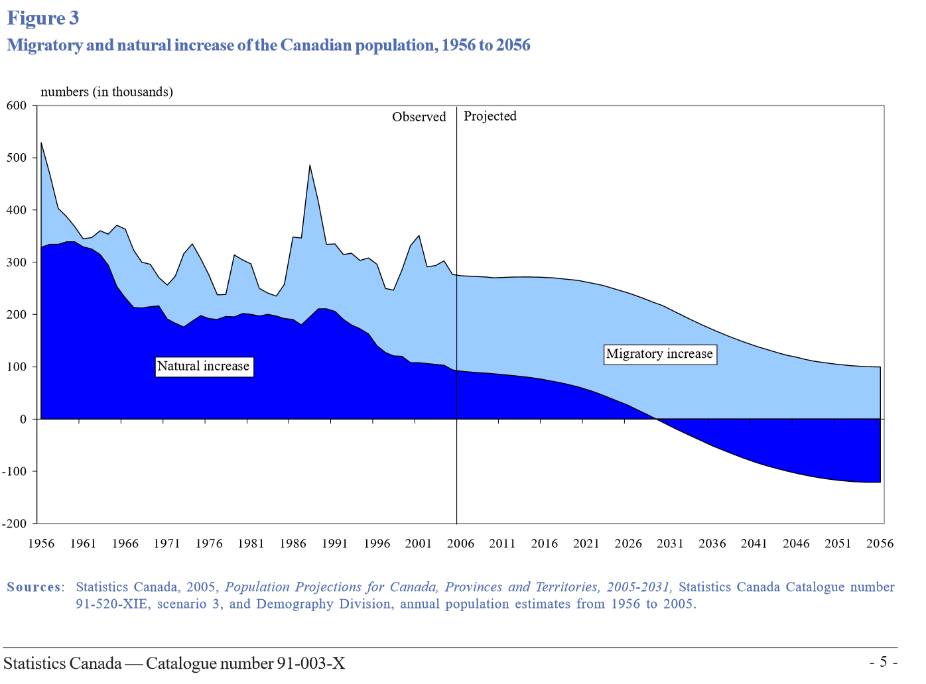
Natural Increase and Migration Canada, 1956 to 2056
Population growth will depend increasingly on migration, and, by 2030, entirely on it. But overall population growth will decline.
Natural increase will decrease to zero by 2030 and thereafter become natural decrease.

Slide 29
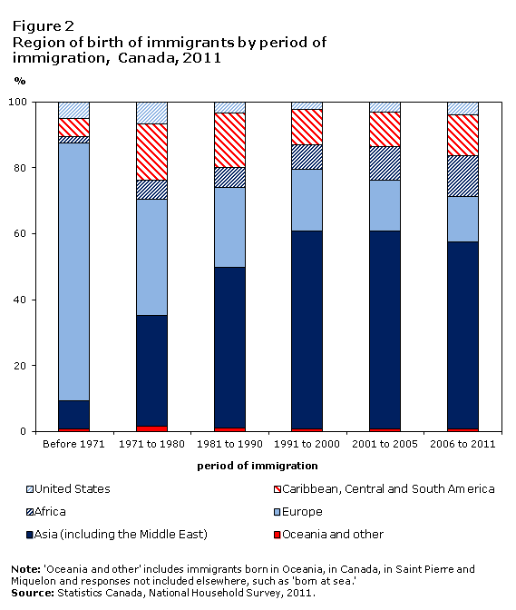
The Changing Face of Immigration to Canada
Immigration origins have changed in the past 50 years, from mainly Europe to mainly Asia and the Middle East, with a growing percentage from African nations.
Mainly European
Mainly Asian
https://www12.statcan.gc.ca/nhs-enm/2011/as-sa/99-010-x/2011001/c-g/c-g02-eng.cfm

Slide 30
Where Canadian Migrants Go
About 62% of migrants go to Canada’s six largest urban areas, with over half going to Toronto.
Census Metropolitan Area | Percent Share of Immigration | Percent Share of Immigration 2006-2011
Toronto | 37.4 | 32.8
Montreal | 12.5 | 16.3
Vancouver | 13.5 | 13.3
Calgary | 3.7 | 6.1
Edmonton | 3.5 | 4.3
Winnipeg | 2.2 | 3.9
https://www12.statcan.gc.ca/nhs-enm/2011/as-sa/99-010-x/2011001/tbl/tbl1-eng.cfm

Slide 31
Implications of Migration on Population Growth
If natural increase becomes natural decrease, populations will decline and age rapidly. So…
Equally rapid net migration increases are necessary to offset population decrease and aging to sustain demand, labour and dependency ratios.
But the implications of this are changes in:
Ethnic and cultural composition of the population.
Geopolitical behaviour and power.
Demand/supply patterns for goods and services.
Availability and skillsets of labour.
Income distribution – more inequality.
Resource consumption patterns.
And, of course, racism and xenophobia.
And if recent decades are any indication, we are simply not ready for any of this.

Slide 32
Whither the Rest of the World?
Much as I would love to continue the demographic theme, we must change focus to the social geography of cities.
I would strongly encourage all of you to pursue a course that has some demographics in it, and to learn just what this particular one of the three existential threats to your future (climate change, demography, inequality) and our species has in store for you.
Suffice now to say that everywhere – every single country - in the developed world is on the same track as Canada, and we are one of the best off nations among the group.
The demographic threat will engulf western developed nations before this century is done.
And that is not my opinion. That is just fact.

Slide 33
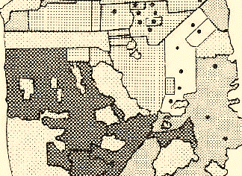
Social
Area
Analysis

Slide 34
☺
Social Area Analysis
Attempt to give the social structure of the city an underlying empirical basis.
Grew out of the sociological discussion of the process of urbanisation, especially Louis Wirth's (1938) ideas on urbanism as a way of life.
Wirth suggested that the old ideas about neighborhoods as homogenous “villages” had to give way to the different societies of the city.
SAA proposed that a city could not be understood without consideration of the society that created it.
Urbanisation had changed everything – economics, demographics, culture – in a word, society.
1: Louis Wirth. Urbanism as a Way of Life. The American Journal of Sociology, Vol. 44, No. 1 (Jul., 1938), pp. 1-24, The University of Chicago Press. http://www.sjsu.edu/people/saul.cohn/courses/city/s0/27681191Wirth.pdf

Slide 35
☺
Urbanisation Process Model - Reprise
Saw this model already as the process by which urban, economic, and demographic transition create a new version of urban areas.
Cities begin to change their nature creating new economies, cultures, mixing and morphing society into urban society that also includes the non-urban components such as rural and frontier areas.
Industrial cities of become new inventions, different from their previous historical manifestation.
The three major transitions of society are linked together like a set of gears, each driving the others through a complex and synchronized set of causes and effects; of positive feedbacks that stimulate and reinforce change in form and structure of cities.

Slide 36
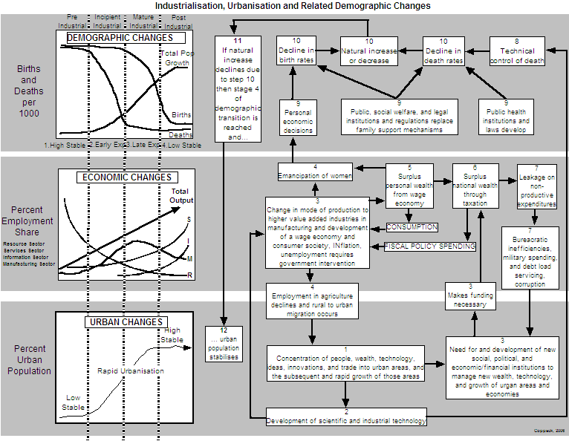
A Simplified Model of Urbanisation - Reprise
☺

Slide 37
☺
These aspects of urbanisation… | … lead to these changes in society… | … whose effects on space are … | … and can be measured thus … | … and are called:
Change in the range and intensity of socio-economic relationships | Changing structure of productive activity. Decreasing importance of manual production. Increasing importance of services sector employment. | Changes in the spatial arrangement of occupations based on function. | Education, income, occupation, own or rent, persons per room, employment status, ownership of items, tax category. | ECONOMIC STATUS
Differentiation of economic functions and family roles. | Decreasing importance of primary production. Movement of women into the labour force. Development of alternate family patterns based on lifestyle. | Changes in housing stock, choice and lifestyles. Filtering, downtown infilling, suburbs become urbs. | Age and gender ratios, number of children, type of dwelling, own or rent, number of persons per household, type of vehicle. | FAMILY STATUS
Variety of origins and differentiation of people | Changing composition of population. Increasing migration and movement. Changes to age and gender distributions. Increasing ethnic diversity. | Redistribution of space into core and periphery. Isolation and segregation of groups. Increase in international migration. | Ethnicity, mother tongue, country of origin, length of residency, movement patterns over time, children’s movement patterns. | ETHNIC STATUS
Urbanisation and its Implications on the Social Geography of Cities
Process of Urbanisation
Social Area Constructs
Increasing Social Scale
Variables

Slide 38
☺
These aspects of urbanisation… | … lead to these changes in society… | … whose effects on space are … | … and can be measured thus … | … and are called:
Change in the range and intensity of socio-economic relationships | Changing structure of productive activity. Decreasing importance of manual production. Increasing importance of services sector employment. | Changes in the spatial arrangement of occupations based on function. | Education, income, occupation, own or rent, persons per room, employment status, ownership of items, tax category. | ECONOMIC STATUS
Differentiation of economic functions and family roles. | Decreasing importance of primary production. Movement of women into the labour force. Development of alternate family patterns based on lifestyle. | Changes in housing stock, choice and lifestyles. Filtering, downtown infilling, suburbs become urbs. | Age and gender ratios, number of children, type of dwelling, own or rent, number of persons per household, type of vehicle. | FAMILY STATUS
Variety of origins and differentiation of people | Changing composition of population. Increasing migration and movement. Changes to age and gender distributions. Increasing ethnic diversity. | Redistribution of space into core and periphery. Isolation and segregation of groups. Increase in international migration. | Ethnicity, mother tongue, country of origin, length of residency, movement patterns over time, children’s movement patterns. | ETHNIC STATUS
Process of Urbanisation
Social Area Constructs
Increasing Social Scale
Variables

Slide 39
☺
Process of Urbanisation and the Development of Social Area Analysis Dimensions
Change in the range and intensity of socio-economic relationships
Social status
Urbanisation
Processes:
Increased societal scale and complexity and functional differentiation creating…
Differentiation of economic functions and family roles.
Family status
Variety of origins and differentiation of people
Ethnic status

Slide 40
☺
Social Area Analysis Dimensions, How They Are Measured, and Their Effects on Space
Measured by census variables such as income, occupation, education.
Social status
Giving rise to different spatial patterns based on conditions of status such as ability to afford best land, need for family lifestyle space, conditions of assimilation model.
Measured by census variables such as marital status, number of children.
Family status
Measured by census variables such as ethnicity, mother tongue.
Ethnic status

Slide 41
☺
Large
Families
Poorer
Large
ethnic
families
Wealthy
large
ethnic
families
Poorer
large
families
Wealthy
large
families
FAMILY
STATUS
DIMENSION
Poorer
ethnic
singles
Wealthy
ethnic
singles
ETHNIC STATUS DIMENSION
Poorer
singles
Wealthy
singles
Singles
Low Medium High
SOCIAL STATUS DIMENSION

Slide 42
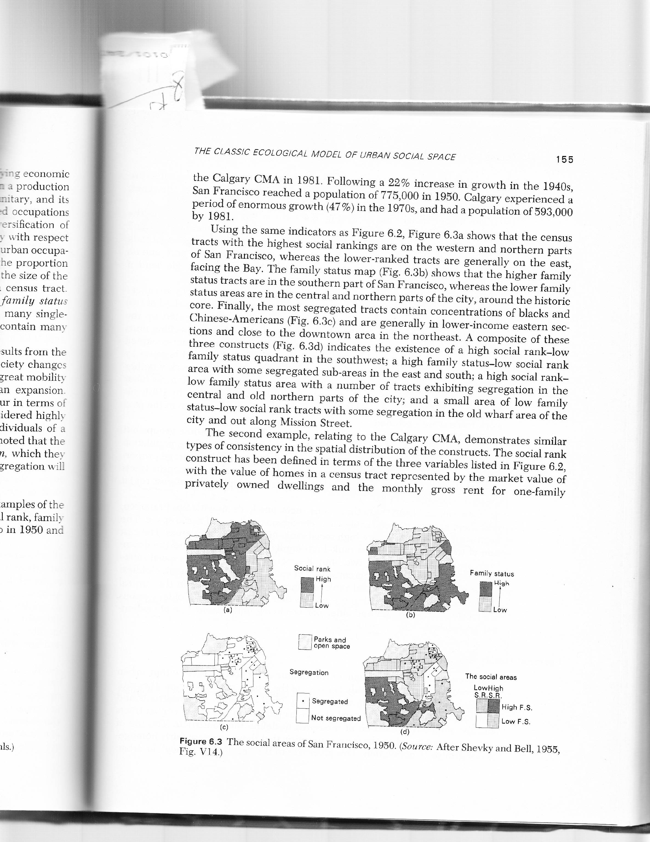
A Social Area Analysis of San Francisco (Shevky and Bell, 1955)
Social Status
Family Status
Income, education, occupation
# of kids, station wagons
Composite Social Geography
Ethnic Status
% mother tongue, labels
Social Area Analysis. Eshref Shevky and Wendell Bell. Stanford, California, Stanford University Press, 1955.

Slide 43
☺
Criticisms of Social Area Analysis
Are the urbanisation processes underlying SAA real?
While the empirical patterns described by urbanisation are real enough, the underlying theoretical postulates can be interpreted differently – e.g. capitalist versus socialist viewpoints.
The dimensions are a priori – that is, they are not derived from empirical analysis.
The researchers made the dimensions up then looked for data to verify them. Being a priori does not in itself negate the rationale for the three dimensions they postulated.
The dimensions are self fulfilling prophecy.
Might also be called the “seek and ye shall find” criticism.

Slide 44

Factorial Ecology
Approach

Slide 45
☺
Factorial Urban Ecology
Evolved from:
The criticisms of SAA.
All of these criticisms except for urbanisation itself could be remedied with data and the rigour of statistical analysis.
The development of computing and data.
The 1960s saw the ‘quantitative revolution’ in most social sciences and especially Geography.
The need for more rigorous social science.
Due to the digitization of data and the computing and statistical advances to analyze it, social science could now be more rigorous.

Slide 46
☺
Differences Between SAA & Factorial Urban Ecology
SOCIAL AREA ANALYSIS | FACTORIAL ECOLOGY
3 intuitive dimensions, where “3" comes from three underlying urbanizing forces postulated by Wirth | “n” empirical dimensions, where “n” is determined by the mathematical relationships of variables to each other over space, and by decision rules related to the techniques
6 basic variables for 'y' census tracts where each variable is of equal weight | “x” basic variables on “y” census tracts, where variables may have unequal explanatory value
a priori dimensions (deductive or "before the fact") | a posteriori dimensions (inductive or "after the fact"), provide objective empirical basis for the existence of the dimensions

Slide 47
☺
Factorial Urban Ecology
SOCIAL AREA ANALYSIS | FACTORIAL ECOLOGY
3 intuitive dimensions, where “3" comes from three underlying urbanizing forces postulated by Wirth. | “n” empirical dimensions, where “n” is determined by the mathematical relationships of variables to each other over space, and by decision rules related to the techniques.
6 basic variables for 'y' census tracts where each variable is of equal weight. | “x” basic variables on “y” census tracts, where variables may have unequal explanatory value.
a priori dimensions (deductive or "before the fact"). | a posteriori dimensions (inductive or "after the fact"), provide objective empirical basis for the existence of the dimensions.

Slide 48
Factorial Urban Ecology Methodology
Uses sophisticated statistical techniques to analyze large amounts of data in order to identify statistically significant patterns among those data.
The techniques are able to use very large data arrays (e.g. one of the first of these analyses used 1,200 census tracts by 2,000 variables).
The techniques are able to find groups of significant and related variables and label them according to how they relate.
Thus the groups they identify are empirically based (use data) and statistically significant (are rigorous).

Slide 49
Example of Factorial Urban Ecology Methodology
Hi
no kids
university
married
just married
rich
rich
single
lots kids
rich
university
rich
no kids
university
just married
lots kids
SOCIAL STATUS
college
married
college
married
SAMPLE SPACE OF DATA AND CTs
D1
single
high school
kids
mid-income
mid-income
high school
kids
no kids
high school
married
no kids
just married
not educated
no kids
not educated
married
single
poor
poor
married
Lo
single
just married
poor
poor
not educated
kids
Lo
D2
Hi
FAMILY STATUS

Slide 50
Factorial Urban Ecology Social Space
Hi
Wealthier
Singles
Wealthier
Families
SOCIAL STATUS
D1
Poorer
Singles
Poorer
Families
Lo
Lo
D2
Hi
FAMILY STATUS

Slide 51
Factorial Urban Ecology Summary
The techniques use very large data arrays (e.g. 1,200 census tracts by 2,000 variables) that include more variables than just the expected ones that would identify the dimensions of SAA in an attempt not to ‘lead’ the analysis.
The techniques ‘score’ each variable and dimension according to the statistical significance that states that we can be 95% sure the identified dimensions exist and are comprised of specific sets of variables.
Most important, the statistics “lead” the analysis, identifying significantly different groups of variables and “labelling’ them as a factor or dimension.
Sometimes there can be more than the three dimensions postulated by SAA, especially for cities that are smaller, specialised (e.g. resource based), regionally differentiated (e.g. rust belt cities).

Slide 52
Spatial Dimensions
Factorial ecology identified a posteriori the dimensions and variables that Shevky and Bell did a priori, but did not explicitly look for the spatial pattern of each dimension.
One of the first spatial types of analysis was done by Robert Murdie at York University in Toronto and on Toronto.
Murdie analysed hundreds of variables for census tracts in Toronto.
His resulting patterns were not unfamiliar:

Slide 53
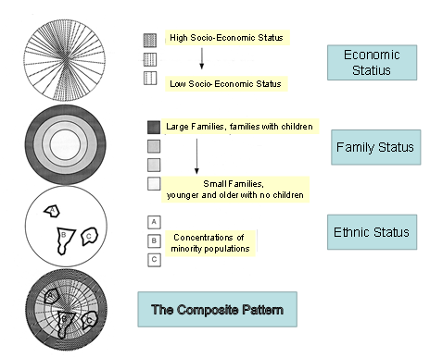
ECONOMIC STATUS
Would be sectoral. As Hoyt had reasoned, ability to pay for best residential land would govern who lived where.
FAMILY STATUS
Would be concentrically zoned and would depend on lifecycle need for space and suburban development policy.
ETHNIC STATUS
Would be an enclave pattern after the assimilation model.

Slide 54
☺
ECONOMIC STATUS
Would be sectoral after Hoyt: ability to pay for best housing would govern who lived where.
FAMILY STATUS
Would be concentrically zoned depending on lifecycle need for space.
ETHNIC STATUS
Would be an enclave pattern after the assimilation model.
COMPOSITE
Would be an overly of the other patterns.

Slide 55
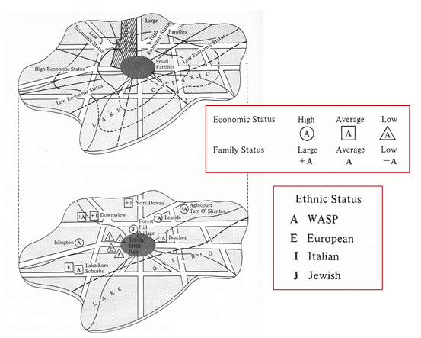
Murdie’s Social Space of Toronto

Slide 56
Social Spaces in the Toronto CMA
Rudimentary social area analysis can be carried out just through thematic mapping of economic and social variables.
The following slides illustrate what Toronto’s patterns would look like for various variables that indicate the dimensions:
Economic status: 3 education and 1 income variable.
Family status: 3 household size and marital status variables.
Ethnic status: 2 origins variables.
These are individually mapped by census tracts – a small spatial unit containing between 2,500 and 8,000 people – for the Toronto Census Metropolitan Area, and there are over 2,000 census tracts in the Toronto CMA.
The following maps are not overlaid or combined in any way; they are designed to show the potential of mapping variables to identify spatial patterns in social geography.

Slide 57
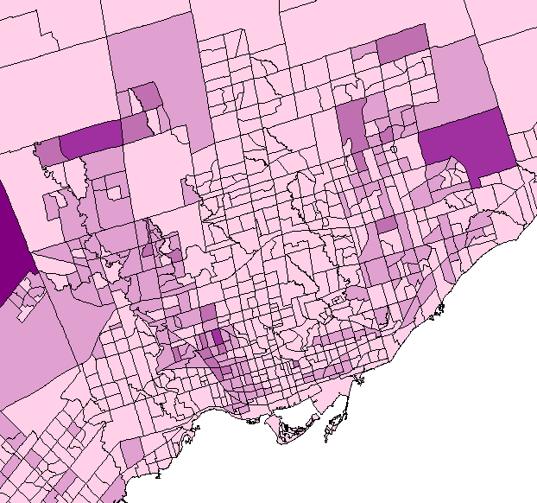
ECONOMIC STATUS
No Certificate, Diploma, Degree, 2006

Slide 58
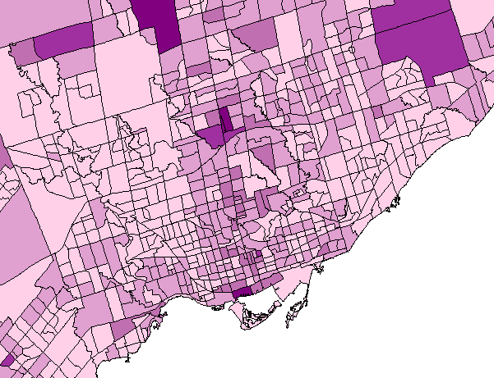
ECONOMIC STATUS
Bachelor’s Degree, 2006

Slide 59
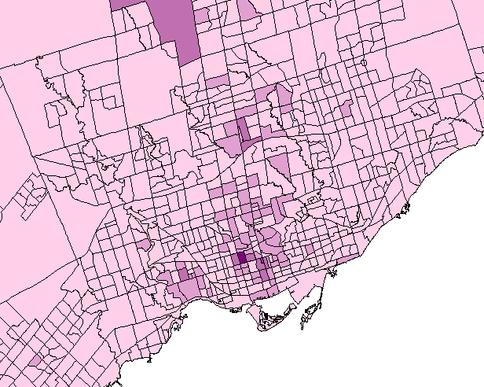
ECONOMIC STATUS
Earned Doctorate, 2006

Slide 60
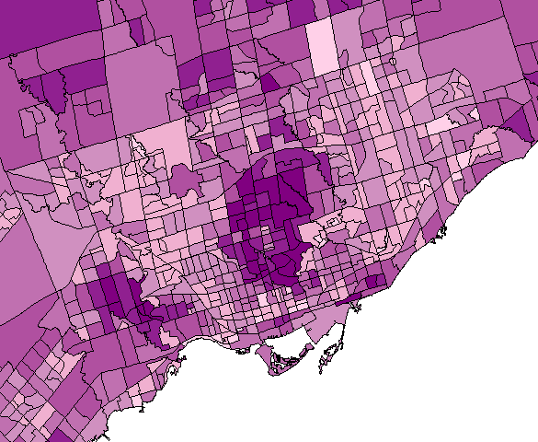
ECONOMIC STATUS
Median Family Income, 2006

Slide 61
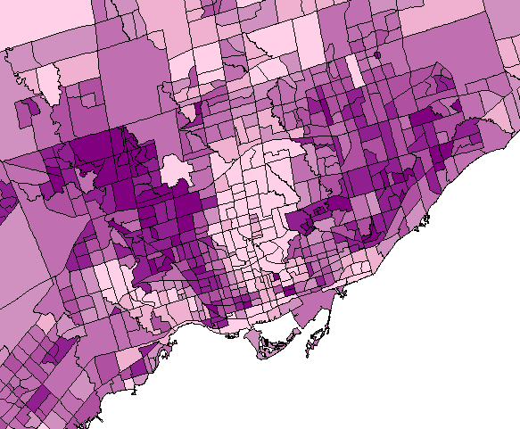
ECONOMIC STATUS
Family Government Transfers, 2006

Slide 62
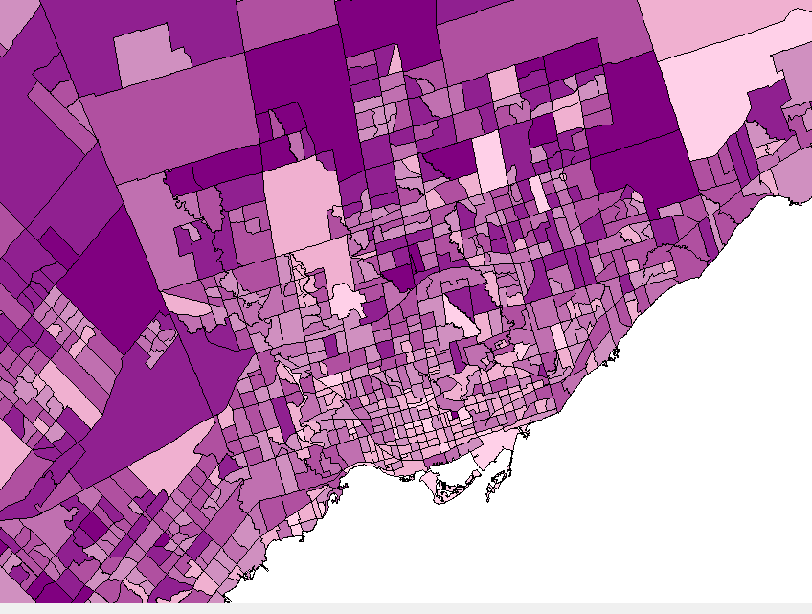
FAMILY STATUS
Married, CMA, 2006

Slide 63
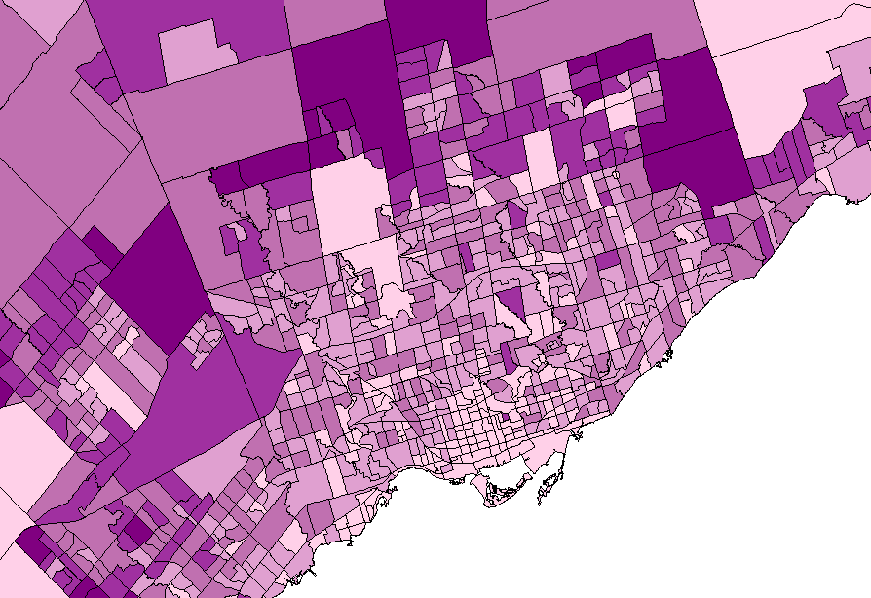
FAMILY STATUS
Size of Household, 4 Persons, CMA, 2006

Slide 64
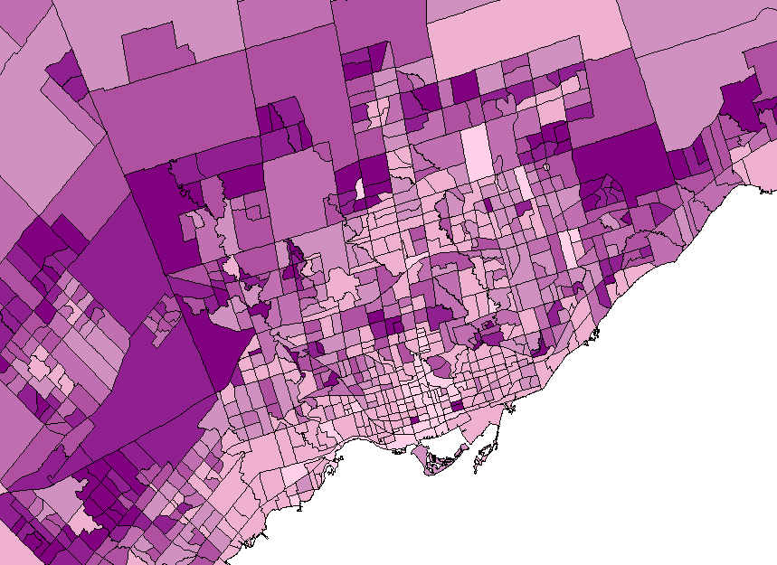
FAMILY STATUS
Average Number of Children at Home, CMA, 2006

Slide 65
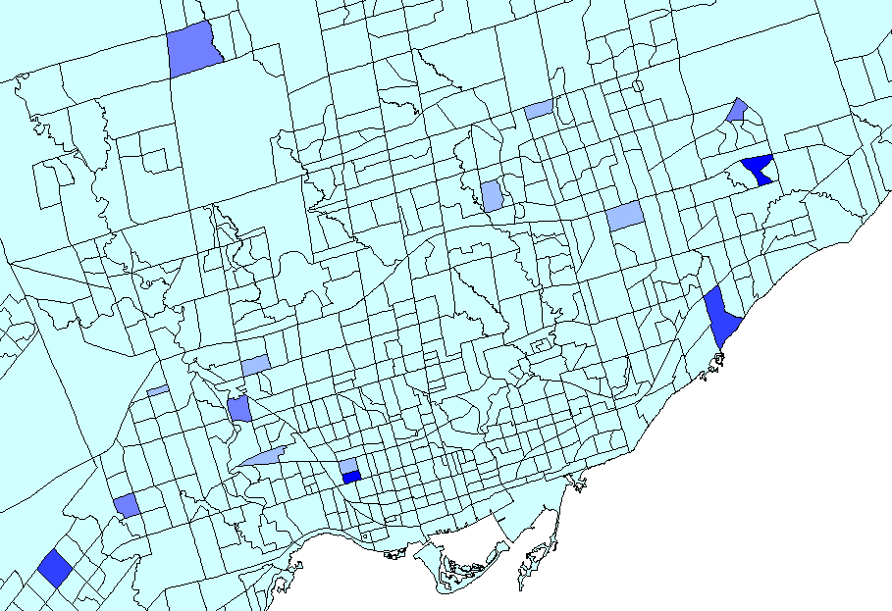
ETHNIC STATUS
Population Of Caribbean Origin, 2006

Slide 66
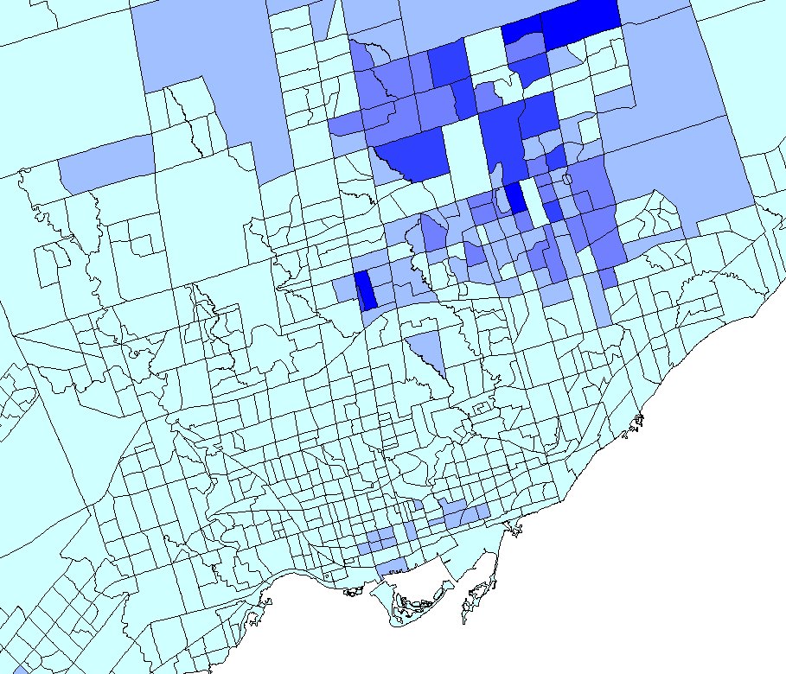
ETHNIC STATUS
Population of Chinese Origin, 2006

Slide 67
☺
Rees - Community Space
Social area analysis and factorial ecology studies look at variables and how they form into dimensions, and what geographic shape those dimensions take.
Other developments in urban social structure have linked housing space to social space.
Rees (1968) undertook a factor analysis of social and family status variables, along with housing stock variables.
He found that there was a distinct pattern of housing space that matched social space.
This blend he called community space.

Slide 68
☺
SOCIAL SPACE
Together…
HOUSING SPACE
A
B
Comprises
E
F
Stage in
Life Cycle
Type of dwelling
Socio-economic
status
D
G
H
C
Value & Quality
COMMUNITY SPACE
W
X
Factor 1
Y
Z
Factor 2

Slide 69
How Factor Analysis Works
☺
SOCIAL SPACE
COMMUNITY SPACE
HOUSING SPACE
A
W
B
E
X
F
Stage in
Life Cycle
Factor 1
Type of dwelling
Socio-economic
status
Z
C
Y
D
G
H
Factor 2
Value & Quality
“Factors” are statistically significant groupings of variables that best describe the mix of social, economic, and family status (the social geography dimensions) and dwelling quality, value and type (the housing geography dimensions). They would be given descriptive labels according to this mix of variable.

Slide 70
☺
SOCIAL SPACE VARIABLES
Single no kids family
Larger with kids family
College + Professional education
Professionals
Small wealthy families
Large wealthy families
High Income
High Middle Income
College education
Managerial
Socio-economic Status
Average Income
High School Education
Clerical/Trades
Stage in the Life Cycle
Low Middle Income
Grade School Education
Operative/Unskilled
Small poorer families
Large Poorer families
Low Income
Little Education
Unskillled/Unemployed
Before &after childbearing
Childbearing years

Slide 71
☺
HOUSING SPACE VARIABLES
Highrise
Lowrise
Townhouse
Single Family
Spacious Luxurious
Expensive Highrise
Dwellings
Expensive Single
Family Dwellings
High price/rent
High medium price rent
Spacious Comfortable
Value and Quality
Average price/rent
Average Space Comfort
Type of Dwelling Unit
Low medium price/rent
Crowded Run Down
Cheap High Density
Highrise
Cheap Single Family
Dwellings
Overcrowded Blighted
Low price/rent
No individual
Lots or yards
Small
Lots or yards
Large lots
and Yards

Slide 72
☺
COMMUNITY SPACE
High Scoring
Small wealthier singles and families living in luxury highrises
Large wealthier families living in expensive single family homes.
FACTOR 1
Small poorer singles and families living in cheap highrises
Large poorer families living in cheap single family homes.
Low Scoring
Low Scoring
FACTOR 2
High Scoring

Slide 73
☺
SOCIAL SPACE
HOUSING SPACE
A
B
E
F
Stage in
Life Cycle
Type of
dwelling
Socio-economic
status
D
G
H
C
Value & Quality
COMMUNITY SPACE
W
X
Factor 2
Z
Y
Factor 1

Slide 74
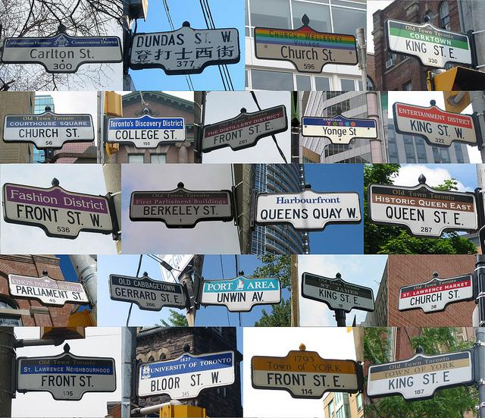
How Land Use Becomes Use of Land
We come full circle back to neighborhoods…
only different, …
with retailing, language, culture, residential.
In short, we come back to community spaces.
http://urbantoronto.ca/news/2010/08/torontos-street-signs-microcosm-world

Slide 75
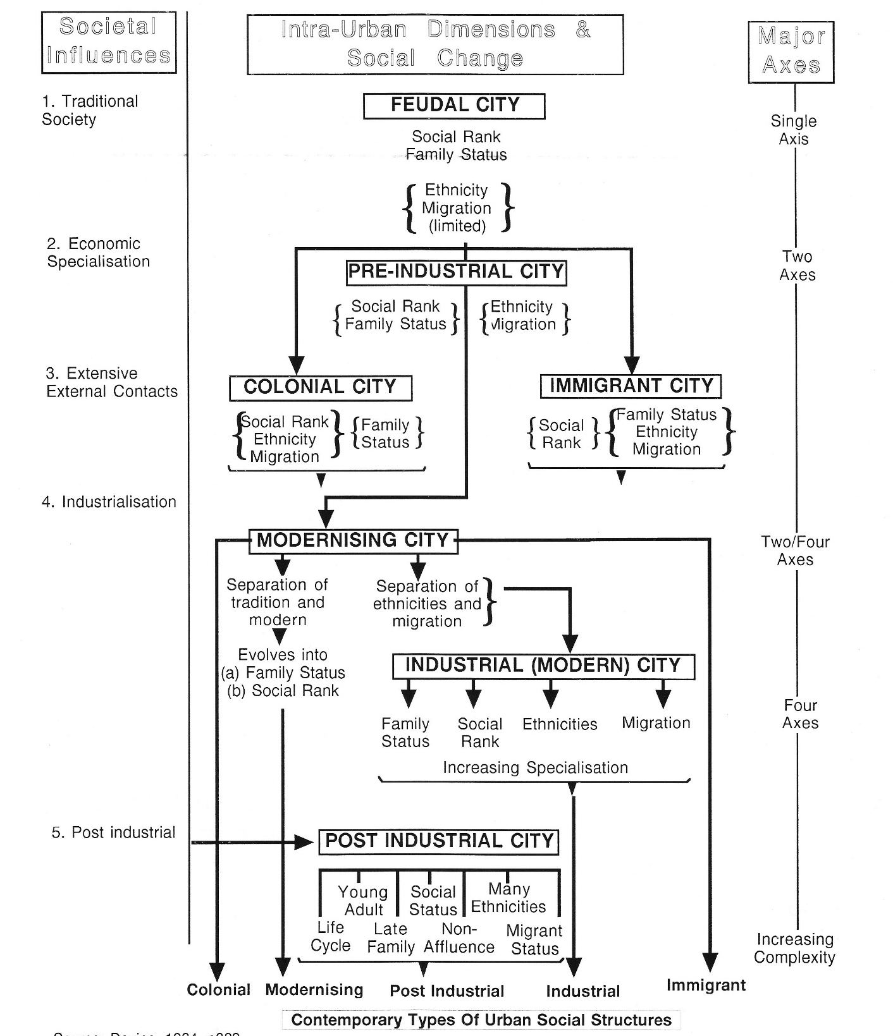
Urban Social Structures Through Time
From feudal times through urbanisation to the post industrial city, urban social structures have become more complex, more multi-dimensional.
The social, family, and ethnic factors remain the same, but have taken on sub-factors, with more kids living at home longer, more complex migrant status, and more complex career paths.

Slide 76
☺
Other ‘Social’ Geographies
Traditional social area analysis and factorial ecology studies look at variables and how they form into dimensions, and what geographic shape those dimensions take.
With the Rees study this has been extended into housing stock and transformed into community space.
But urbanization is a dynamic process, always evolving, and new social groups and family structures are not always captured by the census.
These to have become important in numbers and influence, and they too shape the urban social landscape.

Slide 77
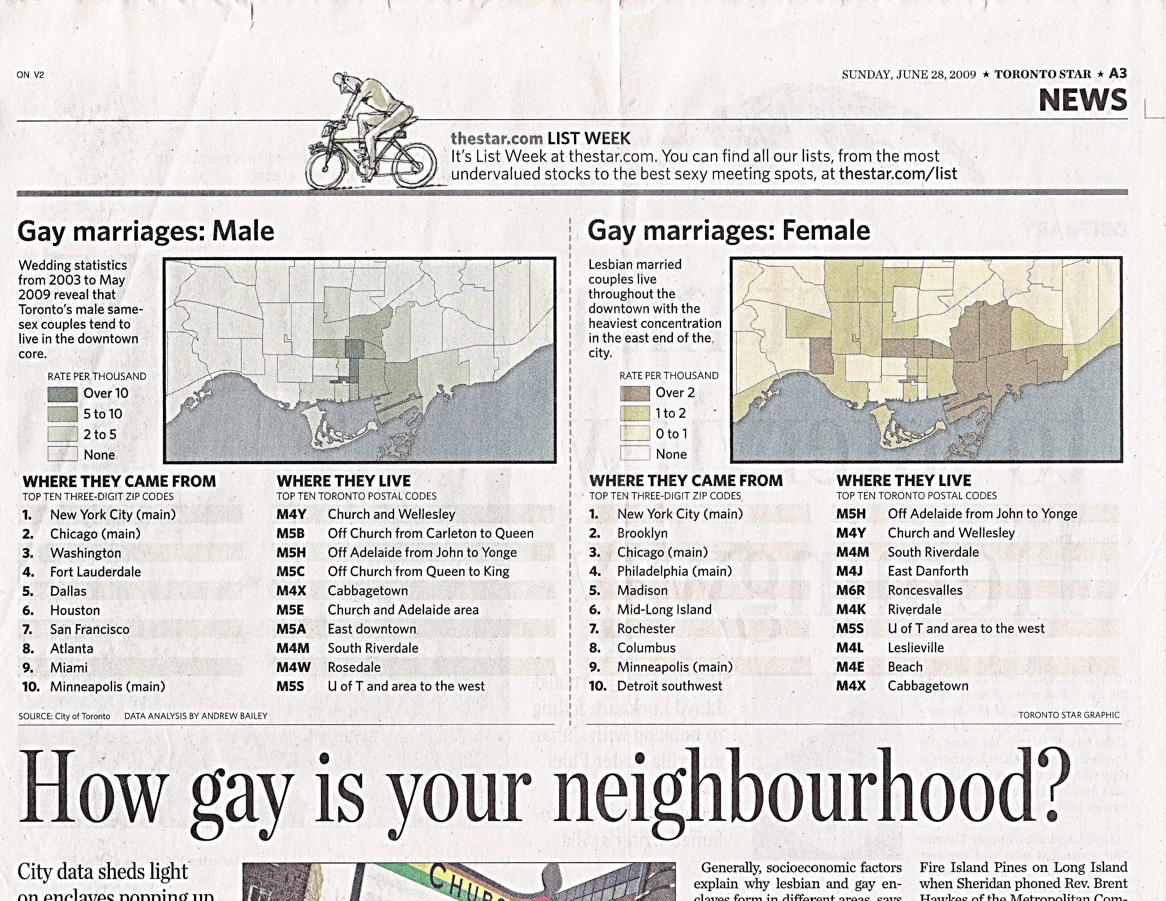
New social groups, family structures, and neighborhoods are not always captured by the census.
Toronto Star, June 28th, 2009

Slide 78
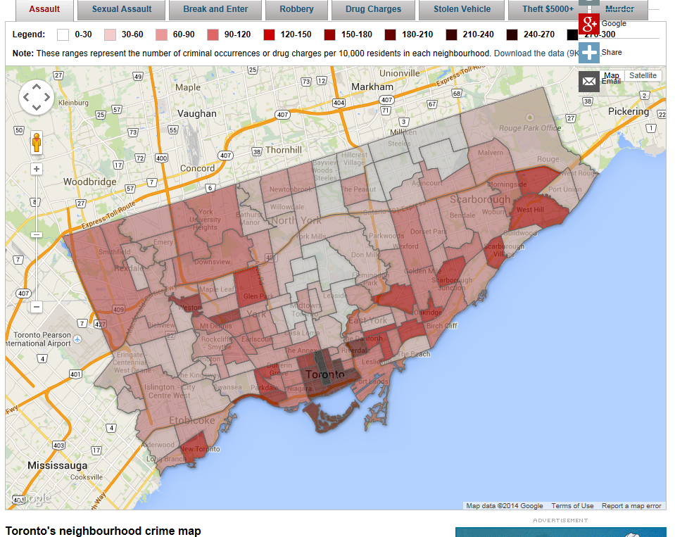
Toronto’s Crime ‘Neighborhoods’
http://www.cbc.ca/toronto/features/crimemap/

Slide 79
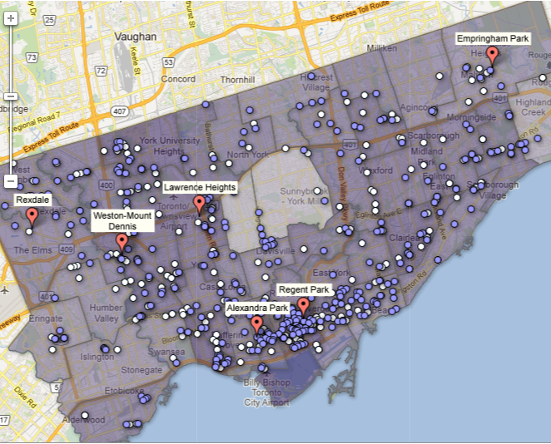
Toronto Gangs? Opportunists Without Opportunities
http://www.theglobeandmail.com/news/toronto/interactive-city-of-toronto-homicides-and-gang-activity-2008-to-present/article4240673/
Notes:
http://www.theglobeandmail.com/news/toronto/interactive-city-of-toronto-homicides-and-gang-activity-2008-to-present/article4240673/

Slide 80
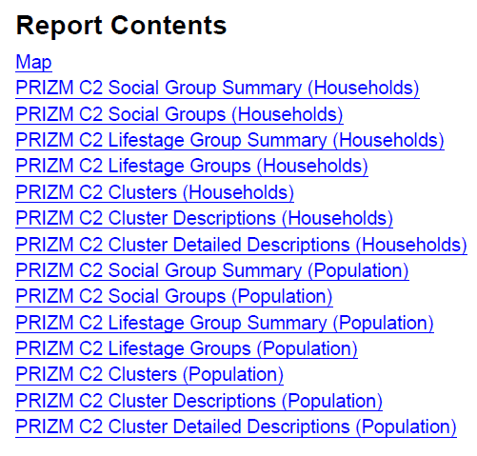
46 Newcomers Rising
37 Old World Style
04 Young Digerati
44 Rooms with a View
42 Urban Spice
02 Urbane Villagers
13 Continental Culture
01 Cosmopolitan Elite
18 Cluttered Nests
15 Electric Avenues
08 Money & Brains
09 Furs & Philanthropy
15 Electric Avenues
31 Grads & Pads
33 New Italy
Some of the many PRIZM C2 cluster descriptions of consumer population segments…

Slide 81
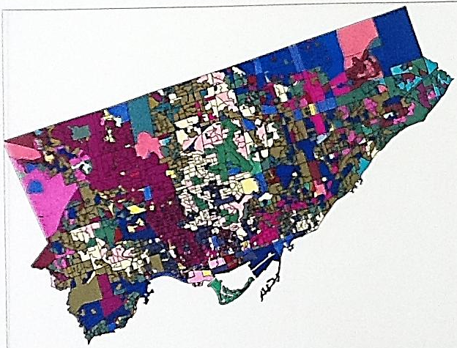
Consumer Groups in Toronto
… and where they live

Slide 82
Summarising Social Geography
We have scratched the surface of concepts underlying soial geography, even demography and the multivariate statistical analyses that delve into enterprise level data.
In many respects we have walked up the Escher staircase, passing the same spot and seeing it with new eyes.
The fresh paint we have applied to each of the steps I hope has enlightened you a little to the breadth of what surrounds you in the geography of everyday life.
But one environment remains and that is the softest layer of the city: quality of life.
And it too, is connected intimately to the hopes that people bring with them to their new – and old – lives in cities.

