Slide 1
“It’s not true that dogs see only in black and white.
Dogs see what they want to see.”
You are your own dog.

Slide 2
How To Use Narrated PowerPoint Slide Shows
Read Only: There is no narration on this slide.
You must click through the items on this slide, and again at the end to start the narrated lecture slides.
The PowerPoint slides in this course are narrated and this means that each item on the slide is timed to synchronise with the narration.
Once you start the first narrated slide (the next one), the whole PowerPoint deck should play through to the end automatically without further clicking. Be patient.
The advantage of this is that the narration (lecture) and the parts of a slide to which the narration pertains are synchronised, but the disadvantage is that you will have to pause the slide show if it is moving too quickly for you.
To pause a slide, right click then use “Pause” on the menu; to continue click anywhere on the screen. Function (Fn) “p” will also pause and restart narration.
To turn off narration so you can run through the slides without the lecture, go to the Slide Show menu ribbon and clear the Play Narrations and Use Timings tick boxes. To resume the narrated lectures click them both back on.
Do not use the Slide Show>Record Slide Show menu item to clear narration or timings! If you do you will erase the narrations and/or timings, possibly for all slides.

Slide 3

GEO 106 On-Line Version Fall 2020
Greetings and welcome to GEO 106, The Geography of Everyday Life, a lower level liberal studies course so be sure this is the type of course you need and that you are eligible to take it.
I am Dr. Philip Coppack a professor in the Depart of Geography and I teach Intro and Inferential Statistics, Globalisation, Economic Geography – and this course, which is about how the world around you is not what you think it is.
We are living in interesting times to say the least and since face-to-face contact is not possible we have to go digital, which means modifying delivery of courses.
The next couple of slides outline how I will do these things in this course and what technology you will need.

Slide 4
On-line Course Version Differences
This course has been adapted to online by:
The addition of voice narration to each slide in lieu of lectures.
Using D2L to do the multiple choice mid-term test and final.
Using email to answer student questions.
Given the bandwidth and computing limitations of working from home (my own included) I have tried to make the course as technically easy to upload, download and participate in as possible.
The material in it is virtually identical to the regular in-class course.
This way of delivering the course is new to me as well, so I hope you’ll forgive the pauses, the odd cut off word or two, and the occasional background noises! – I’ve proofed the PowerPoints to ensure nothing important is missed.

Slide 5
Software Used in This Course
To complete this course you must have:
Access to a computer and the internet.
Access to Ryerson’s D2L system.
MS Office or equivalent access to Word and PowerPoint.
Platform used to create and run it.
I use a small 5 year old PC laptop with the latest versions of Windows and MS Office – nothing fancy.
If you use a Mac, Word and PowerPoint look and work slightly differently than on a PC and you’ll have to cope with this as I cannot help you there.
I use Rogers (supposedly) high speed internet – not really high speed nor the most reliable where I live in the city.

Slide 6
What the Content Looks Like
The PowerPoints
The slide shows are long, detailed and have several hidden slides because they act in lieu of a textbook.
Each slide will have a short voice over narrative in lieu of lectures explaining the concepts and all slides will play automatically as you start the PowerPoint.
There will be no scheduled lectures, despite there being a scheduled day and time for this course.
You will download the PowerPoints from the course D2L website on Monday mornings and go through them at your leisure during the week.
You do have to be online on D2L in the scheduled one hour time slot to write the mid term test.

Slide 7
Course Mechanics

Slide 8
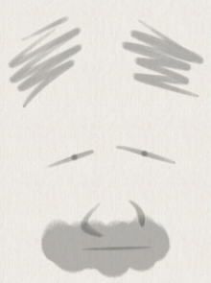
What the Course Outline Looks Like
RYERSON UNIVERSITY
Department of Geography
GEO 106: The Geography of Everyday Life FALL 2020
Instructor: Dr. Philip Coppack
Office: JOR 609 (but not there 2020).
Phone: (416) 979-5000 ex. (I don’t respond well to phone calls but…)
E-mail: pcoppack@ryerson.ca (e-mails - within reason - I will answer)
Website: Course uses D2L for access to all material, writing mid-term, and submitting essay.
Office Hours: By email, whenever.
This outline has been created to accommodate the university’s request for on-line courses for Fall 2020 due to the pandemic restrictions. I have kept it as close to the in-class version as I can. This course will be run mostly asynchronously, which means that there will be no scheduled zoom lectures for this course despite there being a scheduled time for it. I will be using narrated PowerPoints posted to D2L and you may go through them at your leisure during the week. The mid-term test will be run online in the scheduled one-hour time slot on Thursday October 29th (see weekly schedule below). The final exam will also be run on-line and will be scheduled by Ryerson later in the term.
Notes:
Basic stuff then:
RYERSON UNIVERSITY
Department of Geography
GEO 161: INTRODUCTORY ANALYTICAL TECHNIQUES FALL 2009
(Also known as “Yippee! It’s statistics!”)
Instructor: Dr. Philip Coppack
Office: JOR 112 (Dean of Arts’ office)
Phone: (416) 979-5000 ex.5190 (I don’t respond well to phone calls but…)
E-mail: pcoppack@arts.ryerson.ca (e-mails - within reason - I will answer however!)
Office hours: By chance or appointment.
This is a Required Professional Course for students in the Geographic Analysis Program.
Students are required to use their Ryerson e-mail address. This address will be the only one used to communicate with you. It is your responsibility to check your Ryerson e-mail regularly.

Slide 9
READ ALL OF THIS BOX NOW You are responsible for reading everything in this course outline, in the PowerPoint slides, in the Ryerson emails I send, and in the lecture material I provide. I will clarify any email questions you might have, but I will not respond to questions where the answer is clearly stated in the material I provide. Students are required by Ryerson to use only their Ryerson email address for communication with the instructor. It is the responsibility of students to check their Ryerson email and the D2L course website regularly.

Slide 10
Evaluation
Evaluation
Course Component | Weight
Mid Term (50 multiple choice questions) | 25%
Essay (approx. 1,200-1,500 words) | 50%
Final Exam (50 multiple choice) | 25%
The mid term test is one hour long, multiple choice, and will be done online using D2L in the Ryerson scheduled Thursday time slot. Study notes will be provided for the test.
DO NOT MISS THE MID TERM TEST.
The essay is 1,200 to 1,500 words, details are in the course outline, and it will be submitted and marked using D2L, date is in the course outline.
The final exam is one hour long, multiple choice, and will be done online using D2L in the Ryerson scheduled final exam time slot. Study notes will be provided for the test.
DO NOT MISS THE FINAL TEST.

Slide 11
Textbook
None.
Save your money.
Use the PowerPoint.
PowerPoint are detailed and extensive and have all the information you need to get through this course (including the hidden slides).
As well, the web has numerous reliable sources of data, information and explanations of concepts - just be sure they are reliable.

Slide 12
PowerPoint
Hundreds.
And yes, I know they are bad.
They are long.
They are wordy.
And I go through them pretty fast.
But you don’t need to buy a textbook.
What to do:
Slides will be posted by Monday morning of every week.
You choose when you do want to do the “lecture”.
My advice is to pick a 2-3 hour block in the week and go through them as an uninterrupted lecture.
Hidden Slides:
In some lectures there are quite a few hidden slides and they contain extra information, data, concepts, etc, so that the slides can replace a textbook.
They are important – unhide and read them.

Slide 13
Lecture Schedule

Slide 14
Week of… | Lecture #, Topic
Sept 7 | 1. Introduction to the Course: Hmmm. Should I take this course? Decisions, decisions... Course mechanics: how the course works. Course overview: what you can expect to learn.
Sept 14 | 2. Spatial Concepts and Spatial Dynamics: space ain’t what it used to be. Geographic concepts; distance, direction, location, place, scale. Space, time, and space-time. Proxemics.
Sept 21 | 3. Environment, Perception, Cognition: I’ll see it when I believe it. Defining environment(s). Perception, cognition, and cognitive filtering. Decision making: “brown bear, brown bear what do you see?”. The ordering of experience: C-fields and P-planes.

Slide 15
Week of… | Lecture #, Topic
Sept 28 | 4. Mental Maps and Mental Images: what you see is where you get. Definitions and nature. How spatial geometry is perceived and processed. Lynch's model: nodes, landmarks, districts, paths, edges. Development sequence of mental maps. Designative and appraisive perceptions.
Oct 5 | 5. Place and Placelessness: I see the difference; do you see the difference? Sense of place and placelessness. Topophilia and topophobia, safety of place. Sound-scapes, smell-scapes, escape-scapes. Amenity environments, vernacular landscapes, and marketing place.
Oct 12 | R E A D I N G W E E K

Slide 16
Week of… | Lecture #, Topic
Oct 19 | 6. Territory and Territoriality: signs, signs, everywhere there’s signs. Personalization and defence. Home and neighbourhood. Lines in the sand: fences, borders, the creation of nations. Examples of territoriality.
Oct 26 MID TERM TEST, LECTURES 1-6, DURING SCHEDULED ONE HOUR TIME SLOT, ON D2L. | 7. Time, Space, and Time-Space: time and flies. Time isn’t when you think it is. The organisation of time. Nature of time and space. Time-space totality, prisms, paths. Constraints - cognitive, capability, coupling, control. Convergence, divergence.
Nov 2 | 8. Spatial Interaction: comings and goings. Definitions and roles. Activity space and journey to work. Residential search behaviour . Distance decay and gravity models (marketing geography). Diffusion.

Slide 17
Nov 9 | 9. Urbanization: the most complex human made process ever! Defining urban. Urban growth and urbanization. Urbanization processes: economic, demographic and social. Urbanization processes: synchronisation model.
Nov 16 ESSAY DUE | 10. Structure and Design in the City: the most complex human form ever! Bid rent theory. The role of transportation technology in city form. Models of internal structure: concentric ring, sector, multiple nuclei. Adaptive and integrative environments. Neighbourhood design: Garden Cities and the Radburn plan.
Nov 23 | 12. Social Structure: what you see is not necessarily what you get. Urban ecology. Social area analysis, factorial ecology. Spatial patterns of social dimensions. The Rees community model.
Nov 30 | 12. Quality of Life in the City: are we having fun yet? What is quality of life? Indicators and patterns. The gap theory model.
Dec 7 | CLASSES END (but life goes on). Final date to withdraw from an undergraduate program for the Fall 2016 term in good Academic Standing (no refund of Fall 2016 fees).

Slide 18
COURSE ESSAY

Slide 19
Ryerson Liberal Studies Policy requires it so you have to write it.
Sorry.
No, really.
1,200 to 1,500 word essay.

Slide 20
Pandemic Preamble
Given the pandemic restrictions on moving around in space, the essay has been redesigned to be pandemic friendly!
The essay is a social science research paper and as such requires that you collect and analyse data to describe and/or compare one of two topics.
The essay topics allow you to use online data resources for your research.
The best papers will incorporate concepts from the course, be extremely well written using a research format, and follow all the guidelines in the course outline.

Slide 21
ESSAY ASSIGNMENT:
GEOGRAPHICAL INVESTIGATION OF AN ASPECT OF EVERYDAY LIFE
(More details in the course outline)
Objective
Geographic principles are a part of our everyday lives. This assignment gives you the opportunity to choose one area of the course and explore it in more detail, based on your own experiences and/or the experiences of others.
Write a (maximum of) 1,500 word essay.
Essays are research based and require that you analyse data either provided to you or that you find/collect yourself.
Choose a Topic:
1. Mental maps analysis of downtown Toronto.
2. Neighbourhoods analysis of Toronto.

Slide 22
That was the course mechanics.
Now what’s the course about
and is it worth staying in it?

Slide 23
“It’s not true that dogs see only in black and white.
Dogs see what they want to see.”
You are your own dog.

Slide 24
What’s this course about and is it worth staying?
☺
This course weaves together…
Environment,
but not the interpretation you probably have of it.
Behaviour ,
yours and others and why you do what you do.
Perception,
or how you, I and others view the world, and how these perceptions shape urban environments.
Relativism,
or how we can all witness the same event, but have differing views of it depending on the many cognitive filters through which we view those events.
Scale,
or how we judge size, area, distance in relative and absolute terms, and act upon those decisions.

Slide 25
"We make a map of our experience patterns, an inner model of the outer world, and we use this to organise our lives”
Gyorgy Kepes, 1956
“Everything, in hindsight, is obvious.”
Anonymous
Notes:
INTRODUCTION TO THE COURSE
"We make a map of our experience patterns, an inner model of the outer world, and we use this to organise our lives“
Gyorgy Kepes, The New Landscape in Art and Science, pp18-22, 1956.
This course is a bit strange, and not a lot like the geography you are probably used to. It deals with the concept of environment, but not the interpretation you probably have of it. It deals with behaviour - yours and others and why you do what you do. It deals with perception - how you view the world, and how these perceptions shape city environments. Most of all, it deals with relativism: how we can all witness the same event, but have differing views of it depending on the many filters through which we view those events. Furthermore, it deals with how we use those perceptions, most times unknowingly, to make decisions - large and small - that comprise our lives and affect other people's lives.
The world is comprised of a multitude of environments that exist at different scales. These scales range from personal space to neighbourhoods, communities (both towns and cities), regions, nations and the world itself. These environments are in turn shaped by people's behaviour, and this behaviour is in turn governed by the decisions made by individuals and groups of individuals (populations). The types of decisions people make are dictated by their cultural, economic, political, social, gender, sexual, and religious backgrounds, as well as their relative intellectual abilities to make decisions and the quantity and quality of information at their disposal. These differing backgrounds give rise to differing perceptions of similar events, issues and environments - indeed of life itself. In turn, these differing perceptions generate different interpretations of, and actions toward, environments, that in turn impact how these environments appear (both perceptually and physically).
In this course we will be examining many aspects of this complex web of relative processes. Our goal is to peel back the many layers of the city environment, to demonstrate that it is actually comprised of many environmental interpretations. Some of these are obvious, others not so obvious. But even though it may be obvious how something looks, it is often not obvious how it got to look that way - as you will find out.
If you could peel back the layers of the city, they would be countless, arranged and conceived of by each of us according to our perceptions, from each of us according to our cognitive processes, to each of us according to the way others view us. None are wrong interpretations and none are right; they are just different. Some of the layers affect us all of the time and all of the layers affect us some of the time. Each of itself can be conceived of clearly when it is slipped from the deck and played out. But together, the stack of layers (Figure I) creates the game we call the city that is pregnant with permutations.
The following pages suggest the structure of the course and the types of material at which we will be looking. Figure II summarises and connects many of the concepts dealt with in the course. This figure should become your "road map" for the course. Refer back to it often. Because it is a road map, you can start anywhere and move in any direction. While you may not understand it all at first, you will by the end of the course.
Your geography - the spaces you occupy - is your primary reference point for locating yourself and your activities relative to all other happenings. As an infant you learned about geographic space by manipulating objects directly, by playing, by sucking on things, by screaming and assessing the reactions of other people. Gradually you learn that you are not the whole universe; for example, your parent doesn't feed you when you scream and you learn that they are not you. You learn your room and home are "like this", and are located "here" in relationship to other rooms and structures. As you grow, your space expands through direct experience to include other homes, your neighbourhood, other neighbourhoods, large areas of your city, town or region and a few select places your family visits. Through indirect experiences (family, friends, books, newspapers, magazine, radio, television, the Internet, etc) you learn about parts of your city, region, province, country, continent, globe and universe you have never visited. All of these views are partial and incomplete
.
FIGURE 1: THE LAYERED CITY
By now you rarely think directly about geography. Yet you are constantly making geographical decisions and acting upon them. Where will I sit in this class? in the movies? at temple? Which stores and malls will I visit to buy a winter coat? a VCR? a car? Which clubs will I hang out in? Where in the club will I sit, stand or hang? Will I walk, blade, bike, take the TTC or take the car to shop? to travel to (Ryerson (RPU)? to travel to recreation? You are constantly behaving spatially, that is you act upon geographic decisions. And without realizing it you know a lot experientially about the concepts in this course.
In order to show up for the first class you understood relative location, distance and direction from your starting place (eg home) to the classroom. You consulted your mental maps of the city and the campus, and transportation options ( especially in relationship to trip time). You might have noticed something new and revised those maps. You may have taken a longer path to avoid an undesirable area (e.g. construction zone, unsafe place, undesirable people). While on the subway and in class you use front country behaviour which indicates you understand the unwritten, as well as the written, rules of behaviour of those particular behavioural settings. While in the subway, for example, you follow the unwritten rules of (not) invading people's personal space (microterritory) by averting your eyes and apologizing for bumping into someone, and feel uncomfortable and anxious when others invade your personal space. As you moved through locations, they had meaning for you, or in geographic jargon possessed sense of place. Places on your journey had certain attractiveness drawing you to them (if only in memory, eg the Starbucks where you had that lovely latte with that amazing person eliciting topophilic daydreams). Others elicited topophobic avoidance due to their unattractiveness as crime sites, the apartment of your ex-lover or whatever. Your negotiation across these spaces as you move through your day created your time-space path for the day.
Your ability to achieve these interactions across space depended, in part, upon your constraints : cognitive (eg. what options you knew about), capability (eg. your ability to access transportation), coupling (eg. the need to be at RPU in a specific room at a specific time) and authority (eg. the need for a TTC token). In addition, the attractiveness of various options and the friction of distance influenced these interactions, for example, influencing how early you left home and where you went for lunch between classes. The first seven chapters focus on these concepts, asking you (in particular, in the TRY THIS exercises) to investigate how they relate to your own life.
Your geography focuses on “you” and “yours”. We all are, thus, egocentric, and as groups we are ethnocentric, nationalistic, human-centred. In so far as your geography focusses on YOU and your experiences (direct and indirect), your perception of the environment is strongly influenced by cognitive filters related to you (your attitudes, values, preferences, needs and desires and the reasons for being in that environment) and "yours" (i.e. the various sub-groups of society that your belong to and are relevant for the purpose at hand). Thus, your evaluation of experiences and environments are relative to your frame of reference and display distance decay with respect to both physical and cultural distance. Thus closeness, rather than breeding contempt, may lead to acceptance and a suggestion that this is how things should be, while physically and culturally distant environments are "exotic", the people are "ethnic", their clothes are "costumes", they speak with "accents", their culture is "under- or un-developed", their relative lack of (our) technological toys is "backward", and they are in general judged by us as "inferior".
The spatial decisions of all the past and present people in the city jointly create the tangible, phenomenal (physical and built environments) and the less tangible, hidden (socioeconomic environments) spaces and places in the city. The existing phenomenal environment (ie things) is perceived of, and responded to, by individuals in response to their needs and desires in relationship to their individual personal environments and their understanding of the various contextual environments (ie sub-groups of society) that have influenced, and continue to influence, them. These responses in turn create new phenomenal and socioeconomic environments. The last five chapters discuss our attempts to understand and interpret internal city structure - neighbourhoods, the pattern of urban land uses, quality of life, and changes in those patterns - from both our understanding of the spatial behaviours discussed in the first seven chapters and our understanding of more macro processes operating in the urban environment.
This book has three components : the text, READINGS and TRY THIS exercises. The text presents the major concepts covered in this course. The READINGS present additional related material, generally in the form of short stories and poems that illustrate particular concepts. The READINGS are referred to in the text (and often in TRY THIS exercises) and are for the whole text are found after Chapter 12. The titles of the TRY THIS exercises are inserted into the text in a box. The complete set of TRY THIS exercises is found after the set of READINGS forming the last section of this book.
FIGURE I : THE LAYERED TORONTO

Slide 26
Layers of the City
Rural Areas
Industry
High Income Housing
Low income housing
Commercial strip
Hospital
Green
space
CBD
Middle income
housing
Industry
Commercial strip
Middle income
housing
Low income housing
Rural Areas
Land Use

Slide 27
Layers of the City
Transportation

Slide 28
Layers of the City
Flows

Slide 29
Layers of the City
c
c
c
c
c
c
c
c
Activity Systems

Slide 30
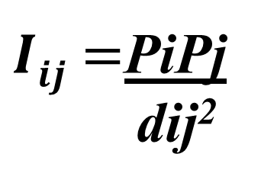
Layers of the City
High
$Iij=$PiPj
dij²
Degree of interaction
(I)
Low
X
Place
(i)
Place
(j)
Distance
(d)
Distance Decay

Slide 31
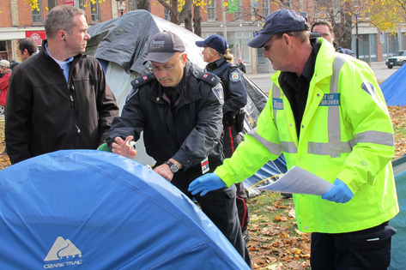
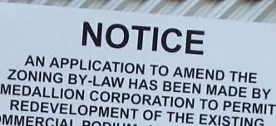
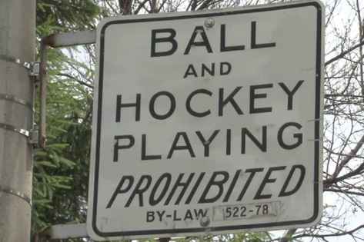

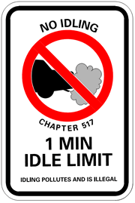
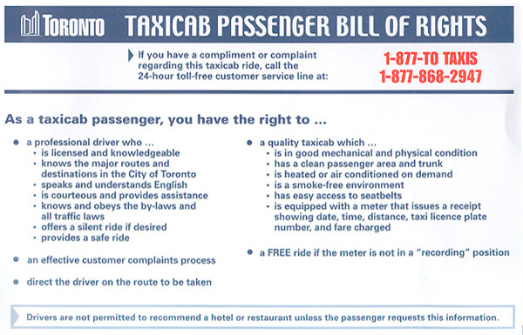
Layers of the City
TORONTO MUNICIPAL CODE
NOISE
ARTICLE I
Interpretation
591-1. Interpretation
In this chapter, all the words which are of a technical nature or
meanings specified for them in Publication NPC-101 – “Technic
Definitions.
As used in this chapter, the following terms shall have the meani
COMMISIONER – The Commissioner of Urban Development o
designate.
Formal Institutions (Rules)

Slide 32
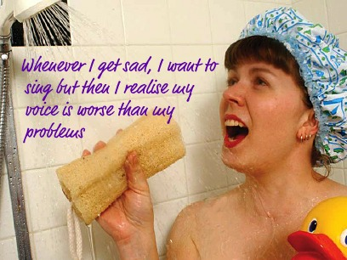

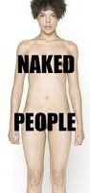
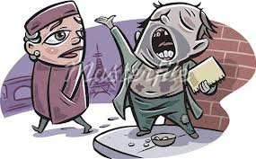
Layers of the City
Informal Institutions (Convention)

Slide 33
Layers of the City
Economics: Bid Rent

Slide 34
Layers of the City
LOW
MED
HIGH
Social Areas 1: Family Status

Slide 35
Layers of the City
LOW
CBD
LOW
MED
MED
HIGH
Social Areas 2: Socio-Economics

Slide 36
Layers of the City
Italian
Jewish
Chinese
Indian
Social Areas 3: Ethnicity

Slide 37
Layers of the City
Italian
LOW
Jewish
Chinese
LOW
CBD
LOW
Indian
MED
MED
MED
HIGH
HIGH
Social Area Analysis of the City

Slide 38
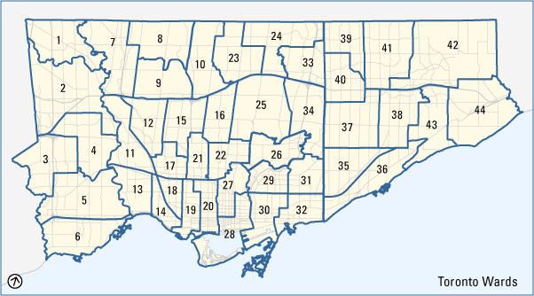
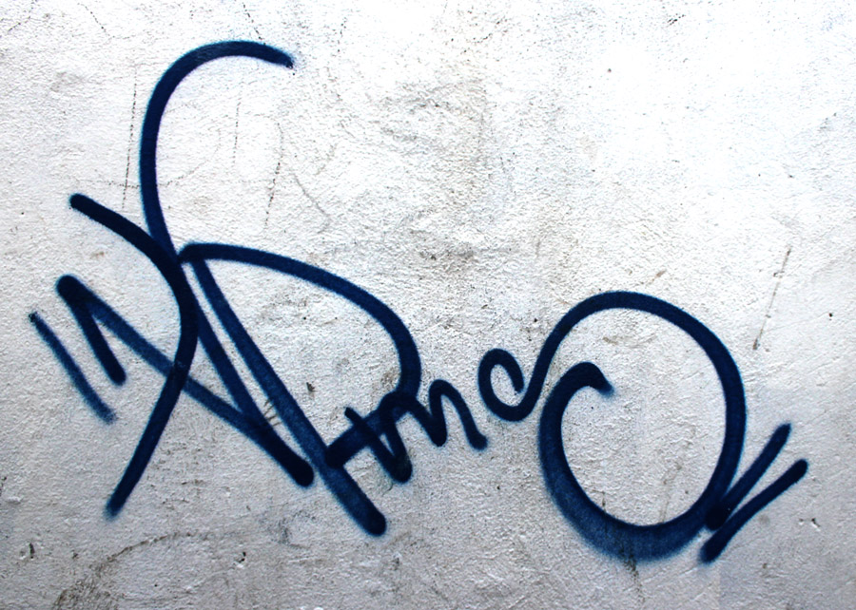
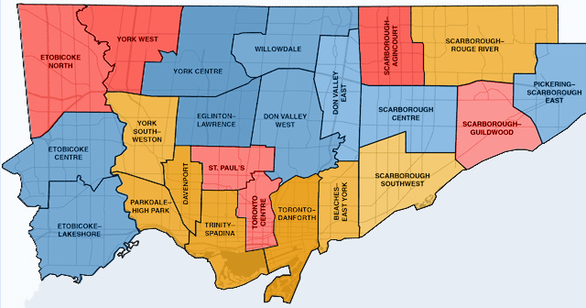
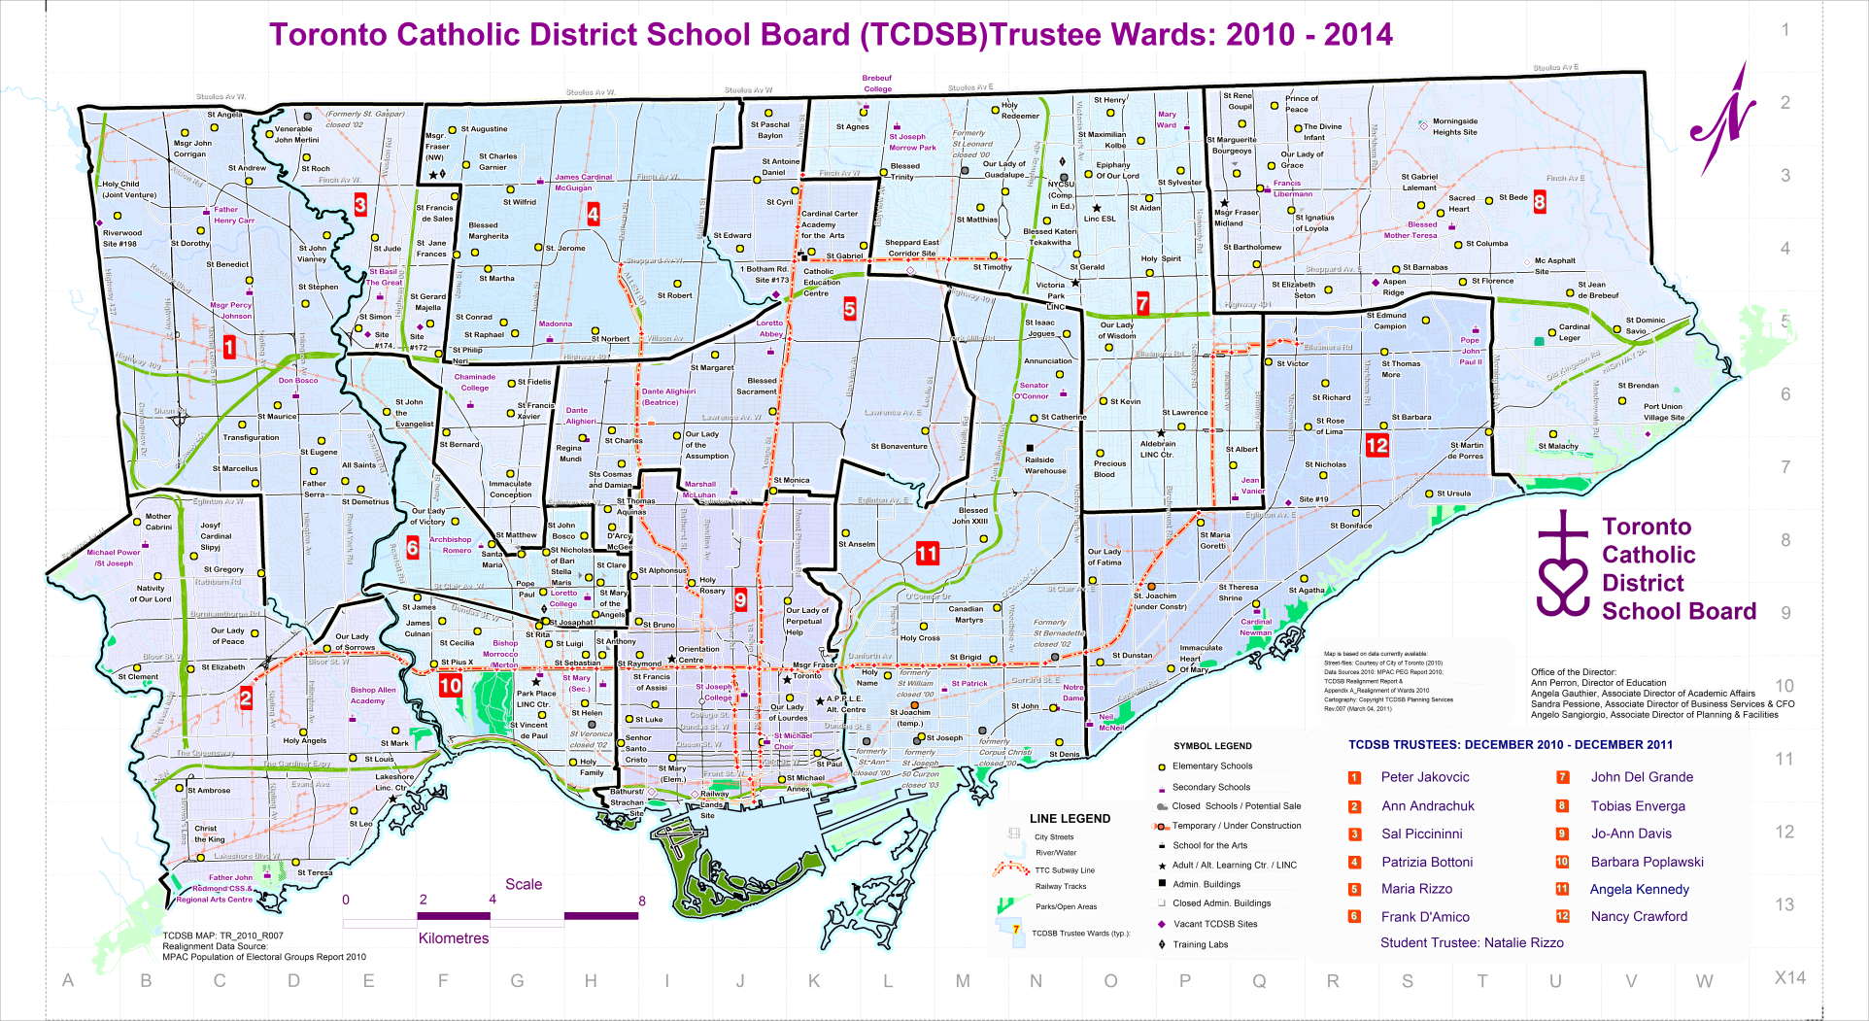
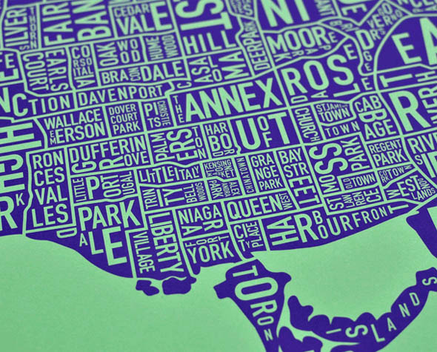
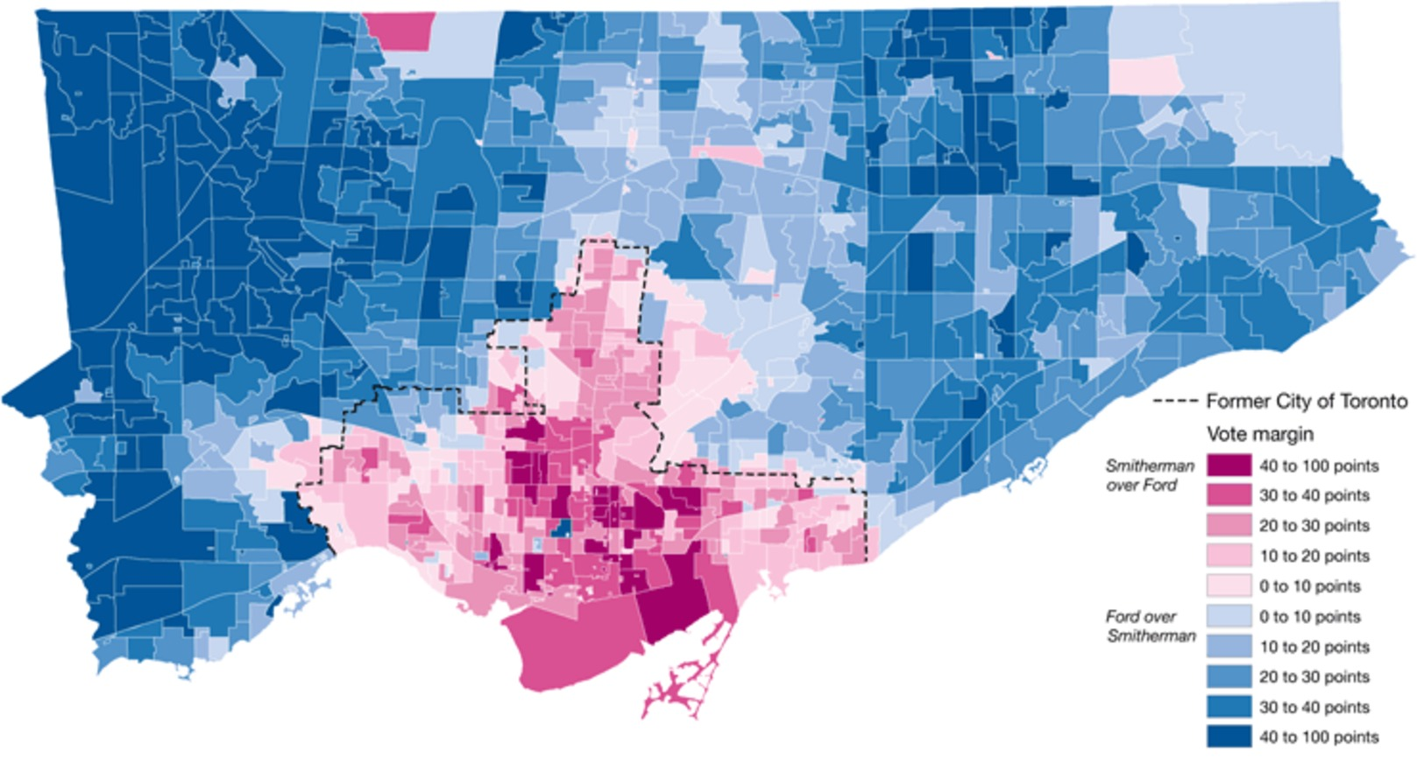

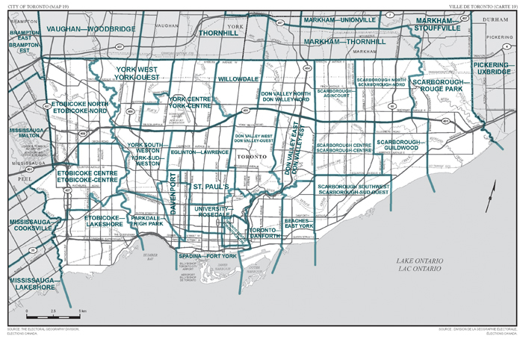

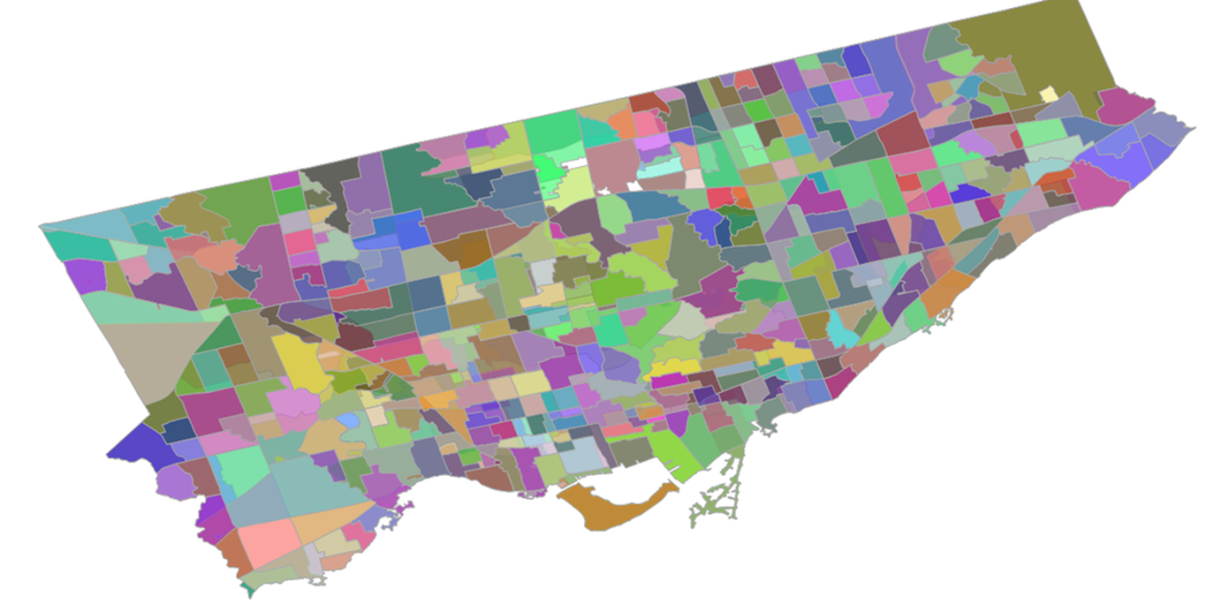
Layers of the City
Territorial Boundaries

Slide 39
Layers of the City
Mental Maps

Slide 40
Layers of the City
Mental Images

Slide 41
Layers of the City
BAD
MEH
LOVELY
SKETCHY
GOOD
REALLY NASTY
Quality of Life

Slide 42
Layers of the City
QOL = F (G-B/t)
Quality of Life 2

Slide 43
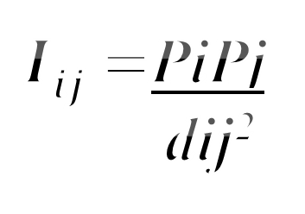
Layers of the City
High
TORONTO MUNICIPAL CODE
NOISE
ARTICLE I
Interpretation
591-1. Interpretation
In this chapter, all the words which are of a technical nature or
meanings specified for them in Publication NPC-101 – “Technic
Definitions.
As used in this chapter, the following terms shall have the meani
COMMISIONER – The Commissioner of Urban Development o
designate.
Rural Areas
BAD
c
OK
c
$Iij=$PiPj
dij²
c
High Income Housing
LOVELY
Industry
Italian
Low income housing
Degree of interaction
(I)
Course will peel them away.
QOL = F (G-B/t
Commercial strip
Hospital
Jewish
LOW
CBD
SO-SO
Chinese
LOW
CBD
GOOD
Middle income
housing
Industry
c
LOW
Commercial strip
Middle income
housing
Indian
c
c
c
REALLY NASTY
Low
MED
MED
MED
HIGH
HIGH
Place
(i)
Place
(j)
Distance
(d)
Rural Areas
c
Mental Images
Mental Maps
Distance Decay
Quality of Life 2
Social Areas 3: Ethnicity
Social Areas 2: Socio-Economics
Social Areas 1: Family Status
Formal Institutions (Rules)
Formal Institutions
Economics: Bid Rent
Activity Systems
Quality of Life
Transportation
Land Use
Flows

Slide 44
A Guide to the Course
1. The Elements
2. Ways of Analyzing The Elements

Slide 45
GOING TO BE EXPLORING
PLACE
Sense of Place
Topophilia
Topophobia
Placelessness
SPACE
Location Distance
Morphology Morphogenesis
Perceptions
PEOPLE
Attitudes Preferences Values
Abilities Needs Wants
Perceptions
Characteristics/attributes of and interaction between them leads to and creates…
CONCEPT OF ENVIRONMENT
Space that is created by, used by, or impinges on people,
whether they are aware of it or not.

Slide 46
☺
AS A THING
Physical Environment
the “natural” world
Built Environment
the human built world
Socio-Economic Environment
the cultural world
AS A SET OF CONDITIONS
Phenomenal Environment
Physical milieu in which behavior takes place
Behavioural Environment
Psychological milieu in which behavior takes place
Abstraction Increases
Definitions and use of these environments are influenced by…

Slide 47
☺
Contextual Environment
Life Cycle
Event Intensity:
depends on life stage
Child
Adult
Old
Life Level
Socio-economics
Demographics
Psychographics
=
level of health and political involvement
Life Style
Yuppie
Student
DINK
WOOF
et al
Environments are shaped by and in turn influence the decision making process

Slide 48
The Human Decision Making Process
☺
Positive feedback
satisfaction
Problem to be solved
stress
experience
Information
data
certainty
Evaluation
uncertainty
solved?
Decision
unsolved?
Negative feedback
Where the quality of such decision making depends on…
Johari Window
 | Known | Unknown
Known | Known knowns | Known unknowns
Unknown | Unknown knowns | Unknown unknowns
Quantity and quality of information
Pred
Matrix
+
Ability to use information

Slide 49
A Guide to the Course
Ways of Analyzing The Elements

Slide 50
PROXEMICS (Hall) – (DISTANCE)
NORMAL DISTANCE---------------contrasted with--------------SOCIAL DISTANCE
Linear mileage time cognitive intimate personal social public
TERRITORY – (SPACE)
STRUCTURE-----------------------------contrasted with--------------------------------USE
(Porteous) (Sonnenfeld)
personal home behavioral perceptual
neighborhood public operational geographical
THE PERCEPTION PROCESS
FILTERS
MINE
REAL WORLD
YOURS
OURS
EVENTS
PERCEPTION
CONSTRUCTS
CONCEPTS
… and how it influences and is influenced by …

Slide 51
☺
THE WAY WE VIEW ENVIRONMENTS
AS MENTAL MAPS
Paths Nodes Edges
Districts Landmarks
AS ECONOMIC LANDSCAPES
Surfaces Networks Hierarchies Nodes Movement Bid-rent
AT DIFFERENT SCALES
Personal Familial Community Regional National Global
IN DIFFERENT CONTEXTS
Life-cycle
Life-style
Life-level
AS WE MAKE DECISIONS
THE WAY WE USE ENVIRONMENTS
Where use is constrained by time and space to create activity bundles in the form of:
Daily Life Paths
Time
Time Space Prisms
Time
Constraints
coupling capability
Time control
SPACE

Slide 52
THE BOTTOM LINES
The hidden dimensions of the environment
are as important as the visible ones.
Behavior creates structure.
Structure limits behavior.

Slide 53
THE HIDDEN ENVIRONMENT
“The real voyage of discovery lies
not in seeking new landscapes
but in seeing old ones with new eyes.”
Proust (or close enough)

Slide 54
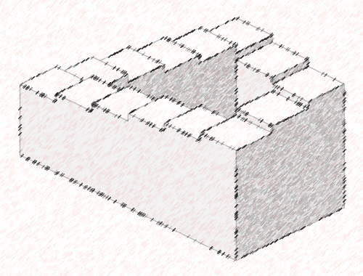
We shall not cease from exploration, and the end of all our exploring will be to arrive where we started and know the place for the first time.
T.S.Eliot, Little Gidding (1942)
Because I know that time is always time
And place is and only place
And what is actual is actual only for one time
And only for one place.
T.S. Eliot, Ash Wednesday, (1930)
Notes:
Because I know that time is always time
And place is always and only place
And what is actual is actual only for one time
And only for one place.
T.S. Eliot, Ash Wednesday, (1930)

Slide 55
SO…
Geography 106.
The Geography of Everyday Life.
This is the course.
Dr. Philip Coppack.
pcoppack@ryerson.ca
This is me.
If you don’t think you will like either, then now’s the time to find another liberal arts course.
Otherwise, welcome.
Let’s explore why the obvious isn’t.
Notes:
INTRODUCTION TO THE COURSE
"We make a map of our experience patterns, an inner model of the outer world, and we use this to organise our lives“
Gyorgy Kepes, The New Landscape in Art and Science, pp18-22, 1956.
This course is a bit strange, and not a lot like the geography you are probably used to. It deals with the concept of environment, but not the interpretation you probably have of it. It deals with behaviour - yours and others and why you do what you do. It deals with perception - how you view the world, and how these perceptions shape city environments. Most of all, it deals with relativism: how we can all witness the same event, but have differing views of it depending on the many filters through which we view those events. Furthermore, it deals with how we use those perceptions, most times unknowingly, to make decisions - large and small - that comprise our lives and affect other people's lives.
The world is comprised of a multitude of environments that exist at different scales. These scales range from personal space to neighbourhoods, communities (both towns and cities), regions, nations and the world itself. These environments are in turn shaped by people's behaviour, and this behaviour is in turn governed by the decisions made by individuals and groups of individuals (populations). The types of decisions people make are dictated by their cultural, economic, political, social, gender, sexual, and religious backgrounds, as well as their relative intellectual abilities to make decisions and the quantity and quality of information at their disposal. These differing backgrounds give rise to differing perceptions of similar events, issues and environments - indeed of life itself. In turn, these differing perceptions generate different interpretations of, and actions toward, environments, that in turn impact how these environments appear (both perceptually and physically).
In this course we will be examining many aspects of this complex web of relative processes. Our goal is to peel back the many layers of the city environment, to demonstrate that it is actually comprised of many environmental interpretations. Some of these are obvious, others not so obvious. But even though it may be obvious how something looks, it is often not obvious how it got to look that way - as you will find out.
If you could peel back the layers of the city, they would be countless, arranged and conceived of by each of us according to our perceptions, from each of us according to our cognitive processes, to each of us according to the way others view us. None are wrong interpretations and none are right; they are just different. Some of the layers affect us all of the time and all of the layers affect us some of the time. Each of itself can be conceived of clearly when it is slipped from the deck and played out. But together, the stack of layers (Figure I) creates the game we call the city that is pregnant with permutations.
The following pages suggest the structure of the course and the types of material at which we will be looking. Figure II summarises and connects many of the concepts dealt with in the course. This figure should become your "road map" for the course. Refer back to it often. Because it is a road map, you can start anywhere and move in any direction. While you may not understand it all at first, you will by the end of the course.
Your geography - the spaces you occupy - is your primary reference point for locating yourself and your activities relative to all other happenings. As an infant you learned about geographic space by manipulating objects directly, by playing, by sucking on things, by screaming and assessing the reactions of other people. Gradually you learn that you are not the whole universe; for example, your parent doesn't feed you when you scream and you learn that they are not you. You learn your room and home are "like this", and are located "here" in relationship to other rooms and structures. As you grow, your space expands through direct experience to include other homes, your neighbourhood, other neighbourhoods, large areas of your city, town or region and a few select places your family visits. Through indirect experiences (family, friends, books, newspapers, magazine, radio, television, the Internet, etc) you learn about parts of your city, region, province, country, continent, globe and universe you have never visited. All of these views are partial and incomplete
.
FIGURE 1: THE LAYERED CITY
By now you rarely think directly about geography. Yet you are constantly making geographical decisions and acting upon them. Where will I sit in this class? in the movies? at temple? Which stores and malls will I visit to buy a winter coat? a VCR? a car? Which clubs will I hang out in? Where in the club will I sit, stand or hang? Will I walk, blade, bike, take the TTC or take the car to shop? to travel to (Ryerson (RPU)? to travel to recreation? You are constantly behaving spatially, that is you act upon geographic decisions. And without realizing it you know a lot experientially about the concepts in this course.
In order to show up for the first class you understood relative location, distance and direction from your starting place (eg home) to the classroom. You consulted your mental maps of the city and the campus, and transportation options ( especially in relationship to trip time). You might have noticed something new and revised those maps. You may have taken a longer path to avoid an undesirable area (e.g. construction zone, unsafe place, undesirable people). While on the subway and in class you use front country behaviour which indicates you understand the unwritten, as well as the written, rules of behaviour of those particular behavioural settings. While in the subway, for example, you follow the unwritten rules of (not) invading people's personal space (microterritory) by averting your eyes and apologizing for bumping into someone, and feel uncomfortable and anxious when others invade your personal space. As you moved through locations, they had meaning for you, or in geographic jargon possessed sense of place. Places on your journey had certain attractiveness drawing you to them (if only in memory, eg the Starbucks where you had that lovely latte with that amazing person eliciting topophilic daydreams). Others elicited topophobic avoidance due to their unattractiveness as crime sites, the apartment of your ex-lover or whatever. Your negotiation across these spaces as you move through your day created your time-space path for the day.
Your ability to achieve these interactions across space depended, in part, upon your constraints : cognitive (eg. what options you knew about), capability (eg. your ability to access transportation), coupling (eg. the need to be at RPU in a specific room at a specific time) and authority (eg. the need for a TTC token). In addition, the attractiveness of various options and the friction of distance influenced these interactions, for example, influencing how early you left home and where you went for lunch between classes. The first seven chapters focus on these concepts, asking you (in particular, in the TRY THIS exercises) to investigate how they relate to your own life.
Your geography focuses on “you” and “yours”. We all are, thus, egocentric, and as groups we are ethnocentric, nationalistic, human-centred. In so far as your geography focusses on YOU and your experiences (direct and indirect), your perception of the environment is strongly influenced by cognitive filters related to you (your attitudes, values, preferences, needs and desires and the reasons for being in that environment) and "yours" (i.e. the various sub-groups of society that your belong to and are relevant for the purpose at hand). Thus, your evaluation of experiences and environments are relative to your frame of reference and display distance decay with respect to both physical and cultural distance. Thus closeness, rather than breeding contempt, may lead to acceptance and a suggestion that this is how things should be, while physically and culturally distant environments are "exotic", the people are "ethnic", their clothes are "costumes", they speak with "accents", their culture is "under- or un-developed", their relative lack of (our) technological toys is "backward", and they are in general judged by us as "inferior".
The spatial decisions of all the past and present people in the city jointly create the tangible, phenomenal (physical and built environments) and the less tangible, hidden (socioeconomic environments) spaces and places in the city. The existing phenomenal environment (ie things) is perceived of, and responded to, by individuals in response to their needs and desires in relationship to their individual personal environments and their understanding of the various contextual environments (ie sub-groups of society) that have influenced, and continue to influence, them. These responses in turn create new phenomenal and socioeconomic environments. The last five chapters discuss our attempts to understand and interpret internal city structure - neighbourhoods, the pattern of urban land uses, quality of life, and changes in those patterns - from both our understanding of the spatial behaviours discussed in the first seven chapters and our understanding of more macro processes operating in the urban environment.
This book has three components : the text, READINGS and TRY THIS exercises. The text presents the major concepts covered in this course. The READINGS present additional related material, generally in the form of short stories and poems that illustrate particular concepts. The READINGS are referred to in the text (and often in TRY THIS exercises) and are for the whole text are found after Chapter 12. The titles of the TRY THIS exercises are inserted into the text in a box. The complete set of TRY THIS exercises is found after the set of READINGS forming the last section of this book.
FIGURE I : THE LAYERED TORONTO

